Slide 1
New York Truck Voucher Incentive Program (NYTVIP)
Utility Engagement Webinar
Fall 2025

Slide 2
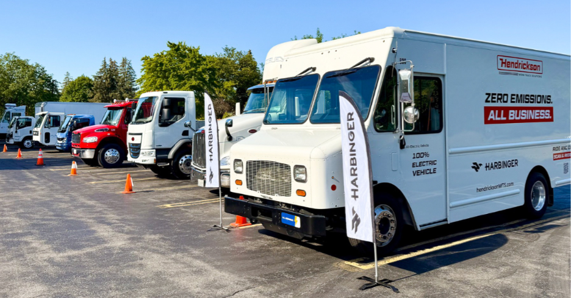
Agenda
Introductions
NYTVIP Background
Joint Utilities EV Make-Ready Pilot
Utility Engagement
Q&A

Slide 3
New York Truck Voucher Incentive Program
NYTVIP is administered by the New York State Energy Research and Development Authority (NYSERDA) in partnership with the New York State Department of Environmental Conservation (DEC)
All Program questions can be directed to the Voucher Help Center
    NYTVIP Voucher Help Center (VHC)
    866-595-7917 (operates 9am-5pm EST) NYTVIP@energycenter.org
NYTVIP Project Managers:
    Natalie Tauro | Natalie.Tauro@nyserda.ny.gov
    Adam Lomasney | Adam.Lomasney@nyserda.ny.gov

Slide 4

Orange and Rockland
Joseph Nash
Clean Energy Project Manager
Nashjo@oru.com | ev@oru.com
Orange and Rockland Electric Vehicle Make-Ready Program

Slide 5

PSEG Long Island
Mohammad Khan
Electric Vehicle Program Manager
Mohammad.Khan4@psegliny.com | EVMRP@coned.com
PSEG Long Island Fleet Make Ready Program

Slide 6
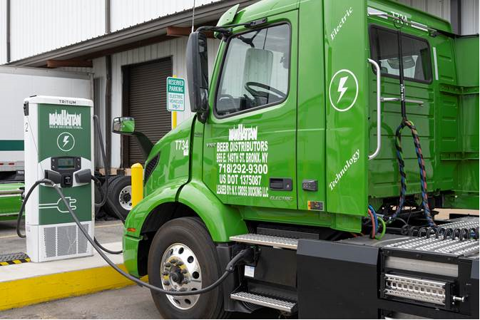
New York Truck Voucher Incentive Program
Provides funding for new 100% zero-emission medium and heavy-duty trucks, buses, and non-road equipment
Vouchers reduce the upfront purchase cost and accelerate or eliminate the payback period associated with zero-emission vehicles
Program engages multiple parties, so fleets don't bear the full burden
Funding is available to public, non-profit, and private fleets located in New York State

Slide 7
Customer Journey
Initiate the TVIP Application
  In the meantime, connect with your utility to discuss charging infrastructure needs and requirements, assess eligibility for the Make-Ready Pilot, and apply for fleet assessment services.
Once your voucher has been approved, you may utilize the contractor list to find a contractor and apply for make-ready funding through your utility’s make-ready portal.
If applicable, find a participating vehicle dismantler to complete scrappage of your old diesel truck or bus. Contact NYSERDA for more information about vehicle scrappage requirements if you are participating in the NYTVIP scrappage bonus.
Keep in regular communication with your vehicle dealer, electrical contractor, and utility regarding status of vehicle production and infrastructure work.
Once chargers are commissioned and vehicle is delivered, you may provide final documentation and receive payment. Remember to complete a utility survey and any applicable reporting for TVIP.
Notes:
Speaker: voice over 3 important points:
Eligibility and coverage (you may not be eligible for costs you'd like to have covered)
Even if ineligible, you need to submit a service request to ensure the new load is documented and your service can accommodate
Hiring a contractor is highly recommended since engineering documents (site plan and one-line) are required for submission

Slide 8
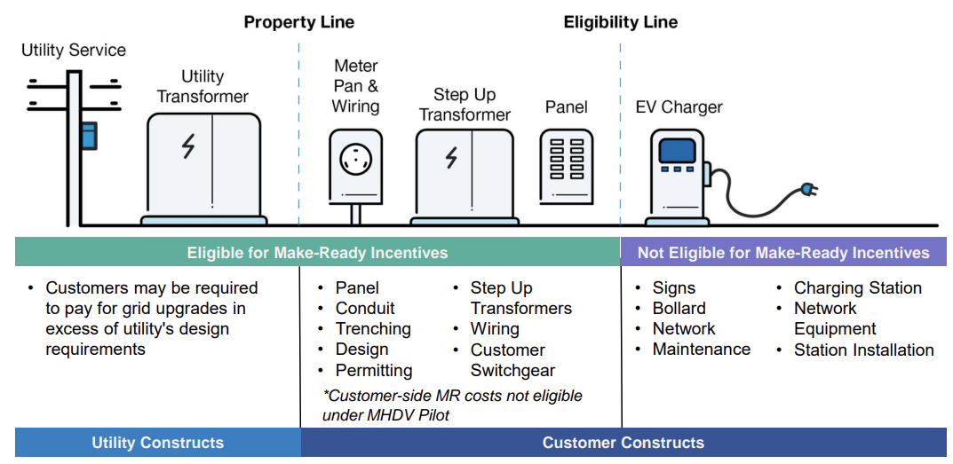
Joint Utilities MHD Make-Ready Pilot
NYTVIP participants are eligible for Joint Utilities of New York's Medium-and Heavy-Duty EV Make-Ready Pilot, which can provide incentives for the infrastructure costs associated with preparing a site for EV charger installation.
* MHD Pilot currently limits customer-side make-ready costs to publicly accessible or DAC projects
Accepting applications until funding is allocated or a new program is established
(expected 2026-2027)
Notes:
Speaker:
Note the difference between USC and CSC
Charger is not eligible

Slide 9
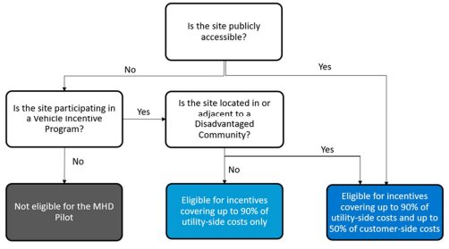
Joint Utilities MHD Make-Ready Pilot
The MHD Pilot provides incentives for up to 90% of utility-side infrastructure costs (step-down transformers, overhead service lines, utility meters, etc.). Qualifying projects may also be available for up to 50% of customer-side costs.
The JU has proposed a petition to expand customer-side cost eligibility:
Shared hub models
Projects located outside (DACs
Projects without a voucher incentive
TVIP is an eligible Vehicle Incentive Program

Slide 10
MHD Pilot Process
The Joint Utilities have a similar process across all utilities for the MHD Pilot.
Pre-Application
(optional)
Applications
Review & Approval
Construction
Activation & Payment
Request a site assessment to determine if capacity upgrades are needed
Meet with program team to understand eligibility requirements for incentives
Submit service request application and all required documents
Submit incentive application and all required documents
Engineering teams review service request application
Incentive program team reviews incentive application for eligibility, calculates incentives, and sends program agreement
Upload customer-side construction costs
Complete customer-side and utility-side work
Upload required closeout documents
Utility completes work verification
Utility issues incentive payment
Activation timelines can vary based on project complexity, but can be 6-18+ months
Notes:
Speaker: note that these are high-level milestones meant to give a general overview of the process. Details and specific steps should be discussed and coordinated with your respective utility.

Slide 11

Available Resources By Program
PSEG Long Island offers incentives and affordable rates to help support electric vehicles at your business.
EV Make Ready
Level 2 Chargers – Up to $6,500/port and up to $20,000 in Utility Upgrades
DC Fast Chargers – Up to $45,000/port and up to $100,000 in Utility Upgrades
Fleet Make Ready
Public Fleets – Up to $30,000 in Customer Upgrades and up to $100,000 in Utility Upgrades
Public Transportation – Up to $100,000 in Customer Upgrades and up to $100,000 in Utility Upgrades
Private Fleets – Up to $30,000 in Customer Upgrades and up to $50,000 in Utility Upgrades
EV Phase In Rate
Discounted rates for commercial EV stations—whether you serve customers, employees, or your own fleet
Time of Day (TOD)
EV owners can save automatically on all Time-of-Day Rate Plans by charging during off-peak hours.
© 2025 PSEG. All Rights Reserved

Slide 12
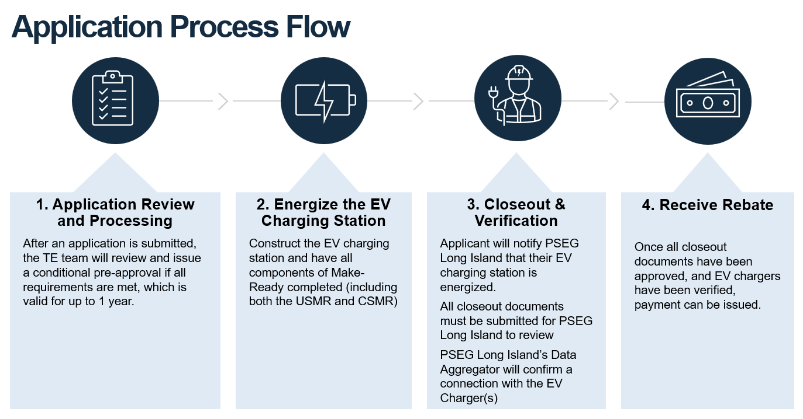
© 2025 PSEG. All Rights Reserved

Slide 13
Utility Engagement Best Practices
Questions |  | Answers
How early in the procurement process should a fleet contact their utility? |  | Contacting your utility should be your first step, to align on your expected electrification timeline. Grid capacity can't be reserved until a service request is initiated, so initiating ASAP is crucial. Typically, construction should not begin until Make-Ready Pilot application is approved.
What recommendations can utilities make for fleets? |  | Utilities can provide crucial information for your project: Incentives available to reduce upfront and operational charging costs Infrastructure needed and timeline to support your plan Recommendations for charging schedules and the cost of electricity Guidance on potential phases to your electrification plan

Slide 14
Utility Engagement Best Practices
Questions |  | Answers
Should service/infrastructure upgrades/charger installations be done before purchasing a vehicle? |  | Yes. Service requests should be initiated ASAP, in parallel with the NY TVIP process. Make-Ready incentive applications can be finalized after the NY TVIP voucher is approved. Getting started with a site assessment is the best way to understand potential timelines and sequencing of service and voucher and make ready incentive applications.
Is utility engagement optional? |  | No. Even if you don't qualify for Make Ready incentives, you need to complete a service request to ensure the new charging load is added to your service safely. We can still help you plan your project and review available charging rates and incentives.

Slide 15



Utility advisory services and incentives can support your project today
Operating Cost Relief
Managed charging programs (Con Edison only) and EV Phase-in Rates available at each utility
Fleet Assessments
Apply for assistance from your utility to evaluate your site and prepare for electric vehicle charging
Hosting Capacity Maps
Provides a high-level view and snapshot in time of available load capacity for electric vehicle charging
Rates Tools
Tools that can help estimate fuel cost savings and the most cost-effective charging rate
Load Management Technology Incentive Program
While funds last - more than $24M made available in 2024 to support energy storage and advanced load management software and equipment

Slide 16
Joint Utilities EV Make Ready Program Contacts
Utility | EV Made Ready Program Email | Program Website
Central Hudson | EVMakeready@cenhud.com | Electric Vehicle Make-Ready Infrastructure Program
Con Edison | dl-evmhd@coned.com | Electric Vehicle MHD PowerReady Program
National Grid | NGFleetProgram@nationalgrid.com | Electric Vehicle Charging Station Programs
New York State Electric and Gas (NYSEG) | evprograms@nyseg.com | Electric Vehicle Charger Make-Ready Program
Rochester Gas and Electric (RG&E) | evprograms@rge.com | Electric Vehicle Charger Make-Ready
Orange and Rockland (O&R) | ev@oru.com | Electric Vehicle Make-Ready Program

