Slide 1
Scrappage 101 Webinar
New York Truck Voucher Incentive Program (NYTVIP) New York School Bus Incentive Program (NYSBIP)
October 30, 2025

Slide 2
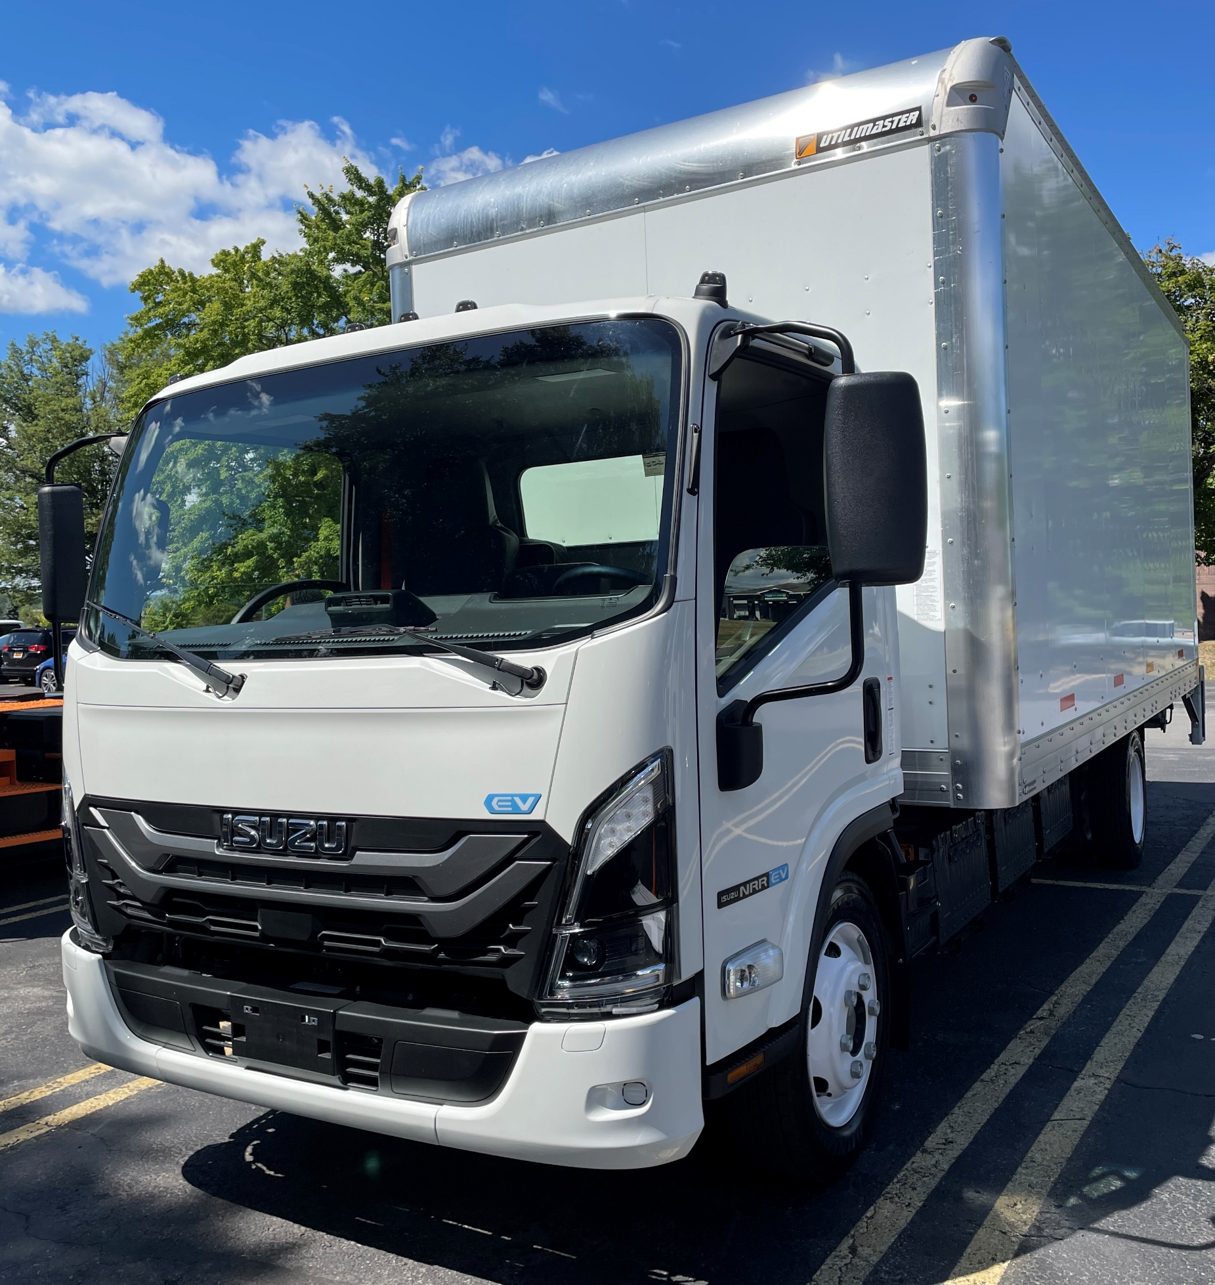
Agenda
Introductions
What is Scrappage?
New York Truck Voucher Incentive Program (NYTVIP)
New York School Bus Incentive Program (NYSBIP)
Scrappage Events and How to Prepare
Q&A
Notes:
Sydney slide

Slide 3
Panelists
Facilitator: Sydney Hayes – Lead Project Manager at CALSTART
Natalie Tauro – Truck Voucher Project Manager at NYSERDA
Jay Craig – School Bus Project Manager at NYSERDA
Jonah Kasdan – Program Manager at Empire Clean Cities
Barry Carr – Board Chair at Clean Communities of Central New York
Notes:
Sydney slide

Slide 4
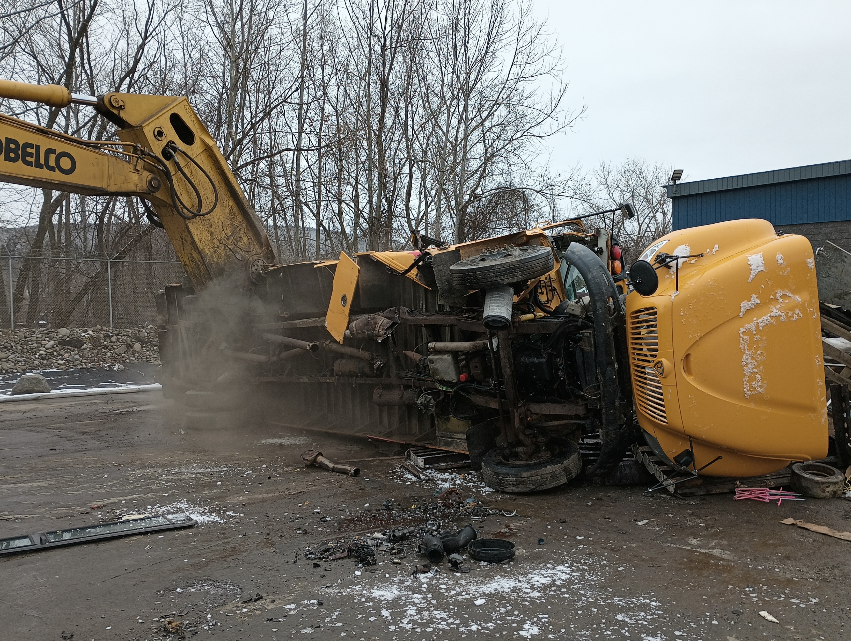
What is Scrappage?
Scrappage is verifiably rendering inoperable an internal combustion engine (ICE) powered vehicle/equipment by cutting a three-inch-by-three-inch hole in the engine block and disabling the chassis by cutting the vehicle’s frame rails completely in half
Scrappage is completed to ensure that the ICE vehicle/equipment is permanently taken out of operation and therefore cannot emit any more pollutants
Scrapped vehicles/equipment are replaced with clean zero-emission technology, battery electric or hydrogen fuel cell
Notes:
Sydney slide

Slide 5
New York Truck Voucher Incentive Program
NYTVIP is administered by the New York State Energy Research and Development Authority (NYSERDA) in partnership with the New York State Department of Environmental Conservation (DEC)
All Program questions can be directed to the Voucher Help Center
    NYTVIP Voucher Help Center (VHC)
    866-595-7917 (operates 9am-5pm EST) NYTVIP@energycenter.org
NYTVIP Project Manager:
    Natalie Tauro: Natalie.Tauro@nyserda.ny.gov
Notes:
Natalie slide

Slide 6
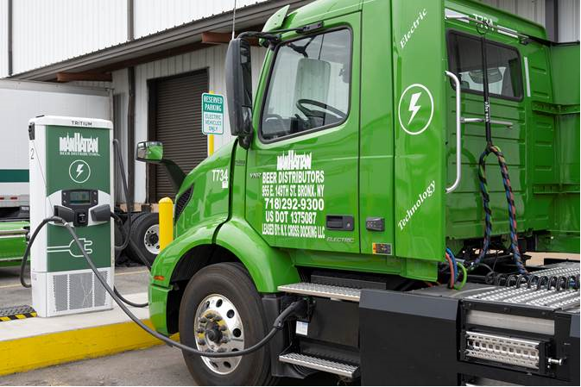
New York Truck Voucher Incentive Program
Provides funding for new 100% zero-emission medium and heavy-duty trucks, buses, and non-road equipment
Vouchers reduce the upfront purchase cost and accelerate or eliminate the payback period associated with zero-emission vehicles
Program engages multiple parties, so fleets don't bear the full burden
Funding is available to public, non-profit, and private fleets located in New York State
Notes:
Natalie Slide

Slide 7



NYTVIP Funding Tracks
Class 3-8 Zero Emission Vehicles (ZEVs): Funded through the Regional Greenhouse Gas Initiative (RGGI) investment plan.
  Scrappage is optional
Non-Road Equipment: Funded through the New York Volkswagen Mitigation Plan EPA DERA option.
  Scrappage is required
Transit Buses: Funded through the New York Volkswagen Mitigation Plan.
  Scrappage is required of a 1992 - 2009 or older diesel bus
Notes:
Natalie

Slide 8
NYTVIP: Class 3-8 ZEVs Voucher Amounts and Bonuses
Vehicle Weight Class | Base Incentive | Disadvantaged Community Bonus | Small Fleet Bonus | Scrap Bonus | Maximum Amount Per Vehicle
Class 3 (10,001 – 14,000 lbs.) | $50,000 | $15,000 | $10,000 | $10,000 | $85,000
Class 4 (14,001 – 16,000 lbs.) | $85,000 | $25,000 | $17,000 | $17,000 | $144,000
Class 5 (16,000 – 19,500 lbs.) | $100,000 | $30,000 | $20,000 | $20,000 | $170,000
Class 6 (19,501 – 26,000 lbs.) | $150,000 | $45,000 | $30,000 | $30,000 | $255,000
Class 7 (26,001 – 33,000 lbs.) | $185,000 | $55,000 | $37,000 | $37,000 | $314,000
Class 8 (Over 33,000 lbs.) | $200,000 | $60,000 | $40,000 | $40,000 | $340,000
Class 8 Fuel Cell | $285,000 | $60,000 | $40,000 | $40,000 | $425,000
Notes:
Natalie

Slide 9
NYTVIP: Scrappage Requirements
1. Class 3-8 Zero Emission Vehicles (ZEVs): Purchasers receive a voucher bonus for scrappage
  Scrapped vehicles must be at the time of voucher application:
    Vehicle model year 2015 or older and be operational/drivable
    Equal weight class or one larger than the new electric vehicle purchased
    Be registered at time of scrappage for at least one of the previous two years
    Vehicles can have a diesel or gasoline engine
2. Non-Road Equipment: Required to scrap an older piece of equipment for a new piece of equipment
  No specific model year or engine tier required
  Scrapped equipment must be similar function and vocation to the new equipment
3. Transit Buses: Required to scrap an older transit bus for a new transit bus
  Scrap transit bus must be engine model year 1992 to 2009
  Scrapped vehicle cannot be a part of a contingency fleet or considered a spare bus
  Vehicles with alternative fuel powertrains are eligible on a case-by-case basis
Notes:
NAtalie

Slide 10
NYTVIP: Scrappage Timelines
Funding Track | Allowable Scrappage Time
Class 3-8 Zero Emission Vehicles | Any time after Voucher Approval, through 1 calendar year (365 calendar days) after Vehicle delivery.
Non-Road Equipment | Any time after Voucher Approval, through 1 month (30 calendar days) after Equipment delivery.
Transit Buses | Any time after Voucher Approval, through 21 calendar days after Vehicle delivery.
Notes:
Natalie

Slide 11
NYTVIP: Scrappage Event Procedure
Scrapped vehicle must be in drivable condition with the chassis and engine intact at the time of scrappage
Documentation of scrappage is required, including pictures
  It is recommended that a Purchaser representative attend the Scrappage event to ensure it is properly documented and that all required before and after photos are taken to avoid delay or denial of full or scrap bonus voucher payment
Scrappage must be performed by a Participating Vehicle Dismantler
Scrapped vehicle or equipment must be rendered inoperable by cutting a three-inch hole in the engine block and disabling the chassis by cutting the vehicle’s frame rails completely in half
During the Scrappage process, before any crushing or shredding, equipment must be decommissioned, meaning the potential environmental contaminants including, but not limited to, fluids, batteries, refrigerants, mercury switches and airbags, have been drained and/or properly removed
Notes:
Natalie

Slide 12
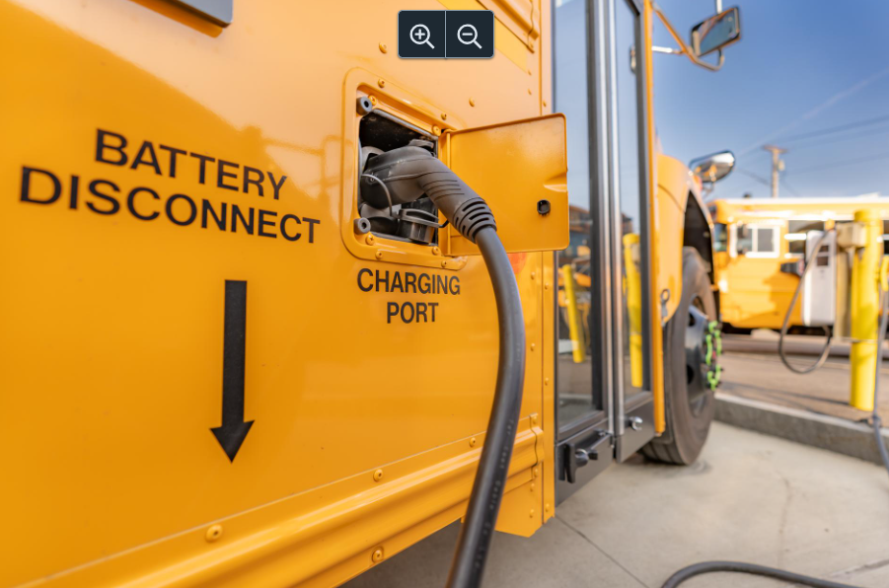
New York School Bus Incentive Program
NYSBIP is administered by the New York State Energy Research and Development Authority (NYSERDA) and backed by the 2022 Environmental Bond Act to support the transition to zero-emission school buses.
All Program questions can be directed to the Voucher Help Center
  NYSBIP Voucher Help Center
  866-595-7917 (operates 9am-5pm EST) NYSBIP@energycenter.org
NYSBIP Project managers:
  Jay Craig: Jay.Craig@nyserda.ny.gov
  Sophie Patka: Sophie.Patka@nyserda.ny.gov
Notes:
Jay

Slide 13
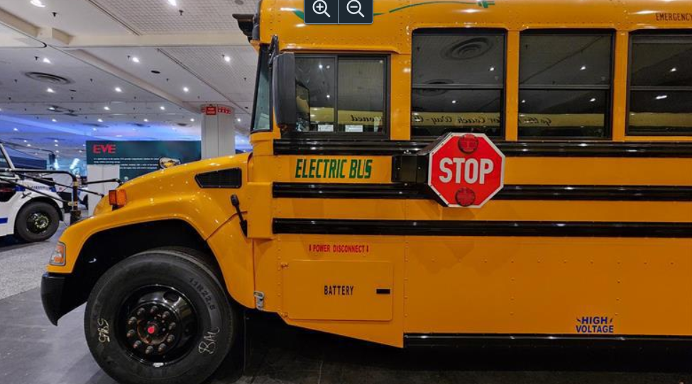

New York School Bus Incentive Program
The Base School Bus Voucher amounts for NYSBIP intends to cover a large percentage (60%) of the incremental cost of an electric school bus.
Accelerate the deployment of zero-emission bus technology to reduce greenhouse gas emissions and air pollution.
Reduces upfront costs to New York State school districts purchasing zero-emission school buses and associate Charging Infrastructure.
Provide environmental and health benefits to all New Yorkers, with a focus on improved outcomes for residents of Disadvantaged Communities as defined by the Climate Act.
Notes:
Jay

Slide 14
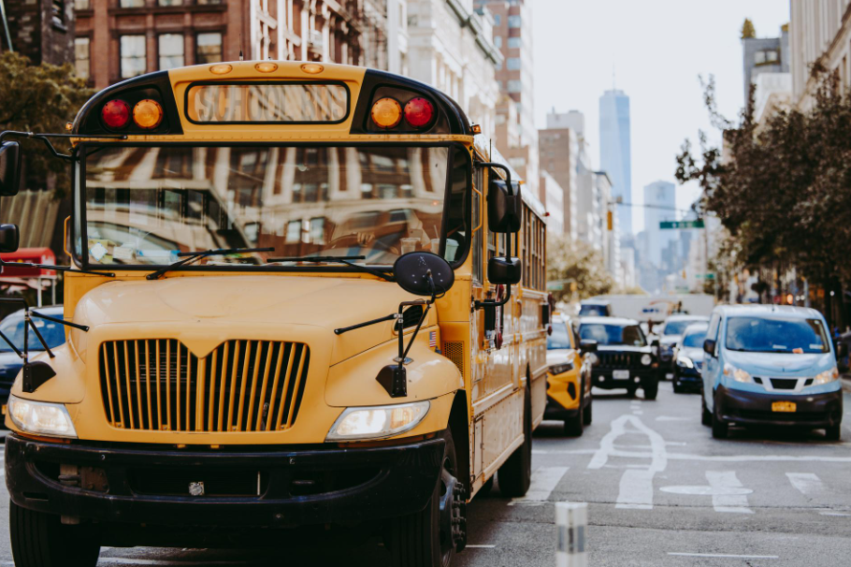
NYSBIP Funded Vehicles
New Type A (NTA)
  Scrappage is optional
New Type C (NTC)
  Scrappage is optional
New Type D (NTD)
  Scrappage is optional
Repowered Type A (RTA)
  Scrappage not applicable
Repowered Type D (RTD)
  Scrappage not applicable
All eligible Vehicle Make & Models can be found on the NYSERDA website under the NYSBIP program.
  Link to list: Eligible ESB List
Notes:
Jay

Slide 15
NYSBIP Voucher Amounts and Bonuses
School Bus Type | Priority District Bonus Amount | Scrappage Bonus Amount | V2G Add-On Amount | Wheelchair Add-On Amount
NTA | $28,500 | $47,500 | $9,500 | $8,000
NTC | $36,750 | $61,250 | $12,250 | $8,000
NTD | $39,000 | $65,000 | $13,000 | $8,000
RTA | $21,000 | N/A | $7,000 | N/A
RTC | $27,000 | N/A | $9,000 | N/A
Notes:
Jay

Slide 16
NYSBIP: Scrappage Requirements
New Type A to New Type D Electric School Buses: Fleets receive a voucher bonus for scrapping.
Scrappage Definition:
To destroy the engine: Cut or drill a minimum three-inch hole through the engine block.
To destroy the chassis: Cut or shear both the chassis rails between the two axles.
Vehicle Qualifications:
Scrapped vehicles must be owned by the purchaser or the school district that the purchaser is providing transportation services.
Scrapped vehicle must have been driven 2,500 miles or more in the last twelve (12) months. If that criteria can't be met an exception can be made for Buses with engine model year ten (10) years or older and 110,000 miles.
Scrapped vehicles engine must be a model year at least (7) years older than the year of application.
Scrapped bus must be replaced with the same school bus type.
Notes:
Jay

Slide 17

Scrappage Event Photos
Photos of the scrappage event must be captured to document that the scrappage occurred and followed program guidelines.
NYTVIP Requirements
“Before” photos:
  Side of the vehicle, VIN plate (with VIN, GVWR) , entire vehicle engine, engine tag (with engine serial number, engine family, and engine model year)
  “After” Photos
    Photo of 3-in hole in engines block (with ruler/sticker), close picture of cut chassis, full side photo of the destroyed vehicle
NYSBIP Requirements
“Before” photos:
  VIN plate (with VIN, GVWR and manufacture date), front of bus (with license plate)
  “After” Photos
    Photo of 3-in hole in engines block (with ruler/sticker), full side photo of the destroyed vehicle (showing cab, identifying photo, cut chassis)
Notes:
Jay and Natalie slide

Slide 18
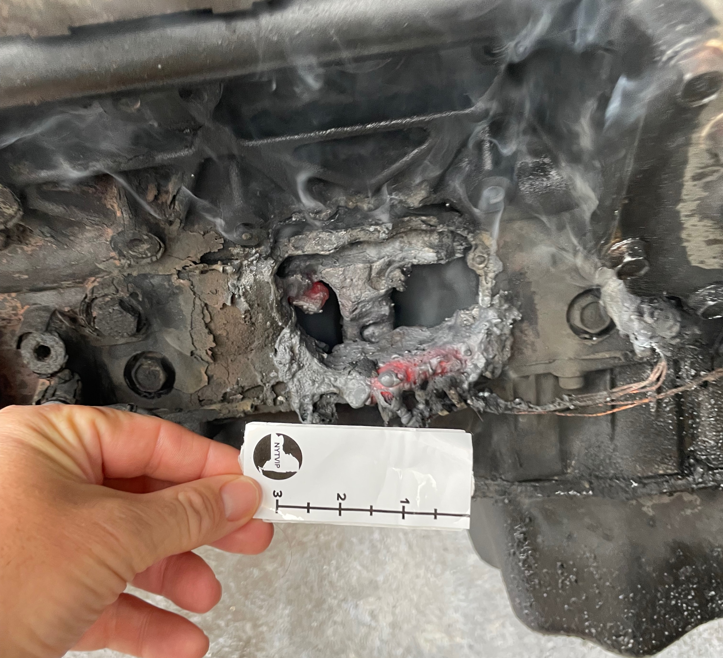
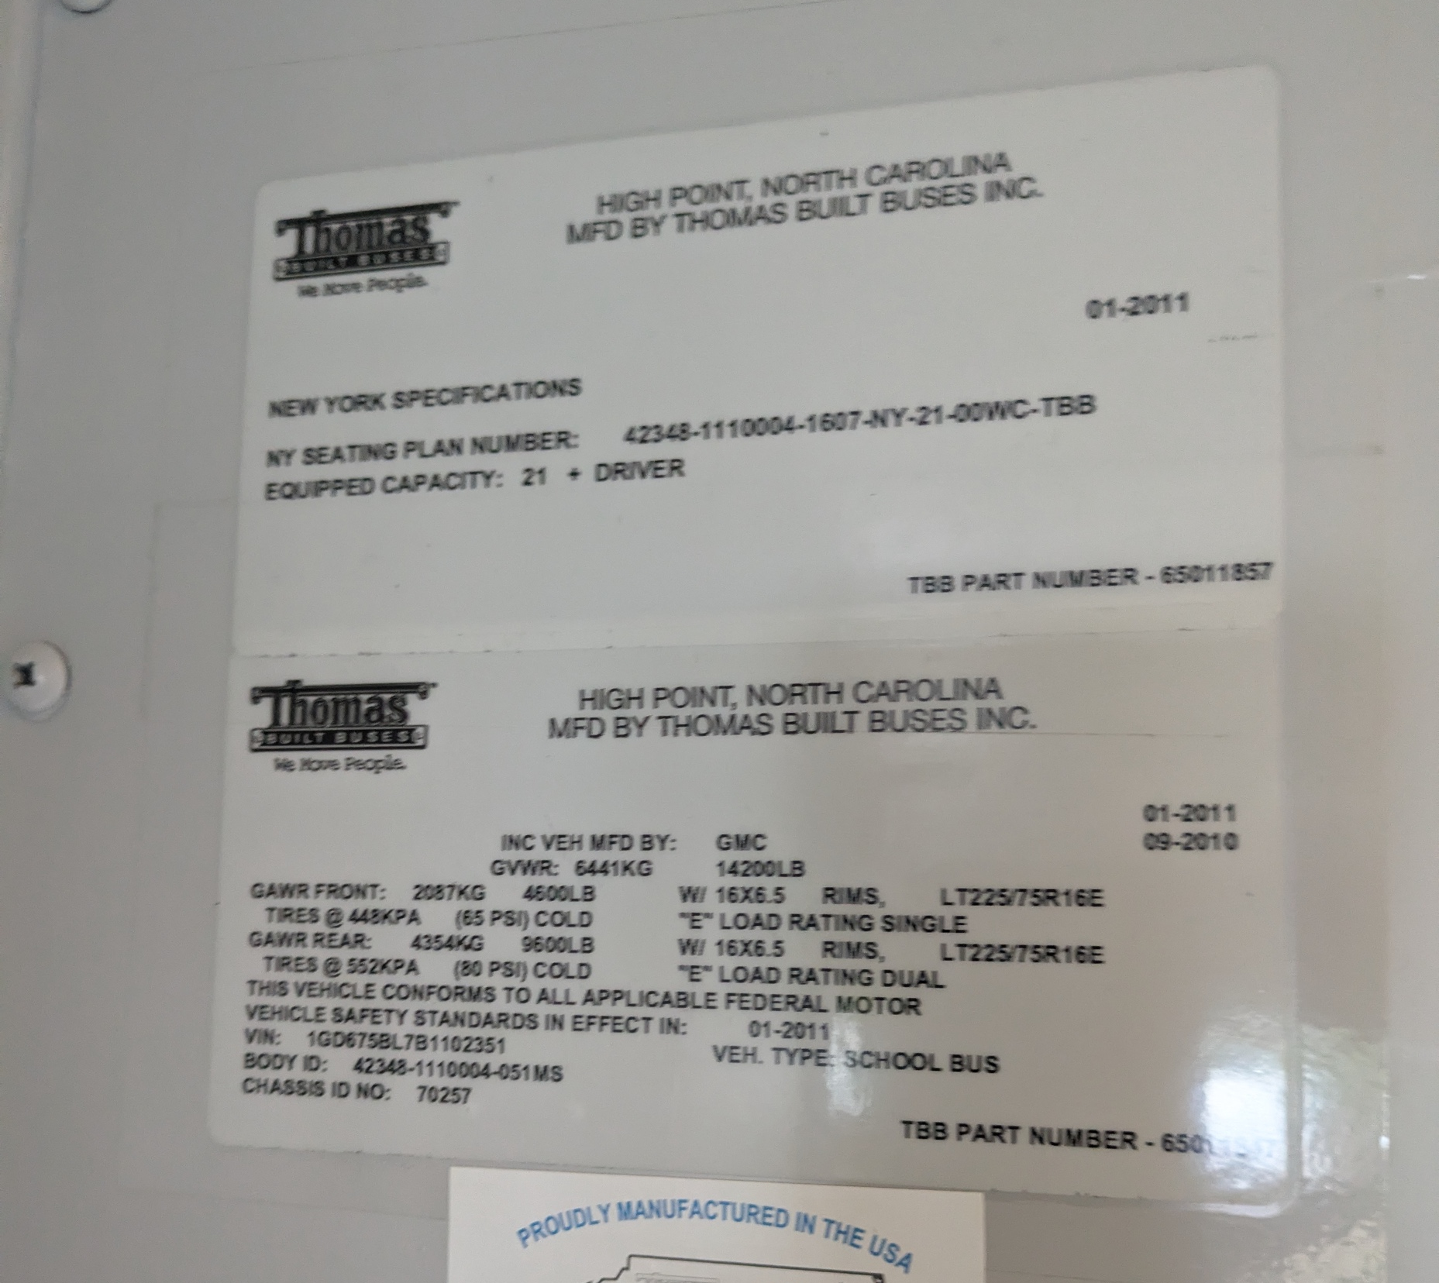
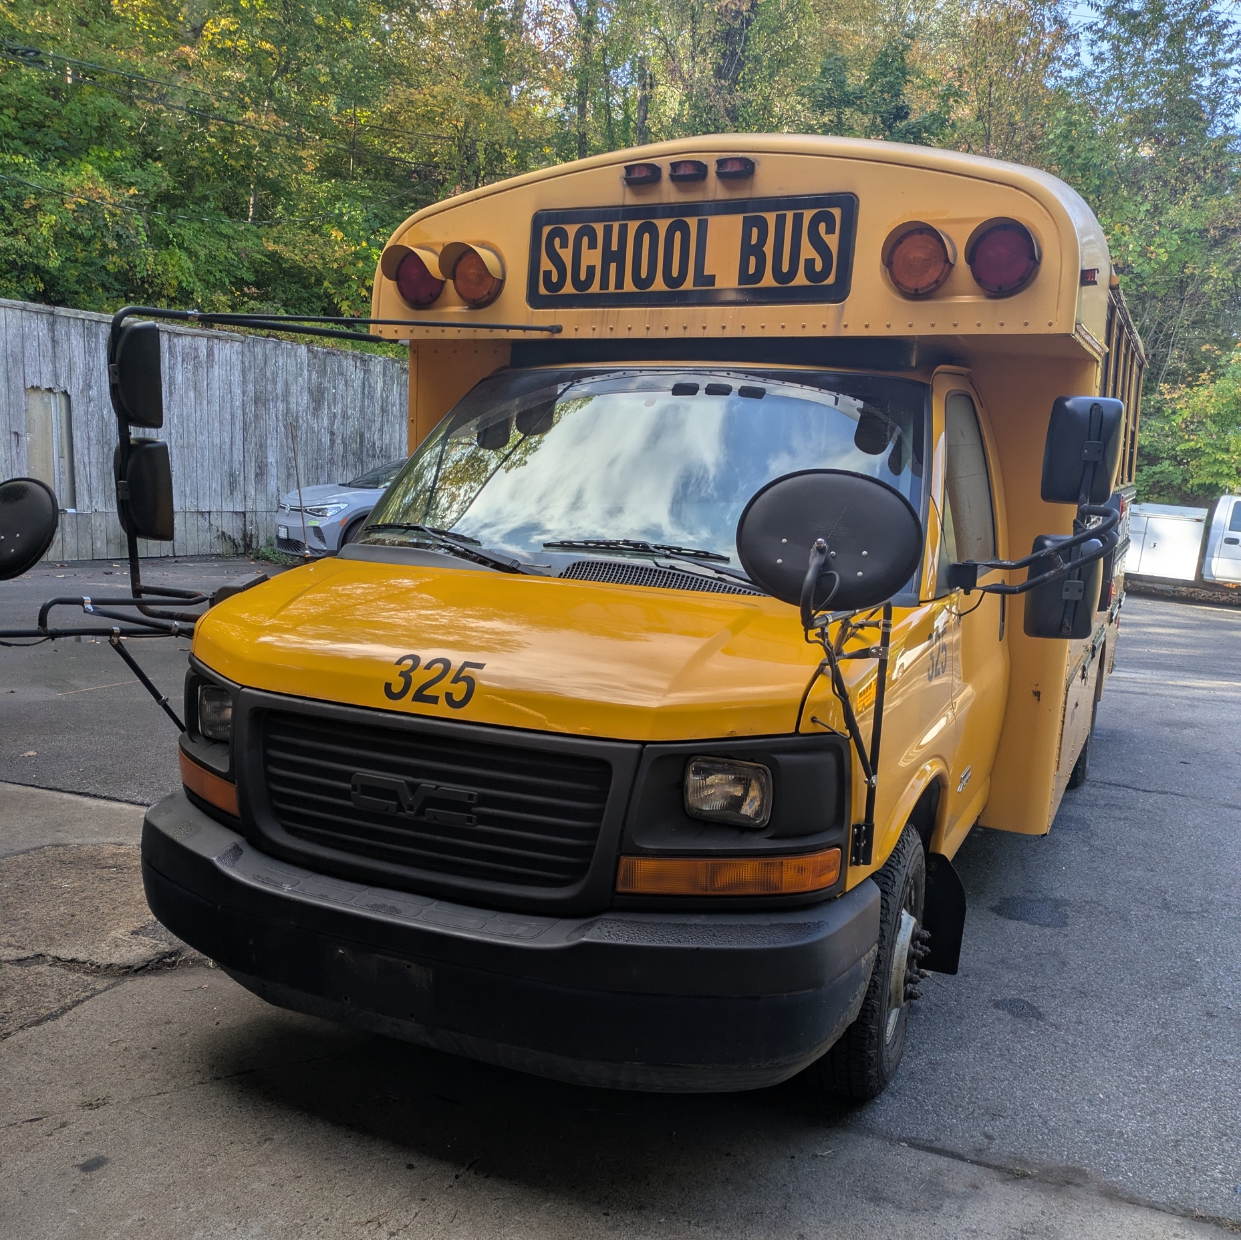
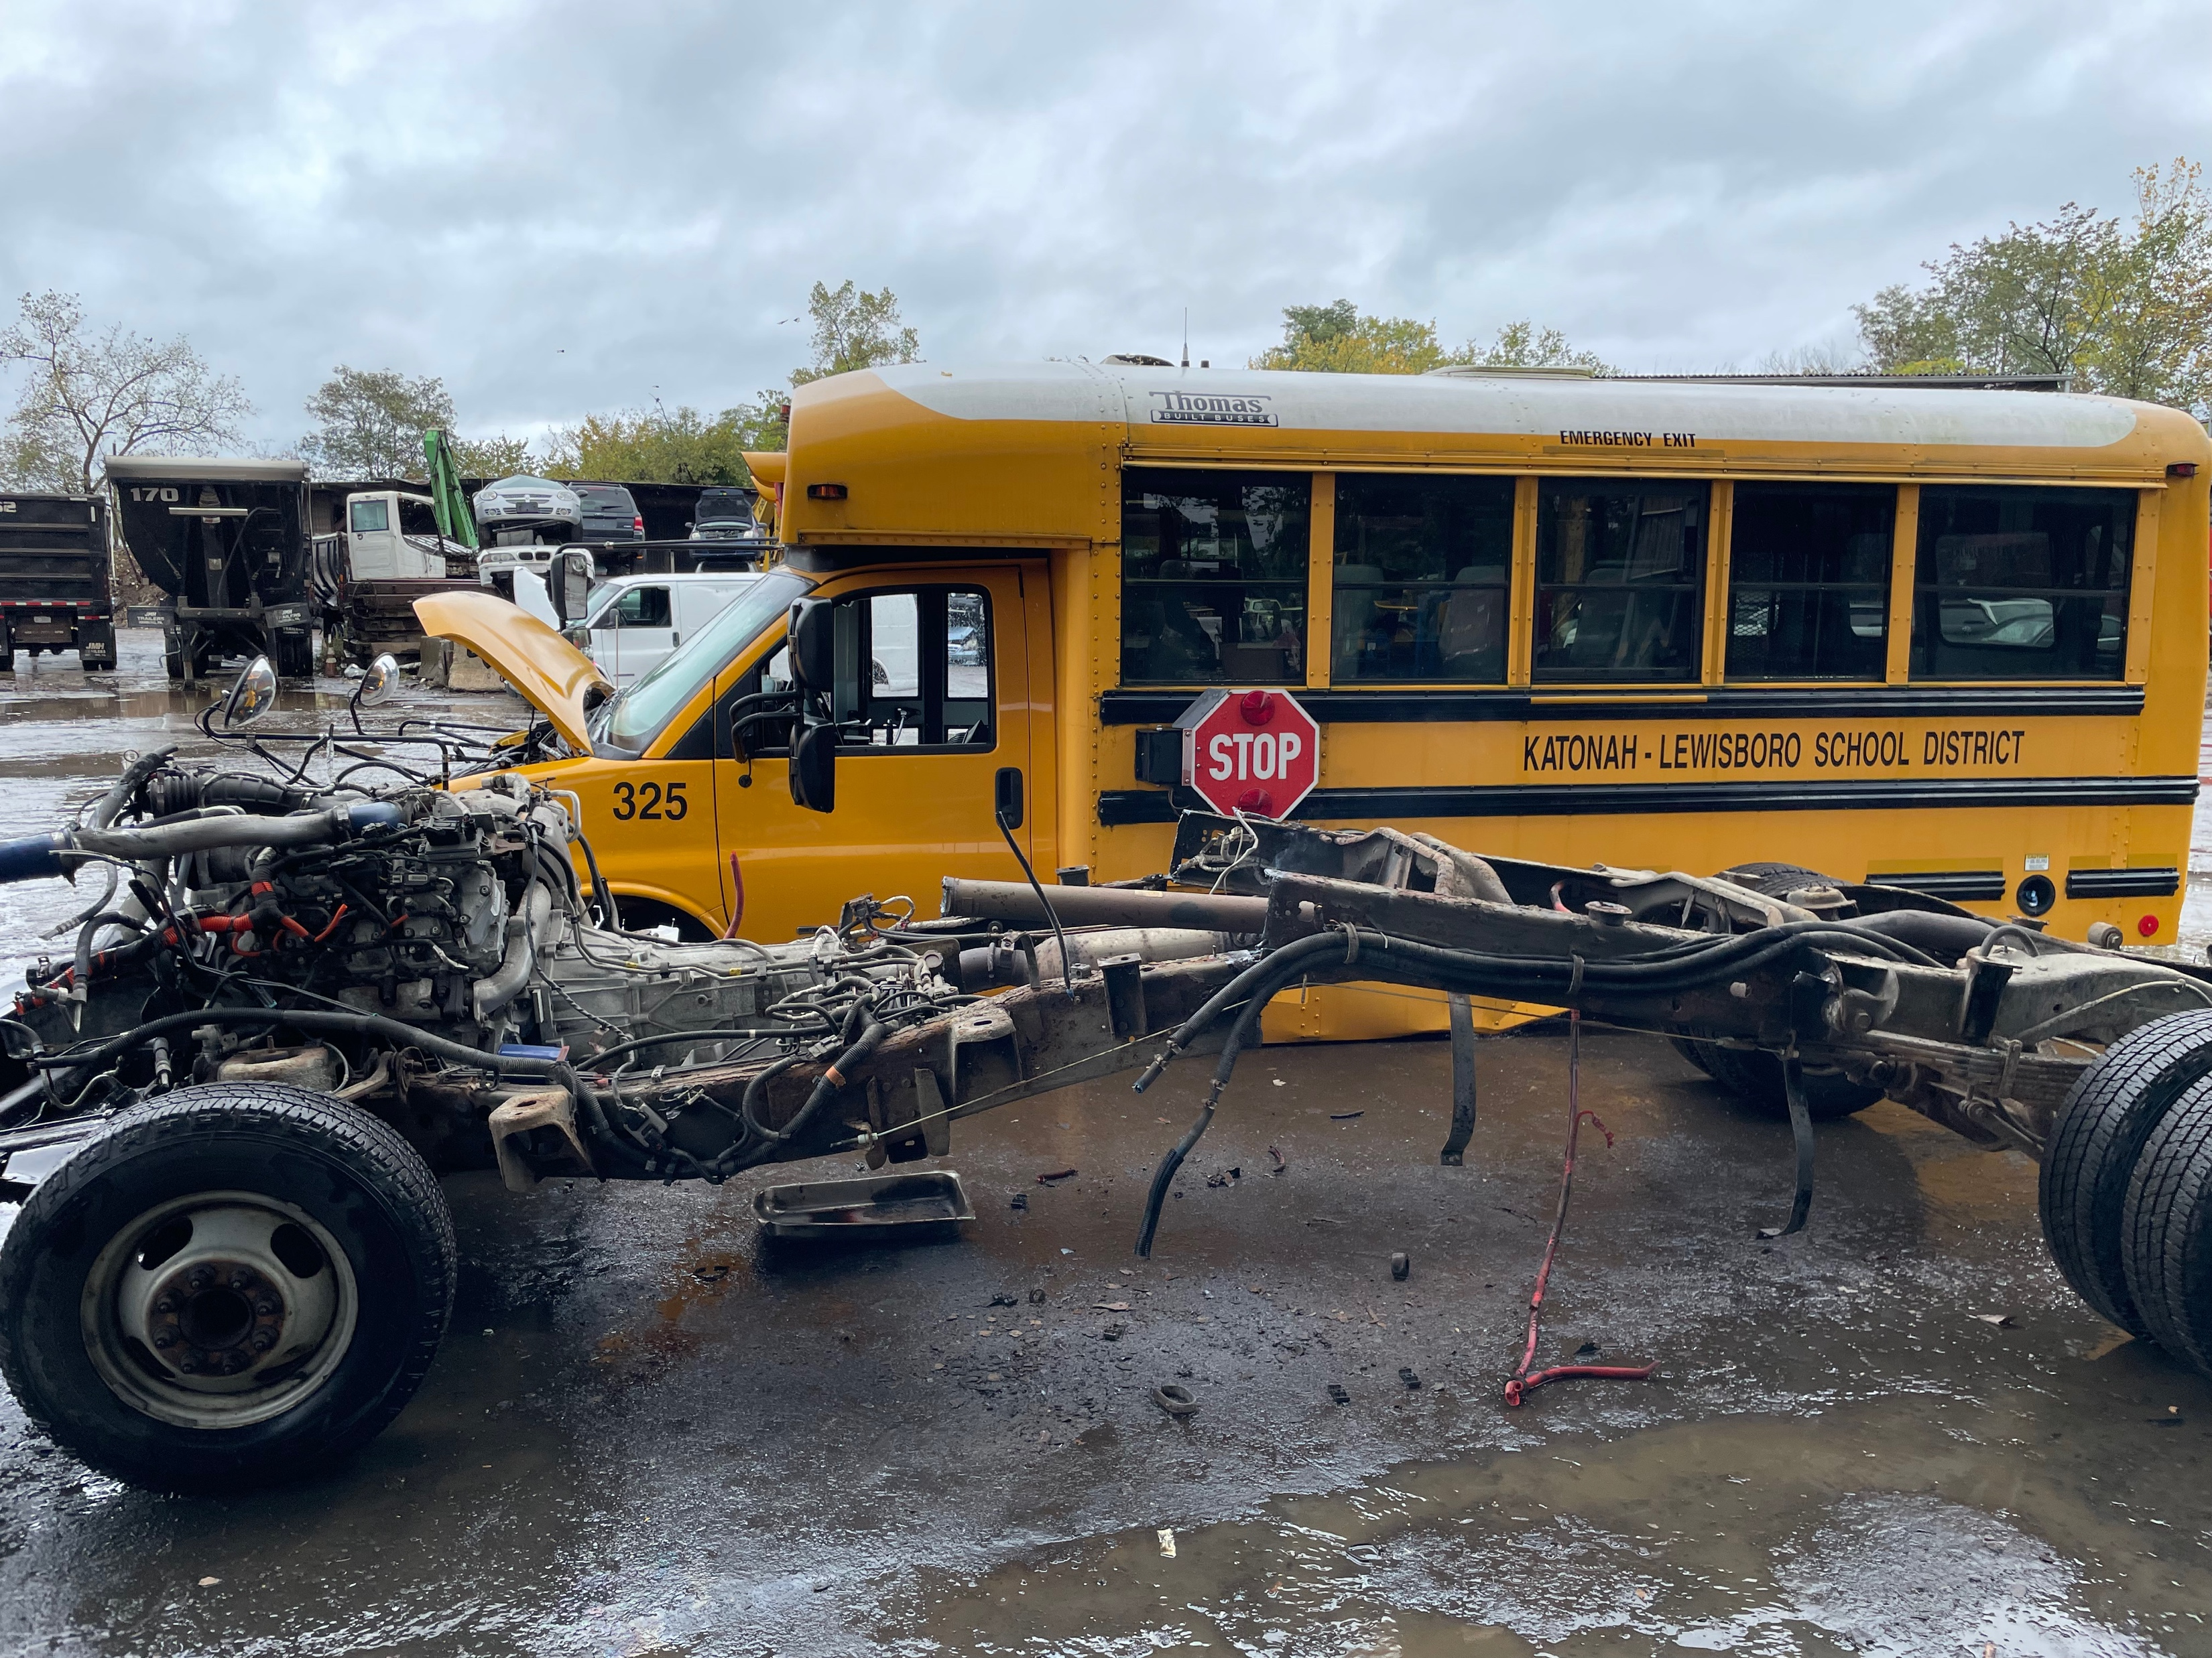
NYSBIP Scrappage Event Photos
Before
After
Notes:
Jonah slide

Slide 19
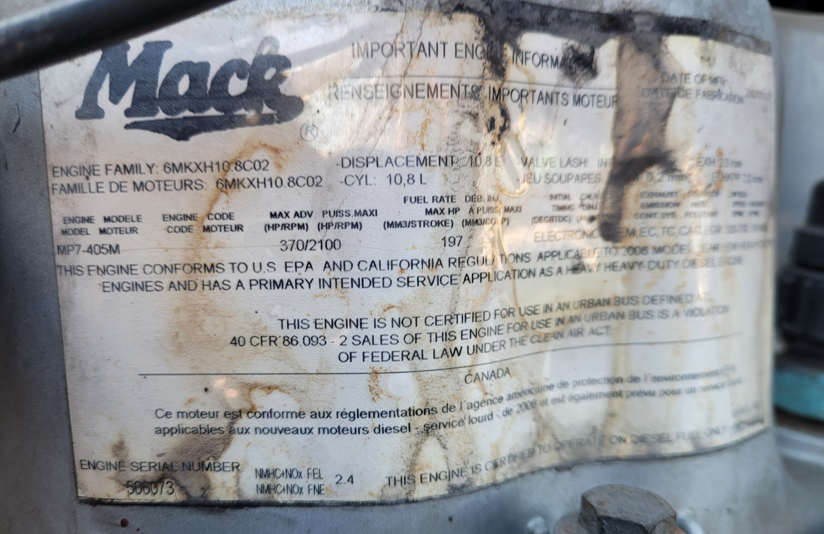
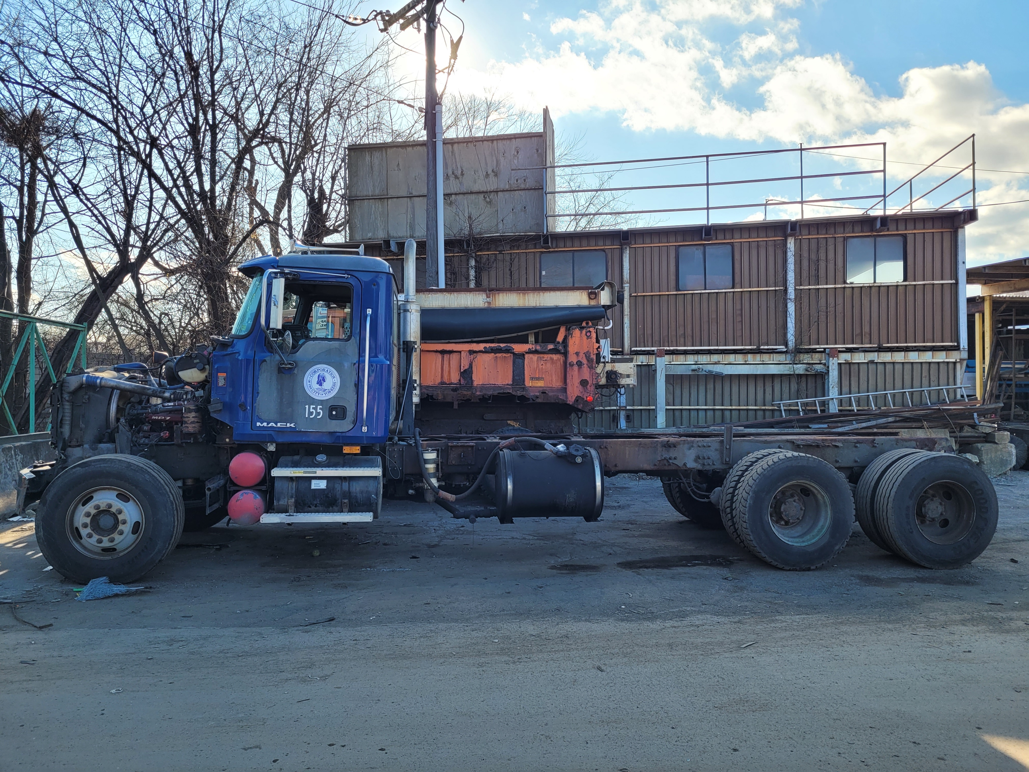
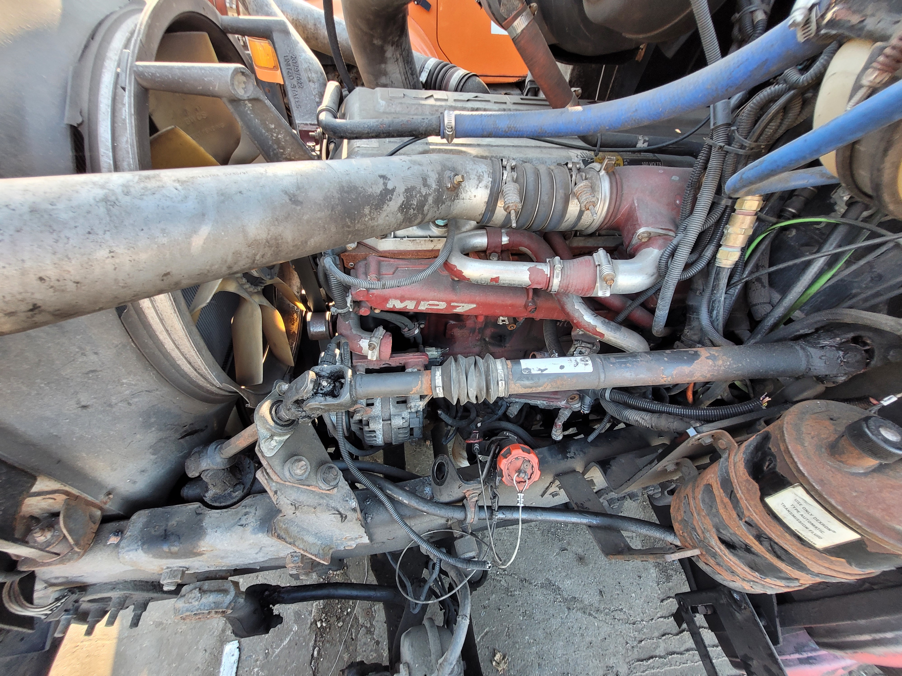
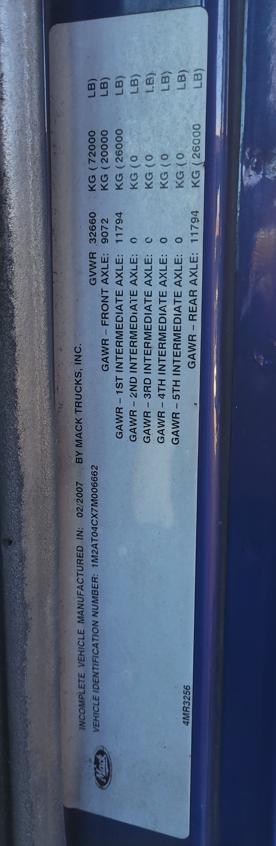
NYTVIP Scrappage Event Photos
Before
Notes:
Barry slide

Slide 20
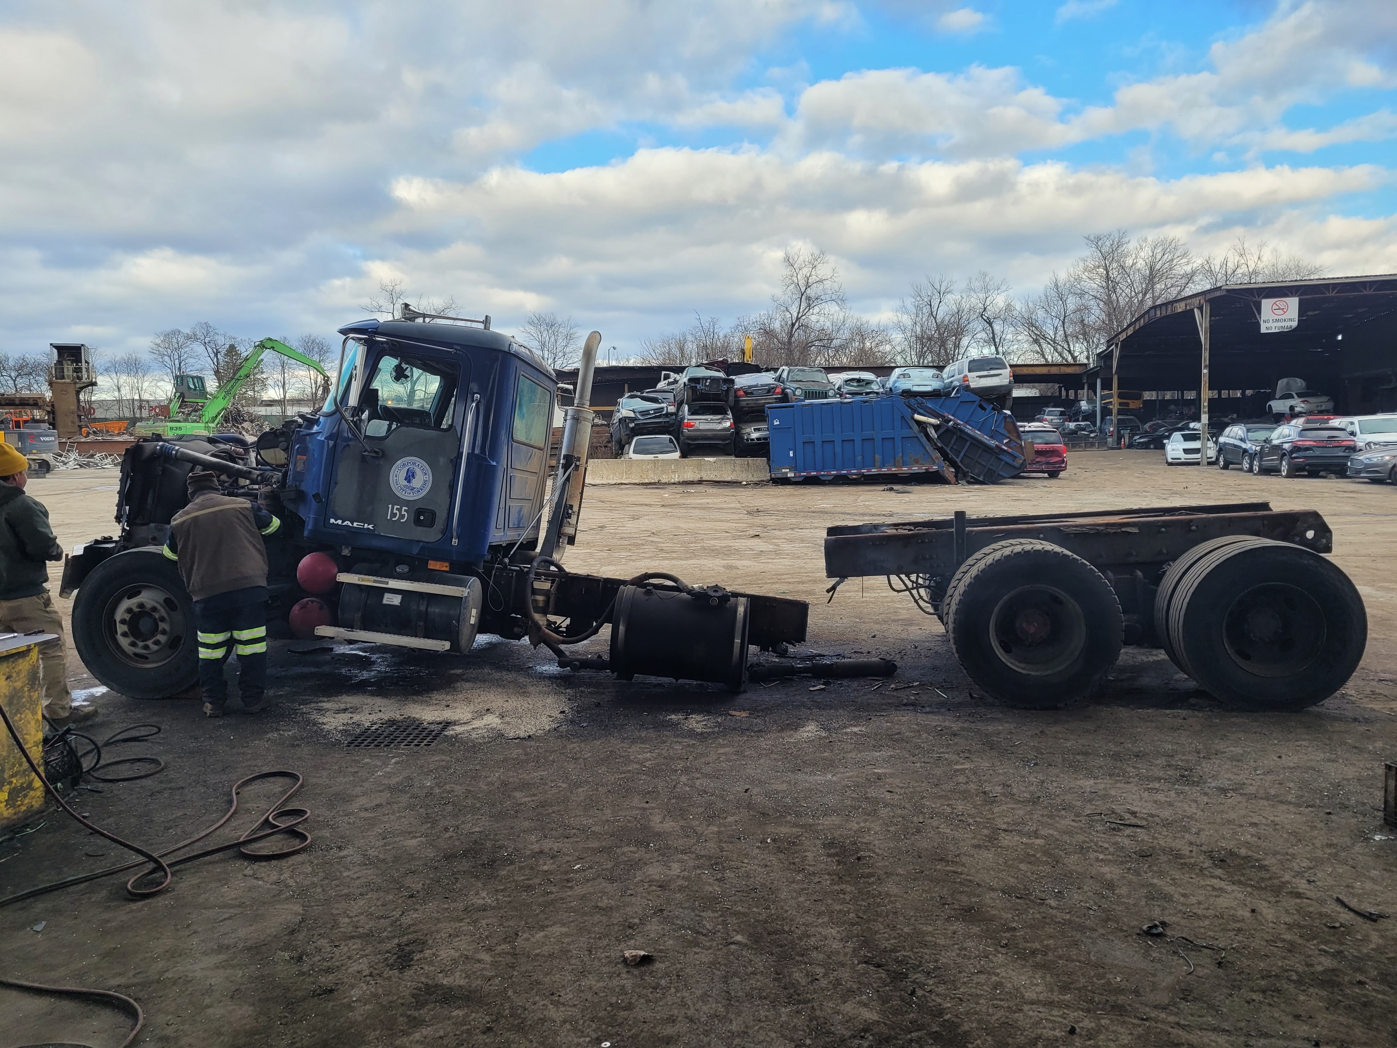
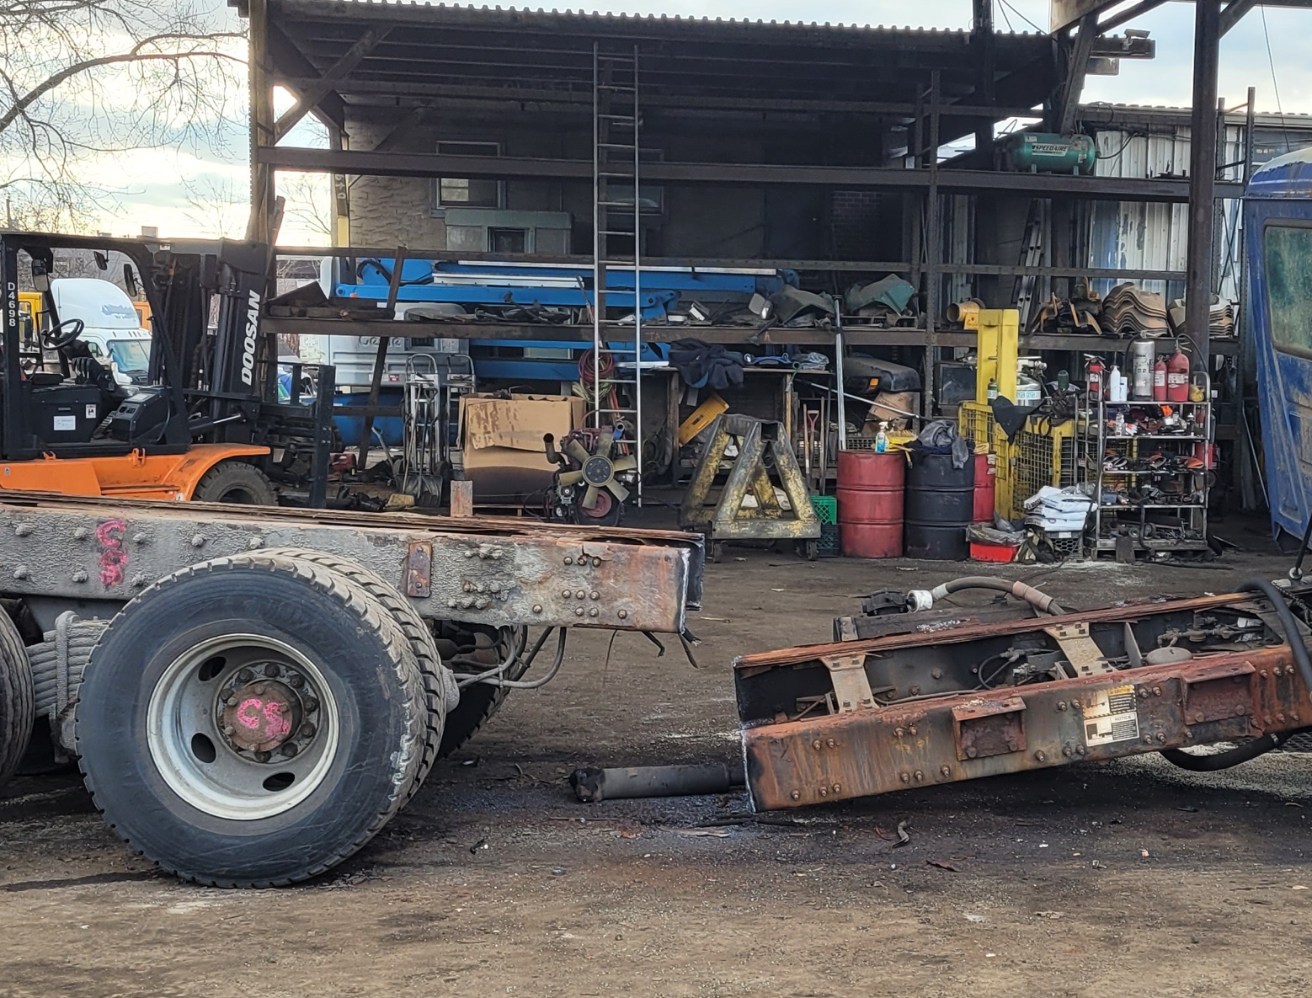
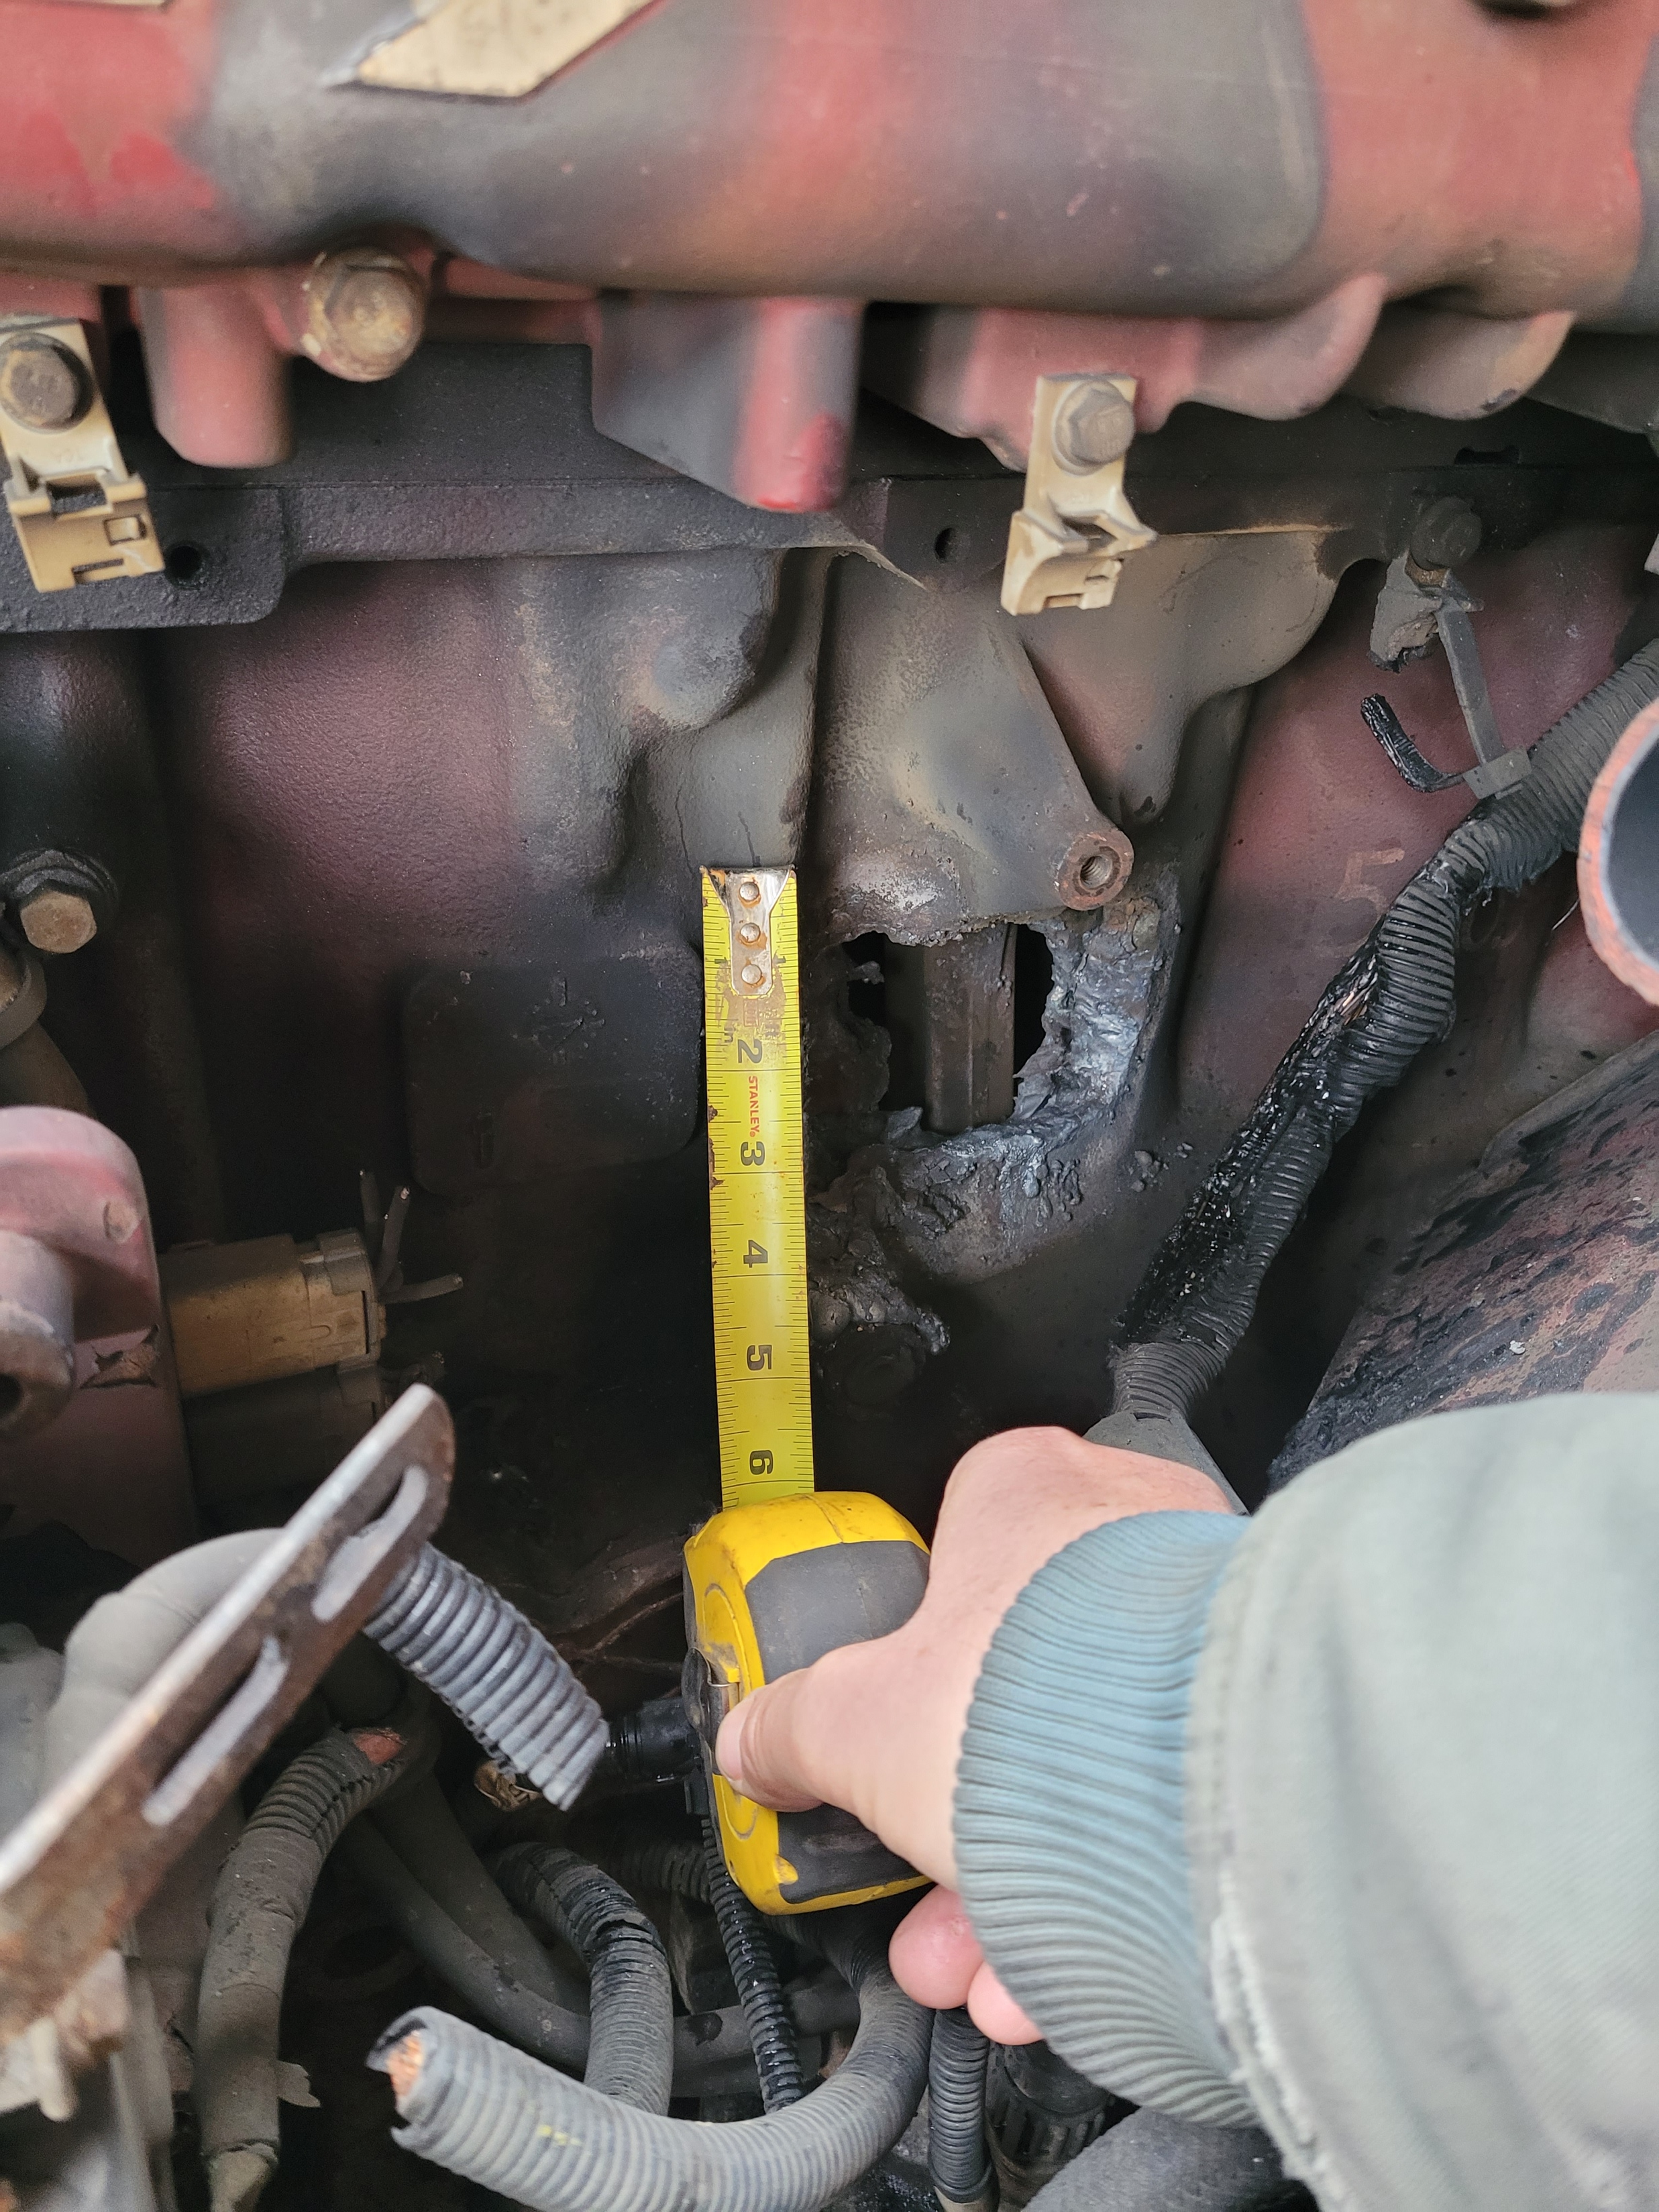
NYTVIP Scrappage Event Photos
After
Notes:
Barry slide

Slide 21
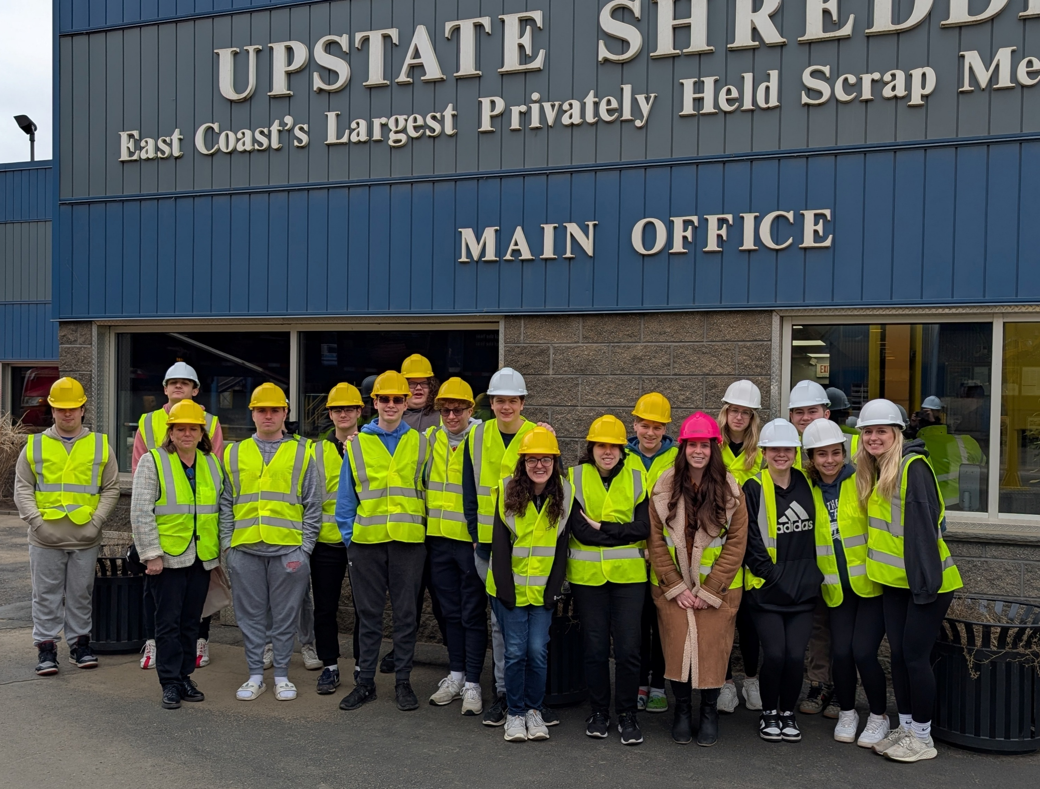

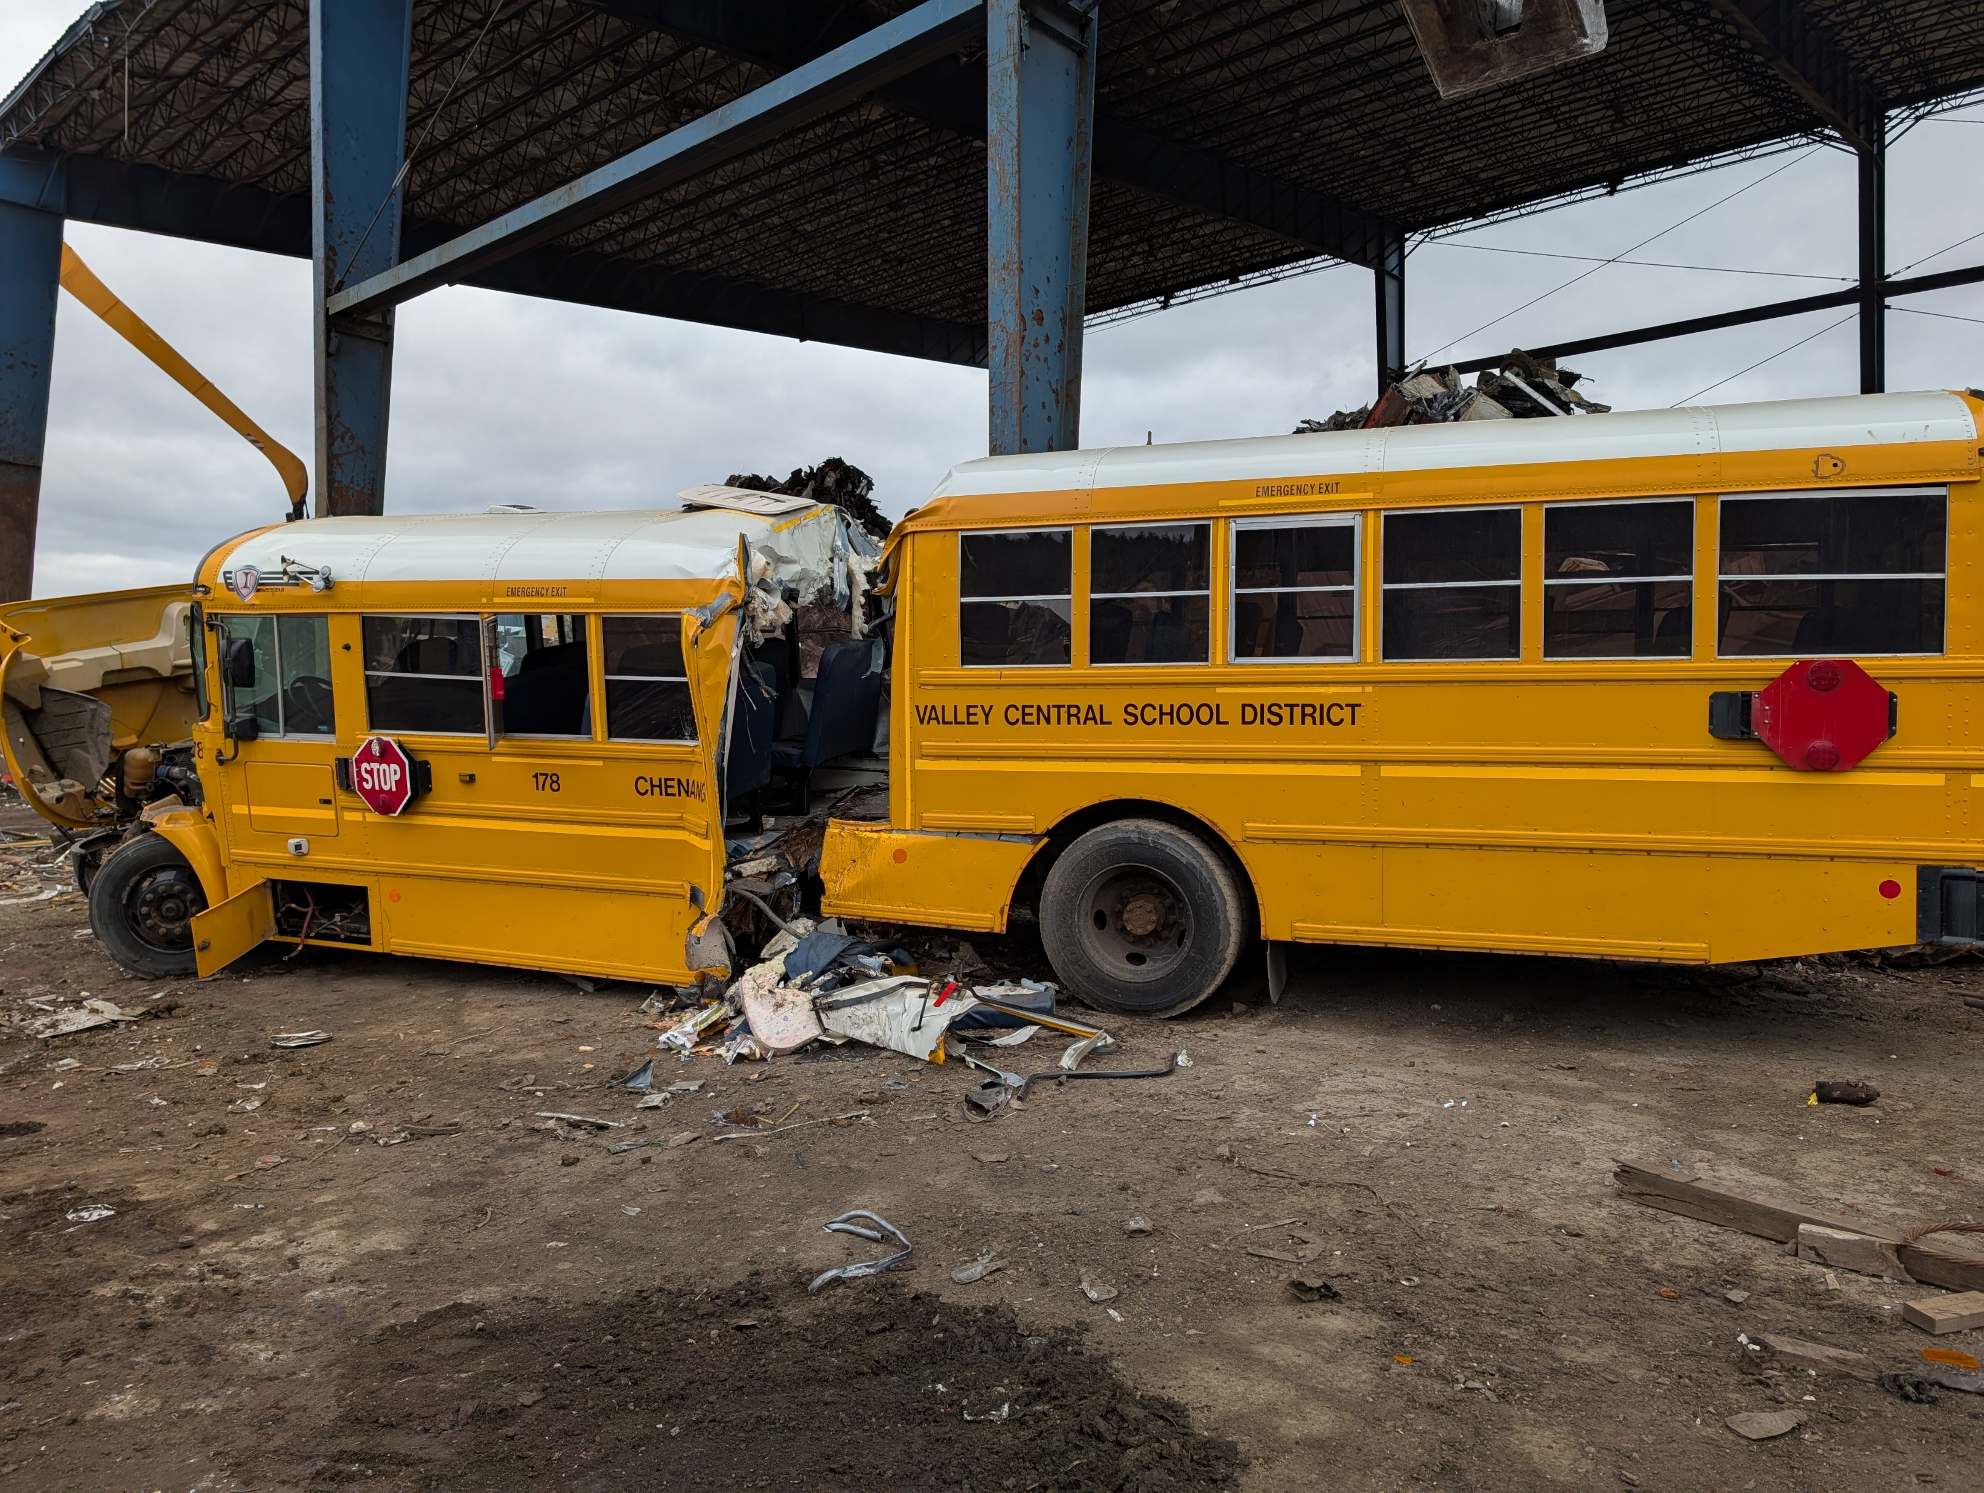
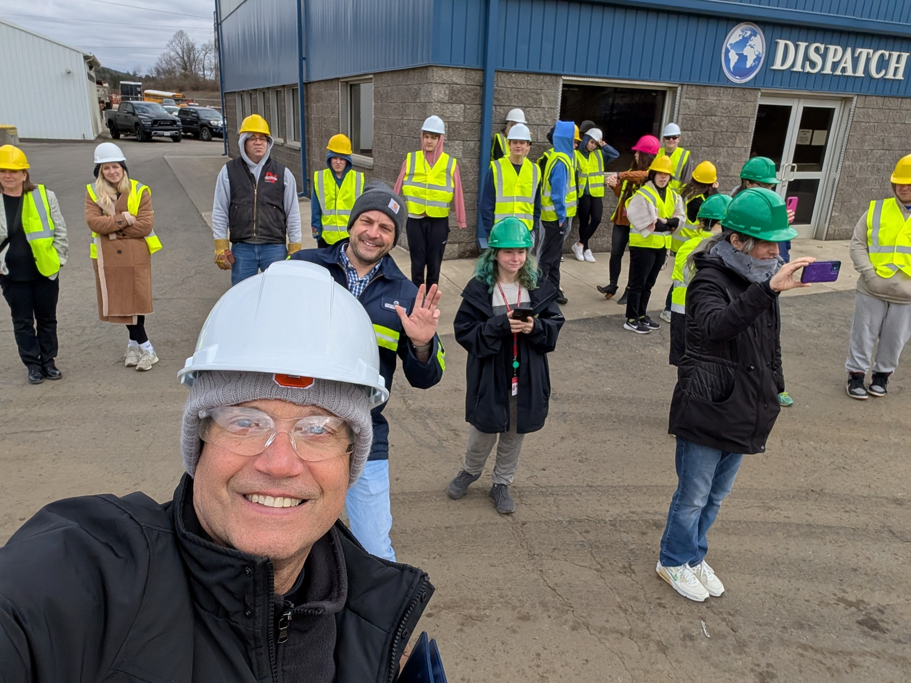
Scrappage Event Photos: Upstate NY
Educate!
Collaborate!
Notes:
Barry slide

Slide 22
How to Prepare for your Scrappage Event
Ensure all fluids and batteries have been removed from the vehicle/equipment prior to scrappage event
Be proactive: Reach out to Eligible Dismantler Facility to begin scheduling your scrappage event and NYSBIP/NYTVIP program staff to coordinate and secure an auditor if needed 1-2 months ahead of your desired scrappage date.
  Keep scrappage and voucher redemption timelines in mind and don’t let scrap events pile up!
Coordinate with parties involved including the purchaser, dealer, and scrappage auditors
  For new Vehicle Dismantling facilities in NYSBIP and NYTVIP, or if the Purchaser is new to either program, a Scrappage Auditor is required to attend the scrap event.
  Scrappage Auditors are available for fleets to utilize to ensure the event goes smoothly.
Notes:
Jonah slide

Slide 23

How to Prepare for your Scrappage Event cont.
Be prepared: Make sure you have all the vehicle documentation that you need
  NYTVIP: scrappage photos, scrappage documents:
    Scrappage Certification for Class 3-8 vehicles – voucher redemption document
    Scrappage Plan for non-road equipment – voucher application submission document
  NYSBIP: scrappage photos, two DOT Inspection Records, copy of registration, prepped vehicle attestation form
  Be communicative:
    Coordinate with the scrap yard and scrap auditor (if needed) in the lead-up to the scrappage event to ensure that all logistical details, including:
      exact scrappage date
      vehicle drop off time
      Number and details of vehicles/equipment being scrapped
    Communicate with the voucher program staff and scrappage auditor about scrappage event details and any changes
Notes:
Jonah slide

Slide 24

Scrappage Best Practices
Do your best to make sure the vehicle is delivered to the scrappage yard on time, possibly the day before
  If vehicle is delivered the day before the scrap event, clearly communicate to the scrappage yard that it should not be scrapped until the next day.
Take more pictures than you think you need, just to be safe!
If possible, try to have redundant sets of pictures from multiple attendees
Be flexible: If certain requested details aren’t available (i.e. no front license plate), or the scrappage needs to be done a certain way (i.e. engine needs to be taken out of the vehicle), just take the pictures that you can and communicate the details to program staff ASAP. Email NYTVIP@energycenter.org and program staff will determine next steps.
Wear appropriate clothing and shoes – they will most likely get dirty.
Notes:
Jonah slide

Slide 25
Questions?
Notes:
Sydney

Slide 26

Thank you!
NYTVIP:
Visit the NYTVIP website: https://nyserda.ny.gov/truck-voucher-program/
Contact the NYTVIP Voucher Help Center: NYTVIP@energycenter.org or 866-595-7917
NYSBIP:
Visit the NYSBIP website: https://www.nyserda.ny.gov/All-Programs/Electric-School-Buses/NY-School-Bus-Incentive-Program-Overview
Contact the NYSBIP Voucher Help Center: NYSBIP@energycenter.org or 866-595-7917
Notes:
Sydney

