Slide 1
Harnessing RTEM in Healthcare
@
September 13, 2023

Slide 2
September 13, 2023
1-2 PM
RTEM Talks
with Memorial Sloan Kettering and utiliVisor
Speakers: Jonathan Liang, Energy Project Manager at Memorial Sloan Kettering Cancer Center Ed Harvey, Systems Engineer at utiliVisor Moderator: Thomas Yeh, the Technical Advisor of the Real Time Energy Management (RTEM) Program for New York State Energy Research and Development Authority (NYSERDA)

Slide 3
Agenda 9/13/23
Welcome (5 min)
MSKCC presentation (20 min)
Panel discussion (20 min)
Online audience Q&A (10 min)
Closing remarks (5 min)

Slide 4
Harnessing RTEM in Healthcare
@
September 13, 2023

Slide 5
AGENDA
What is RTEM?
RTEM at the Josie Robertson Surgery Center
Challenges and Successes with RTEM
Results

Slide 6
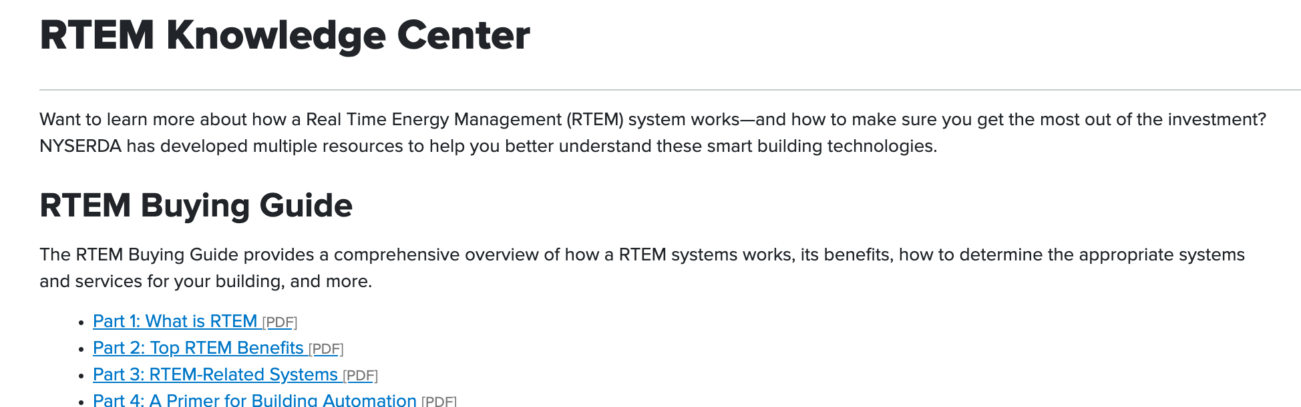
What is RTEM?
DEFINITION
“
Real Time Energy Management is a combination of systems and services employed to monitor and identify building improvement opportunities. The system consists of hardware, software, and secure internet connectivity that continuously transmits a building’s current and historical performance data to the cloud.
”

Slide 7
Why Real-Time?
RTEM & HEALTHCARE
RTEM helps discover potential capital projects
Justify implementing projects (boilers)
Measure ECMs, baselines, and points

Slide 8
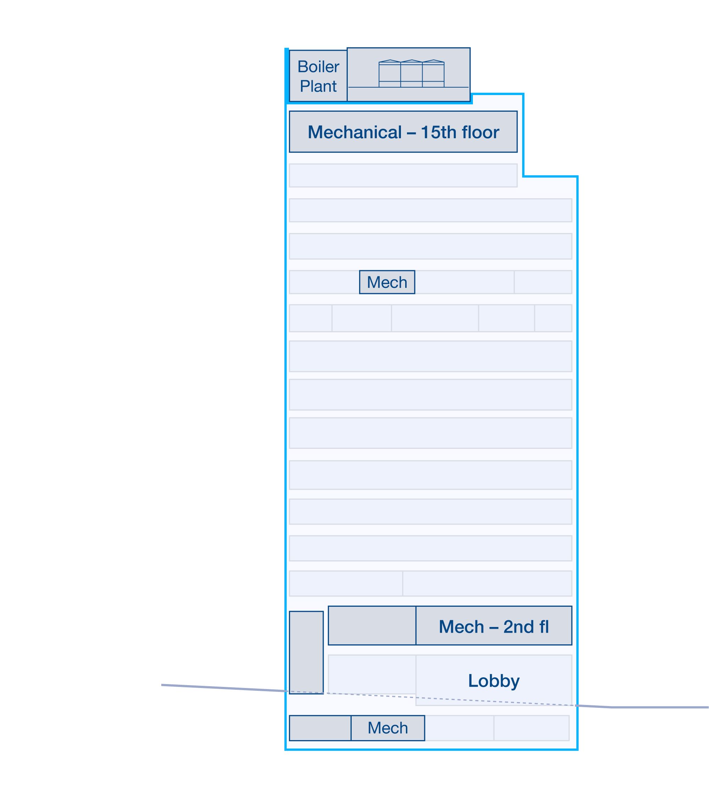
RTEM & HEALTHCARE
RTEM implementation
Right place, right time
Alignment with NYSERDA incentives
30% of installation cost coverage
30% of service for first three years

Slide 9
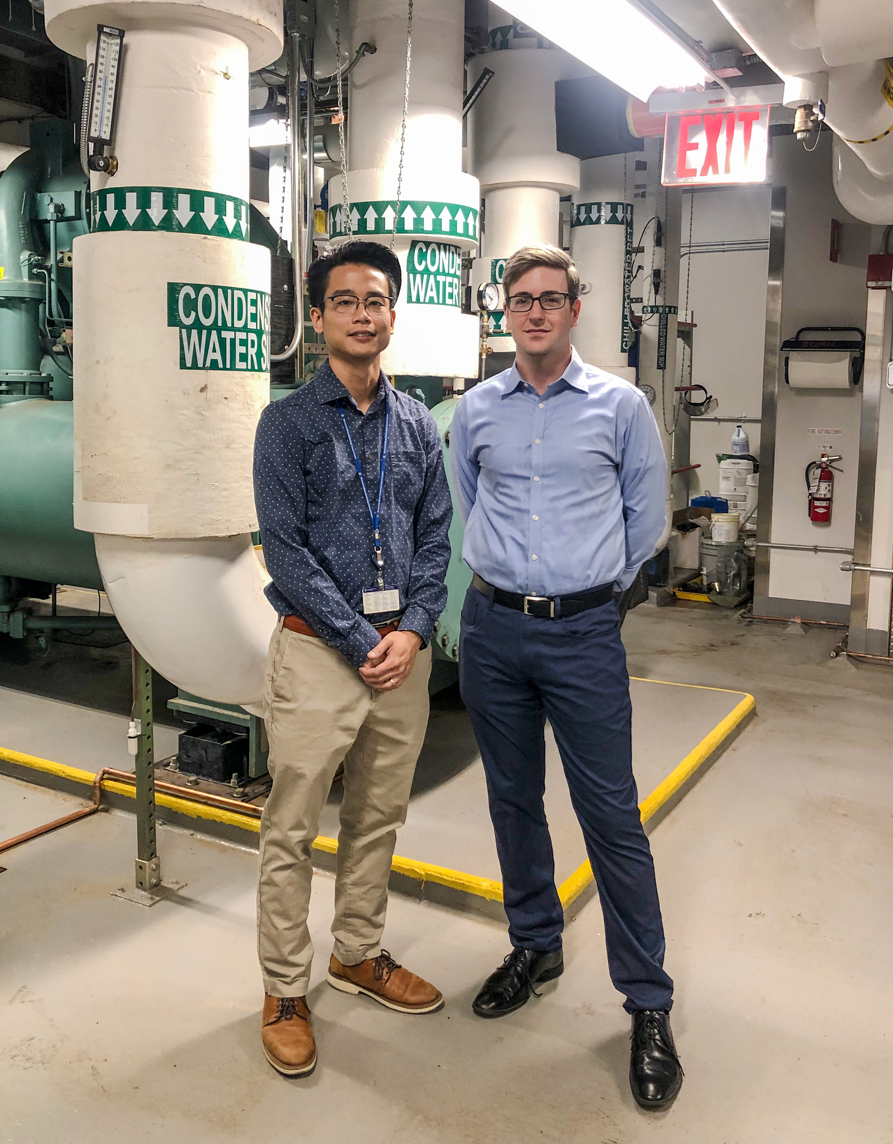
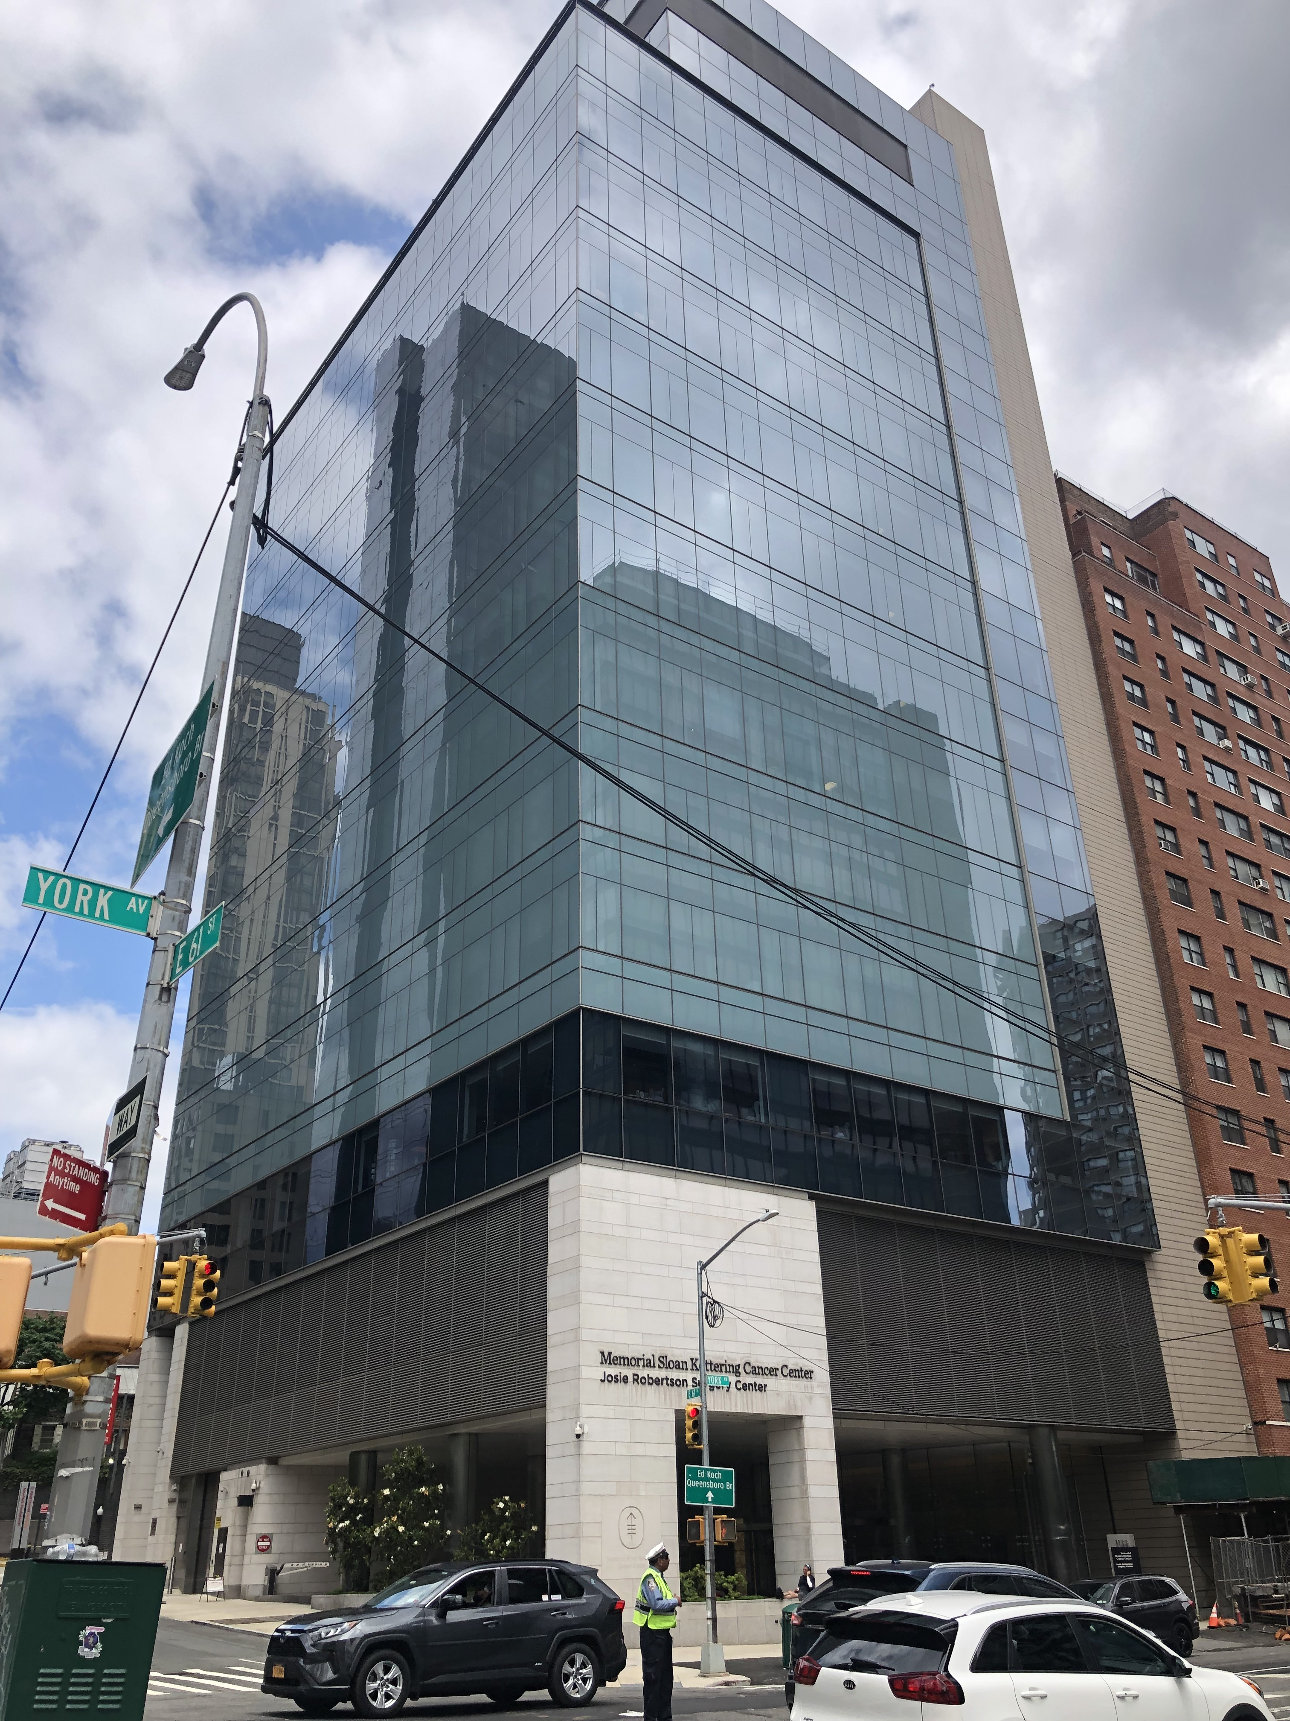
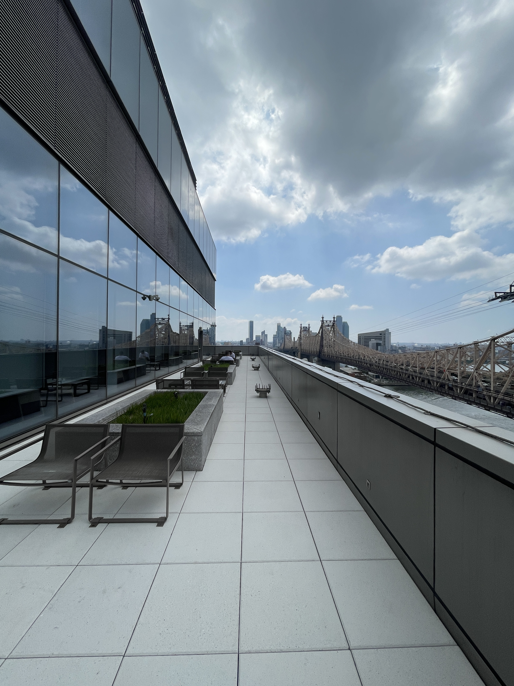
ABOUT

Slide 10
ABOUT
2016 – facility first started seeing patients
2017 – hardware furnished & programmed
2017 – utiliVisor started monitoring

Slide 11
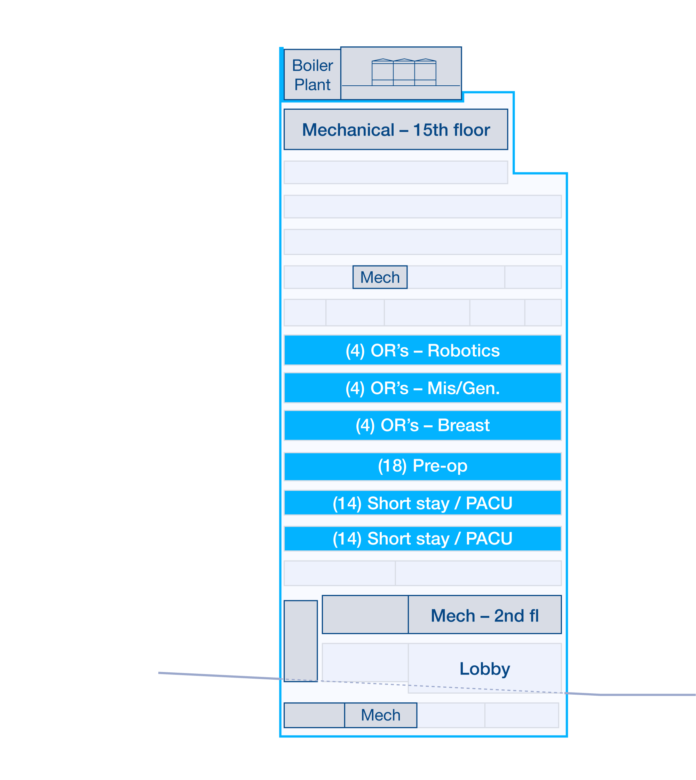
Challenges at Josie Robertson
RTEM
Best way to save energy is to turn it off
VS
24/7 facility operation & operating rooms
Balance of performance/compliance
Joint commission
ASHRAE standards
NYC local laws (LL97/LL87)

Slide 12
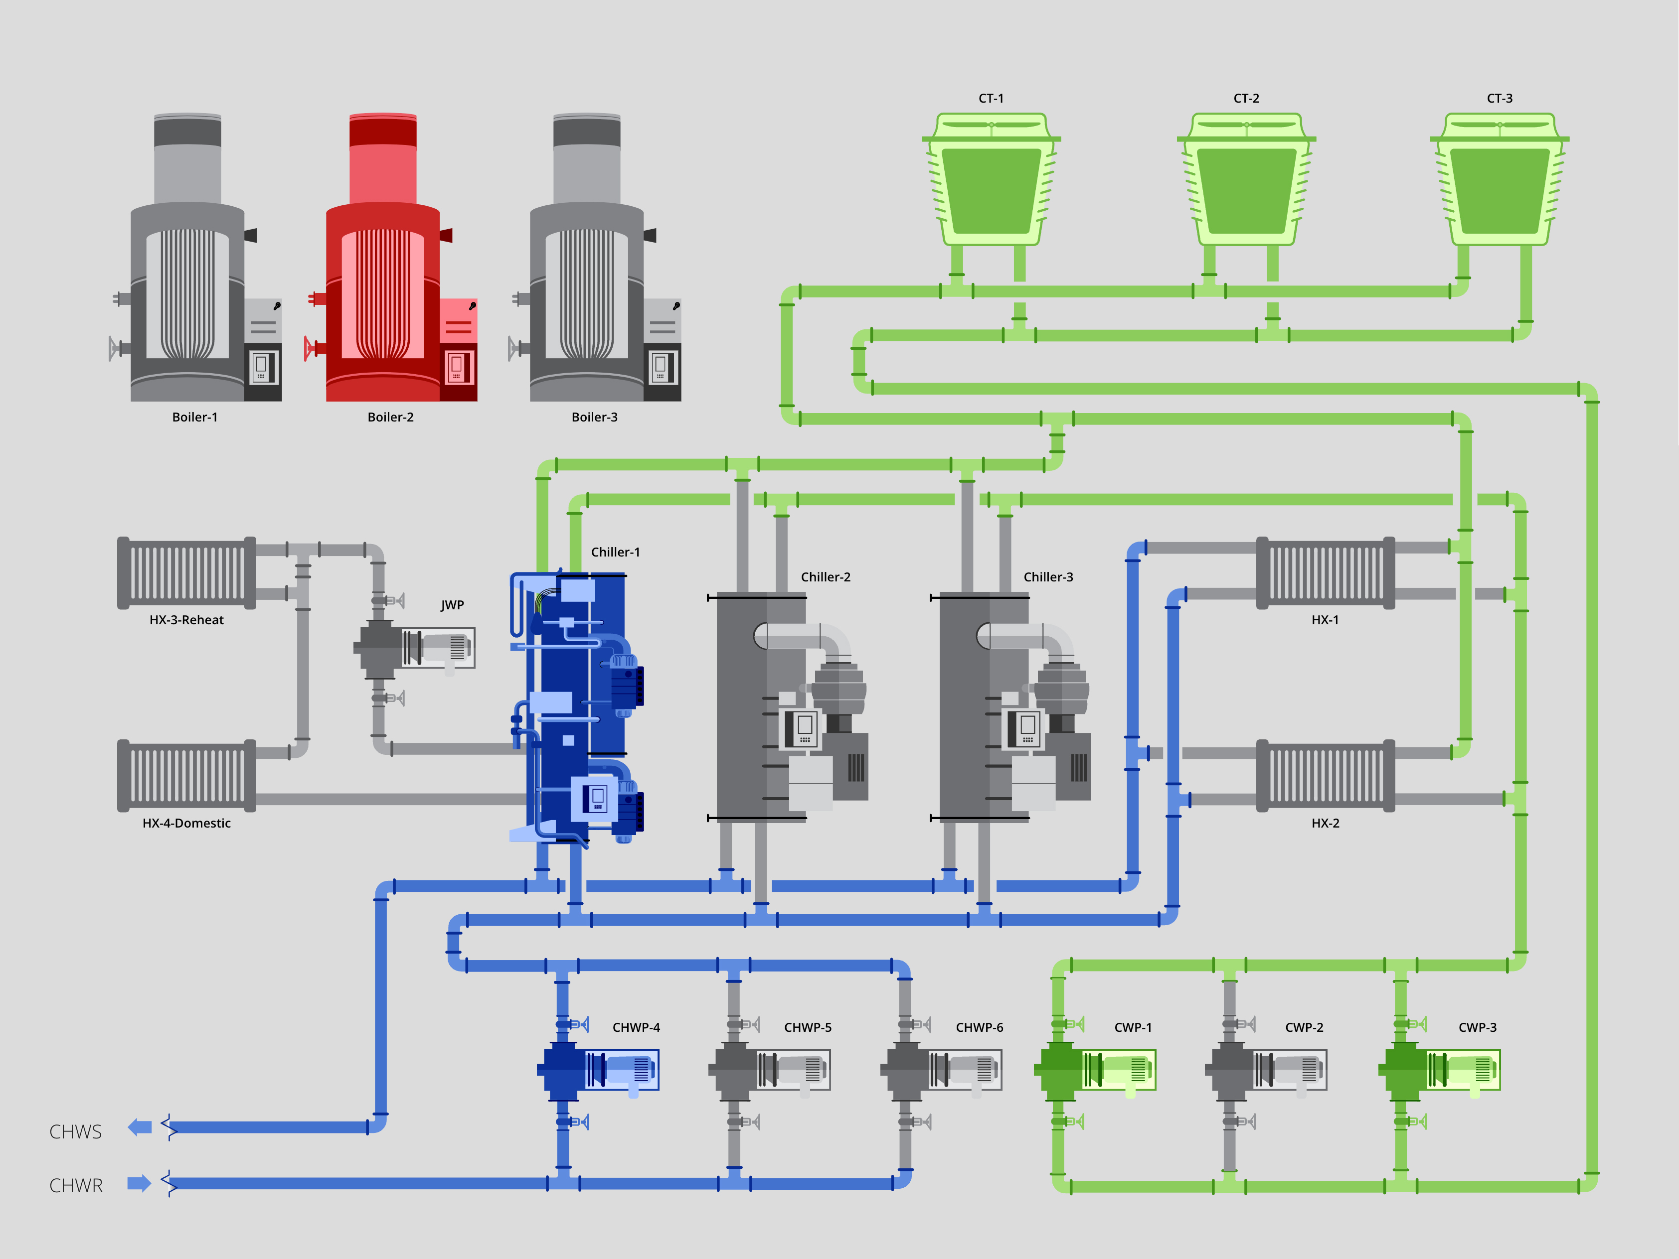
Challenges at Josie Robertson
RTEM
Working with the data available
BMS limitations (data volume, frequency, detail)
No bypass installed / preheat setpoints / etc.
Ideal world: designed at 100%, not reality
Using information received to the best of our abilities

Slide 13
Successes at Josie Robertson
RTEM
TOP FIVE IMPLEMENTED ECMS
Reduce Condenser Approach
Found at >6 Deg F; lowered to <1 Deg F
Free Cooling Heat Exchangers
Increased Enthalpy in use from 18 BTU/lb up to 22 BTU/lb.
AHU Scheduling
Static Reset During unoccupied hours (Manual to Automatic)
AHU Preheat Valve Operations
Found enabling at 65 Deg F OAT, lowered to 45 Deg F.
Clear Chiller Surge Maps
Chiller VFD not found not operating below 50Hz with vane operation not optimized.

Slide 14
Results of RTEM

Slide 15
Comparison of Site EUI by Year
RESULTS
SATURDAY
SURGERIES

Slide 16
JRSC Total Utility Cost
RESULTS
utiliVisor started monitoring

Slide 17
Savings since 2017 to date
RESULTS
523,000 total kWh energy savings
$53,200 energy cost reduction (annually)
14.65% reduction in site energy use intensity (EUI)

Slide 18
Questions?

Slide 19
NYSERDA’ RTEM Resources
RTEM Talks webinar series
Qualified Vendor Lists (RTEM Vendors , + Tenant Vendors)
Existing Success Stories
Project Dashboard of 1000+ sites
Buying Guide in Knowledge Center
Contact us at RTEM@nyserda.ny.gov

