Slide 1
Residential Financing Updates
September 8, 2016

Slide 2
Agenda
Pipeline Cleanup Overview
Interest Rate Structure
Income Estimator Tool
Application Overview
Single Family Application
One- to Four-Family Application
Auto-decisioning / Auto-withdrawal
Proforma Tool Updates
Useful Links
Q&A

Slide 3
Pipeline Cleanup Overview

Slide 4
Pipeline Cleanup
Total loan applications withdrawn – 1938
Estimated total loan value of withdrawn loans: $20.8M
Estimated value of pre-approved loans withdrawn: $17.9M
Estimated value of approved loans withdrawn: $2.9M

Slide 5
Interest Rate Structure

Slide 6
Interest Rate Structure
The interest rate is assessed based on the project type (Energy Efficiency, Renewable Energy, or a combination of Energy Efficiency and Renewable Energy), credit history and financing underwriting guidelines.
The interest rate and eligibility for an incentive is further determined by comparing household income levels to the State or Area Median Income, and is structured such that lower income households and those households that lack access in the private lending marketplace can afford to make energy efficiency improvements through NYSERDA’s expanded loan underwriting criteria (“Tier 2”) offered through GJGNY.

Slide 7
The table below summarizes the interest rate structure and is used to evaluate reduced interest rate availability.
 |  | Project Type: Energy Efficiency¹ |  |  | Project Type: Renewable Energy¹/ Combined²
Income Level Indicator | Income Level³ | Smart Energy (Pay by mail) | Smart Energy (Auto Pay) | On-Bill Recovery | Smart Energy (Pay by mail) | Smart Energy (Auto Pay) | On-Bill Recovery
Low (L) | Less than or equal to 80% | 3.99% | 3.49% | 3.49% | 3.99% | 3.49% | 3.49%
Moderate (M) | Greater than 80% up to 120% | 5.49% | 4.99% | 4.99% | 5.49% | 4.99% | 4.99%
High (H) | Greater than 120% | Tier 1=7.49% Tier 2=6.49% | Tier 1=6.99% Tier 2=5.99% | Tier 1=6.99% Tier 2=5.99% | Tier 1=8.49% Tier 2=6.49% | Tier 1=7.99% Tier 2=5.99% | Tier 1=7.99% Tier 2=5.99%
Tier 1 Primarily based upon a FICO score of 640 or greater; and a debt-to-income ratio of 50% or less; and no bankruptcies within the past 7 years. Tier 2 - Primarily based upon a FICO score lower than 640; or a debt-to-income ratio above 50%; and no bankruptcies within the past 2 years.
NYSERDA offers several Energy Efficiency and Renewable Energy programs. There may be specific program or contractor requirements associated with projects eligible for financing
Energy Efficiency and Renewable Energy projects in combination.
Based on percentage of State or Area (county) Median Income, whichever is higher, for the household size.

Slide 8
Income Estimator Tool

Slide 9
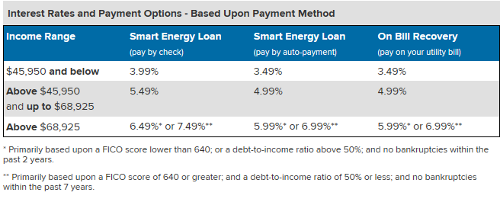
Interest Rate Estimator Tool (https://www.nyserda.ny.gov/interest-rate-estimator)

Slide 10
This chart provides an example of the Area Median Income document, which includes both the 80% and 120% income limits.
2016 Income Limits
HH Size |  | 1 | 2 | 3 | 4 | 5 | 6 | 7 | 8 | 9 | 10
2016 SMI (80%) |  | 35,908 | 46,956 | 58,005 | 69,053 | 80,101 | 91,151 | 97,947 | 109,040 | 120,133 | 131,227
2016 SMI (120%) |  | 53,862 | 70,434 | 87,008 | 103,580 | 120,152 | 136,726 | 146,920 | 163,560 | 180,200 | 196,840
County | Income Limits
Albany County | 80% | 45,950 | 52,500 | 59,050 | 69,053 | 80,101 | 91,151 | 97,947 | 109,040 | 120,133 | 131,227
 | 120% | 68,925 | 78,750 | 88,575 | 103,580 | 120,152 | 136,726 | 146,920 | 163,560 | 180,200 | 196,840
Allegany County | 80% | 35,908 | 46,956 | 58,005 | 69,053 | 80,101 | 91,151 | 97,947 | 109,040 | 120,133 | 131,227
 | 120% | 53,862 | 70,434 | 87,008 | 103,580 | 120,152 | 136,726 | 146,920 | 163,560 | 180,200 | 196,840
Bronx County | 80% | 50,750 | 58,000 | 65,250 | 72,500 | 80,101 | 91,151 | 97,947 | 109,040 | 120,133 | 131,227
 | 120% | 76,125 | 87,000 | 97,875 | 108,750 | 120,152 | 136,726 | 146,920 | 163,560 | 180,200 | 196,840
Albany County | 80% | 45,950 | 52,500 | 59,050 | 69,053 | 80,101 | 91,151 | 97,947 | 109,040 | 120,133 | 131,227
 | 120% | 68,925 | 78,750 | 88,575 | 103,580 | 120,152 | 136,726 | 146,920 | 163,560 | 180,200 | 196,840
Allegany County | 80% | 35,908 | 46,956 | 58,005 | 69,053 | 80,101 | 91,151 | 97,947 | 109,040 | 120,133 | 131,227
 | 120% | 53,862 | 70,434 | 87,008 | 103,580 | 120,152 | 136,726 | 146,920 | 163,560 | 180,200 | 196,840
Bronx County | 80% | 50,750 | 58,000 | 65,250 | 72,500 | 80,101 | 91,151 | 97,947 | 109,040 | 120,133 | 131,227
 | 120% | 76,125 | 87,000 | 97,875 | 108,750 | 120,152 | 136,726 | 146,920 | 163,560 | 180,200 | 196,840
Broome County | 80% | 35,908 | 46,956 | 58,005 | 69,053 | 80,101 | 91,151 | 97,947 | 109,040 | 120,133 | 131,227
 | 120% | 53,862 | 70,434 | 87,008 | 103,580 | 120,152 | 136,726 | 146,920 | 163,560 | 180,200 | 196,840

Slide 11
Recommendations for Communicating Interest Rates
Discuss the interest rate associated with the highest income level to not overpromise
Energy Efficiency Projects: NYSERDA offers a loan program with interest rates up to 7.49%
Renewable Energy/Combined Projects: NYSERDA offers a loan program with interest rates up to 8.49%
For Smart Energy Loans, a .5% discount applies if you pay with direct ACH payments.
The goal of the interest rates is to cover the cost of issuing residential loans. Energy efficiency and renewable energy loans have separate interest rates because it costs NYSERDA different amounts to sell these loans to the capital markets.
Interest rates will be lower for lower income customers and customers who lack access to traditional financing i.e., those households who most need energy efficiency and those who most need our help to acquire services.
Emphasize the health benefits and project savings not the difference in interest rates so that it speaks to how the customer often sees some of their money back through the reduction in their bills.

Slide 12
Application Overview

Slide 13
Application Overview
The loan application and incentive application have been combined into one.
Application for Single Family Owner Occupied Property – Applicant/Co-Applicant must own and reside at the property.
Application for One- to Four- (1-4) Family Property is for two- to four- family properties, or for single family properties where the Applicant and/or Co-Applicant do not own and reside at the property.

Slide 14
Single Family Owner-Occupied Property Application

Slide 15
Applicant – Person applying for loan and/or incentive. The Applicant must both own and occupy the installation property.
Household Members - All individuals living at the installation property (whether full-time students living in the household or not)
Household Income - The interest rate will be determined based on the household income of all income recipients (age 18 or over and who are not full-time students) the loan type, underwriting criteria, and project type (energy efficiency, renewable, or combined).
If the Applicant does not want to provide the required income information to be considered for a reduced interest rate loan the Applicant may opt-out in Section 2.

Slide 16
Using this application the Applicant can apply for the following:
Financing only → Complete Section 1: General Information, Section 2: Financing Information, Section 4: Consent Information and Signatures
Financing with a reduced interest rate loan → Complete all sections (Section 1 through Section 4)
Incentive only → Complete Section 1: General Information, Section 3: Household Income Information, Section 4: Consent Information and Signatures
Financing and an incentive → Complete all sections (Section 1 through Section 4)

Slide 17
One- to Four- (1-4) Family Property Application

Slide 18
Applicant – Person applying for loan and/or incentive. The Applicant does not need to own nor occupy the installation property.
Household Members - All individuals living at the installation property (whether full-time students living in the household or not)
Household Income - The interest rate will be determined based on the household income of all income recipients (age 18 or over and who are not full-time students) the loan type, underwriting criteria, and project type (energy efficiency, renewable, or combined).
If the Applicant does not want to provide the required income information to be considered for a reduced interest rate loan the Applicant may opt-out in Section 2.

Slide 19
Using this application the Applicant can apply for the following:
Financing only → Complete Section 1: General Information, Section 2: Financing Information, Section 4: Consent Information and Signatures
Financing with a reduced interest rate loan → Complete all sections (Section 1 through Section 4)
Incentive only → Complete Section 1: General Information, Section 3: Household Income Information, Section 4: Consent Information and Signatures
Financing and an incentive → Complete all sections (Section 1 through Section 4)

Slide 20
Section 1: General Information
Section 2: Financing Information
Section 3: Household Income Information = Financing and Incentive Application Addendum
Section 3 is the Addendum which captures all income recipients within each unit of the installation property.
The Addendum must be provided for each unit to be income-qualified for the reduced interest rate and/or income-eligible incentive.
Section 4: Consent Information and Signatures

Slide 21
Interest Rates for One- to Four- (1-4) Family Properties
If at least 50% of the units are up to 80% AMI/SMI, the rate is 3.49% or 3.99%
If at least 50% of the units are up to 120% AMI/SMI, the rate is 4.99% (could be a mix of moderate/low income)
Otherwise the rate is 5.99% or 6.99% or 7.99% (Tier 2 or Market Rate)
If the Applicant is low- to moderate-income and lives in the property, then no additional units are needed to qualify for a lower interest rate.

Slide 22
Auto-decisioning for Financing

Slide 23
Auto-decisioning
EFS now has auto-decisioning- a new functionality for the customers’ loans. Now a customer applying online will know in seconds if they have been conditionally pre-approved for financing.
Auto-decisioning helps simplify every step of loan origination and improves processing times.
Auto-decisioning is the automatic assessment of information provided by the customer at the time of application: qualifying ratios, risk-rating parameters combined with credit bureau scores to automatically decision loans.
For customers not conditionally preapproved, an EFS loan specialist will provide a response after standard underwriting is complete.

Slide 24
Auto-withdrawal
The loan origination system will have an automated feature that enables NYSERDA to regularly review application pipeline status. Applicants not meeting the stated timelines will have their application withdrawn unless they have requested an extension.
If the application was submitted on-line and is withdrawn, an automated email will be generated to the Applicant stating the following:
The status of your application with EFS has changed. Your loan application has been withdrawn. This change may have occurred per your request, or may indicate that your loan application has expired. For more information, or if you would like to reactivate your application, please call or email your loan specialist.

Slide 25
Proforma Updates

Slide 26
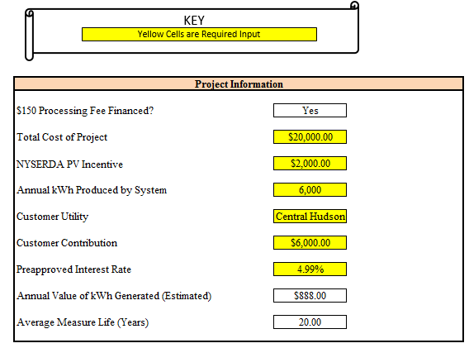
Proforma Updates
The Proforma Tools now have the ability to calculate loan eligibility based upon available interest rates.
A new drop-down box has been added to the Project Information section of the Proforma Tools which allows the interest rate to be selected based upon the interest rate provided in the EFS PreApproval letter.

Slide 27
Useful Links

Slide 28
Useful Links
https://www.nyserda.ny.gov/residential-financing: to access applications
https://www.nyserda.ny.gov/interest-rate-estimator: information on household eligibility and interest rates
http://www.nyserda.ny.gov/About/Green-Jobs-Green-New-York/Advisory-Council/Meetings: Information on loan fund sustainability

Slide 29
Q & A
Session

Slide 30
All questions, comments, or recommendations should be emailed to residential.financing@nyserda.ny.gov.

