Slide 1
Solar for All

Slide 2
Solar for All Overview

Slide 3
What is Solar for All
State-administered program that provides a utility bill assistance to eligible New Yorkers
Save money through a free community solar subscription
Gain access whether you are a renter or a homeowner
Similar to HEAP, credits appear on your electric utility bill

Slide 4
What You Get
Example of where the Solar for All credit will appear on the Orange and Rockland Bill
Monthly credits on your electric bill from solar energy
No change to the utility provider, service, or supplier
Save $5-15 a month
No upfront costs, fees, or payments to participate
Does not affect any existing benefits that you have
Free cancellation at any time

Slide 5
What You Get
Example of where the Solar for All credit will appear on the NYSEG Bill
Monthly credits on your electric bill from solar energy
No change to the utility provider, service, or supplier
Save $5-15 a month
No upfront costs, fees, or payments to participate
Does not affect any existing benefits that you have
Free cancellation at any time

Slide 6
What You Get
Example of where the Solar for All credit will appear on the National Grid Bill
Monthly credits on your electric bill from solar energy
No change to the utility provider, service, or supplier
Save $5-15 a month
No upfront costs, fees, or payments to participate
Does not affect any existing benefits that you have
Free cancellation at any time

Slide 7
How Solar for All Works

Slide 9
About Your Project: Underhill Farm
Based on where you are doing outreach, project specifics slides that you can use to help sign people up.
2.99 MW Solar Project in Poughkeepsie, NY
1MW is reserved for Solar for All
Project is live
~800 spots remaining for Solar for All participants
Available to electricity customers of Central Hudson Gas & Electric

Slide 10
About Your Project: Nexamp Rochester
Based on where you are doing outreach, project specifics slides that you can use to help sign people up
5.7 MW Solar Project in the Town of Rochester
1MW is reserved for Solar for All
Project will go live this Summer
~850 spots remaining for Solar for All participants
Available to electricity customers of Central Hudson Gas & Electric.

Slide 11
About Your Project: Crans Mill
Based on where you are doing outreach, project specifics slides that you can use to help sign people up
2.7 MW Solar Project in Crawford, NY
1MW is reserved for Solar for All
Project is live
~1,000 spots remaining for Solar for All participants
Available to electricity customers of Orange and Rockland

Slide 12
About Your Project: Sackett Lake
Based on where you are doing outreach, project specifics slides that you can use to help sign people up
2.74 MW Solar Project in Thompson, NY
1MW is reserved for Solar for All
Project will go live this Fall
~700 spots available for Solar for All participants
Available to NYSEG customers in Sullivan, Delaware, Otsego, Chenango, and Madison Counties

Slide 13
About Your Project: Johnstown A&B
Based on where you are doing outreach, project specifics slides that you can use to help sign people up
2 Solar Projects
2.7 MW & 2.8 MW in Johnstown, NY
2 MW is reserved for Solar for All
Projects are live
~1,400 spots remaining for Solar for All participants
Available to National Grid customers in the Capital Region

Slide 14
About Your Project: Nexamp Seneca
Based on where you are doing outreach, project specifics slides that you can use to help sign people up
2.6 MW Solar Project in Seneca, NY
1MW is reserved for Solar for All
Project is live
~200 spots remaining for Solar for All participants
Available to all NYSEG customers

Slide 15
About: Grand Island
Based on where you are doing outreach, project specifics slides that you can use to help sign people up
2.3 MW Solar Project in Grand Island, NY
1MW is reserved for Solar for All
Project will go live late Summer/early Fall
~458 spots remaining for Solar for All participants
Available to all National Grid customers in Western NY

Slide 16
About: Boas #4
Based on where you are doing outreach, project specifics slides that you can use to help sign people up
2.79 MW Solar Project in Mooers Fork, NY
1MW is reserved for Solar for All
Project will go live this Fall
~650 spots remaining for Solar for All participants
Available to all NYSEG customers

Slide 17
Solar for All Projects

Slide 18
How to
Sign Up

Slide 19
Step 1: Are you Eligible?
You can use this slide for eligibility or the following one. Whichever one you think is better for your audience. Please remove the slide that you will not use.
Do you pay your own electric utility bill?
Include a copy of your last electric bill (all pages) with your application
If you average less than ~$25 per month in electric bill costs NYSERDA may need to review your usage to ensure that you qualify
Is your household income under 60% of State Median Income?
Include a copy of your award letter from HEAP, SNAP, EmPower, TANF, SSI, or utility assistance program
If you don’t participate in any of these programs, you can provide alternative documentation
Visit http://nyserda.ny.gov/solar-for-all-eligibility for details and forms

Slide 20
Step 1: Demonstrate Eligibility
You can use this slide for eligibility or the one before. Whichever one you think is better for your audience. Please remove the slide that you will not use.
Income
Electric Usage
Provide documentation that demonstrates income qualification - 60% SMI
Option 1: Provide a copy of your award letter for another assistance program.
Show that you pay your own electric utility bill to a participating utility*.
Easiest way to show eligibility: Submit an entire utility bill (all pages) when you apply for the program.
*If you average less than ~$25 per month in electric bill costs NYSERDA may need to review your usage to ensure that you qualify
EmPower New York
HEAP
SNAP
TANF
Supplemental Security Income
Utility bill assistance program
Option 2: Submit documentation with income information, http://nyserda.ny.gov/solar-for-all-eligibility

Slide 21
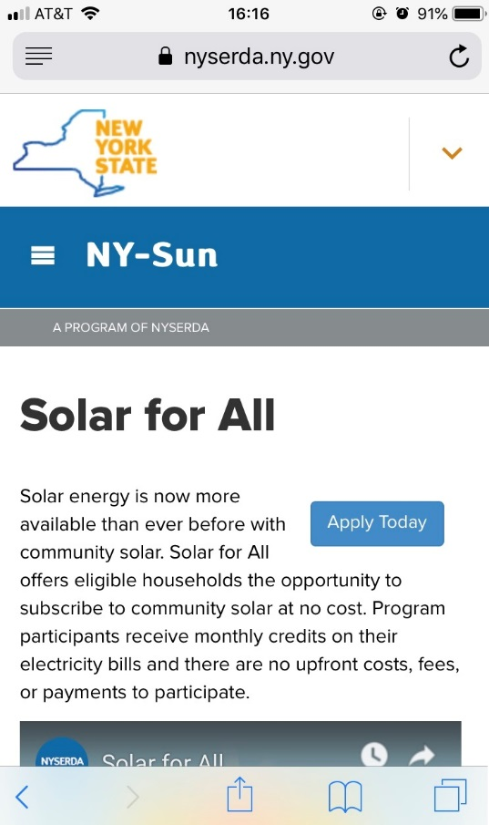
Step 2: Sign up for Solar for All
Sign up two ways
Online: sign up directly on nyserda.ny.gov/solar-for-all using a mobile device, tablet or computer
Paper Application: call 1-877-NYSMART to receive a paper application in the mail

Slide 22
What Happens Next
Within a few days of submitting an application, you will receive an eligibility notification from solarforall@nyserda.ny.gov
If you are eligible, you will be matched to a community solar project
After 2-3 months, you will start receiving credits on your monthly electric bills, reducing your costs
If your project has not yet finished construction, you will not receive credits until it is operational
If you are on a level or budget bill plan, the way the credits are handled will vary depending on your utility

Slide 23
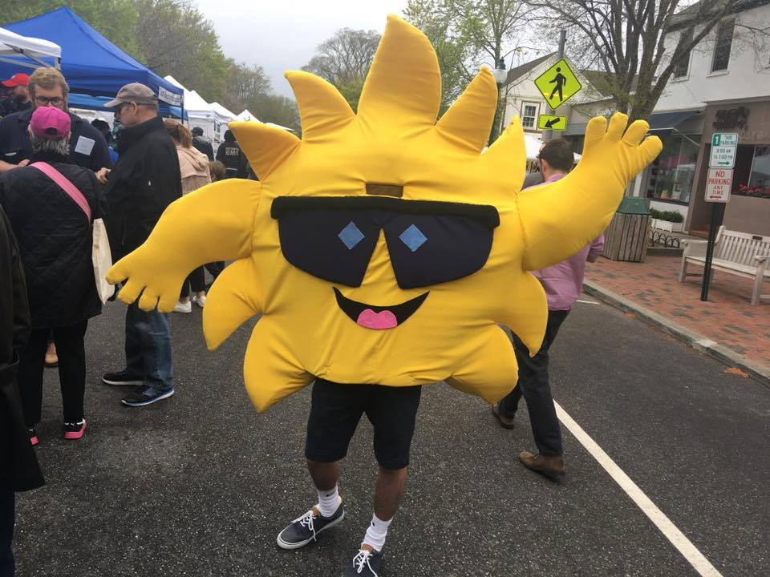
Any Questions? Contact Us
Residents can sign up directly by visiting nyserda.ny.gov/solarforall
If you have any questions, please contact solarforall@nyserda.ny.gov, or call 1-877-NYSMART

