Slide 1
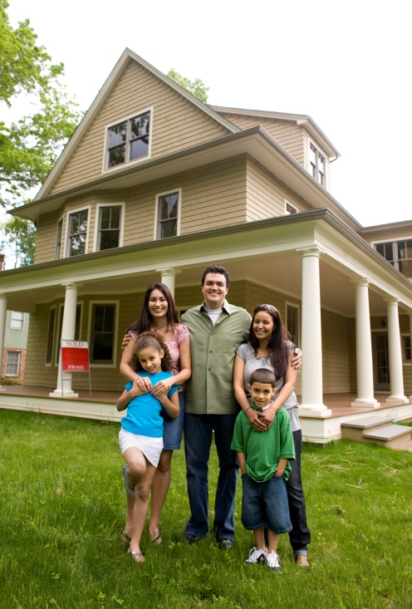
Solarize
[municipality]
Solar. Simple. Together.
[Add Solarize URL to website]

Slide 2
Solarize [municipality]
Solar. Simple. Together.
Agenda
www.websitegoeshere.com

Slide 3
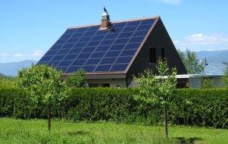
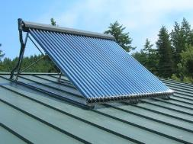
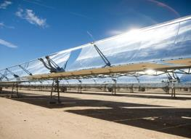
Solar Technologies
Solar Photovoltaic (PV)
Solar Hot Water
Concentrated Solar Power

Slide 4
Solar Technologies
Solar Electric (also known as photovoltaic or PV)
Solar Hot Water
Concentrated Solar Power

Slide 5
Solar Technologies
Cell
Panel / Module

Slide 6
Some Basic Terminology
Array

Slide 7
Some Basic Terminology
Production
Kilowatt-hour (kWh)

Slide 8
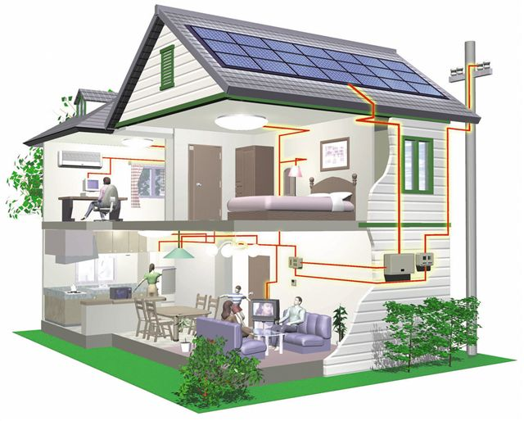
System Components
Grid-Tied Solar Electric System
Solar Panels Sunlight creates DC Electricity
Inverter Changes DC Power to AC (AC Power used in Home)
Net Metering Excess (unused) power turns your meter backward and travels back into the grid. Utility issues credits for power produced.

Slide 9
Scale
Residence
5 kW
Factory
1 MW+
Office
50 – 500 kW
Utility
2 MW+

Slide 10
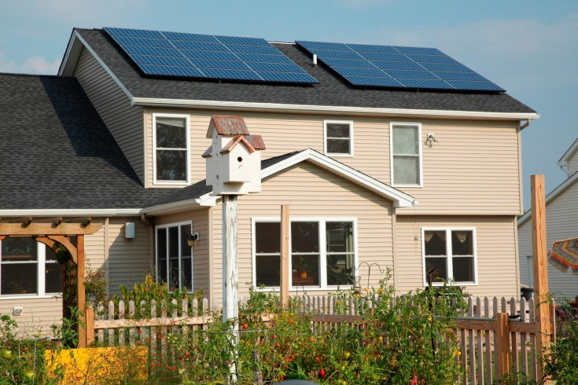
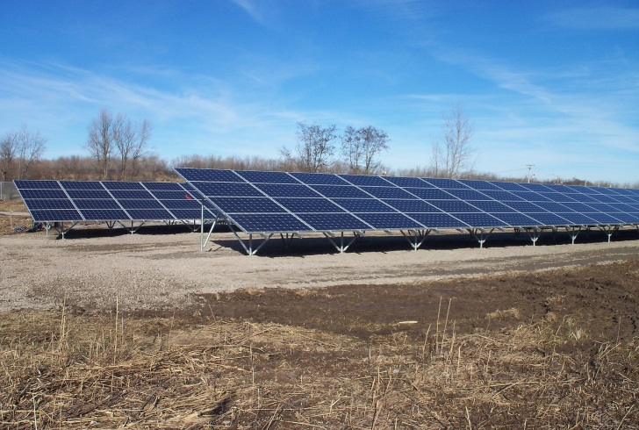
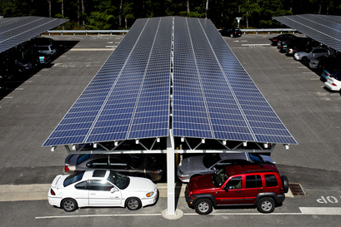
System Types
Roof Mount
Ground Mount
Parking Canopy

Slide 11
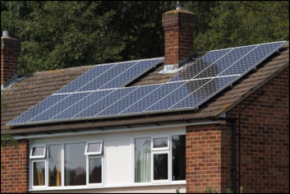
What Makes a Good Site for Solar?
South-facing roof
No shading or obstructions (especially to the south)
Large contiguous area (100 Sq Ft needed per kilowatt)
Roof in good condition
Adequate electrical service

Slide 12
Solarize [municipality] Campaign
[Add details about campaign: background, length of campaign, goals of the campaign, etc]
www.websitegoeshere.com

Slide 13
Solarize [municipality] Team Members
[List Team Members]
www.websitegoeshere.com

Slide 14
Solarize [municipality] Partners
[List Partnering Organizations]
www.websitegoeshere.com

Slide 15
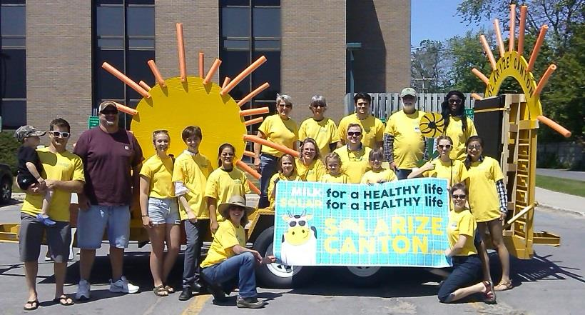
What is Solarize?
Events and Community Outreach
Campaign presence in Community throughout program
Lunch & Learns to company/organization employees
Community education events
Exhibiting at community events
Neighborhood coffees and socials
Installation parties
Festivals
Volunteer driven
www.websitegoeshere.com

Slide 16
What is Solarize?
Streamlined Customer Experience
Transparent pricing structure
Pre-qualified, experienced installers
Free, no obligation site evaluations
Clear deadline
Support through the Solarize Campaign
www.websitegoeshere.com

Slide 17
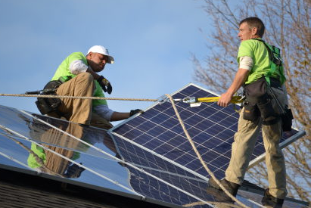
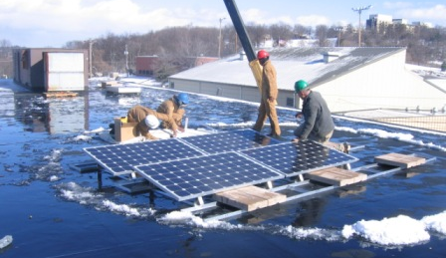
What is Solarize?
Streamlined Installer Experience
Intensive marketing benefits all installers
Brings firm leads to installer with higher close rates
Provides solar education and financing education to customers before installer interaction
Reduces customer acquisition costs
www.websitegoeshere.com

Slide 18
How to Go Solar Through Solarize [Municipality]
Introduction to installer
Explain how to request a quote (e.g., go to website to sign up, etc.)
What will the customer expect after signing up for quote (timeframe for installer contact, quote delivery, and installation; explain that installer will get permits from municipality and utility; etc.
www.websitegoeshere.com

Slide 19
Current Solar Owner Experience
Introduce current solar owners who are in attendance
Show pictures of their installations
Allow them to talk about why they went solar and their experience
Allow audience to ask them questions
www.websitegoeshere.com

Slide 20
Questions & Answers
www.websitegoeshere.com

