Slide 1
Commercial Industrial Stakeholder Meeting
7/27/17

Slide 2
Introduction
After each discussion item, we will pause for questions
Use the chat box
Feel free to reach us afterwards with other questions and feedback at Commercial.IndustrialPV@nyserda.ny.gov
Slides and webinar recording will be available in a couple of days on our website on our new C/I Stakeholder Meeting Page
Notes:
We will start with questions in the room, then defer to the chat feature on the webex for other questions
Please note: Use the chat box, where we have the ability to respond and send relevant links, NOT the Q&A box, as we don’t have that option
If there is time at the end, we may open up the phone line (maybe for people not at a computer?)

Slide 3
Agenda
Introduction from David Sandbank
A word from Alicia Barton
Competitive Bid Program
Commercial / Industrial MW Block
VDER Changes/Calculator
Solar Market Accelerator
LMI CDG Program
Storage
Open discussion

Slide 4
Competitive Bid Program

Slide 5
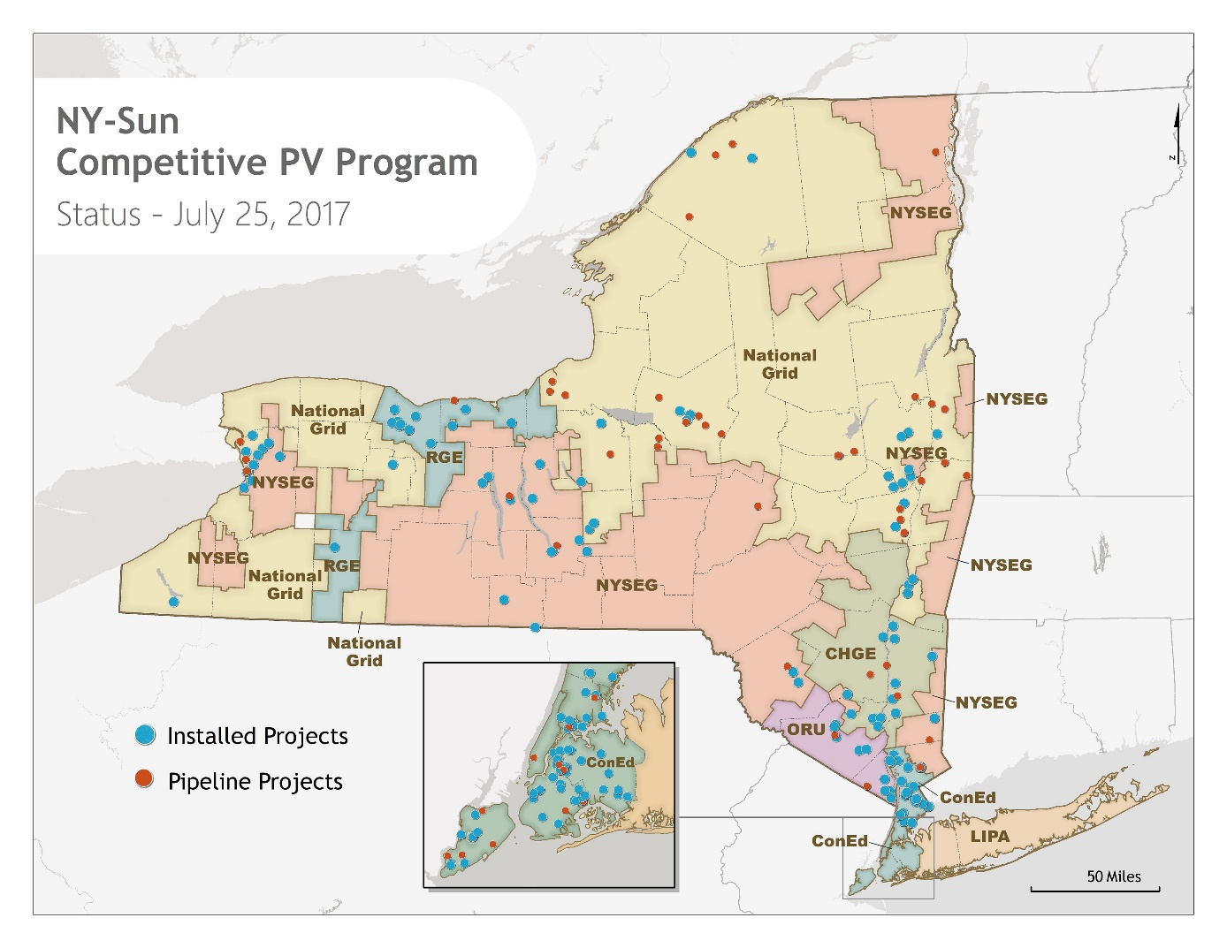
Utility | # of Projects | Capacity (kW)
Con Ed | 121 | 43,745
CHG&E | 16 | 10,543
ORU | 13 | 14,190
National Grid | 74 | 137,127
NYSEG | 30 | 44,977
RG&E | 14 | 15,015
Grand Total | 268 | 265,598
Installed kW | 140,786
Pipeline kW | 124,812
Total kW | 265,598

Slide 6
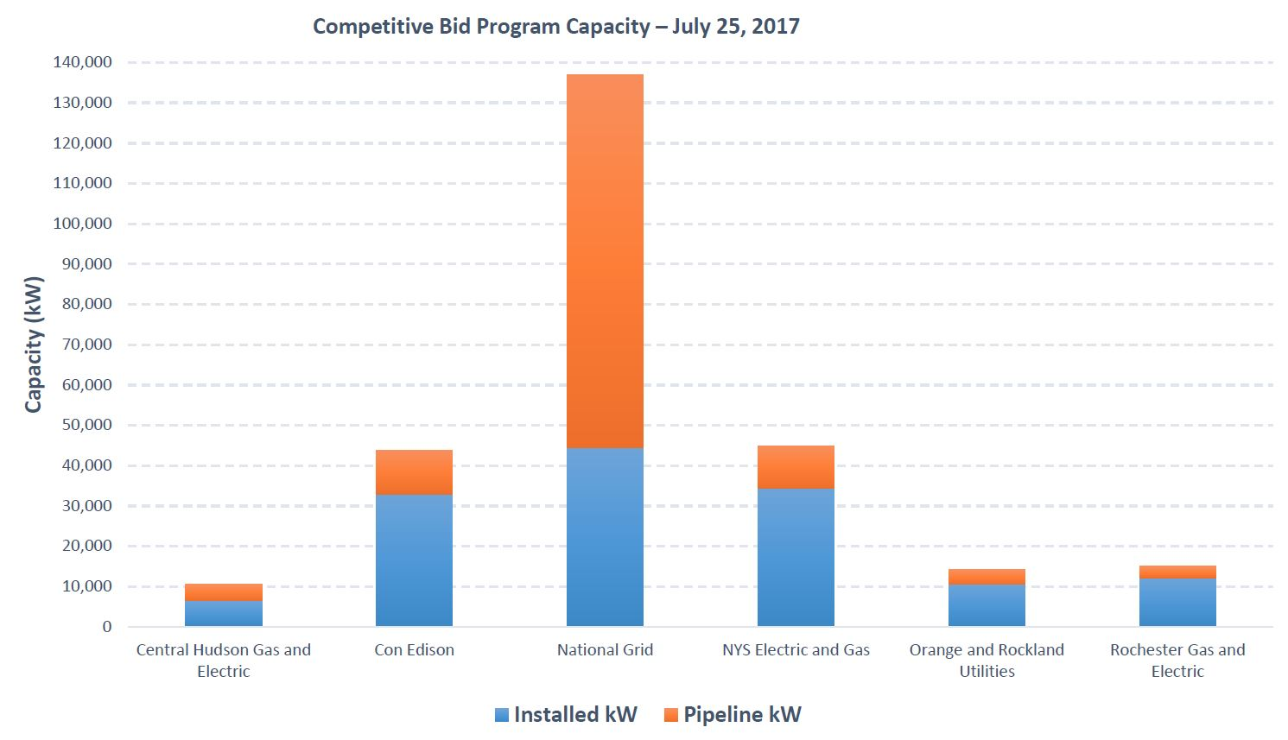

Slide 7
Commercial / Industrial MW Block

Slide 8
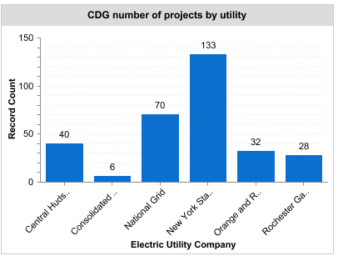
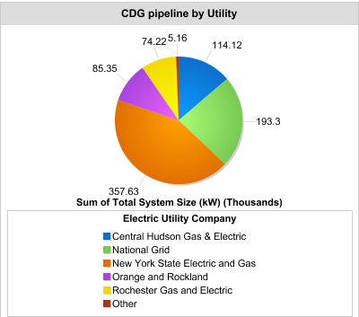
C&I CDG
Notes:
Prior stakeholder meeting slide

Slide 9
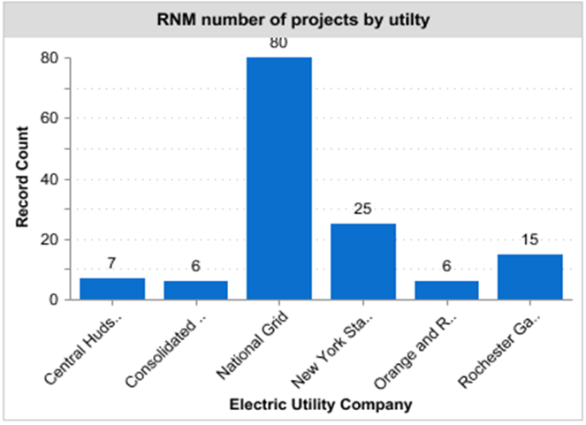
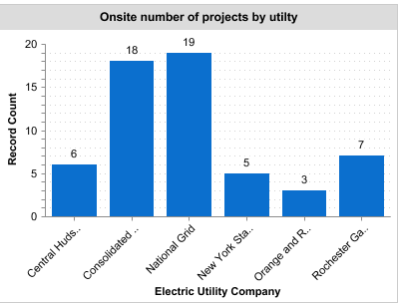
C&I RMN and Onsite
Notes:
Prior stakeholder meeting slide

Slide 10
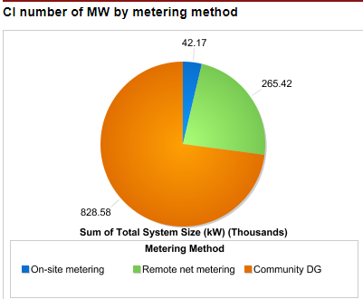
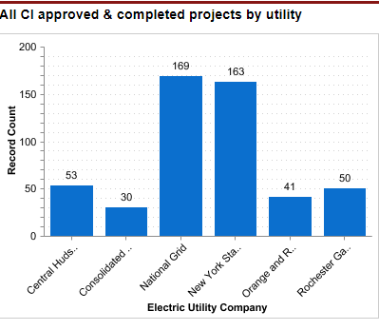
C&I Overview
Notes:
Prior stakeholder meeting slide

Slide 11
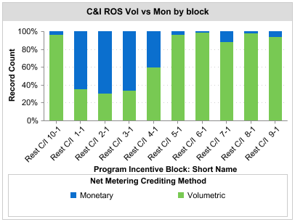
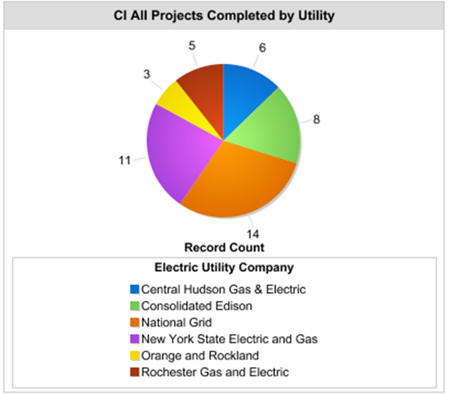
C&I Overview
Notes:
8 completed CDG projects

Slide 12
MW Block Discussion Items
What changes can be made that control ratepayer costs, while continue to maintain and expand solar growth across the State?
Program eligibility criteria
Systems size changes
Payment Structure changes: 50/25/25, Split for a two year PBI
Storage, Energy Efficiency, Track 2, and energy assessment
Removal of security for one time six month extension
Changes to 110% demand rule
Canopy adder for NYC
Notes:
Cesir to 25%
No more track 2 - only 4 projects used it
Strategic locations no more needed w/ VDER
Eliminate Storage and EE
Payment cap - projects in excess of 3MW holds up budget
PBI term 2 years

Slide 13
VDER Update and
Value Stack Calculator

Slide 14
VDER Update
Phase 1 VDER Implementation Order will provide greater clarity on value stack. The Order may be released late summer/early fall 2017
Utilities submitted proposed values and methodologies to DPS on May 1, 2017.
Initial work on VDER Phase 2 is underway. Three Working Groups held initial meetings July 17-18
Rate Design Working Group
Value Stack Working Group
Low-to-Moderate Income Working Group

Slide 15
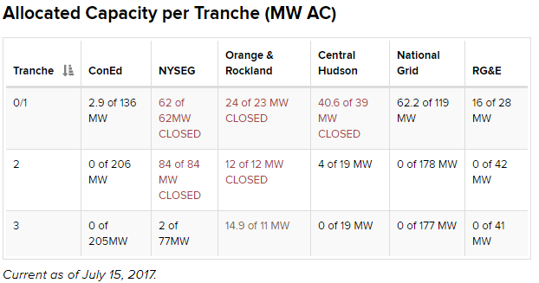
VDER Update – CDG Tranches
nyserda.ny.gov/vder
Notes:
Total capacity is 324.6MW

Slide 16
Value Stack Calculator
Will present total $ value of a PV system’s production under VDER
Flexible tool – user selects metering type and project details/assumptions
Will be available after VDER Implementation Order released (i.e. once values and methodologies are finalized by PSC)

Slide 17
Solar Market Accelerator

Slide 18
The NY Solar Guidebook for Local Governments
Current Chapters:
The PILOT Toolkit
Solar PV Permitting and Inspecting
Solar in Agricultural Districts
Land Lease Considerations Fact Sheet
Decommissioning Fact Sheet
New Chapters:
Land Use Tools for Siting Solar PV on Farmland
The State Environmental Quality Review (SEQR) for Solar
Municipal Procurement Toolkit
NY Solar Guidebook Website:
www.nyserda.ny.gov/SolarGuidebook

Slide 19
Free Assistance for Local Governments
NY-Sun offers free one-on-one assistance to local governments on:
Adopting a PILOT law and PILOT Agreements, and determining a PILOT rate
Permitting and Inspections
Adopting and implementing the Unified Solar Permit and improving the inspection process
Planning and Zoning
Adopting a model solar energy law
Updating a comprehensive plan and zoning regulations
Siting PV on farmland and in Agricultural Districts
Completing the SEQR Process for Solar PV Systems
To request assistance on solar issues, email solarhelp@nyserda.ny.gov

Slide 20
Soft Cost Working Group Update
The Soft Cost Working Group completed three successful meetings since May
Solar developer and local government Working Group members contributed to the development of the following New York Solar Guidebook resources:
The Solar PILOT Toolkit
Land use tools for siting solar PV on agricultural land
A guidance document on the SEQR process for PV projects
Future collaborations will continue on market needs on a demand-basis
If you have an issue you would like the Working Group to address, please notify NY-Sun.

Slide 21
LMI CDG Program

Slide 22
LMI Community Solar Initiative
Community Solar is the best opportunity for low and moderate income customers to benefit from solar
NYSERDA initiative is in planning/approval phase
Use NYSERDA’s purchasing power to reduce costs and risks for both low income customers and community solar developers
Mobilize investment in community solar projects serving LMI customers and affordable housing
Customer education, outreach, and referral

Slide 23
Storage

Slide 24
Storage
Value Stack offers additional revenue for storage
ICAP Alternative #2 – based on grid injections 2-7PM in summer
DRV and LSRV payments based on system grid injections during year’s top 10 hours of peak grid demand
NYSERDA PON 3541 offers support for PV+ Storage demos that also stack wholesale (ancillary) or utility (NWA) service
Notes:
How compelling do you find the added values (ICAP, DSRV, LSRV) that can be improved by adding storage?
In what types of PV projects (BTM, RNM, CGD) do you think energy storage will make sense first?
Does adding storage to a PV project help or hinder getting project signed, financed and built? How so?
Besides system cost, what complications arise from adding storage to a project that NYS can help address? (i.e. interconnection, financing, utility coordination, permitting)
Does the tariff’s focus on summertime values (ICAP) raise questions of lumpy revenue or low storage utilization? (i.e. uses in non-summer)
What year and quarter do you predict you would commission your 1st PV + storage system?

Slide 25
Open Discussion

Slide 26
Thank you for your participation!
Stakeholder documents and information:
http://ny-sun.ny.gov/About/Stakeholder-Meetings.aspx
Suggest future agenda items or provide other input: Commercial.IndustrialPV@nyserda.ny.gov

