Slide 1
NY Prize Community Microgrid Benefit-Cost Analysis: Facility Questionnaire
Prepared for:
New York State Energy Research and Development Authority (NYSERDA)
Prepared by:
Industrial Economics, Incorporated
2067 Massachusetts Ave.
Cambridge, MA 02140
USA
617/354-0074
November 2015

Slide 2
Facility Questionnaire Overview
Why do we collect information about facilities served by the microgrid?
A key function of a microgrid is improving the resiliency of electric service during severe storms or other events typically considered beyond a utility’s control.
For this reason, the BCA model estimates the benefits of preventing economic losses from major power outages.
The analysis of your microgrid project will present results assuming:
No major power outages over the 20-year operating period (average annual rates of “routine” power outages only).
The expected frequency and duration of major power outages required for project benefits to equal costs.
Categories of economic losses from power outages include:
Measures taken to maintain service (e.g., renting, installing, and running a generator).
The value of any service that would be lost if backup measures fail.

Slide 3
Facility Questionnaire Overview (cont.)
The facility questionnaire focuses on three categories of information for each facility:
Current backup generation capabilities.
Costs that would be incurred to maintain service during a power outage (both when operating on backup power and when backup power is unavailable).
The types of services the facility provides (used to estimate the value of any services lost during a major power outage).

Slide 4
Site Identification and Contact Information
To begin, identify your site using the dropdown list.
For consistency, the questionnaires use NYSERDA’s site naming convention.
For example: “1. Village of Babylon”
Identify a point of contact who can answer questions regarding the information provided in the questionnaire.
IEc will follow up with this point of contact as necessary.

Slide 5
Backup Generation Capabilities: Question 1
Section I is designed to gather information about the backup generation capabilities of the facilities your microgrid would serve.
If none of the facilities have backup generation, answer “No” to Question 1 and skip to Section II, Question 4: Costs of Maintaining Service while Backup Power is Not Available.
For facilities that do have backup generation, please fill out the information in the table in Question 2.

Slide 6
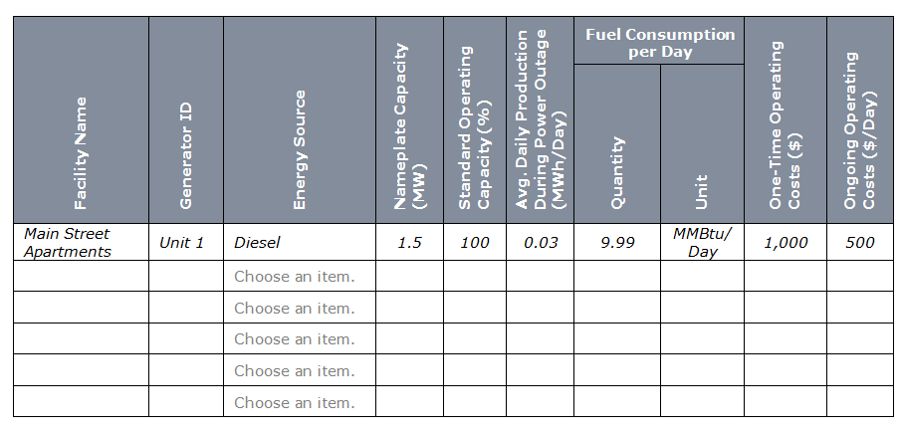
Backup Generation Capabilities: Question 2
Question 2 asks for information to be provided in 10 fields for each backup generator.

Slide 7
Backup Generation Capabilities: Question 2 (cont.)
The information requested includes:
Facility name: Note that a single facility may include multiple generators. Please list each generator on a separate row.
Generator ID: Please assign each generator a separate ID.
Energy source: The fuel used by each generator (e.g., diesel or natural gas). This field uses a dropdown list, so if you select “other,” please also type in the energy source used.
Nameplate capacity: Installed capacity of each generator (MW).
Standard operating capacity: The percentage of nameplate capacity at which the generator is likely to operate during an extended power outage (%).
Average daily production during a power outage: Please estimate the average daily electricity production (MWh/day) for the generator in the event of a major power outage, considering (1) the unit’s capacity, (2) the daily demand at the facility it serves, and (3) the hours of service the facility requires.

Slide 8
Backup Generation Capabilities: Question 2 (cont.)
Fuel consumption per day: Estimate the quantity of fuel required per day to generate the amount of electricity specified above, and indicate the appropriate unit. This question does not apply to renewable energy resources, such as wind and solar.
One-time operating costs: Identify any one-time costs (e.g., labor or contract service costs) associated with connecting and starting the backup generator ($).
Ongoing operating costs: Estimate the average daily costs (e.g., maintenance costs) associated with operating the backup generator, excluding fuel costs ($/day).

Slide 9
Cost of Emergency Measures
Section II asks for information that can be used to estimate the costs of any emergency measures required to maintain service during a major power outage, defined as a total loss of power for at least 24 hours.
Question 3 focuses on the costs of maintaining service while operating on backup power.
Question 4 focuses on the costs of maintaining service in the absence of backup power or while backup power is not available.
These costs include both:
One-time expenditures (e.g., the cost of evacuating and relocating residents); and
Ongoing costs (e.g., the daily expense of renting a portable generator).

Slide 10
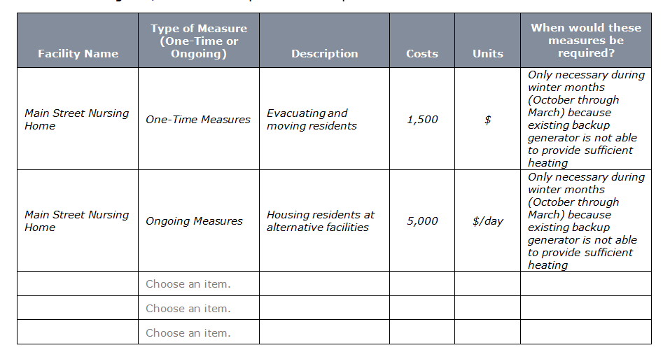
Cost of Emergency Measures: Question 3
Question 3 asks for information on any one-time or ongoing emergency measures that would be undertaken at each facility while operating on backup power, (excluding any costs associated with running the facility’s existing backup generator(s), as estimated in Section I).

Slide 11
Cost of Emergency Measures: Question 3 (cont.)
The information requested includes:
Facility name.
Type of measure (one-time or ongoing).
Description: Provide a brief description of the measure.
Costs: Estimate the cost of implementing the measure.
Units: Specify the appropriate unit for the cost (e.g., $, $/day).
When measures would be required: Provide a brief description of when the measures would be undertaken. For example, measures undertaken for heating purposes may only be required during winter months, or commercial facilities may undertake emergency measures during the work week only.

Slide 12
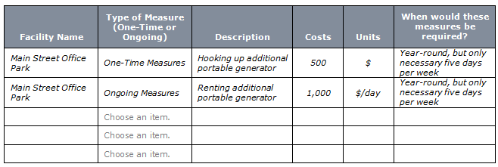
Cost of Emergency Measures: Question 4
Question 4 asks for information on any one-time or ongoing emergency measures that would be undertaken at each facility when backup power is not available.

Slide 13
Cost of Emergency Measures: Question 4 (cont.)
The information requested is similar to that requested in Question 3.
This information includes:
Facility name.
Type of measure (one-time or ongoing).
Description.
Costs.
Units.
When measures would be required.

Slide 14
Services Provided
Section III asks for information on the types of services provided by each facility your microgrid would serve.
This information is used to estimate the value of services that might be lost during a major power outage (in the absence of a microgrid).
Please answer these questions based on educated estimates of facility operations and impacts.
This section includes separate questions for various facility types:
All Facilities (Questions 5-6).
Fire Services (Questions 7-9).
Emergency Medical Services (Questions 10-13).
Hospital Services (Questions 14-16).
Police Services (Questions 17-19).
Wastewater Services (Questions 20-21).
Water Services (Questions 22-23).
Residential Facilities (Questions 24-25).

Slide 15
Services Provided (cont.)
For Fire, Emergency Medical, Hospital, Police, Wastewater, and Water services, the BCA model uses a methodology developed by the Federal Emergency Management Agency (FEMA) for its Hazard Mitigation Assistance grants.
For each service, this methodology estimates the number of people affected if the service provider is lost and the value per person of that lost service (e.g., the costs they would incur by seeking services from the next-closest provider).

Slide 16
Services Provided: Questions 5 and 6
Questions 5 and 6 apply to all facilities served by your microgrid.
Question 5 asks whether facilities are able to provide the same level of service as under normal operations when using backup generation.
If not, estimate the percent loss in the level of service provided.
Question 6 asks whether facilities are able to provide the same level of service as under normal operations when backup generation is not available.
If not, estimate the percent loss in the level of service provided.

Slide 17
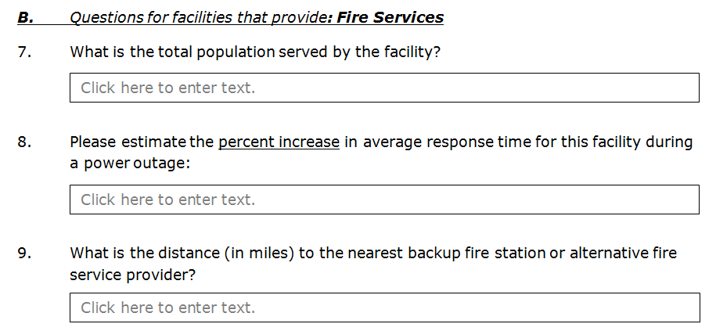
Services Provided: Questions 7, 8, and 9
Questions 7, 8, and 9 apply only to facilities that provide fire services.
If you are unable to answer both Question 8 and Question 9, answering only one of the two is sufficient.

Slide 18
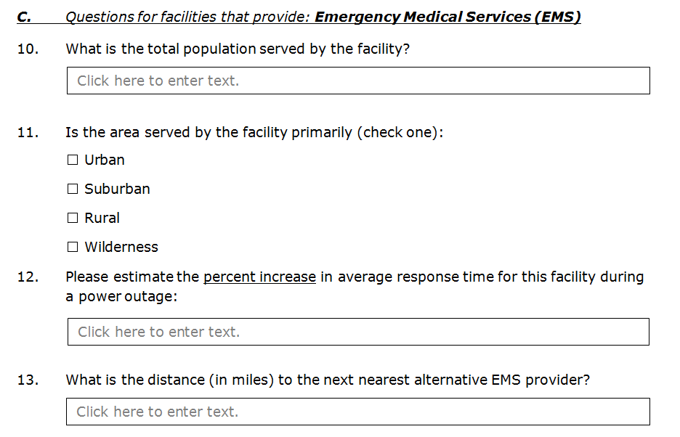
Services Provided: Questions 10, 11, 12, and 13
Questions 10, 11, 12, and 13 apply only to facilities that provide emergency medical services (EMS).
If you are unable to answer both Question 12 and Question 13, answering only one of the two is sufficient.

Slide 19
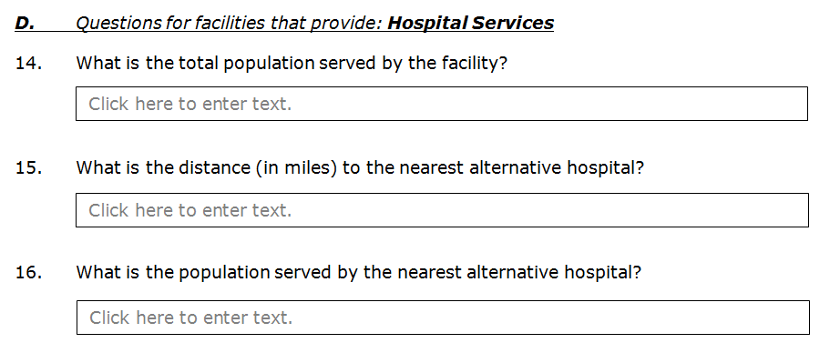
Services Provided: Questions 14, 15, and 16
Questions 14, 15, and 16 apply only to facilities that provide hospital services.

Slide 20
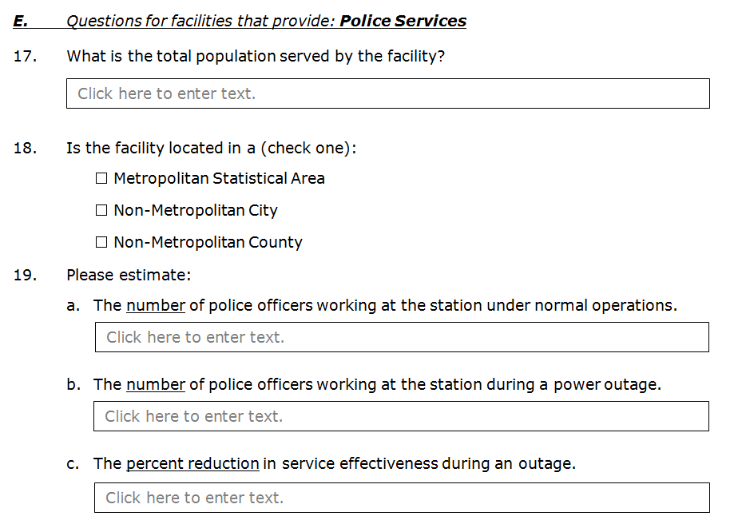
Services Provided: Questions 17, 18, and 19
Questions 17, 18, and 19 apply only to facilities that provide police services.

Slide 21
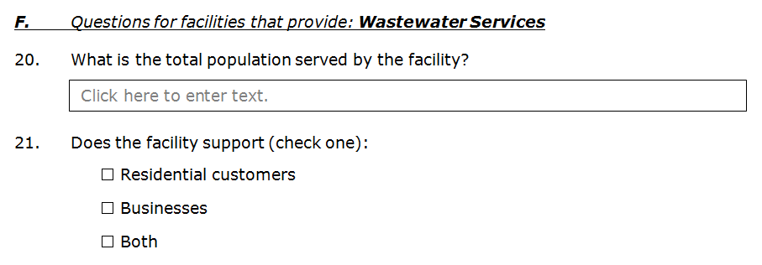
Services Provided: Questions 20 and 21
Questions 20 and 21 apply only to facilities that provide wastewater services.

Slide 22
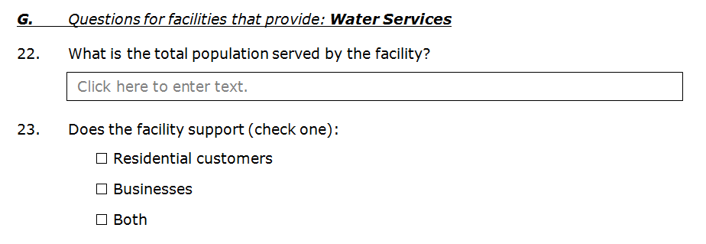
Services Provided: Questions 22 and 23
Questions 22 and 23 apply only to facilities that provide water services.

Slide 23
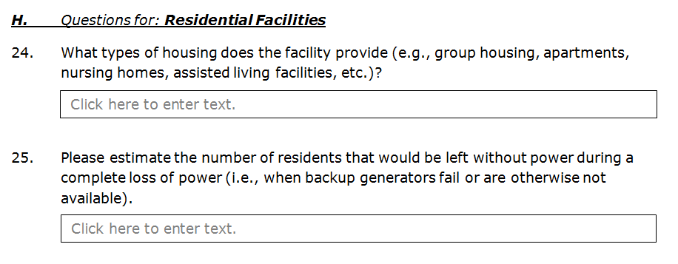
Services Provided: Questions 24 and 25
Questions 24 and 25 apply only to residential facilities (e.g., group housing, apartments, dormitories, nursing homes, assisted living facilities, single family homes).

Slide 24
For Additional Information
Questions?
NYPrize@indecon.com
(929) 445-7641
For additional information, see materials posted at: http://www.nyserda.ny.gov/All-Programs/Programs/NY-Prize/Resources-for-applicants
Microgrid questionnaire.
Facility questionnaire.
BCA model.
User’s guide for BCA model.
Note: questionnaires posted to NYSERDA’s website are for reference only. If you need questionnaires to fill out, please contact NYSERDA or IEc for formatted, up-to-date versions.

Slide 25
IEc
INDUSTRIAL ECONOMICS, INCORPORATED
617.354.0074

