Slide 1
NY Prize Community Microgrid Benefit-Cost Analysis: Microgrid Questionnaire
Prepared for:
New York State Energy Research and Development Authority (NYSERDA)
Prepared by:
Industrial Economics, Incorporated
2067 Massachusetts Ave.
Cambridge, MA 02140
USA
617/354-0074
November 2015

Slide 2
Microgrid Questionnaire Overview
The microgrid questionnaire is organized into seven sections:
Project Overview, Energy Production, and Fuel Use
Capacity Impacts
Project Costs
Environmental Impacts
Ancillary Services
Power Quality and Reliability
Other Information
The questionnaire uses dropdown lists, checkboxes, and other form features to ensure that each site provides consistent information in a format that can be used in the model.
Some questions only apply when you have answered a previous question a certain way. In these cases, hyperlinks direct you to the next applicable question.

Slide 3
Site Identification and Contact Information
To begin, identify your site using the dropdown list.
For consistency, the questionnaires use NYSERDA’s site naming convention.
For example: “1. Village of Babylon”
Identify a point of contact who can answer questions regarding the information provided in the questionnaire.
IEc will follow up with this point of contact as necessary.

Slide 4
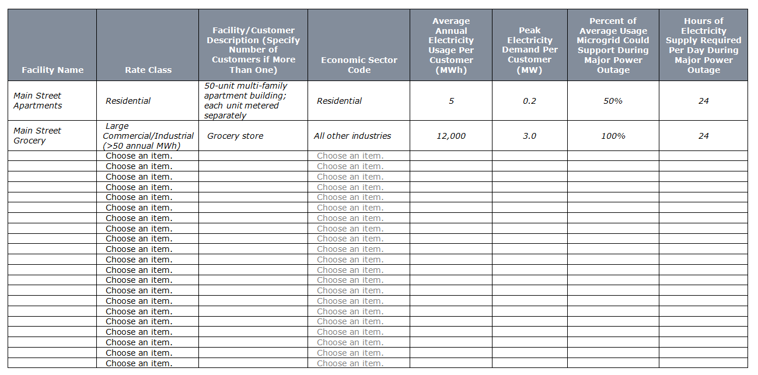
Project Overview: Question 1
Question 1 is designed to gather general background information on the facilities your microgrid would serve.

Slide 5
Project Overview: Question 1 (cont.)
The first several columns of the table are used in the estimation of reliability benefits:
Facility name: Note that a single facility may include multiple customers (e.g., multi-family apartment buildings).
Rate class: Residential, small commercial/industrial (defined as a facility using less than 50 MWh of electricity per year), or large commercial/industrial (defined as a facility using more than 50 MWh of electricity per year).
Facility/customer description: A brief description of the facility, including the number of customers at the facility if more than one.
Economic sector: Residential, construction, manufacturing, or all other industries.
Average annual usage: MWh annual electricity usage per customer, not facility.

Slide 6
Project Overview: Question 1 (cont.)
Other columns are used in the estimation of major power outage benefits:
Peak demand: MW peak electricity demand per customer, not facility.
Percent of the facility’s average usage the microgrid could support in the event of a major power outage.
Hours of electricity supply the facility would require each day in the event of a major power outage: This value may be less than 24 hours for some facilities; for example, some commercial facilities may require electricity during business hours only.
This information may be estimated by the facilities the microgrid will support and/or the microgrid’s design engineers.

Slide 7
Project Overview: Question 2
Question 2 asks you to provide information on the distributed energy resources (DER) the microgrid will incorporate.
Throughout the questionnaire, note that many dropdown menus allow you to select “other – please specify.” If you select this option, please also type in the information requested.

Slide 8
Project Overview: Question 2 (cont.)
This information is used in the analysis of fuel costs, avoided electricity generating costs, and major power outage benefits:
DER name: Unique identifier for each resource.
Facility name: Facility where the resource will be based.
Energy source: Natural gas, diesel, wind, solar, hydro, other.
Nameplate capacity: Installed capacity (MW).
Average annual production: Estimated electricity production under normal operating conditions (MWh per year). If the resource will operate only in the event of an outage, enter zero.
Average daily production in the event of a major power outage: Estimated electricity production during a major power outage (MWh per day).
Fuel consumption per MWh: For fuel-based DER, the amount of fuel required to generate one MWh of electricity (MMBtu/MWh).
The information requested in Question 2 can probably best be estimated by the microgrid’s design engineers.

Slide 9
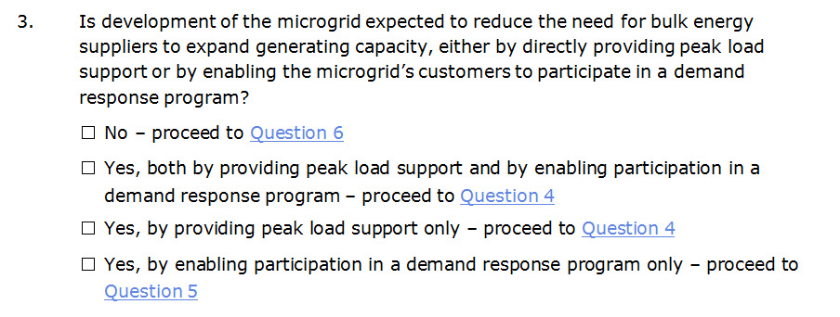
Capacity Impacts: Question 3
Question 3 asks whether development of the microgrid is expected to reduce the need for bulk energy suppliers to expand generating capacity.

Slide 10
Capacity Impacts: Question 3 (cont.)
As the question indicates, a microgrid could reduce the need for bulk energy suppliers to expand generating capacity by:
Directly providing peak load support;
Enabling the microgrid’s customers to participate in a demand response program; or
Both.
Based on your answer to Question 3, you should proceed to Question 4, 5, or 6, using the hyperlinks in the questionnaire.
This information is used to estimate generation capacity benefits.
This information may best be estimated by the microgrid’s design engineers and/or utility partners.

Slide 11
Capacity Impacts: Question 4
Question 4 applies to microgrids that are expected to reduce the need for bulk energy suppliers to expand generating capacity by providing peak load support.
The question asks for information on the capacity expected to be available for peak load support, by DER (MW/year).
In your response, please use the same unique DER and facility names from Question 2.
The question also asks whether the DER currently provides peak load support (absent the development of the microgrid). This information will allow us to estimate the incremental effect of the microgrid on generating capacity requirements.

Slide 12
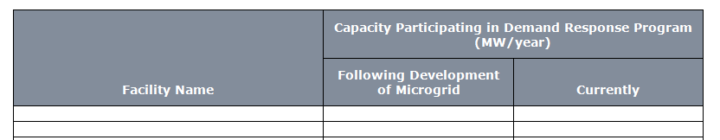
Capacity Impacts: Question 5
Question 5 applies to microgrids that are expected to reduce the need for bulk energy suppliers to expand generating capacity by enabling customers to participate in a demand response program.
The question asks for information on the capacity available for participation in a demand response program, by facility (MW/year):
Following development of the microgrid.
Currently (absent development of the microgrid).
This information will allow us to estimate the incremental effect of the microgrid on potential participation in a demand response program.

Slide 13
Capacity Impacts: Question 6
Question 6 asks whether development of the microgrid is expected to enable utilities to avoid or defer expansion of their transmission or distribution networks.
This information is used to estimate transmission and distribution capacity benefits.
This information may best be provided by the microgrid’s utility partners.

Slide 14
Capacity Impacts: Questions 7 and 8
Question 7 asks you to estimate the microgrid’s impact on utility transmission capacity requirements (MW/year).
Question 8 asks you to estimate the microgrid’s impact on utility distribution capacity requirements (MW/year).

Slide 15
Capacity Impacts: Questions 7 and 8 (cont.)
Impacts on transmission or distribution capacity requirements could be either positive or negative.
Such impacts generally are not anticipated, but are possible.
This information may best be estimated by the microgrid’s utility partners.

Slide 16
Project Costs
Section C, Project Costs, asks a series of questions designed to develop a year-by-year profile of project costs over a 20-year operating period.
The questions in this section are organized by cost category:
Capital costs.
Initial design and planning costs.
Fixed operations and maintenance (O&M) costs.
Variable O&M costs, excluding fuel costs.
Fuel costs.
Emissions control costs.
The information in this section can probably best be estimated by the microgrid’s design engineers.

Slide 17
Project Costs: Question 9
Question 9 asks you to estimate the fully installed capital cost and lifespan of all equipment associated with the microgrid, including:
Power generation systems (e.g., DER, CHP).
Energy storage systems.
New distribution infrastructure.
Interconnection with the local utility.
Equipment with the same lifespan may be grouped together into a single line item (e.g., microgrid controls).
In this case, use the “Description” field to indicate what is included.

Slide 18
Project Costs: Question 10
Question 10 asks for an estimate of initial design and planning costs, including costs associated with:
Project design.
Securing building and development permits.
Efforts to secure financing (but not interest expenses).
Marketing the project.
Negotiating contracts.
This estimate should include costs borne by all parties, not just the project’s potential developers, and should be estimated as a lump-sum expense.

Slide 19
Project Costs: Question 11
Questions 11, 12, and 13 ask for information on fixed O&M costs.
These are costs associated with operating and maintaining the microgrid that are unlikely to vary with the amount of energy produced each year.
For example: software licenses, technical support, operator training.
Question 11 asks whether there is likely to be any year-to-year variation in these costs for other reasons (e.g., maintenance cycles).

Slide 20
Project Costs: Question 12
Based on your answer to Question 11, you should proceed to either Question 12 or 13, using the hyperlinks in the questionnaire.
Question 12 asks for an estimate of annual fixed O&M costs (no year-to-year variation).

Slide 21
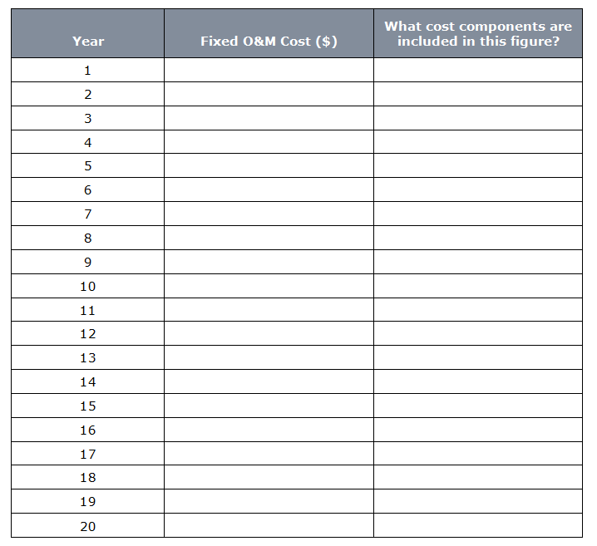
Project Costs: Question 13
Question 13 asks for an estimate of fixed O&M costs for each year of the microgrid’s assumed 20-year operating life.

Slide 22
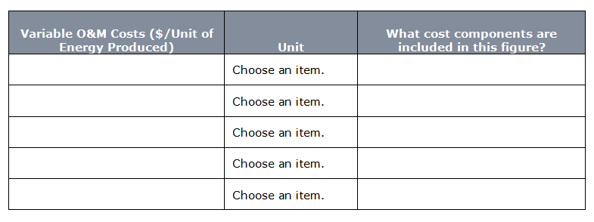
Project Costs: Question 14
Question 14 asks for an estimate of variable O&M costs.
These are costs associated with operating and maintaining the microgrid that will vary with the amount of energy produced (e.g., labor, materials).
This estimate should not include fuel costs; for consistency across sites, the model estimates fuel costs separately using price projections developed for the State Energy Plan.
Estimates may be provided separately for each DER or as a single value for the microgrid as a whole, in $/MWh.

Slide 23
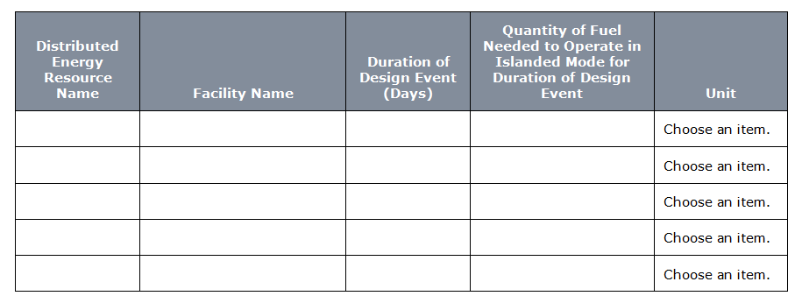
Project Costs: Question 15
Question 15 asks for information on fuel use for each fuel-consuming DER that will be incorporated into the microgrid:
Duration of design event: the maximum period of time (in days) the DER would be able to operate in islanded mode without replenishing its fuel supply.
Fuel consumption: quantity of fuel the DER would consume if it operated in islanded mode for the duration of the design event.

Slide 24
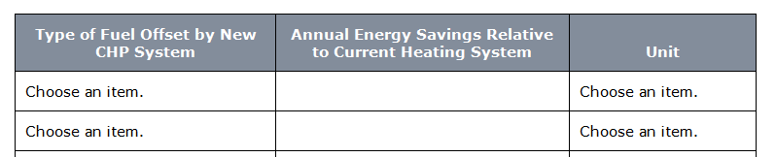
Project Costs: Questions 16 and 17
Questions 16 and 17 ask for information on the development of combined heat and power (CHP) systems.
Question 16 asks if the microgrid will include development of a CHP system.
Question 17 asks for an estimate of the annual energy savings relative to the current heating system (in MMBtu or gallons), for microgrids that will incorporate a CHP system.

Slide 25
Project Costs: Question 18
Question 18 asks for information on the costs of installing and operating emissions control equipment, as well as the engineering lifespan of this equipment, if these costs were not incorporated into your responses to previous questions.
If emissions control costs were incorporated into overall project costs, Question 18 can be left blank.

Slide 26
Project Costs: Question 19
Question 19 asks whether the microgrid will be subject to environmental regulations mandating the purchase of emissions allowances (for example, due to system size thresholds).
If you answer “yes,” the model will estimate costs associated with emissions from the microgrid based on their associated allowance price (for capped pollutants like CO₂).
Otherwise, the model will estimate costs associated with emissions based on the pollutant’s social damage value.

Slide 27
Environmental Impacts: Question 20
Question 20 asks you to estimate the emissions rate (tons/MWh) for the microgrid as a whole, for CO₂, SO₂, NO_{x}, and particulate matter (PM).
This information is used to estimate environmental costs associated with emissions from the microgrid.
The resulting costs will be compared to the model’s estimate of environmental costs avoided by the microgrid’s electricity and CHP production.
This information can probably best be provided by the microgrid’s design engineers.

Slide 28
Ancillary Services: Question 21
Question 21 asks you to identify any ancillary services that the microgrid will provide.
If the microgrid will provide any of these services, IEc will follow up with you for more information.
This information may best be provided by the microgrid’s design engineers.

Slide 29
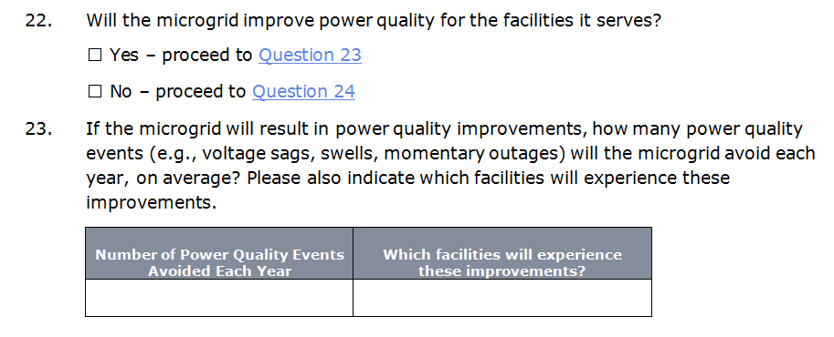
Power Quality: Questions 22 and 23
Questions 22 and 23 ask for information on potential power quality improvements that may result from development of the microgrid.

Slide 30
Power Quality: Questions 22 and 23 (cont.)
Question 22 asks whether the microgrid is likely to provide any power quality improvement for the facilities it serves.
If you answer “yes” to Question 22, Question 23 asks you to estimate the number of power quality events (e.g., voltage sags, swells, momentary outages) that the microgrid will avoid each year.
Question 23 also asks you to identify which facilities will experience these improvements.
Information on such improvements may not be available in all cases.
If available, this information may best be provided by the microgrid’s design engineers.

Slide 31
Reliability: Question 24
Question 24 asks for information on standard reliability metrics for your local utility:
Average outage frequency per customer (system average interruption frequency index, or SAIFI, in events per customer per year).
Average outage duration per customer (customer average interruption duration index, or CAIDI, in hours per event per customer).
This information will be used to estimate reliability improvements that may result from development of the microgrid.

Slide 32
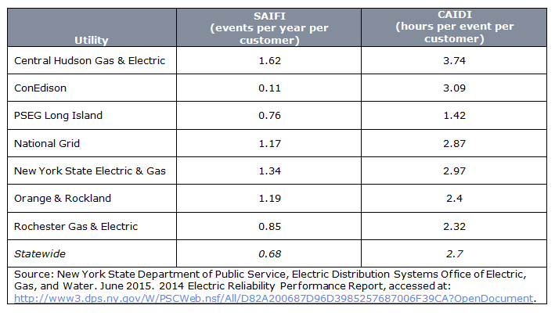
Reliability: Question 24 (cont.)
For reference, the question provides the values cited in Department of Public Service’s 2014 Electric Reliability Performance Report.
For microgrids served by one of the utilities listed, use the values provided for that utility.
For microgrids served by a utility that is not listed, provide your best estimate of SAIFI and CAIDI for the utility that serves your area. For consistency with reported values, please exclude outages caused by major storms.

Slide 33
Other Information: Question 25
Question 25 offers you the opportunity to provide additional information on the proposed microgrid, including any clarifications or supplemental information that you believe may be helpful in developing the BCA.

Slide 34
For Additional Information
Questions?
NYPrize@indecon.com
(929) 445-7641
For additional information, see materials posted at: http://www.nyserda.ny.gov/All-Programs/Programs/NY-Prize/Resources-for-applicants
Microgrid questionnaire.
Facility questionnaire.
BCA model.
User’s guide for BCA model.
Note: questionnaires posted to NYSERDA’s website are for reference only. If you need questionnaires to fill out, please contact NYSERDA or IEc for formatted, up-to-date versions.

Slide 35
IEc
INDUSTRIAL ECONOMICS, INCORPORATED
617.354.0074

