Slide 1
Implementing Electronic Signature Solutions
11/10/2015

Slide 2
Agenda
Methodology, Framework & Approach: High-Level
Overarching Parameters Regarding Electronic Service Delivery
Business Analysis & Risk Assessment Are Required
Identifying Signature Type
What Is An Electronic Signature Solution?
Ensure Clarity & Capture Of Signer’s Intent
Electronic Signature Solutions
Methodology, Framework & Approach: Detailed
  Inventory Existing Wet Signatures
  Analyze Existing Wet Signatures
  Eliminate Any Unneeded Existing Wet Signatures
  Determine Whether, Where, And How To Replace Remaining, Required Wet Signatures With Electronic Signature Solutions
  Optimize Workflow For Any Remaining Wet Signatures

Slide 3
Methodology, Framework & Approach – High-Level
Inventory existing wet signatures (+ initials and notarizations) required on forms / applications.
Analyze existing wet signatures (+ initials and notarizations).
Eliminate any unneeded existing wet signatures (+ initials and notarizations) – without adding risk.
Determine whether, where, and how to replace remaining, required wet signatures (+ initials) with electronic solutions.
Optimize workflow in the case where an existing wet signature (+ initials and notarizations) can’t be transformed into an electronic solution, for whatever reason(s).

Slide 4
Overarching Parameters Regarding The Development & Introduction Of Electronic Service Delivery
According to ESRA (Electronic Signatures and Records Act), government entities must:
Ensure that citizens can access records as permitted by law and receive copies of them in paper form.
Accept hard copy documents for submission or filing, unless otherwise required by law.
Not require someone to submit or file records electronically, unless otherwise provided by law.

Slide 5
Business Analysis & Risk Assessment Are Required
It is extremely important to bear in mind that governmental entities must conduct and document a business analysis and risk assessment when electing to use or accept an electronic signature solution.
Business analysis and risk assessment is defined by ESRA regulation as:
“identifying and evaluating various factors relevant to the selection of an electronic signature for use or acceptance in an electronic transaction. Such factors include, but are not limited to, relationships between parties to an electronic transaction, value of the transaction, risk of intrusion, risk of repudiation of an electronic signature, risk of fraud, functionality and convenience, business necessity and the cost of employing a particular electronic signature process.”

Slide 6
Business Analysis & Risk Assessment Are Required
Is there a business need for a wet signature?
Signatures are often used on paper documents for authentication, security, or other purposes even if they are not legally mandated. For instance, it may be necessary or desirable to document through the use of a signature that a party to a transaction attested to the accuracy of the information provided, agreed to certain conditions, and / or read and understood related documents.
In some cases, system security, audit, and program management issues may require an electronic signature. Higher risk transactions may also need the level of protection against fraud or repudiation provided by certain types of electronic signature solutions.
Notes:
2nd bullet, haven’t run into at NSYERDA, but there are other bank transactions, bond issues, big dollar transaction, risky things, filing conflict of interest, set up electronically (Conflict of interest/HR training) a good example.

Slide 7
Business Analysis & Risk Assessment Are Required
Is there a legal requirement for a wet signature?
The law (statutes or regulations) can require that an application, form, document, etc. capture a signature. The Statute of Frauds requires certain contracts and other documents to be in writing and others to be in writing and signed to be enforceable.
Specific federal, state, and local government laws and regulations require signatures for certain transactions.
Notes:
Keep in mind, legal requirement for wet signature—separate out from signature in general. Emphasize wet. Some laws writing in 70’s and 80’s that has language left over that was normal at the time. Ex. Must sign in ink.
If all it says is verify information is true, or sign, or agree to conditions, you are fine in switching to electronic, as long as solution manages risk and tech can support.
One baby step in right direction is to accept scanned or fax copies

Slide 8
Identifying Signature Type
A signature can serve the following business and legal purposes:
Demonstrate intent: A signature identifies the signer and signifies that the signer understands and intends to carry out whatever was stipulated in the document that is signed.
Authentication and approval: A signature authenticates a document by linking the signer with the signed document. A signature may also express the signer’s approval or authorization of the signed document and what it contains, and his or her intent that it has legal effect. The signature provides evidence that the signer really did something and actually saw and approved a particular document at the time of signing.

Slide 9
Identifying Signature Type
A signature can serve the following business and legal purposes:
Security: A signature is often used to protect against fraud, impersonation, or intrusion. For instance, to a limited degree the signature on a check is a form of security because drafting an unauthorized check often requires forging a signature.
Ceremony: The act of signing warns or puts the signer on notice that he or she may be making a legally binding commitment. A signature should force the person to deliberate over the document and become aware of its significance before making it final.

Slide 10
What Is An Electronic Signature?
What is an electronic signature?
ESRA, at §302 (3), defines an “electronic signature” as:
  an electronic sound, symbol, or process, attached to or logically associated with an electronic record and executed or adopted by a person with the intent to sign the record.
This definition affords the parties to an electronic transaction the greatest possible flexibility in selecting an appropriate electronic signature solution.
Notes:
Best supports business process, manages risk, supported by IT = holly grail
Difficult to crack password
Dual authentication

Slide 11
What Is An Electronic Signature?
ESRA also sets some parameters on what constitutes an electronic signature:
“An electronic sound, symbol, or process. . .”
ESRA provides that a very wide range of digital objects may serve as an electronic signature. These objects can be as simple as a set of keyboarded characters or as sophisticated as an encrypted hash of a document’s contents.
ESRA also allows a process to serve as an electronic signature. A process can create an electronic signature when a system used to create a signed electronic record associates the recorded events of accessing an application with the content to be signed, thereby creating a virtual record of the signer’s actions and intent. Often such signing processes also utilize a password, PIN, or other digital object for authenticating the signer.
Notes:
More examples
A system generated data and action can also take place of a signature… ie PeopleSoft approval with users / time / date stamp

Slide 12
What Is An Electronic Signature?
“Attached to or logically associated with . . .”
A wet, inked signature becomes part of the physical paper document and remains with it during transit and after it is filed. Under ESRA, an electronic signature is considered to be “attached to or logically associated with an electronic record” if the electronic signature is linked to the record during transmission and storage; a digital signature can be a discrete digital object that is part of the document in the same manner as an ink signature or it can be an object associated with the document through an embedded link, or maintained separately but logically associated with the record through a database, index, or other means.
Under ESRA the attachment or logical association between the signed record and signature must be created at the point a record is signed, maintained during any transmission of the signed record, and retained as long as the signed record is needed and retained.
Notes:
Can’t be a floating thing, has to be attached to the record, the same way a signature is attached to record.
Understand a requirement—
When retrieved, ie signed piece of paper and a separate contract.
Need to twin signature with record in question.

Slide 13
What Is An Electronic Signature?
“Executed or adopted by a person with intent to sign the record.”
A signature identifies the signer and signifies that he or she understood and intends to carry out whatever was stipulated in the signed document, warning the signer that he or she may be making a legally binding commitment.
ESRA requires that an electronic signature be accompanied by the same intent as the use of a signature affixed by hand. ESRA does not require any specific level or method of signer identification or authentication. Therefore, governmental entities are free to select an identification and authentication method that meets their needs. The selection of an appropriate approach to identify and authenticate signers is one of the considerations in selecting an electronic signature solution.
Notes:
Theme, meets needs, in technology toolkit, but flexibility within to best meets their needs

Slide 14
Ensure Clarity & Capture Of Signer’s Intent
A signer’s intent can be captured in a number of ways. A number of simple practices can help avoid confusion regarding a signer’s intent:
Afford the signer an opportunity to review the document, prior to signing.
Make it impossible for an electronic signature to be applied to a document without the signer having been informed that a signature is being applied.
Format an electronically signed record to contain the same accepted signature elements captured in a paper record (in the same general position).
Allow the signer’s intent to be expressed as part of the record or in a certification statement submitted with and linked to the signed record.
Require the signer to act affirmatively to indicate assent to the document being signed. For example, deploy an "Accept" or “Reject” button.
Record the date, time, and fact that the signer indicated his or her intent and retain this information for evidentiary purposes.

Slide 15
Ensure Clarity & Capture Of Signer’s Intent
Below is an example of a generic signature attestation / affirmation statement:
I agree, and it is my intent, to sign this document by (describe the electronic signature solution used) and by electronically submitting this document to (name of recipient individual or entity). I understand that my signing and submitting this document in this fashion is the legal equivalent of having placed my handwritten signature on the submitted document and this affirmation. I understand and agree that by electronically signing and submitting this document in this fashion I am affirming to the truth of the information contained therein.
Notes:
Record is last in list
Big paragraph summarize them all together into multi-component affirmation statement. Only thing missing is date/time stamp

Slide 16
Electronic Signature Solutions
Electronic signature solutions:
Click through or click wrap
Personal Identification Number (PIN) or password
Digitized signature / signature dynamics
Biometrics
Shared private key (symmetric) cryptography
Public / private key (asymmetric) cryptography
Microchip devices
Hybrid approaches (combining two or more of the above solutions)

Slide 17
Electronic Signature Solutions
A range of solutions exist to enable electronic signing, most methods of creating an electronic signature involve one or more technologies, credentials or digital objects, and processes;.
Different solutions provide varying levels of security, authentication, record integrity and protection against repudiation.
The solutions on the previous slide are roughly organized from the lowest to the highest level of security, authentication, record integrity and non-repudiation
Each solution can be implemented in various ways and can be combined with techniques from other solutions to increase the strength of desired attributes.
The ultimate selection of an electronic signature solution or combination of solutions for use in a governmental transaction will involve the weighing of various factors, including public policy and legal concerns that might relate to the use of certain technologies or processes.
Notes:
Want simplest solution that will fit your risk profile.
Need all players involved—program, legal, IT, contracts, do in right sequence

Slide 18
Inventory Existing Wet Signatures
Inventory existing wet signatures required on forms / applications.
  Create a table to keep track of existing wet signatures (+ initials and notarizations) - keep focused on making the inventory complete and exhaustive – rather than on coming up with solutions at this point!
  Name of form? Page of form? Where on form?
  Last revised?
  Part of what program?
  Is it signature only or signature and date?
  Initial notation only or signature?
  Is there a notarization requirement?
Notes:
Now, we will shift into the “how to”
Do one analysis at a time
Start with something easy

Slide 19
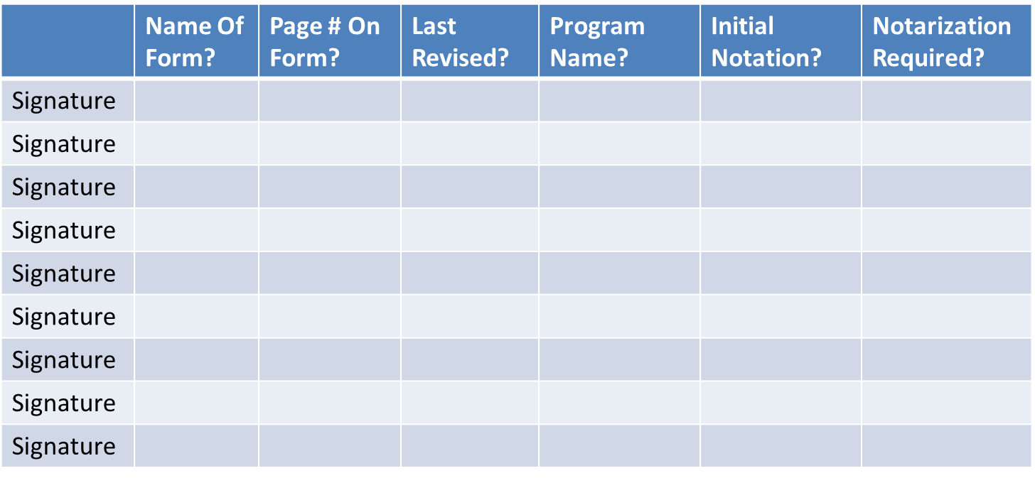
Inventory Existing Wet Signatures

Slide 20
Analyze Existing Wet Signatures
Analyze existing wet signatures (+ initials and notarizations).
  Determine actual business need / purpose of each existing wet signature (signature type).
  Determine current risk mitigation (if any) that each existing wet signature provides.
  Determine any legal basis for requiring existing wet signatures (or notarization).
    Is a signature legally required? Is there a law (local, state, federal) that requires a signature?
    If a signature is legally required, does the law specify that the signature needs to be a wet, ink signature on paper?
Notes:
Legal and business basis may be the same
Does it have to be ink, or just obtained

Slide 21
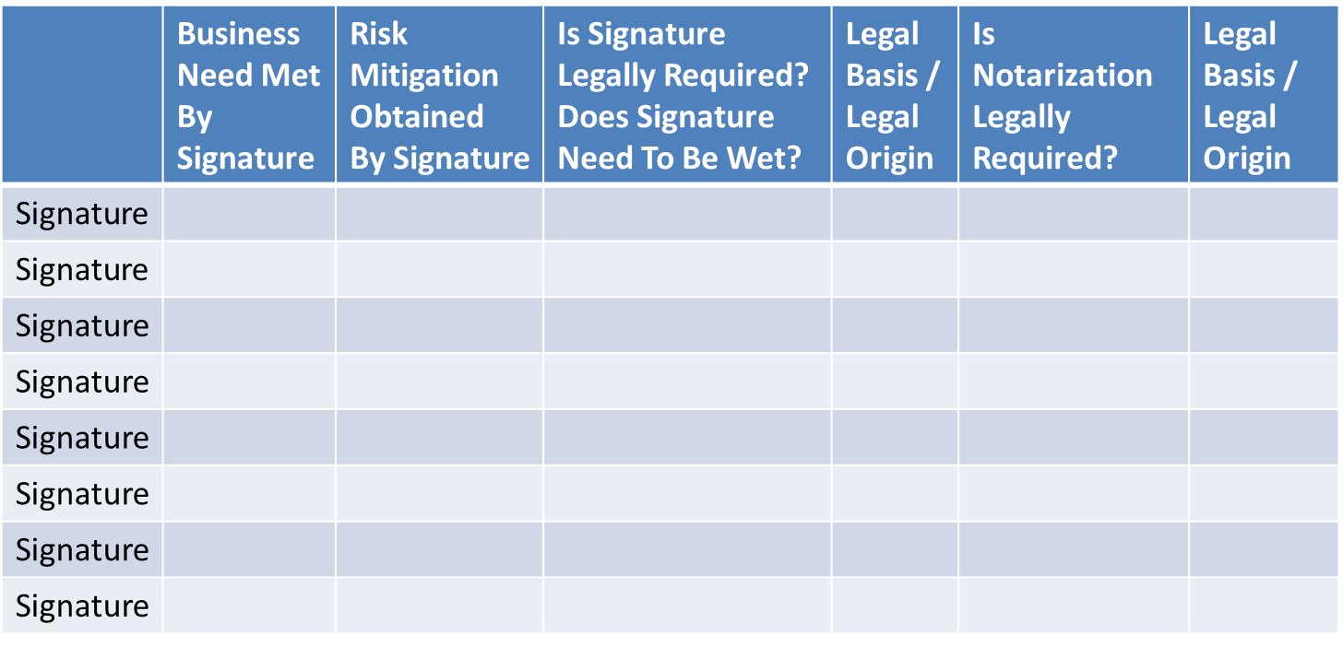
Analyze Existing Wet Signatures

Slide 22
Eliminate Any Unneeded Existing Wet Signatures
Eliminate any unneeded existing wet signatures (+ initials and notarizations) – without adding risk.
  Where there is no business need and / or the wet signature is a hold-over artifact from when the form or program was first designed / last revised.
  Where the risk is nonexistent or acceptably low – or where the signature had / has no connection to risk mitigation, i.e. “good intentions” (including a wet signature or a notarization requirement on a form thinking it is more “official” or “secure” - but there being no benefit / risk mitigation gotten from the wet signature or the notarization requirement).
  Where there exist no legal requirements for the existing signature – and therefore by definition no legal requirements for the existing wet signature.

Slide 23
Determine Whether, Where, And How To Replace Remaining, Required Wet Signatures With Electronic Signature Solutions
Determine whether, where, and how to replace remaining, required wet signatures (+ initials) with electronic signature solutions.
  Categorize remaining, required wet signatures according to signature type.
  Perform thorough business / legal / risk / regulatory analyses of remaining, required wet signatures using electronic workflow / storage / security lenses.
  Determine best electronic signature solution(s) (if any) for remaining, required wet signatures.

Slide 24
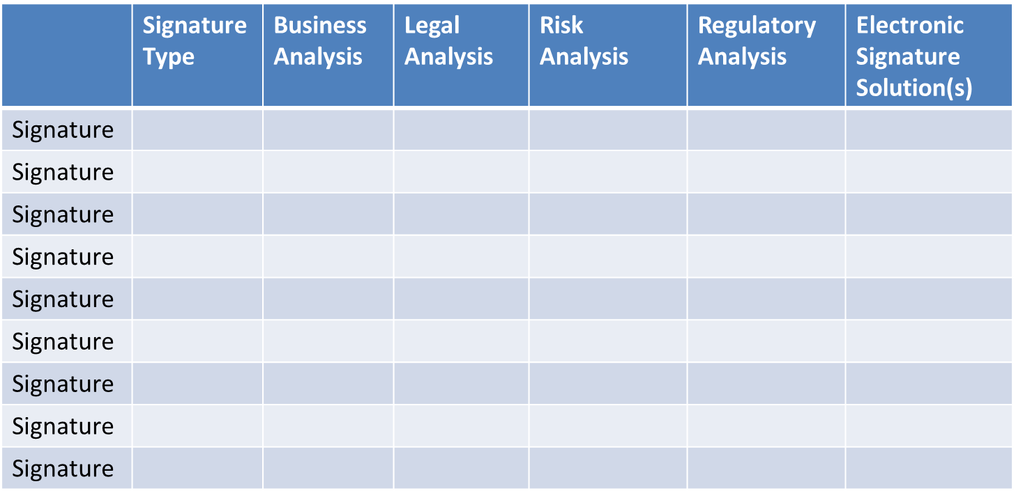
Determine Whether, Where, And How To Replace Remaining, Required Wet Signatures With Electronic Signature Solutions

Slide 25
Optimize Workflow For Any Remaining Wet Signatures
Optimize workflow in the case where an existing wet signature (+ initials and notarizations) can’t be transformed into an electronic signature solution, for whatever reason(s).
  Combine the collecting of wet signature(s) (+ initials and notarizations) with other in-person steps that must be retained (like fingerprinting) – so that all non-electronic parts of the workflow are handled at the same time – reducing the number of manual steps.
  Allow wet signature(s) (+ initials and notarizations) to be collected through a mail-in step, rather than an in-person step.

Slide 26
Lessons Learned
Review and analyze one signature at a time
Include Program, Contracts, Legal and Information Technology in review process.
Develop a set of off-the shelf technology solutions that can be used in combination as appropriate.
Create a library of approved analysis / signatures

Slide 27
Useful Reference Materials
Useful reference materials:
Electronic Signature and Record Act (ESRA) Guidelines – Executive Summary:
http://www.its.ny.gov/document/revised-electronic-signatures-and-records-act-esra-guidelines
Electronic Signature and Record Act (ESRA) Guidelines:
http://www.its.ny.gov/document/revised-electronic-signatures-and-records-act-esra-guidelines

