Slide 1
PROJECT NAME
EMPIRE BELT(S)
Month Day, Year

Slide 2
Agenda
Lean Overview
Introduction to the Project & Team
The Process
Next Steps

Slide 3
Guiding Principles
Staff closest to the work have the best (feasible and impactful) ideas for improvements.
A series of small or low cost improvements can have a significant impact.
Evaluate and improve the process, not the people.

Slide 4
What is Lean?
Official Definition:
A lean organization understands customer value and focuses its key processes to continuously increase it. The ultimate goal is to provide perfect value to the customer through a perfect value creation process that has zero waste.
“Lean-er” Definition:
Maximizing customer value while minimizing waste.

Slide 5
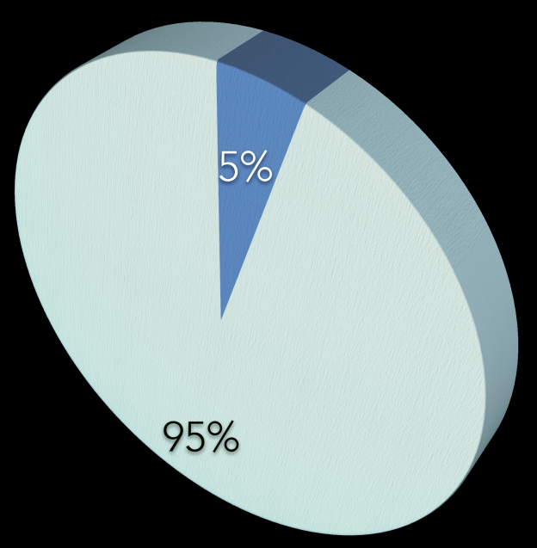
What is Waste?
Transportation
Inventory
Motion
Waiting
Over-Production
Over-processing
Defects
Skills
TYPICALLY 95% OF ALL LEAD TIME IS NON-VALUE ADDED

Slide 6
The Project
DESCRIBE PROJECT IN HIGH LEVEL

Slide 7
The Team
LIST TEAM MEMBERS, THEIR ROLE Etc.

Slide 8
The Process
Project Selection
Charter Creation
Value Stream Mapping
Data Collection
Finalize Value Stream
Kaizen
Implement

Slide 9

Focus on Processes with…
Long Lead Times
Customer Confusion
Significant Paperwork
Several Reviews
Requesting an IT Solution

Slide 10
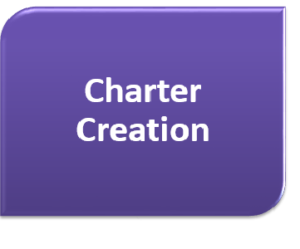
Define the Scope
Define Beginning / End of Scope
Define Items out of Scope
Identify Current Metrics
Articulate Problem Statement

Slide 11

Map it Out!
Identify Process Blocks
Capture All Micro-steps
Identify Works In Progress

Slide 12

Collect the Goods
Establish Data Collection Plan
Collect for each Process Block:
  Cycle Time
  Process Time
  Quality Rate (first time right)
  Full Time Equivalent
  Work in Progress
Voice of Customer
  Open Ended Questions
  Random Sampling

Slide 13
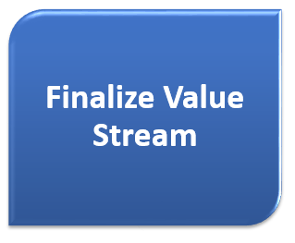
Finalize Everything
Populate Value Stream Map
Calculate Process Metrics
  Cycle Time
  Process Time
  Quality Rate
Identify Problem Areas

Slide 14

Kaizen!
Evaluate Current Process
Root Cause Analysis
Idea Generation
Creation of Future State
Develop Implementation Plan
Identify Metrics

Slide 15

Make it Happen
Obtain Executive Buy-in
30, 60, and 90 Day Plans
Work with Appropriate Staff
Document Process & Outcomes

Slide 16
Next Steps
Complete Charter as a Team
Due end of this week
Finalize Important Dates
Value Stream Construction (next week)
Final Check-in (Friday before Kaizen)
Kaizen
Familiarize yourself with the process
Start taking notes on your tasks
Think about data collection

Slide 17
Questions?

