Slide 1
Lean for Executives & Managers
Friday April 8, 2016

Slide 2
Workshop Agenda
What is Lean and Why is it Important?
Lean as a Management Tool
Lean Structure
Management’s Role in Lean
Resource Allocation
Project Identification
Project Implementation
Incorporating Lean into Your Day
Group Discussion: Challenges with Implementing Lean

Slide 3
What is Lean?
A structured approach to maximizing customer value while minimizing waste
Lean consists of a variety of approaches and tools that are fit
to purpose
Guiding Principles:
- Staff closest to the work have the best (feasible and impactful) ideas for improvements
- A series of small or low cost improvements can have a significant impact
- Evaluate and improve the process, not the people
- Challenge the conventional wisdom
- Focus on actual need

Slide 4
What is Lean: The 8 Wastes
Transportation – movement of materials
Inventory – materials / items kept in storage
Motion – movement of people
Waiting – time spent waiting on something or someone
Over-Production – producing more than what is needed
Over-Processing – reviewing / processing more than what is needed
Defects – errors that lead to rework
Skills – using staff for tasks that are not aligned with their skillset

Slide 5
Why is Lean Important?
The methodology supports organizations in their efforts to ensure they are:
Responsive to partners and customers
Adaptable
Easy to navigate and access
Streamlined and technology-enabled
Encourages and enables a culture of continuous improvement.

Slide 6
Lean as a Management Tool
Performance Management Reporting & Analysis
- Break down problems into their “prime number” components
- Analyze trends and monitor progress
- Identify problem areas
- Assign resources appropriately
Resource Management
- Frees up time that might be spent on non-value added items
- Prevents building unnecessarily complex and large systems
Corporate Culture
- Improves morale
- Encourages employees to challenge conventional wisdom

Slide 7
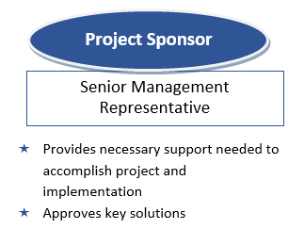
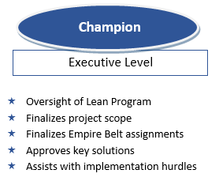
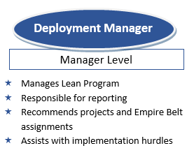
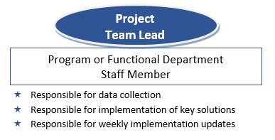
Lean Staff Structure

Slide 8
Management’s Role: Resource Allocation
Identify Strong Resources
- Empire Belt traits & characteristics include:
Motivated & eager
Strong public speaker
High energy
Operationally minded
Sharp / intelligent
Star performer of that department
Providing relevant team members
Support their Development / Involvement
Consider it as an investment
Work with appropriate parties to ensure they have the bandwidth
Encourage participation

Slide 9
Management’s Role: Project Identification
Responsible for identifying processes / workflow that have:
Long lead times
Customer confusion
Significant paperwork
Several reviews
Requested an IT solution
Received customer complaints
Not met KPI Targets

Slide 10
Management’s Role: Project Implementation
Stress that the “end” is NOT creating the Implementation Plan
Accountability falls across all levels of management
Consider yourself a resource
Enlist leadership support
Attend and provide regular progress updates
Communicate progress widely
Provide the time & resources to support the work
Ask “What can I help with”
Work through any barriers or issues

Slide 11
Incorporating Lean into Your Day
Look for opportunities to reduce waste in all processes
Ask why, dig deeper, and challenge conventional wisdom
Leverage resources and include the appropriate people in key decisions
Always think about the customer experience
Focus on actual need

Slide 12
Group Discussion:
Challenges Implementing Lean

