Slide 1
How to Manage a Lean Program
Tuesday November 10, 2015

Slide 2
Workshop Agenda
Management Tips
Lean Structure
Empire Belt Selection / On-boarding
Empire Belt Development
Project Selection
Project Implementation & Reporting
Program Visibility
Lean Resources

Slide 3
Management Tips
Get Executive Support
Have the Right Resources
Crawl Before You Walk Before You Run
Develop a Sense of Community
Instill Accountability
Lean is not an Initiative, but “The Way”
Continuous Improvement
Be Flexible Where it Makes Sense
Right Size Your Efforts

Slide 4
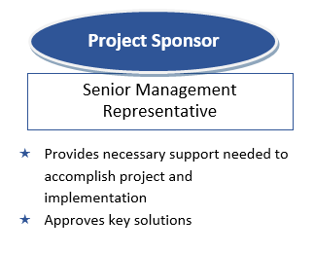
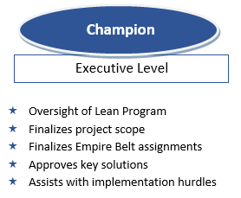
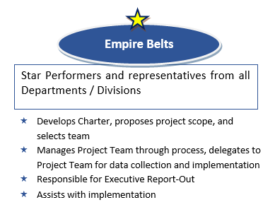
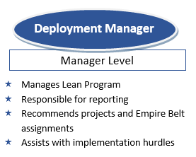
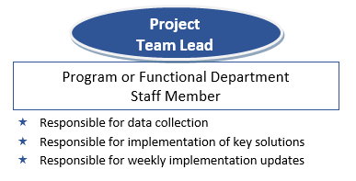
Lean Staff Structure

Slide 5
Empire Belt Selection and On-boarding
Empire Belt Selection
Select Representatives from each division, department, and / or group to not only serve as empire belts but also as Lean Program Liaisons to the various departments
Traits & Characteristics Include:
  Motivated & eager
  Strong public speaker
  High energy
  Operationally minded
  Sharp / intelligent
  Star performer of that department
Empire Belt On-boarding
Send Welcome email, including their chain of command, Co-Champions, etc.
Meet with them for a half hour to go over the Lean program, the roles & responsibilities, the resources available, and their next steps (boot camp).

Slide 6
Empire Belt Development
Succession of Projects
  1st project - paired with a more senior Belt, usually a process they are already familiar with
  2nd project - paired with an equal level Belt
  3rd project - facilitate on their own
  4th project - external certifying project
Encourage Empire Belts to attend any and all trainings and report back to the team
Lean Program Meetings
  - Half hour meetings every other week
  Deployment Manager shares program updates
  Group discussion on Best Practices and Brainstorming. Past topics included:
  - Visibility across the authority - Lessons Learned for Joint Agency Projects
  - Risk Management and Mitigation - Data Analysis
  - EPA Lean Government Materials - Metrics Collection

Slide 7
Project Selection
Start of the Program (8/2014)
Covered each department and functional area to expose all staff to Lean
Focused on processes that had:
  Long lead times
  Customer confusion
  Significant paperwork
  Several reviews
  Requesting an IT Solution
  Received customer complaints
  Not met KPI Targets
One Year Later…
More strategic focus on processes that align with our roadmap to transform our Authority not only strategically through the Clean Energy Fund but Operationally through our Operations Agenda.

Slide 8
Project Implementation & Reporting
Project Implementation
Stress that the “end” is NOT the implementation plan, but rather that it is a means to an end. Encourage the Empire Belts and Team Leads to adjust the implementation plan if necessary.
Instill Accountability from Project Sponsor down to Team Lead.
Champion, Deployment Manager, and Project Sponsor are Resources
Project Reporting
Receive scoreboard metrics by 5th of every month
For projects in Active Implementation:
  Bi-Weekly Status Updates via Implementation Plan
  Monthly Status Meetings with Champions, Deployment Manager, Sponsor, Empire Belt(s) and Team Lead
For Projects in Maintenance Mode:
  6 Month Check-in and Analysis to Look for Areas of Opportunity
  Champion, Deployment Manager, Sponsor, Empire Belt(s) and Team Lead

Slide 9
Program Visibility Across The Organization
Lean Exposure through Projects & Empire Belts into all areas
Held a “Brown Bag” luncheon highlighting the program and operational wins for All Staff
Planning to hold tailored trainings for departments that support Lean Projects (Legal, IT, and Finance)
Present “Lean Wins” and Project Statuses at Senior Management Meetings
Develop Lean Abstracts to share and post around the Authority

Slide 10
Resources for Empire Belts
We have been working to pull together various templates, guides, and resources for our Empire Belts
So far we have the following:
- Empire Belt Guidebook
- Meeting agenda and PowerPoint Templates
- Implementation & Risk Management Tables
Resources can be found at:
www.nyserda.ny.gov/LeanResources

Slide 11
Questions?

