Slide 1
Bidder’s Conference RFP 5481:
Conceptual Design Services for Tier 4 Verification and Settlement
March 7, 2024 | 12:00 PM

Slide 3
AGENDA
Introduction to NYSERDA
Background
Solicitation Summary
Submission Instructions
Questions

Slide 5
AGENDA
Introduction to NYSERDA
Background
Solicitation Summary
Submission Instructions
Questions

Slide 6
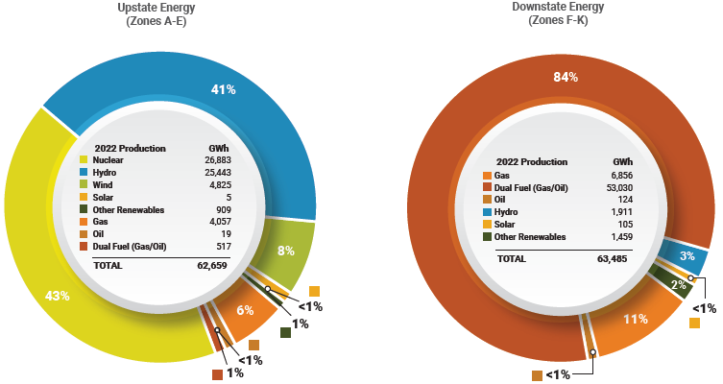
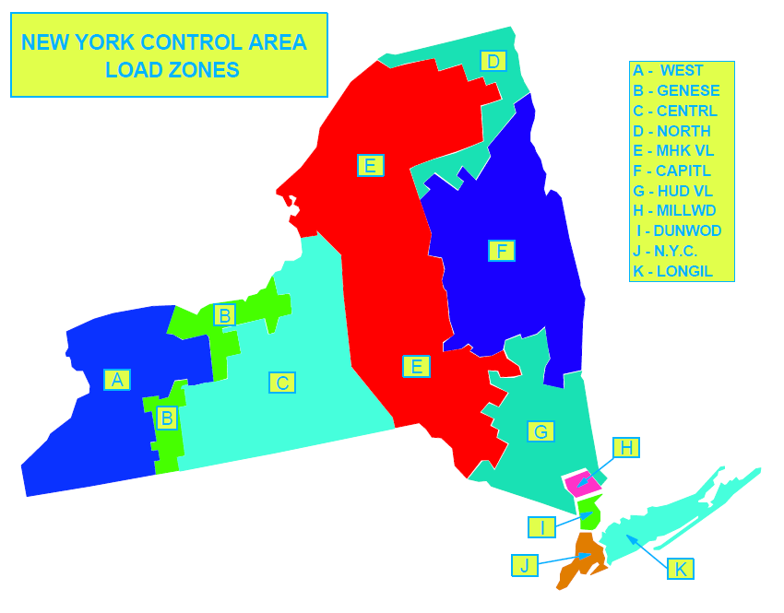
Tale of Two Grids
~94% Clean
~95% Fossil
Source: 2023 Power Trends, A Balanced Approach to a Clean and Reliable Grid, NYISO Annual Grid & Markets Report, August 14, 2023.

Slide 7
Establishing Tier 4
NYC represents nearly 2/3 of all statewide load
Projects will deliver almost 33% of NYC’s annual electric consumption, or 18 TWh per year
CES Modified in October 2020 to create Tier 4
Goal to deliver renewable energy directly into Zone J (New York City)
Tier 4 Solicitation issued in 2021
33 Bid Variants - 2 projects awarded
25-Year Contracts
Contracts Approved - April 2022
Largest transmission projects in New York State in the last 50 years

Slide 8
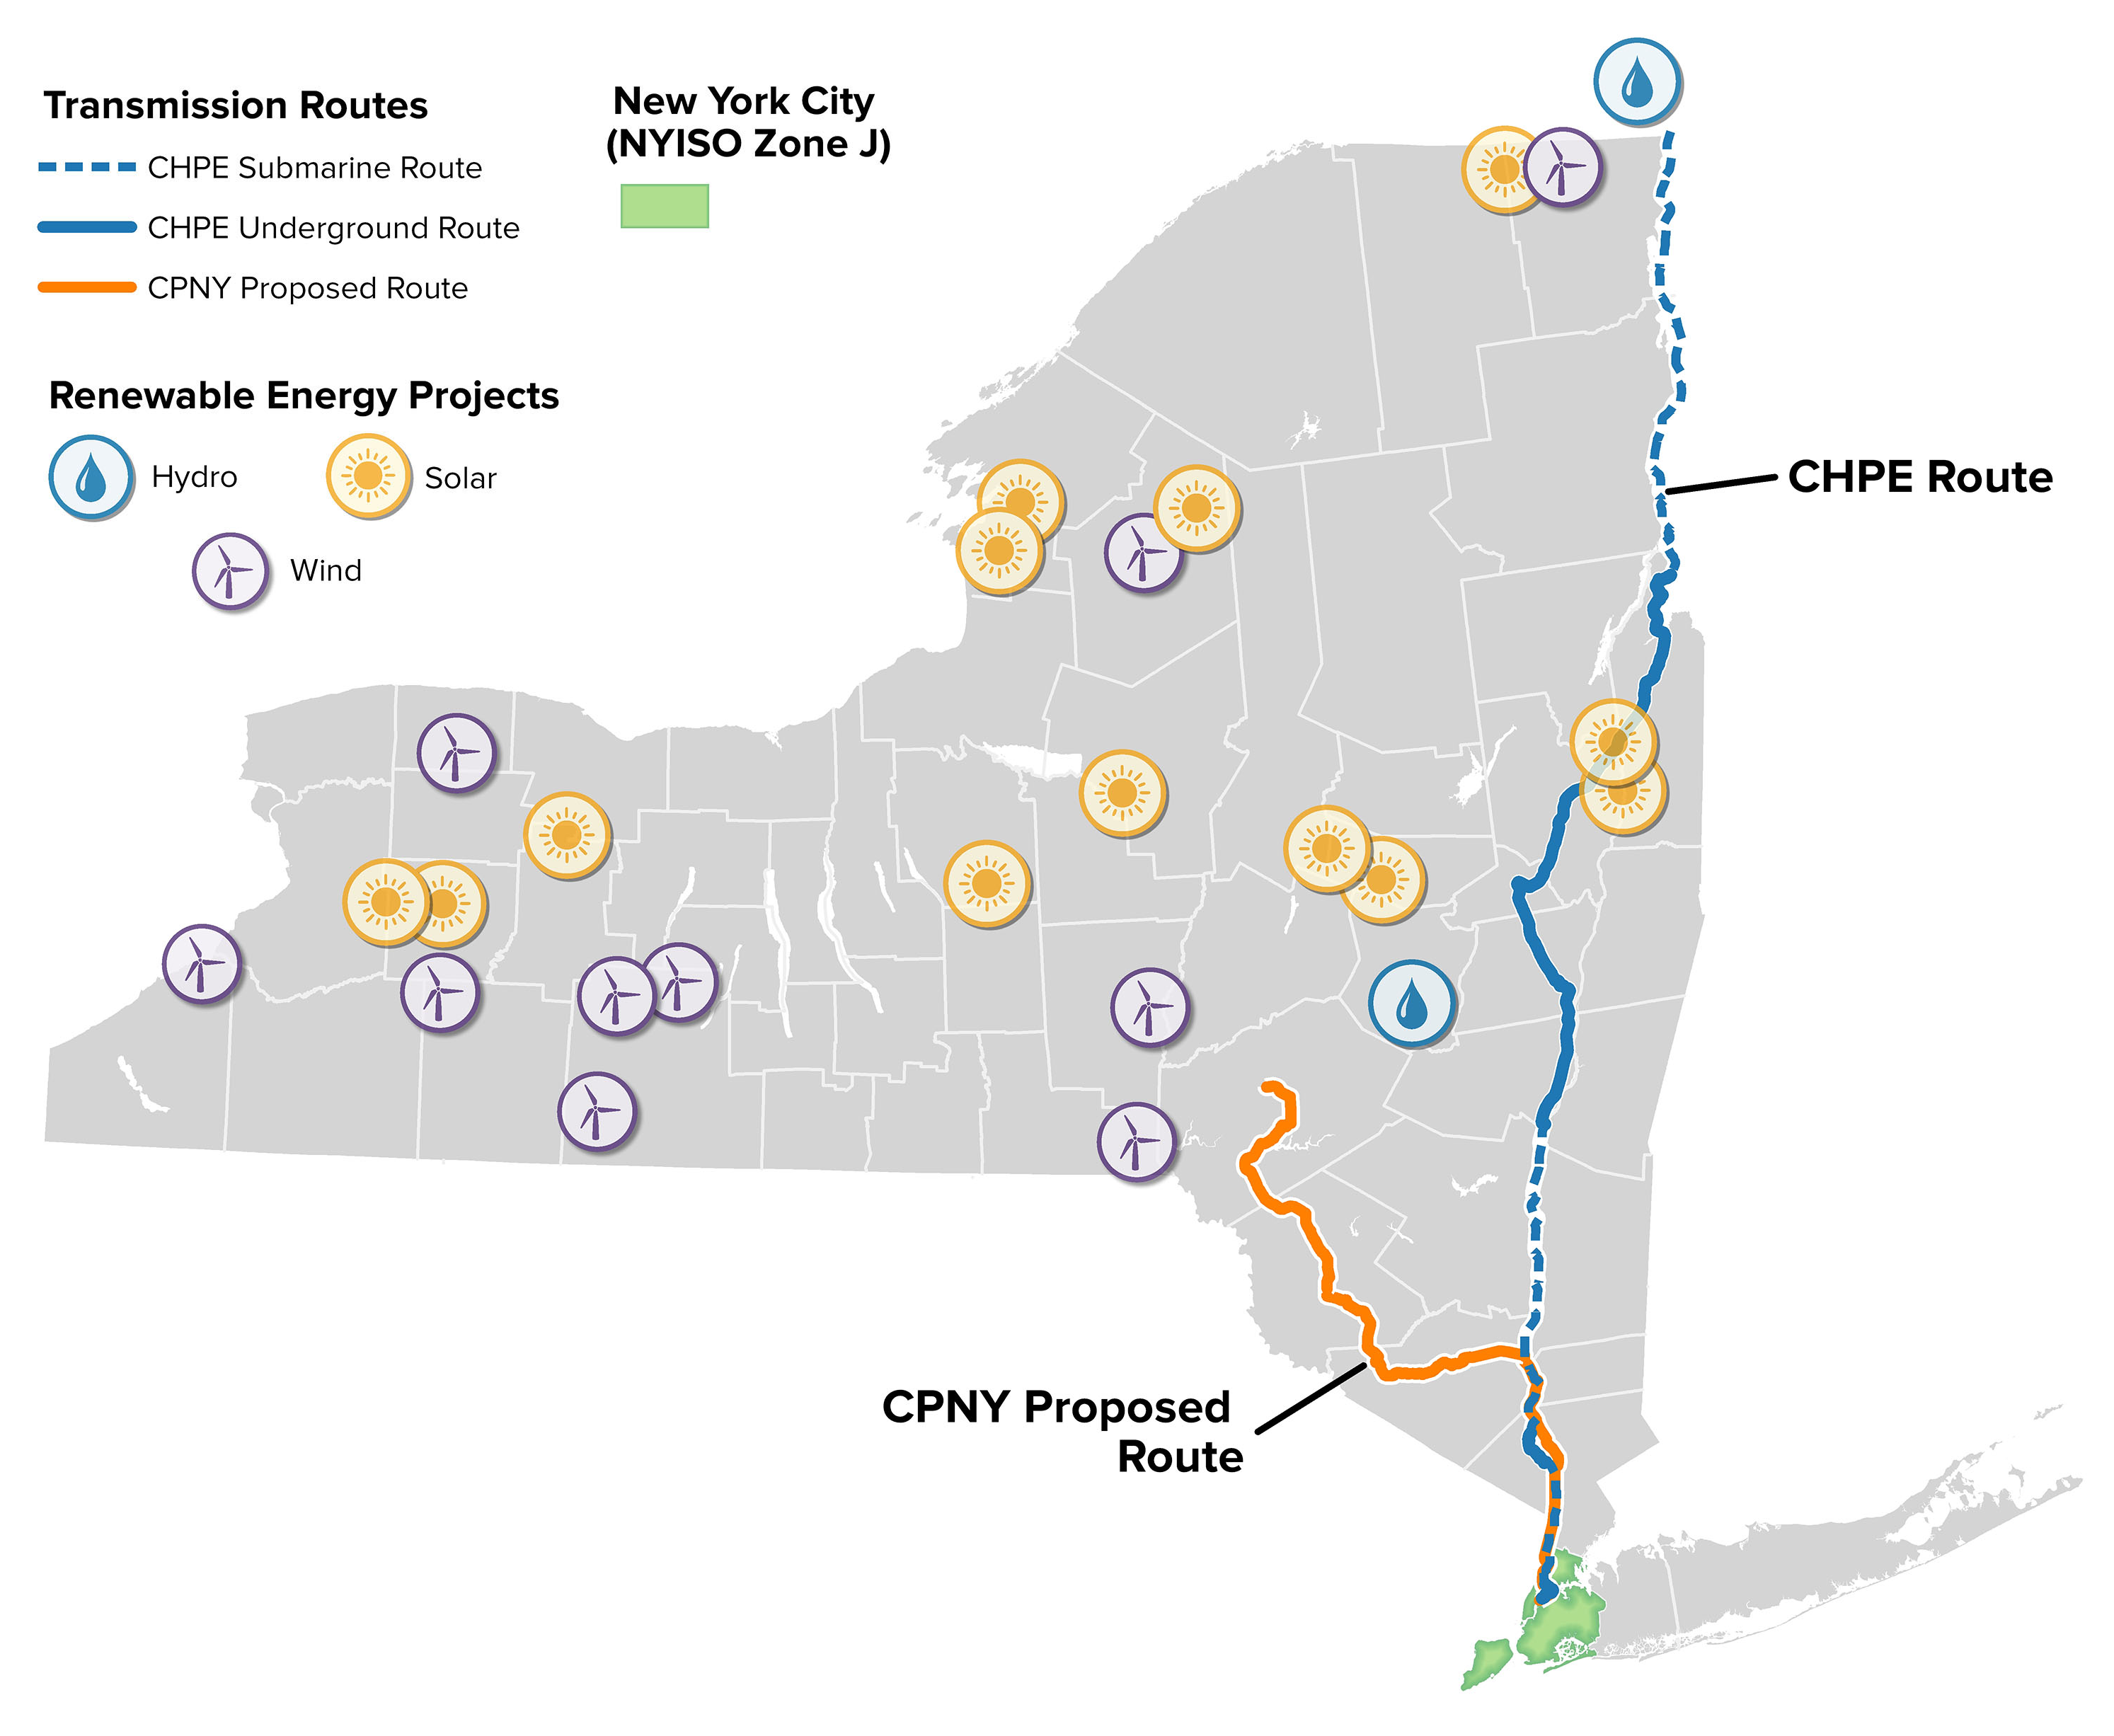
Clean Path NY (CPNY)
Forward Power (Invenergy and EnergyRe) and NYPA
1,300 MW, 175-mile underground+ underwater HVDC line
Deliver 7.9m MWh from 24 upstate wind and solar resources
Projected in-service date: June 2027
Status: Article VII Permitting Process
Docket: 22-T-0558
Champlain Hudson Power Express (CHPE)
Transmission Developers Inc. and Hydro-Québec
1,250 MW, 339-mile underground + underwater HVDC line
Deliver 10.4m MWh from 61 hydropower plants
Projected in-service date: May 2026
Status: US & Quebec lines & converter stations under construction
Docket: 10-T-0139
Zone J

Slide 9
The Basics: Renewable Energy Certificates (RECs)
1 MWh = 1 REC
Tier 4 Renewable Energy Certificate (Tier 4 REC):
The electronic record of generation data created by NYGATS¹ and representing all of the attributes, including the Environmental Attributes, of one MWh of energy generated from the Selected Project and delivered into Zone J other than Excess RECs.
NYSERDA contracts* incentivize development by guaranteeing support payments for the environmental attributes per MWh of renewable energy delivered to the grid in the form of RECs.
Tier 4 RECs will be generated starting the first day of the month after the Project reaches COD.
Tier 1, 2, ZEC, OSW RECs: A single plant’s clean energy (MWhs) delivered at its grid injection point(s).
Tier 4 RECs: Energy from a portfolio of plants matched with delivered energy in Zone J.
*
¹ New York Generation Attribute Tracking System
*Renewable Energy Certificate Purchase and Sale Agreements

Slide 10
Why is Tier 4 REC Process Unique?
Sample Settlement
Tier 4
Hourly Settlement Period
MANY Plants, MANY injection points
NEW: energy delivery verification
Tier 4 REC Quantity* =
Sum of Portfolio Hourly MWh matched
to Hourly MWh delivered in Zone J
Monthly Verification:
30 days X 24 hours = 720 hrs/per plant
720 hours x 75 plants = 54,000 data points matched to 720 data points in Zone J
Many new verification and pre-settlement compliance requirements for Tier 4
Hourly matching is just one compliance process to determine the volume of RECs eligible for payment
MWh
REC Quantity = Sum of Monthly MWh
Index REC Price Inputs:
Zonal DA Hrly Average LBMP
Zonal Spot Market UCAP
Generation data available
REC minted
NYSERDA creates invoice
Invoice approved by developer
NYSERDA issues payment
Up to 75+ plants will energize the Tier 4 projects
NYISO
NYGATs
Salesforce
Accounting

Slide 11
Tier 4 REC Payments Contingent Upon:
Selected Project
The Resource or portfolio of Resources that delivers Qualified Renewable Energy into Zone J….Seller may remove or add Resources with NYSERDA’s prior consent.
Resource
A generation or storage facility that generates or discharges Qualified Renewable Energy.
Qualified Renewable Energy:
Electric energy from (i) a generation facility that has first achieved QRE Commercial Operation (including after refurbishment or other repowering) after October 15, 2020 and that produces electricity from solar energy, onshore wind energy, geothermal energy, tidal energy, wave energy, ocean thermal energy, and/or fuel cells that do not utilize a fossil fuel resource in the process of generating electricity; and (ii) hydroelectric energy that does not utilize a New Impoundment.
Many verification processes, in addition to hourly matching, will determine the quantity of MWhs eligible for the Index REC Payment
Requirements are found through the PSA and Schedule 3.01
The required verification and REC eligibility calculations are a time-based assessment that include the volume of energy, grid operations, nature and quantity of generation, plant operations, portfolio-wide generation and a comparative analysis performed periodically:
Month
Season
Annual
Multi-year, seasonal measurement periods
Rolling

Slide 12
Tier 4 : Data Types & Verification Examples
Data Type
Static
Known value
Dynamic
Changes periodically
Asynchronously over time
Event-driven
Periodic
Hourly
Calculated
Formulaic
Algorithmic
CPNY & CHPE (Both)
QRE Hourly MWh by Resource
QRE Hourly Delivery at Zone J
Minimum Delivery Requirement
Negative LBMP <200hrs
Qualifying or Reliability Curtailment
Additional QRE Resource
Force Majeure Outage
Cover Damages
Qualifying Federal Support
etc.
CPNY Only
Dispatch-Adjusted Monthly Pricing
Charging/Discharging/Stored Energy
Storage Commitments
Additional RECs
Profit Sharing
CHPE Only
Supplier GHG Baseline*
QRE Resources
QRE Availability
QRE Compliant Energy 4TWh
Demand Side Mitigation Aggregate Savings
Accrued Net Supplier Production
Excess RECs
Banking/Borrowing Balance
Demonstrative purposes only – Incomplete

Slide 13
AGENDA
Introduction to NYSERDA
Background
Solicitation Summary
Submission Instructions
Questions

Slide 14
Objectives:
RFP 5481
Conceptual Design Services to Support Tier 4 Verification and Settlement
Project Management
Facilitate stakeholder engagement
Identify key business requirements
Create a data inventory
Develop a conceptual design
Develop a functional specifications document
Milestones:
Proposals Due: April 2, 2024 at 3:00 p.m.
Award Contract: by End of April
Execute Contract: Early May
Project Kickoff Meeting: Mid-May
Project Completion: December 2024

Slide 15
RFP 5481 Overview
Proposal Requirements
(Section 3.0)
Evaluation Criteria
(Section 4.0)
Competitively-Selected Proposer
Proposers must demonstrate experience and the ability to provide all relevant services outlined in the RFP.
The prime contractor, subcontractor, and key employees, including the project lead, must be identified
Proposals should not be excessively long SOW should not exceed 8 pages.
Fully describe any proposed new tasks including interim, draft, and final deliverables.
Project Management, Facilitation, and Stakeholder Engagement
Conceptual Design Development
Functional Specifications
Requirements Gathering and Use Case Prioritization
Project Schedule
Proposal Quality
Proposal Cost
Proposer’s Qualifications
MWBE/SDVOB
NYSERDA will issue a single contract covering the completion of the identified tasks and deliverables.
NYSERDA expects the effort not exceed 8 months from contract execution.
Incorporate methods to accelerate this timeline, if possible

Slide 16
RFP 5481: Scope of Work (SOW)
Project Management – Develop and maintain a schedule/work plan, perform biweekly status reporting on tasks and budget for the proposed work. The work plan shall clearly describe:
The work being performed, planned and critical path activities, milestones and dependencies
The communication management practices and products
Stakeholder management and scheduling
Change management approaches to be used during this engagement
The contractor’s lead and assigned resources
Stakeholder Engagement – Facilitate diverse internal and external stakeholder groups through technical discussions on verification requirements to reach consensus on proposed processes as necessary to complete Tasks 3-6
Define Business Objectives and Requirements – Identify processes for monthly, annual, and rolling Tier 4 verification, contractual obligations, and settlement processes. Develop use cases and a Business Requirements Document
Deliverables should include, at a minimum, a Business Requirements Document with figures, tables, and business process flowcharts, as needed

Slide 17
RFP 5481: Scope of Work (SOW)
Inventory Data Inputs – Document initial data requirements, availability, characteristics, and sources to perform contract verification. Undergo a thorough assessment of the data inputs required to support business cases defined under Task 3
The final deliverable is expected to be a Data Inventory of raw data inputs, intermediate inputs, and algorithms, as necessary
Conceptual Design – Prepare a conceptual design to diagram automated data acquisition, warehousing, analytics and methods to summarize process flows necessary to verify contractual obligations
Deliverables should include a Conceptual Design suitable for interpretation by a diverse audience that conveys the process framework that can be incorporated into a Functional Specifications Document
Functional Requirements – Develop a Functional Requirements Document that maps back to the business requirements and describes functional expectations to support Tier 4 verification
The deliverable will be used by NYSERDA to identify and segment any in-house design-build elements from a subsequent RFP to externally source the Tier 4 verification system

Slide 18
Proposal Requirements
Proposal comprised of two documents:
Proposal Submission in Word, pdf etc.
Budget Form in xls
Introduction and Proposal Narrative
Approach
Statement of Work
No more than 8 pages!
Schedule/Work Plan
Budget Proposal
Staffing Plan
Qualifications
Letters of Commitment
Link to RFP: https://portal.nyserda.ny.gov/CORE_Solicitation_Detail_Page?SolicitationId=a0r8z000000GZY3AAO&_gl=1*1u3257d*_ga*MTExOTg5Njg0Ny4xNzA4NDU4OTM0*_ga_DRYJB34TXH*MTcwODYzNTc5MS4zLjAuMTcwODYzNTc5My41OC4wLjA.*_gcl_au*MTI0MjQ1MjM4NS4xNzA4NDU4OTM1

Slide 19
Timeline to Award
 | Week of
Milestone | 2/26 | 3/4 | 3/11 | 3/18 | 3/25 | 4/1 | 4/8 | 4/15 | 4/22 | 4/29 | 5/6
RFP Release
Bidder's Conference
Proposal Submission
Proposal Evaluation – Initial Screen
Proposer Interviews
Selected Awardee & Negotiations
Timeline for Negotiations is short!
Please frame your SOW in “contract-ready” language
Once you have been invited to an Interview, please review and redline the Sample Agreement
Project Kickoff meeting to occur in May!

Slide 20
RFP 5481
Considerations
NYSERDA will have 24 months from this May to design, deploy, test, and operationalize a complex verification and settlement system
Proposed team should include staff with extensive experience working with dynamic data systems
Proposed team must be able to convey complex technical concepts to internal and external stakeholders who may have no experience in software design, automation or dynamic data
NYSERDA welcomes ideas to accelerate this process
Future questions can be addressed by submitting them to: Tier4@nyserda.ny.gov
Questions and Answers will be posted to the Tier 4 Funding Opportunity Web Page.
Last day to submit questions is 3/22/2024.

Slide 21
AGENDA
Introduction to NYSERDA
Background
Solicitation Summary
Submission Instructions
Questions

Slide 22
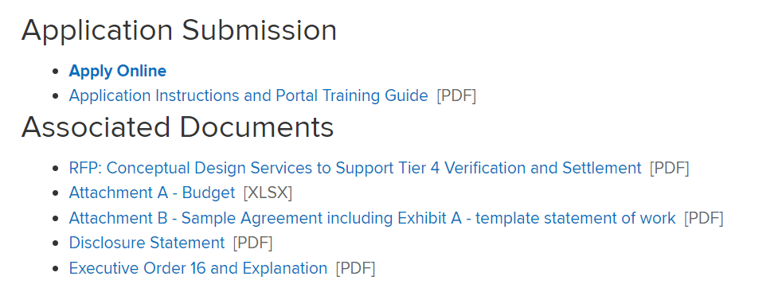
Preparation for Submission
1. Salesforce Portal Registration
2. Once approved, become familiar with additional questions to complete before you can submit the proposal
3. Allow plenty of time to move through the upload process

Slide 23
Questions?
*Note: Responses will be posted to the Tier Solicitation Page
Tier 4 Funding Opportunity: https://www.nyserda.ny.gov/All-Programs/Large-Scale-Renewables/Tier-Four/Funding-Opportunity
Notes:
Ask Marci?

