Slide 1
6 GW Energy Storage Order and Disadvantaged Communities Program Design
Stakeholder Webinar
September 24, 2024

Slide 2
Agenda
Webinar Logistics
6 GW Storage Order: Background
6 GW Storage Order: Key Directives
6 GW Order: Disadvantaged Communities Directives
Storage Benefit Streams for Disadvantaged Communities
Distributed Storage Programs: Implementation Plan Filing
  Residential Program Design
  Retail Program Design
Stakeholder Input Topics, Next Steps and Opportunities for Engagement
Q&A / Discussion

Slide 3
Webinar Logistics
Today’s webinar is being recorded. A copy of the recording and presentation slides will be posted to NYSERDA’s Retail Storage Incentives page in the “Webinar Presentations” section.
Questions and comments may be queued up at any time via the Webex interface.
Q&A and discussion will be facilitated after the presentation.
Feedback will be captured by NYSERDA for review and deliberation; however, stakeholders are encouraged to submit formal comments to the Public Service Commission (PSC) in response to the Residential-Retail Implementation Plan filing (directions to follow).

Slide 4
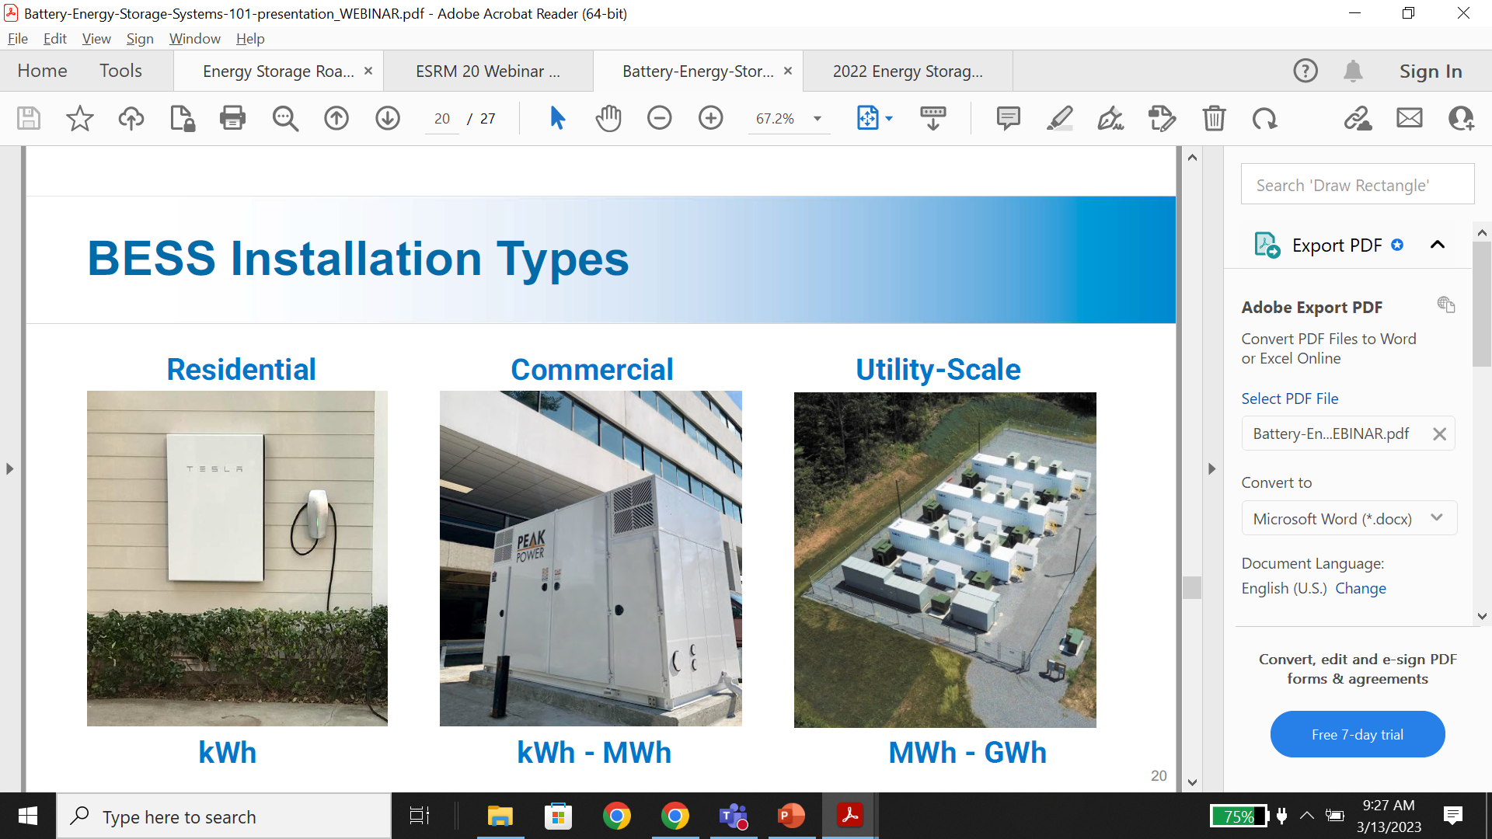
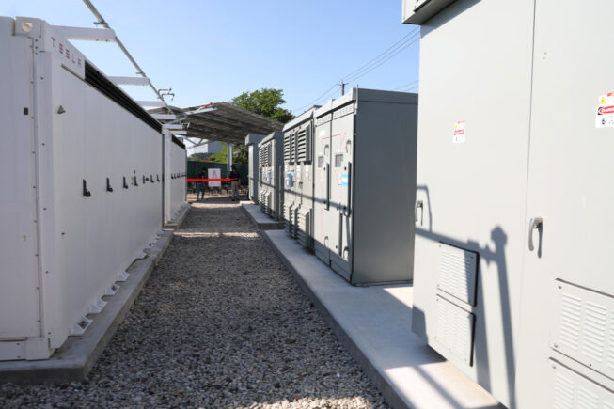
Stationary Energy Storage by Installation Type
Residential
5-10 kW
On-Site Retail
50-750 kW
Off-Site Retail
1-5 MW
Bulk
20-100 MW

Slide 5
6 GW Energy Storage Order: Background
Climate Law (CLCPA) requires minimum of 3 GW of energy storage deployed by 2030.
Analysis conducted to support CLCPA mandates found a need for 12 GW of storage by 2040 and 17+ GW by 2050 to support a fully decarbonized electric sector and economy.
Recognizing longer-term storage needs, Gov Hochul expanded target to 6 GW by 2030 in 2022, and NYSERDA and Dept of Public Service (DPS) were directed to submit a petition (“Roadmap”) proposing new programs, funding and policy recommendations.
6 GW Storage Roadmap filed in Dec 2022, proposed new programs and funding to support large-scale (“Bulk”), distributed commercial (“Retail”) and residential sectors.
June 2024: PSC approved 6 GW Roadmap (“6 GW Storage Order”) and directed NYSERDA to file Implementation Plans for Bulk and Residential-Retail programs with more detailed program design, subject to public comment and PSC approval.

Slide 6
6 GW Storage Order: Key Directives (non-DAC)
NYSERDA to procure 3,000 MW of Bulk storage through competitive solicitations, supported by Index Storage Credit (ISC) mechanism
  ISC payment is a floating incentive, makes up difference between project’s bid/strike price ($/MWh) and reference energy arbitrage and capacity prices
  Winning projects awarded long-term contracts where NYSERDA pays ISC over life of contract
  Minimum of 20% of each procurement must be long-duration (8-hr+) resources
NYSERDA to procure 1,500 MW of Retail storage and 200 MW of Residential storage via standard-offer, up-front, $/kWh incentive programs (MWh Block)
  Total funding of $675 million for Retail program and $100 million for Residential program
All projects 1 MW in size and above must pay Prevailing Wage as a programmatic requirement
NYSERDA to incorporate recommendations from Fire Safety Working Group into program rules (Peer Review, Emergency Response Plan, First Responder Training)

Slide 7
6 GW Storage Order: Disadvantaged Communities Directives – Off-Site Storage
Bulk and Off-site Retail storage can be deployed to reduce emissions from fossil fuel peaking plants across the electrical network (NYISO zone) where the project is built
Accordingly, 6 GW Order directs that at least 35% of off-site storage (Bulk, off-site Retail) program procurements (1,575 MW) must be sited downstate (NYISO Capacity Zones G,H,I, J, K)
  At least 30% of total off-site procurements (1,350 MW) must be in Zone J (NYC), due to concentration of all fossil fuel peakers in Downstate region/NYC
  At least 5% of total off-site procurements (225 MW) must be in Zones G, H, I and K

Slide 8
6 GW Storage Order: Disadvantaged Communities Directives – On-Site Storage
On-site Retail and Residential projects provide direct local benefits to the site at which they are installed
  Value of these projects to be primarily for the benefit of the site owners
Accordingly, 6 GW Order directs that at least 35% of on-site (Residential, on-site Retail) storage program procurements must be located within DAC census tracts

Slide 9
In What Ways Can Storage Provide Benefits to Disadvantaged Communities?
Residential
5-10 kW
Resiliency/Backup Power
On-Site Retail
50-750 kW
Off-Site Retail (Community Storage)
Bill Credits/Discounts
1-5 MW
Fossil Peaker Displacement
Off-Site Retail
1-5 MW
Large-Scale (“Bulk”)
20-100 MW

Slide 10
DAC/EJ Storage Programs: Proposed Strategy
Resiliency: Significantly higher incentive (vs mass-market) to offset cost of on-site storage
  Residential: Eligibility via income, census tract, and potentially additional pathways
  Non-Residential: Critical infrastructure facilities located in and serving DACs
Peaker Reduction: Program focus/carveout for projects sited in same zones as peakers
  Primarily NYC, but also Long Island, Westchester and Lower Hudson
Bill Discounts: Statewide Solar for All (S-SFA) program
  Bill credits from participating community solar/storage projects in a utility pooled together
  Utility Home Energy Assistance Program customers in DAC tracts auto-enrolled into program; bill credits from project pool offset customer bills
  After successful pilot in National Grid territory, PSC approved the SSFA statewide in May 2024; credit distribution to customers to commence EOY 2025

Slide 11
Residential-Retail Implementation Plan: Proposed Program Design
Continues previous “MWh Block” structure for new Residential and Retail programs
MWh Block: Series of capacity-based funding “blocks” or segments
  Blocks specific to market segment and region (e.g. NYC Retail)
  Incentive rate specified in $/kWh of installed capacity for each block
  Incentive paid out at project completion
System can be standalone or paired with solar; in either case, must be grid-connected
Only opening MWh Block sizes and rates are proposed in Implementation Plan
  Landscape for permitting and battery pricing in flux, LIPA participation still TBD
  Subsequent blocks will be published on MWh Block dashboard and announced through NYSERDA Energy Storage mailing list, prior to full allocation of currently open block
  Size/rate for subsequent blocks determined based on uptake trends and prevailing project economics

Slide 12
Residential Program: MWh Block Design
Authorized to procure total of 200 MW statewide utilizing funding of $100 million
Proposed opening market-rate (non-DAC) block sizes and rates:
  Con Edison (NYC + Westchester): 10 MW/25 MWh, $250/kWh
  Rest of State (outside Con Edison and Long Island): 10 MW/25 MWh, $200/kWh
Residential storage incentives for Long Island (LIPA) have been available since 2019, for storage paired with solar PV, funded via Regional Greenhouse Gas Initiative (RGGI)
    To date: 7 MW/14 MWh, $250/kWh, $3.6 million in funding
    Additional incentive of $150/kWh available for projects where solar system meets the requirements of the NY-Sun Affordable Solar Residential Incentive for low-to-moderate income homeowners
    Additional funding TBD based on LIPA participation in statewide programs

Slide 13
Residential Program: DAC Program Design
Residential program will allocate 40% of total program capacity (80 MW) towards the Residential Inclusive Storage Incentive (ISI), available statewide outside LIPA presently
Project must meet one of the following criteria to be eligible:
  Be located within a DAC census tract as identified by the Climate Justice Working Group
  Service the owner-occupied residence with household income less than 80% of the Area Median Income (AMI) or 80% of the State Median Income (SMI), whichever is higher;
  Service a residential (1-4 unit) affordable housing property; or
  Service a customer who has notified their utility of a serious illness or condition that could become life-threatening if electricity is disconnected.
NYSERDA will allocate an initial capacity of 10 MW/25 MWh at an incentive rate of $450/kWh to the first block of Residential ISI
Capacity allocations and incentive rates for future Residential ISI blocks will be determined based on analysis of prevailing market conditions, uptake trends, and stakeholder feedback

Slide 14
Retail Program: MWh Block Design
Authorized to procure total of 1,500 MW statewide utilizing funding of $675 million
Available for on-site and off-site systems up to 5 MW-AC in size
Proposed opening market-rate (non-DAC) block sizes and rates:
  New York City: 300 MW/1,125 MWh, $125/kWh
  Con Edison Westchester: 100 MW/375 MWh, $125/kWh
  Rest of State (outside Con Edison and Long Island): 150 MW/563 MWh, $175/kWh
Availability of Retail MWh block incentives for Long Island projects is TBD and subject to LIPA’s voluntary participation in the Retail Storage program, which, at the time of filing this Plan, had not been determined

Slide 15
Retail Program: DAC Design – Off-Site
Recall: Order requires minimum 35% of off-site Retail to be sited downstate (NYISO Zones G-K), with minimum 30% of total in Zone J (NYC) and 5% in Zones G,H,I,K
Based on high value of storage downstate, concentration of peakers/DAC in NYC, Implementation Plan proposes that:
  Minimum of 50% of Retail program capacity (750 MW) will be allocated to NYC
  Minimum of 10% (150 MW) will be allocated to ConEd Westchester (Zones H-I)
  Can be implemented simply by sizing MWh Blocks for NYC and ConEd Westchester to meet requirements
  May be adjusted upwards based on market conditions and uptake levels
  Retail procurements in LIPA (Zone K), if implemented, will be additive to (i.e., not constrained by) proposed minimum downstate targets

Slide 16
Retail Program: DAC Design – On-Site
Recall: Order requires minimum 35% of on-site Retail to be sited in DAC census tracts
Accordingly, NYSERDA will provide the Retail Inclusive Storage Incentive (Retail ISI) for storage projects sited at eligible critical facilities located in DAC census tracts, available statewide (except LIPA presently)
Proposed list of eligible critical facilities for Retail ISI:
  Affordable housing properties
  Food banks
  Homeless and emergency shelters supported by state, local or tribal governments
  Community cooling centers
  Medical facilities including hospitals, skilled nursing facilities, nursing homes, blood banks, health care facilities, dialysis centers, and hospice facilities
  Independent living centers

Slide 17
Retail Inclusive Storage Incentive (cont’d)
NYSERDA estimates that on-site Retail procurements will at most comprise 10% of overall Retail procurements (150 MW of the 1500 MW total Retail program)
Accordingly, NYSERDA will allocate 60 MW (40% of likely upper bound of on-site procurements) to Retail ISI, with additional allocations subject to on-site Retail procurement levels
NYSERDA will allocate capacity of 15 MW/45 MWh at an incentive rate of $350/kWh to the first block of the Retail ISI; capacity allocations and incentive rates for future Retail ISI blocks to be determined based on analysis of prevailing market conditions, uptake trends, and stakeholder feedback
Additional stakeholder engagement/input is required to finalize the list of eligible critical facilities and additional eligibility criteria for the Retail ISI as well as associated verification requirements and documentation

Slide 18
Storage Benefit Streams ←→ NYS Programs
Resiliency/Backup Power
(clean if paired with solar)
Residential /
On-Site Retail
Inclusive Storage Incentive (ISI)
Bill Credits/Discounts
Off-Site Retail
(Community Storage)
Statewide Solar for All (Storage eligible)
Fossil Peaker Displacement
Large-Scale (“Bulk”) /
Off-Site Retail
Procurement Carveout for Downstate/NYC

Slide 19
Suggested Topics for DAC Program Feedback
Should the Residential Inclusive Storage Incentive (ISI) rate differ for projects serving low- to moderate-income (LMI) households as compared to non-LMI households located in disadvantaged community census tracts?
Should there be additional eligibility pathways for the Residential ISI beyond income-based qualification and location in a disadvantaged community census tract?
What types of facilities should be eligible for the Retail ISI?
Beyond eligible facility type, what additional requirements, documentation and verification should be incorporated into the Retail ISI program design?
What kinds of supplemental activities/activities needing technical assistance are required to prepare a designated site or facility for storage installation and operation?

Slide 20
Next Steps and Opportunities for Engagement
Submit public comments for two implementation plans submitted to PSC
Residential-Retail Implementation Plan filed in August, noticed for public comment September 23; comment period ends November 18
Bulk Implementation Plan must be filed by mid-October; will also be noticed for comment for 60 days
Programs to be launched following PSC consideration of comments and approval of Implementation Plans
Statewide Solar/Storage for All program was approved by PSC in May 2024; utilities must file initial tariff statements by December 2024, with credit distribution to customers beginning December 2025

Slide 21
How to File a Public Comment
Stakeholders are encouraged to submit formal comments to capture feedback in official PSC record:
Go to online docket link for Energy Storage Implementation Plans (Case 18-E-0130): https://documents.dps.ny.gov/public/MatterManagement/CaseMaster.aspx?MatterCaseNo=18-e-0130
Be specific with comments: encourage comments on DAC aspects of program design
Click “Post Comments”—enter comments into text box or attach with submission

Slide 22
Q&A / Discussion

