Slide 1
Third-Party Support and
Advancing Code Compliance Technology Pilot Program
Webinar: January 26, 2022

Slide 2
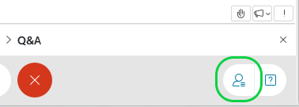
Meeting Procedures
Participation for Members of the Public:
Members of the public are muted upon entry.
Questions and comments may be submitted in writing through the Q&A feature at any time during the event.
Chat is disabled.
The slide deck for today's webinar will be posted at:https://www.nyserda.ny.gov/All-Programs/Energy-Code-Training/State-Energy-Code-Training-and-Resources/Resources
If technical problems arise, please contact Sal.Graven@nyserda.ny.gov
You'll see when your microphone is muted

Slide 3
CODES, PRODUCTS & STANDARDS MATTER
NEW YORK STATE’S (NYS) 2019 CLIMATE LEADERSHIP AND COMMUNITY PROTECTION ACT (CLIMATE ACT) has ambitious clean energy and climate justice goals. It requires NYS to reduce economy-wide greenhouse gas emissions 40 percent by 2030, and no less than 85 percent by 2050 from 1990 levels.
Energy efficiency is the most-cost effective way to reduce harmful GHG related pollution emissions, which are critical for NYS to reach its climate goals.
The built environment in NYS accounts for 40 percent of carbon emissions.
ADVANCING EFFORTS ON CLEAN ENERGY CODES, PRODUCTS:
Partnership-driven work: NYSERDA seeks to work with all stakeholders to advance clean energy building codes, product and appliance standards and practices that improve energy efficiency.
Decarbonizing buildings: NYSERDA efforts to decarbonize buildings have begun and will be expanding steadily through 2035.
Responding to climate and clean energy justice: NYSERDA fully recognizes that work towards decarbonizing buildings and advancing clean energy codes, products and standards should be directly responsive to addressing the needs of frontline communities – currently defined as Disadvantaged Communities (DACs)-interim criteria.

Slide 4
CODES, PRODUCTS & STANDARDS (CPS): Key Work Streams
ADVANCING CLEAN TO ZERO-EMISSIONS CODES THROUGH CODE DEVELOPMENT & ADVANCEMENT, CODE ADOPTION AND CODE COMPLIANCE SUPPORT:
NYStretch 2020
Development of NYStretch 2023
Innovative pilots focused on community engagement with a focus on building technology and online capacities where resource constraints/needs are the greatest.
Energy Code Compliance Training (ECCCNYS 2020 as well NYStretch 2020: https://www.nyserda.ny.gov/All-Programs/Energy-Code-Training)
ADVANCING CLEAN AND ZERO EMISSION PRODUCTS AND APPLIANCE STANDARDS:
Efforts on State and Federal Product and Appliance Standards includes regulatory and research work done by NYSERDA in partnership with key stakeholders

Slide 5
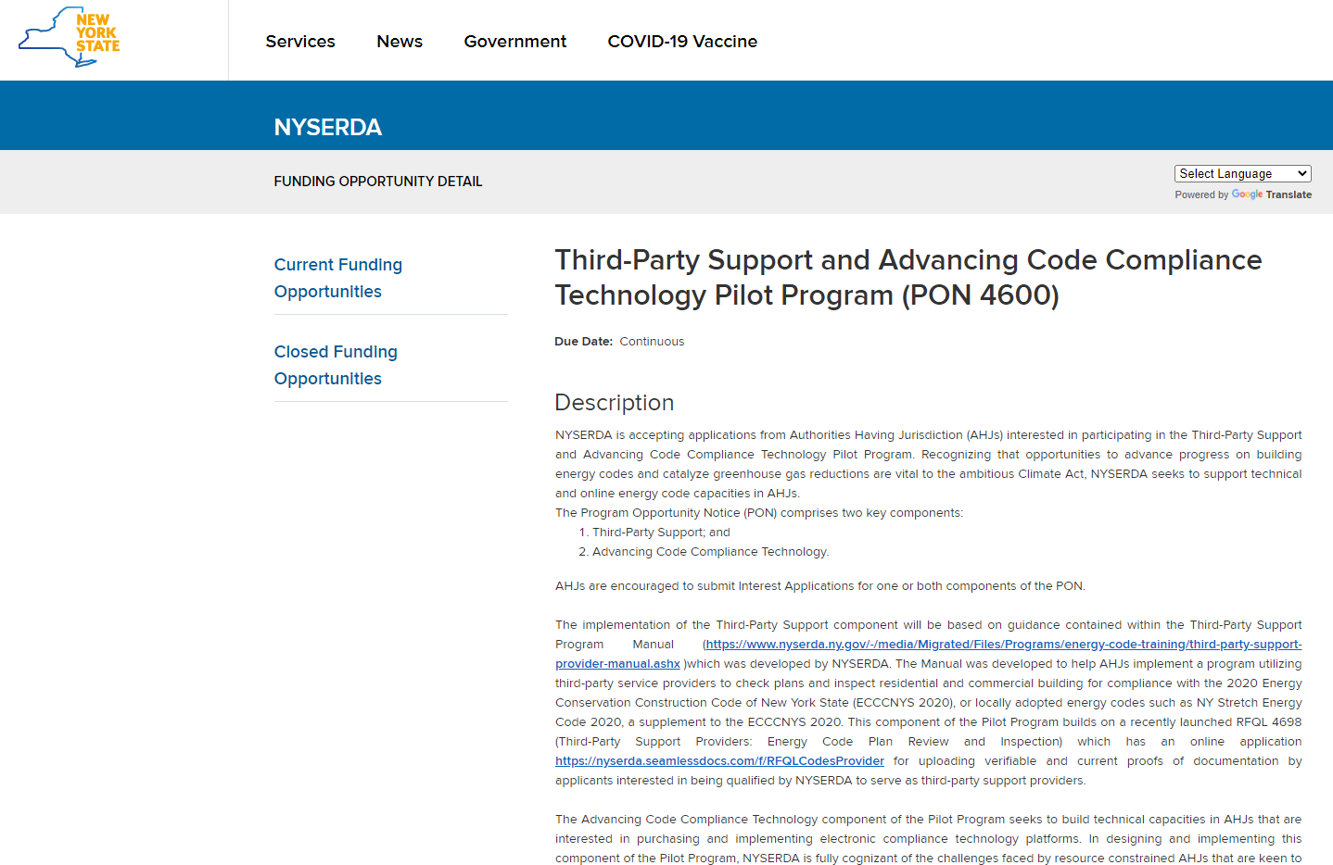
Program Opportunity Notice (PON 4600)
In support of New York State’s 2019 Climate Act, NYSERDA is inviting New York State Authorities Having Jurisdiction (AHJs) to participate in PON 4600 which has 2 components:
Third-Party Support
Advancing Code Compliance Technology
AHJs can submit Interest Applications for one or both components of PON 4600
Third-Party Support and Advancing Code Compliance Technology Pilot Program (PON 4600) (ny.gov)

Slide 6
Third-Party Support: Innovative opportunities for AHJs & qualified third-party support providers
FEEDBACK
PARTNERSHIP
IMPLEMENTATION
AIM: Build-out and diversify technical energy code capacities via the use of qualified third-party support providers and a concise informative Guidance Manual

Slide 7
Third-Party Support: Role of AHJs
Third-Party Support is aimed at assisting AHJs: AHJs face resource and time constraints in undertaking plan checks and building inspections which can be addressed via the use of qualified Third-Party Support Providers in the following roles*:
Residential Plans Examiner
Residential Inspector
Commercial Plans Examiner- Prescriptive
Commercial Plans Examiner- Performance
Commercial Inspector
Guidance Document is the Third-Party Support Manual: Includes qualification criteria and processes for qualified Third-Party Support Providers as well as Model Resolution that interested AHJs who wish to participate in the PON need to adopt; and Building Plan Reviews and Inspection Checklists that AHJs participating in this component of the PON will be able to access.

Slide 8
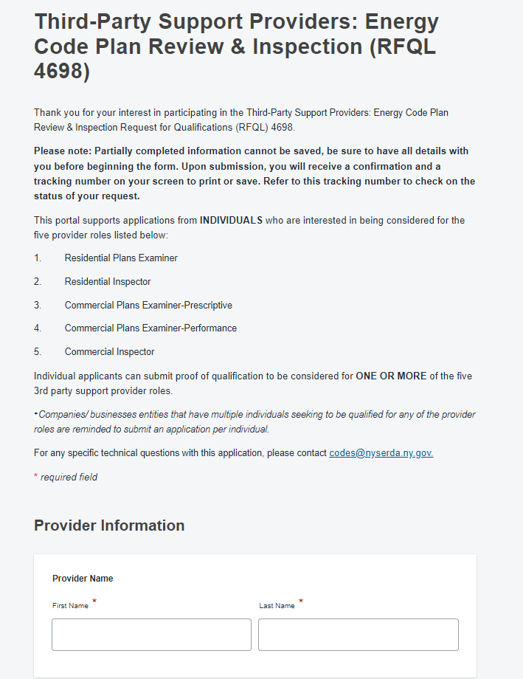
Third-Party Support: Role of Qualified Third-Party Support Providers*
RFQL 4698 Third-Party Support Providers: Energy Code Plan Review & inspection.
Interested Providers can apply online to be qualified at
[NYSERDA] RFQL 4698 Third-Party Support Providers: Energy Code Plan Review &amp;amp; Inspection (seamlessdocs.com)
* NYSERDA is not responsible for the work/outputs of any qualified Third-Party Support Provider. Additionally, NYSERDA will not provide any direct funding/compensation for any individual that NYSERDA qualifies as a third-party support provider

Slide 9
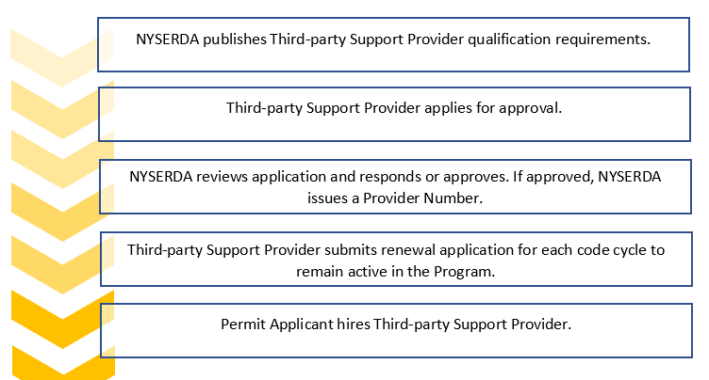
Third-Party Support Process: Qualified Third-Party Support Providers*
*See Third-Party Support Manual for additional information regarding the qualification and roles and responsibilities of providers and related parties: https://www.nyserda.ny.gov/All-Programs/Energy-Code-Training/State-Energy-Code-Training-and-Resources/Resources

Slide 10
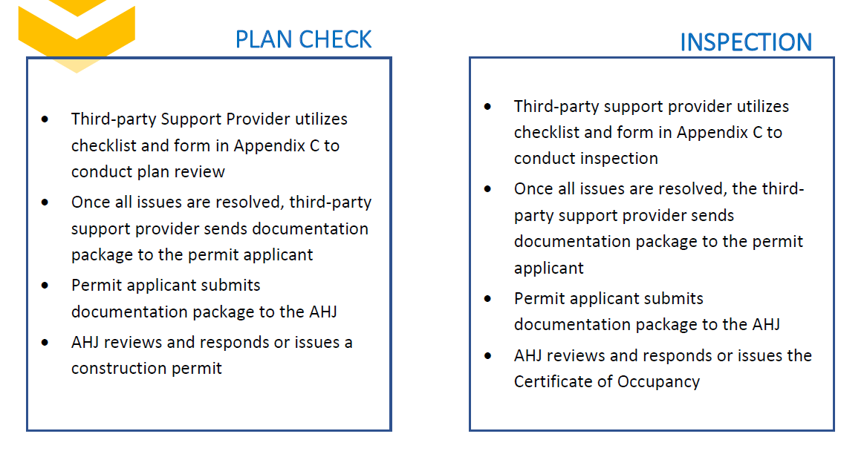
Third-Party Support Process: AHJs are responsible for ensuring energy code compliance for all construction within their jurisdictions.
See Third-Party Support Manual and ADA Compliant Checklists available at: https://www.nyserda.ny.gov/All-Programs/Energy-Code-Training/State-Energy-Code-Training-and-Resources/Resources

Slide 11
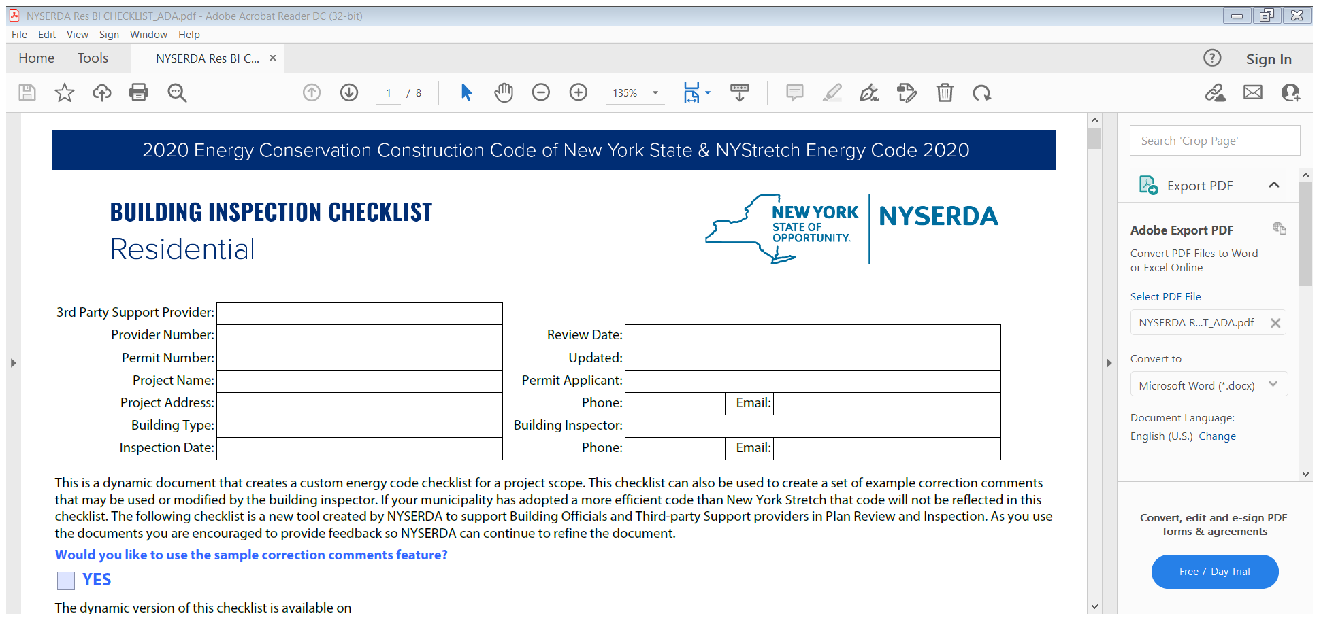
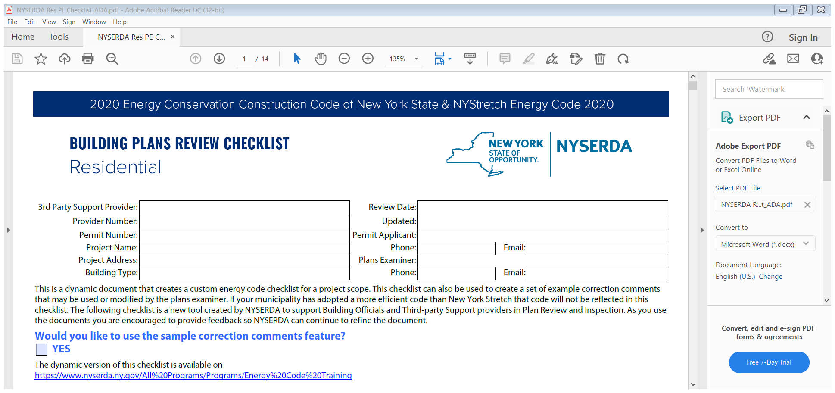
THIRD-PARTY SUPPORT CHECKLISTS: ADA Compliant* *All Checklists are voluntary resources subject to legal provisions reflected in the Manual. AHJs are responsible for ensuring energy code compliance for all construction within their jurisdictions
See Third-Party Support Manual and ADA Compliant Checklists available at: https://www.nyserda.ny.gov/All-Programs/Energy-Code-Training/State-Energy-Code-Training-and-Resources/Resources

Slide 12
Third-Party Support: Application Process for AHJs
Funding will be allocated on a first-come, first-served basis based on both the timely completion of “Interest Application from Authorities Having Jurisdiction” signed by the Chief Elected Official and execution of a formal agreement between NYSERDA and the AHJ.
Implementation of this component will be based on guidance contained within the Third-Party Support Manual (https://www.nyserda.ny.gov/-/media/Migrated/Files/Programs/energy-code-training/third-party-support-provider-manual.ashx ), which was developed by NYSERDA and is based on market and industry expert consultations and inputs. Adherence to the Manual will be a requirement for participation.
First deliverable under the agreement executed with NYSERDA, AHJs will be required to adopt a Model Resolution, (contained in Manual) authorizing the use of third-party plan review and inspection. Once a contract is executed, the AHJ must adopt the Model Resolution and submit to NYSERDA a certified copy in order to receive the first milestone payment- 60% of the total funding award.
Participation/Feedback is key. The remaining 40% of funds will be disbursed at the end of second year and will be tied to the specific lessons learned from the AHJs’ implementation of the Manual and receipt of required quarterly evaluation and feedback reporting based on forms provided by NYSERDA

Slide 13
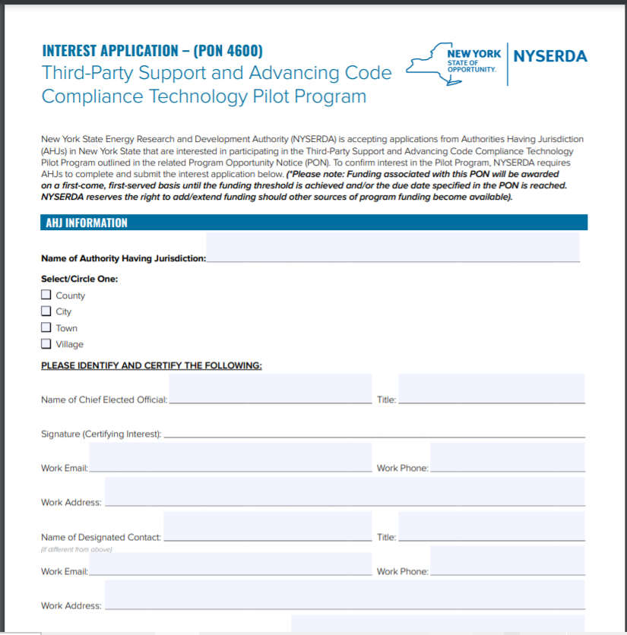
Third-Party Support : How to Apply (Letter of Interest Application from AHJs)
See Interest Application - (PON 4600): Third-Party Support and Advancing Code Compliance Technology Pilot Program (ny.gov)

Slide 14
Third-Party Support: Funding for AHJs
Funding for this component of the PON will be provided as a tiered award amount based on the population size of the selected AHJ as given below:
$1,000,000 total available.
NYSERDA will allocate 35% of total funding for the Third-Party Support component of the PON for use by AHJs that meet the interim criteria for a Disadvantaged Community (DAC) as defined by New York State.

Slide 15
Advancing Code Compliance Technology Component : PON 4600
Technology Platforms to Facilitate Energy Code Compliance within AHJs

Slide 16
Advancing Code Compliance Technology
AHJs face increased budgetary and staff time constraints in their efforts to provide improved energy code compliance for their residents.
Issuing building permits, licenses, and ensuring energy code compliance for residential and commercial buildings are critical functions for AHJs, and can be made more efficient, transparent, and responsive through electronic/online compliance technology platforms
AHJs are invited to participate by purchasing and implementing online/electronic compliance technology platforms that work best for their specific needs.
Online/electronic permitting and compliance platforms can help AHJs by:
Expediting building plan review, inspection, and approval processes,
Making the code compliance process more transparent and responsive,
Reducing workload for code enforcement officers, and
Improving and ensuring consistent energy code compliance.

Slide 17
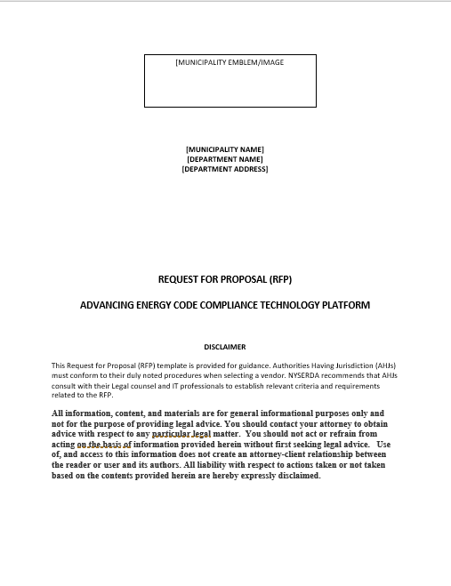
Advancing Code Compliance Technology: PON 4600
Electronic code compliance technology platforms must include, but are not limited to the following capabilities:
Plan submittal and review
Permitting
Scheduling inspections
Fee calculation and collection
Project tracking
Administrative workflow
Virtual Inspections
Customer Communication
Departmental communications and management
PON 4600 Attachment B – Template RFP

Slide 18
Advancing Code Compliance: Application Process for AHJs
Funding will be allocated on a first-come, first-served basis based on both the timely completion of the attached “Interest Application from Authorities Having Jurisdiction” (Attachment A) signed by the Chief Elected Official and execution of a formal agreement between NYSERDA and the AHJ (Attachment C, Sample Agreement).
Once an agreement is executed, NYSERDA funding must be directly applied towards the purchase and implementation of the electronic platform of choice by the AHJ. To ensure reasonableness of costs associated with online energy technology platforms, NYSERDA will require AHJs to provide certified documentation detailing the municipal competitive procurement process as specified in an RFP.
The first milestone payment, representing 60% of funding, will be provided following the submission of an RFP to NYSERDA. A template RFP is attached to the PON (Attachment B).
Participation/feedback is key. The second milestone payment, representing the remaining 40% of funding, will be disbursed at the end of second year, and will be tied to both the purchase and implementation of the online energy technology platform, as well as the completion of the peer to peer learning opportunities and receipt of required quarterly reporting, which will include implementation and evaluation feedback forms provided by NYSERDA.

Slide 19
Advancing Code Compliance Technology: AHJ Submission of RFP Template (Attachment B of PON 4600)

Slide 20
Advancing Code Compliance Technology: Funding
Funding for this component of the PON will be provided as a tiered award amount based on the population size of the selected AHJ as given below
$1,000,000 total available.
NYSERDA will allocate 35% of total funding for the Advancing Code Compliance Technology component of the PON for use by AHJs that meet the interim criteria for a Disadvantaged Community (DAC) as defined by New York State.
Recognizing the need to scale up shared services, NYSERDA will provide an award bonus of $5,000 per qualifying AHJ to encourage small AHJs (population size 0-4,999) to partner on implementation of shared electronic permitting systems. NYSERDA will require all small AHJs that receive the award bonus to provide feedback in terms of their shared implementation experiences

Slide 21
Resources & Contacts PON 4600: https://portal.nyserda.ny.gov/CORE_Solicitation_Detail_Page?SolicitationId=a0rt000001PzSjMAAV Third-Party Support Manual: https://www.nyserda.ny.gov/-/media/Migrated/Files/Programs/energy-code-training/third-party-support-provider-manual.ashx RFQL 4698: Third-Party Support Providers: Energy Code Plan Review & Inspection (RFQL 4698) (ny.gov) Interested Third-Party Support Providers can apply on line at: NYSERDA] RFQL 4698 Third-Party Support Providers: Energy Code Plan Review &amp;amp; Inspection (seamlessdocs.com) NYSERDA TRAINING OPPORTUNITIES: Interested AHJs &Third-Party Support Providers are encouraged to visit Building Energy Code Development, Compliance, and Enforcement - NYSERDA for information regarding currently available NYSERDA-supported energy code training Designated Contact: Chris Sgroi: christopher.sgroi@nyserda.ny.gov; 518-862-1090. Ext 3373 PON CONTACT: Anilla Cherian: anilla.cherian@nyserda.ny.gov; anilla.codes@nyserda.ny.gov; Phone: (518) 862-1090, Ext. 3703; Any additional queries related to CPS team efforts please direct emails to: codes@nyserda.ny.gov

