Slide 1
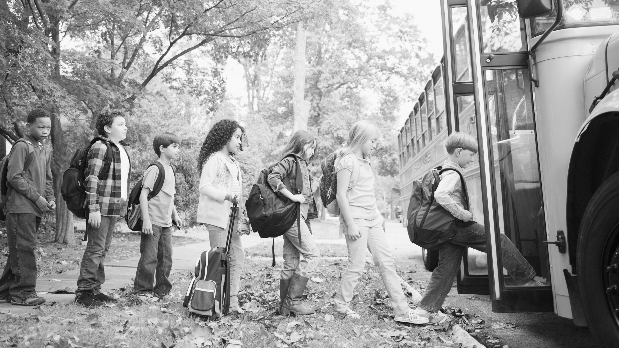
NYSBIP Webinar Series
Charging Voucher Redemption Training
NYSERDA Clean Transportation
June 11, 2024

Slide 2
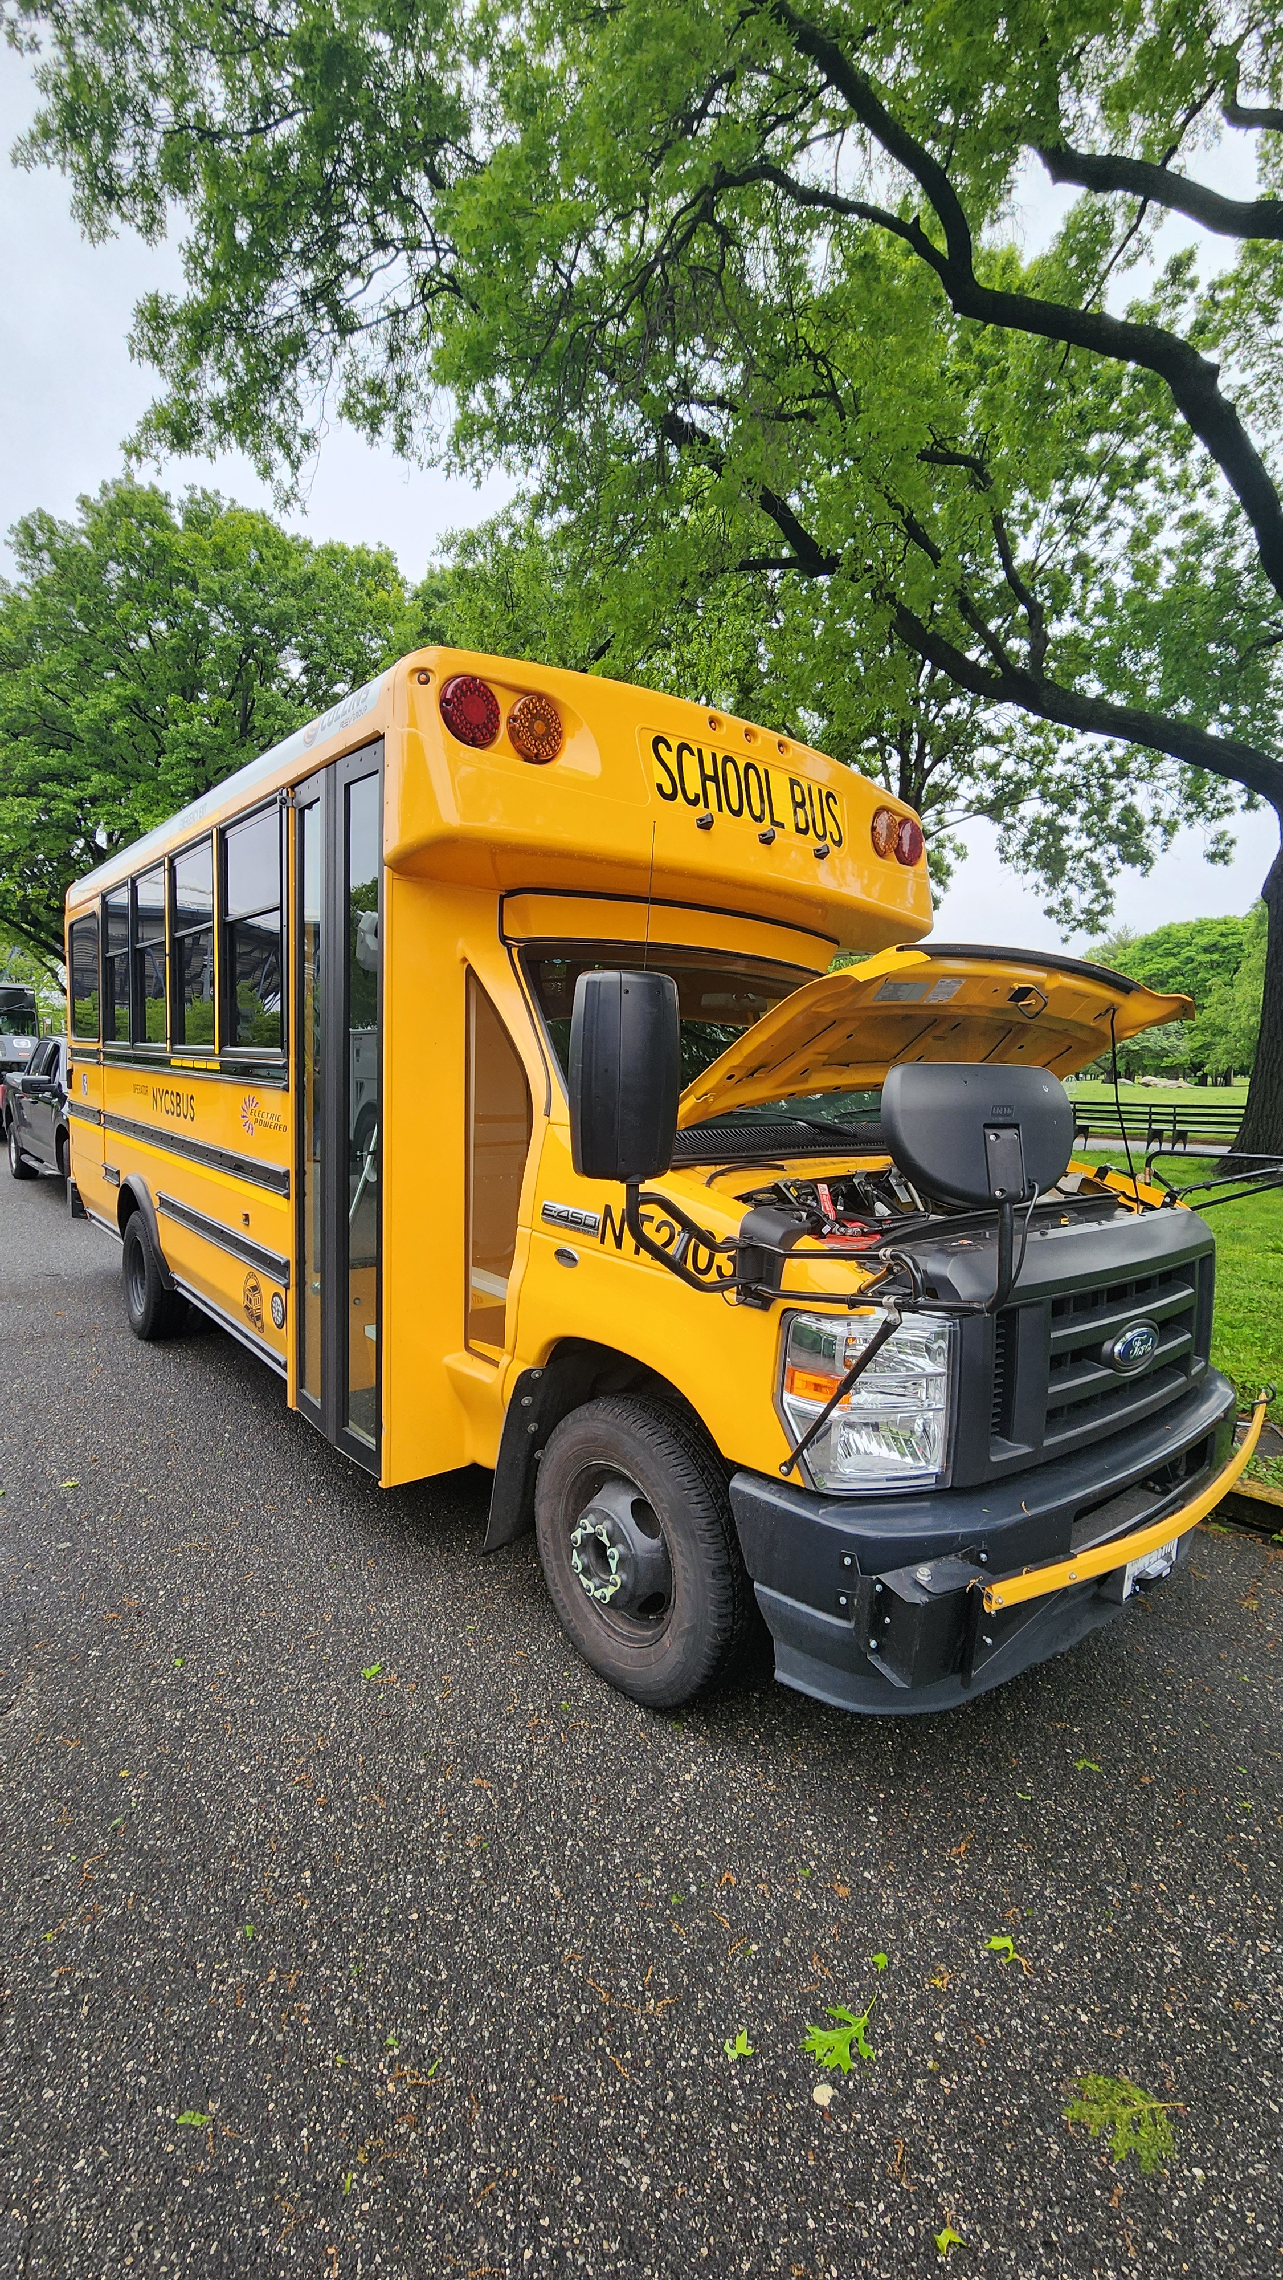
Agenda
NYS Progress
Program Updates
Charging Voucher Redemption Training

Slide 3
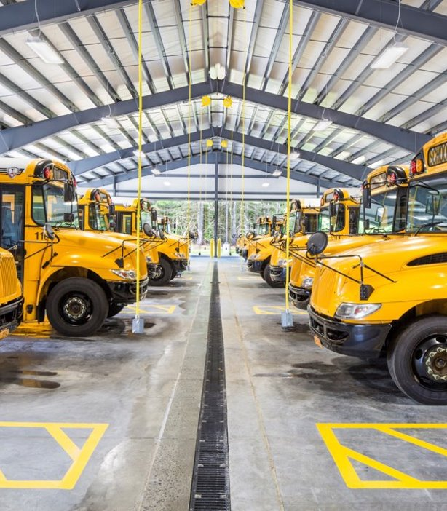
Current Conditions
Where We Started​
There are ~700 school districts in New York State, with more than 45,000 school buses on the road ​
More than half of all buses are contractor-operated​
Recent Progress​
There are currently ~100 ESBs on the road in NY State, with up to 800 projected to be on the road in the near future​
Where We are Heading
Currently, 200+ school districts are actively planning their fleet transition with NYSERDA​
Soft target of 3000 buses on the road by 2027

Slide 4
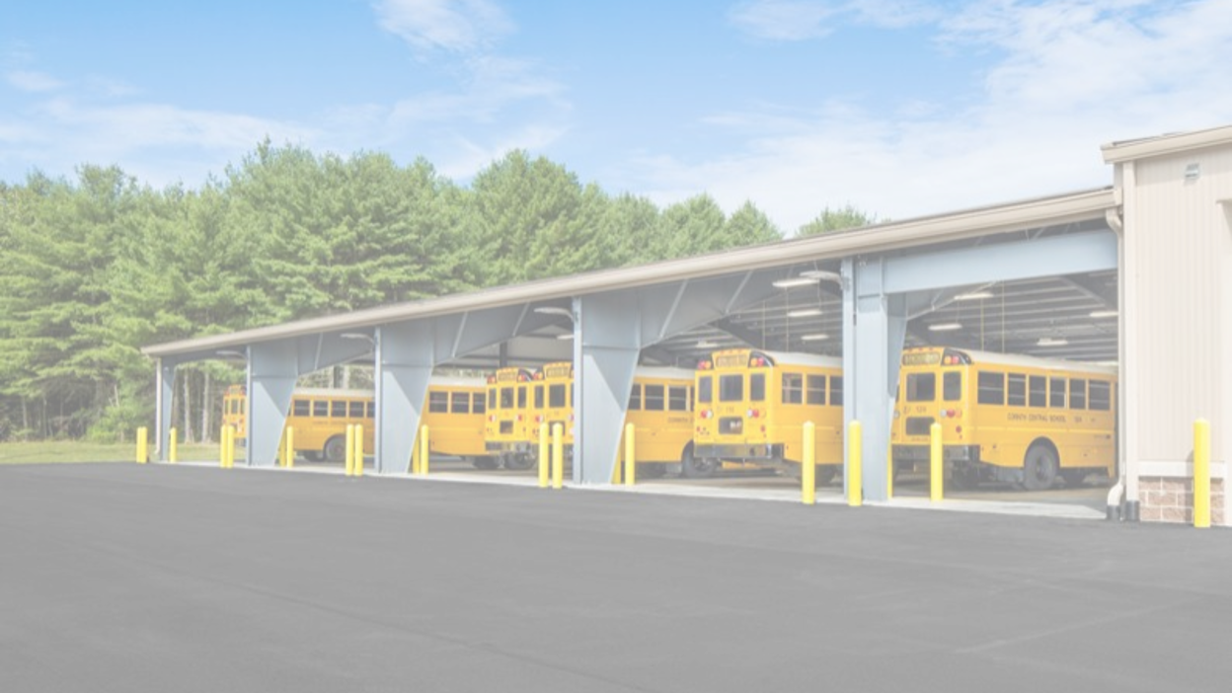
NY School Bus Program Changes

Slide 5
EPA Stacking
Section 1.3.2.1: U.S. EPA Clean School Bus Program Stacking
Applications submitted before July 1, 2024, are eligible for the full NYSBIP incentive amount, up to 100% of the cost of the bus.
Applications submitted after July 1, 2024, are eligible for the incentives in the table. If a Purchaser is approved for NYSBIP and receives an EPA award, the voucher will be adjusted.

Slide 6
School Bus Voucher Caps
Section 2.5: School Bus Voucher Caps
Eliminated the Third-Party Operator cap and replaced with District and Sub-District caps, which apply to each school district and each third-party provider.
In districts where pupil transportation is provided by more than one party, the total number of School Buses is determined using the District Cap. The amount each provider can apply for is determined using the Sub-District Cap, which is determined by the share of vehicles they operate.
Coordination between the school district and any third-party operators must be documented and approved by both the district and the operator by completing the Third-Party Operator Addendum.
District Caps:
Priority District: the greater 10 ESBs or 10% of fleet
Non-Priority District: the greater 6 ESBs or 6% of fleet
Sub-District Caps:
Priority District: the greater of 10 ESBs or 10% of its fleet serving the district
Non-Priority District: the greater of 6 ESBs or 6% of its fleet serving the district

Slide 7
School Bus Voucher Caps
Example: School District A, a Priority District, requires 300 buses for pupil transportation. School District A's pupil transportation is provided Third-Party A (200 buses), Third-Party B (70 buses), and the District (30 buses).
School District A
Fleet: 300 School Buses
District Cap: 30 ESBs
District Cap
Third-Party A
Fleet: 200 School Buses
Sub-District Cap: 20 ESBs
Third-Party B
Fleet: 70 School Buses
Sub-District Cap: 10 ESBs
School District A
Fleet: 30 School Buses
Sub-District Cap: 10 ESBs
Sub-District Cap
While the sum of the Sub-District Cap is 40 ESBs, the District Cap is 30 ESBs. If School District A wants to claim all 30 buses, it must coordinate with its Third-Party Operators to stay within the District Cap.

Slide 8
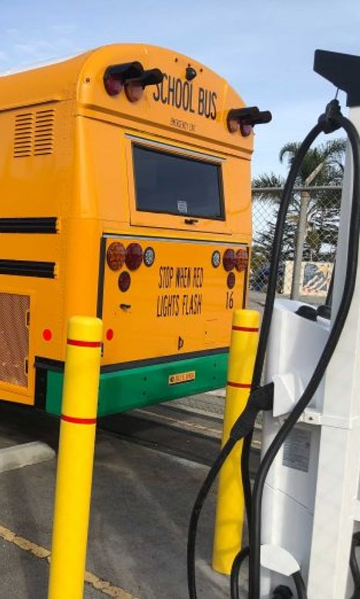
School Bus Voucher Redemption
Section 9.2: School Bus Voucher Redemption Process
School Bus Voucher Redemption must be redeemed within 18 months of application approval.
Submit additional award letters from other incentive programs within 4 months of application approval.
Submit Final Purchase Order within 6 months of application approval.

Slide 9
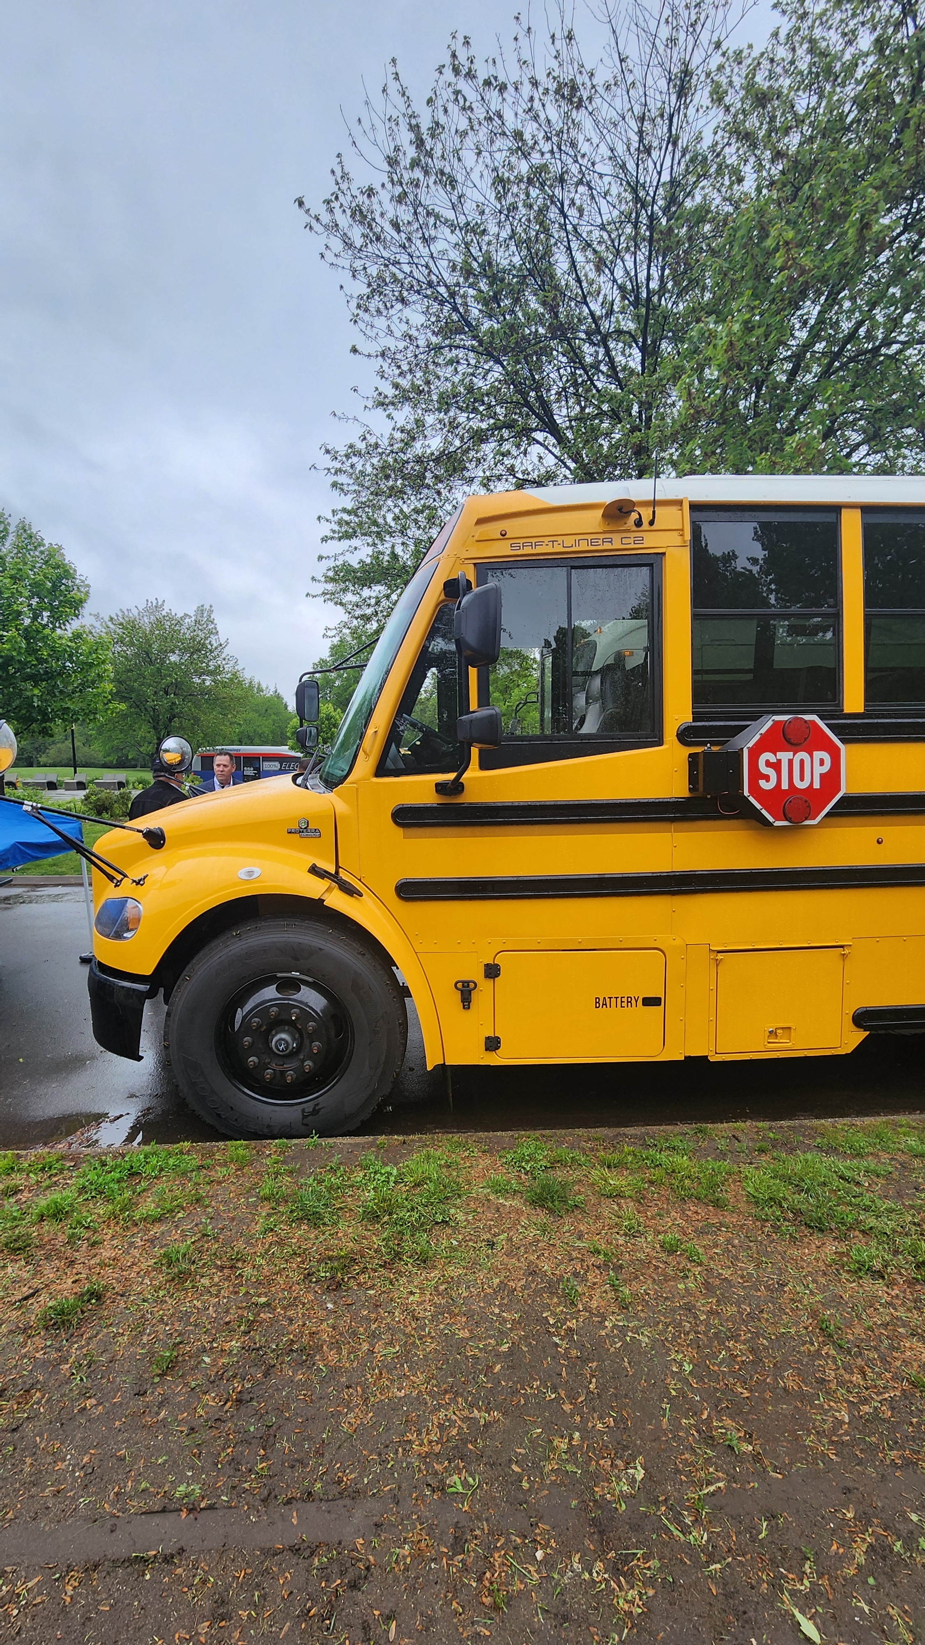
School Bus Vote Date
Section 4.1: School Bus Voucher Process
The Purchaser is required to report at the time of the School Bus Voucher Application the date that the ESBs will be voted on. The Dealer will be asked for the fleet size and the vote date for the vehicles as part of the application.

Slide 10
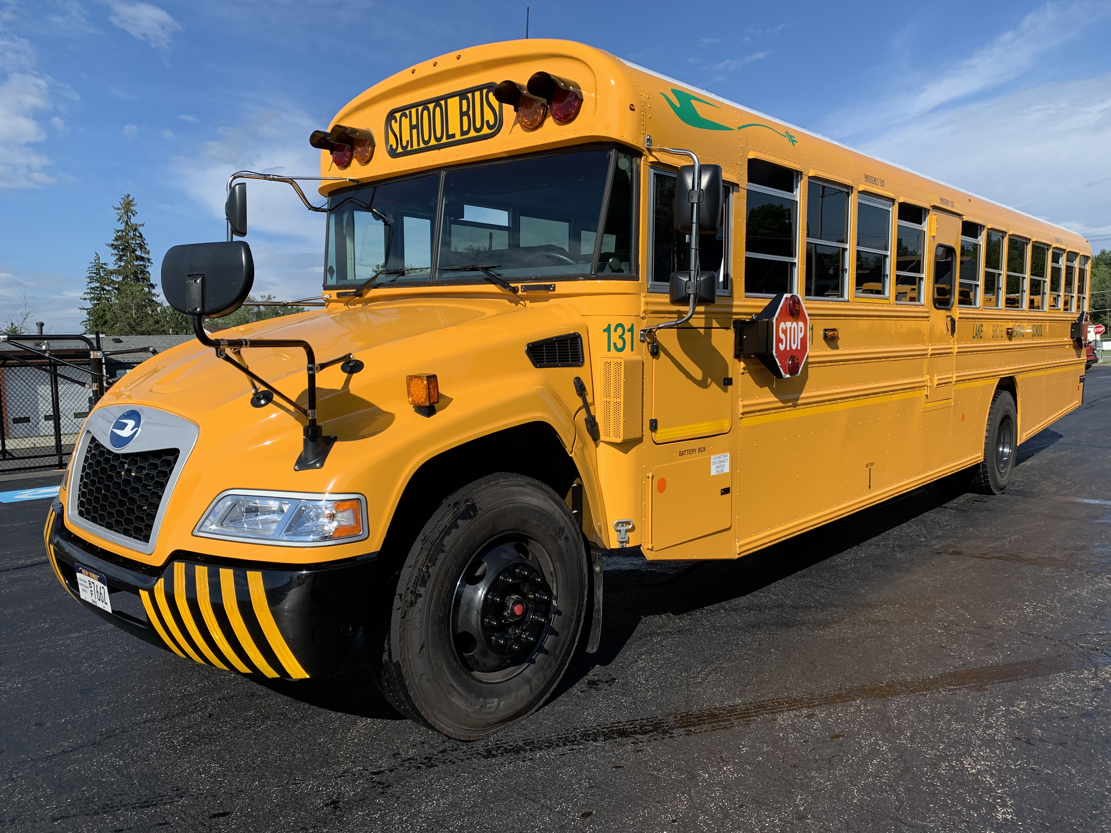
Charging Voucher Redemption Training

Slide 11
NYSBIP Webinar Series
Thank You!
NYSERDA: schoolbus@nyserda.ny.gov
Contact your utility
Stay connected via our email list

