Slide 1
School Bus Incentive Program
Program Updates
Notes:
Welcome to NYSERDA’s Foundational principles training.
For those of you who don’t know me, my name is Cheryl Glanton I am the Vice President, Operations for NYSERDA. I am joined today by Pam Poisson, our Chief Financial Officer
During this session, if you have questions, please put them in the Chat
This course is intended to be foundational only, highlighting core principles to provide a basis for future training.
This session will be recorded and posted in our Course Library for future review.
*MOUSE CLICK TO NEXT SLIDE*

Slide 2
Agenda
Introduction
Charging Voucher Overview
Charging Voucher Demo
TBD

Slide 3
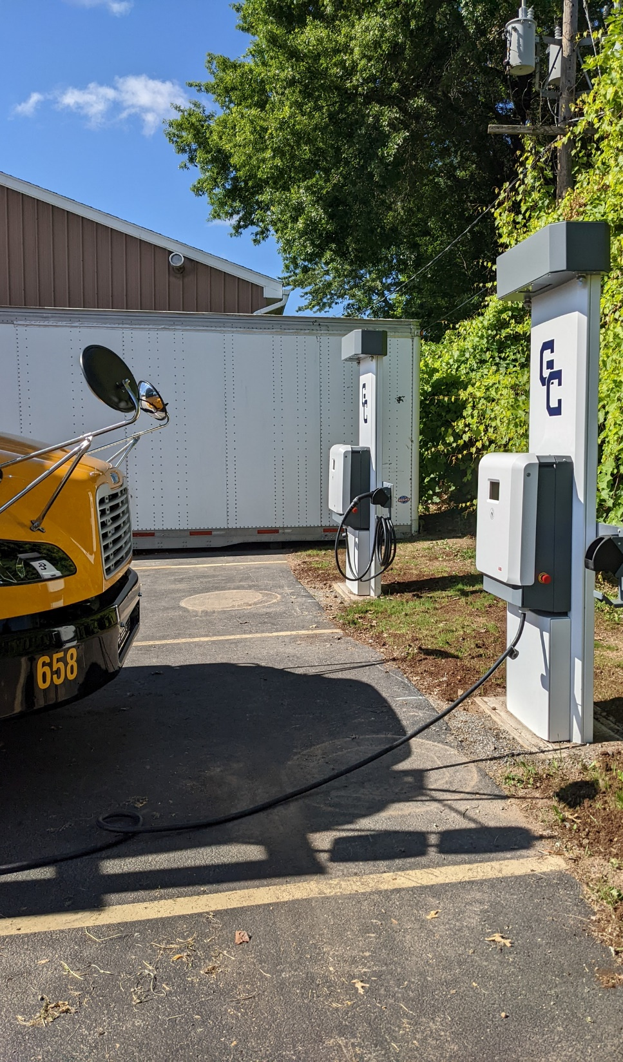
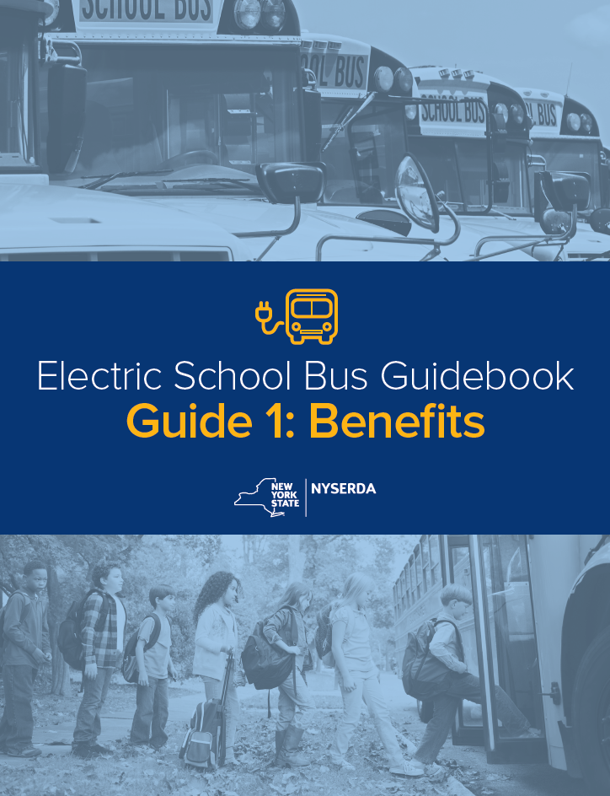
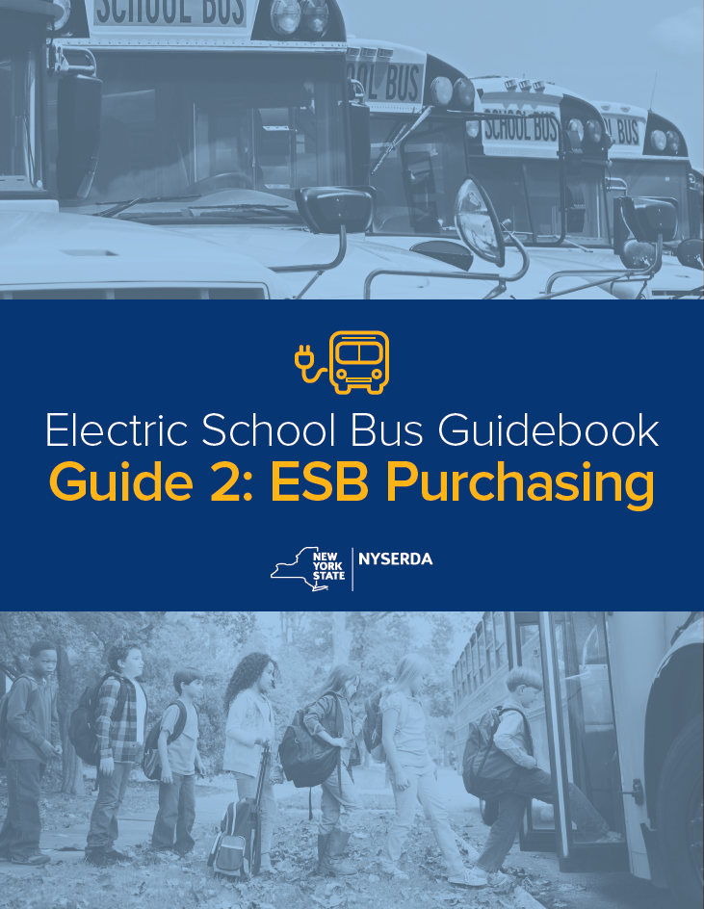
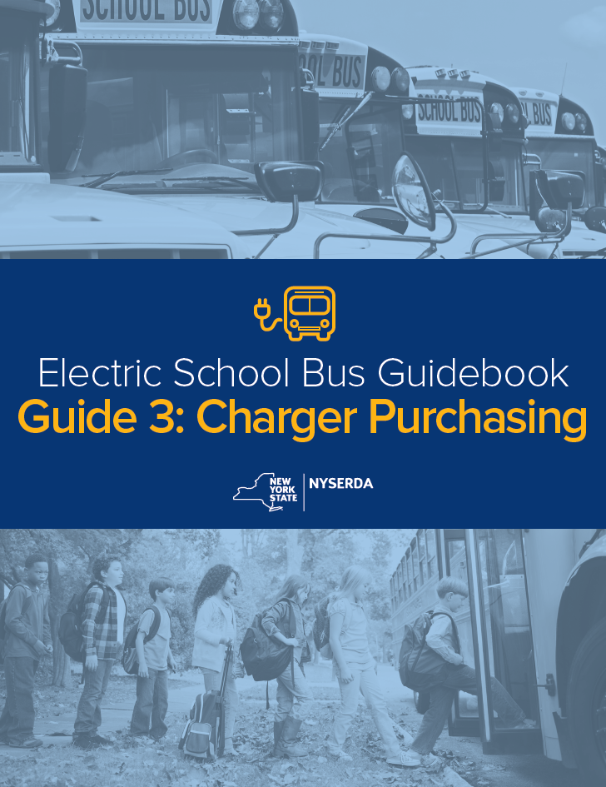
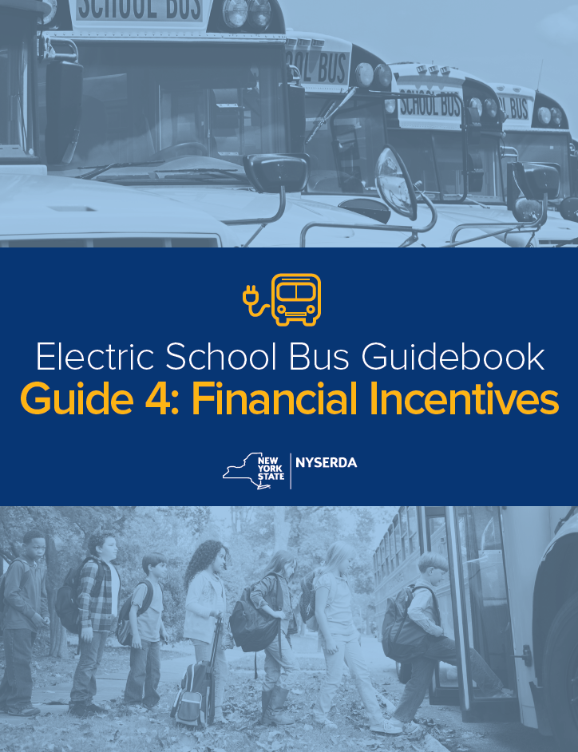
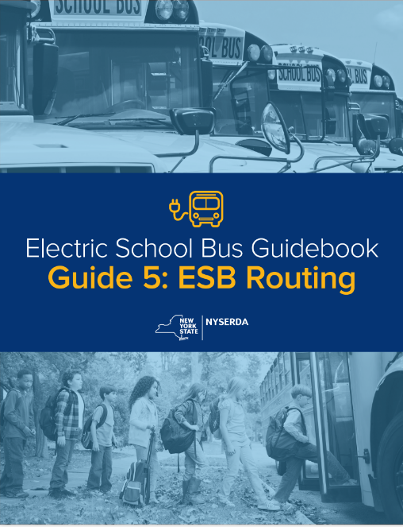
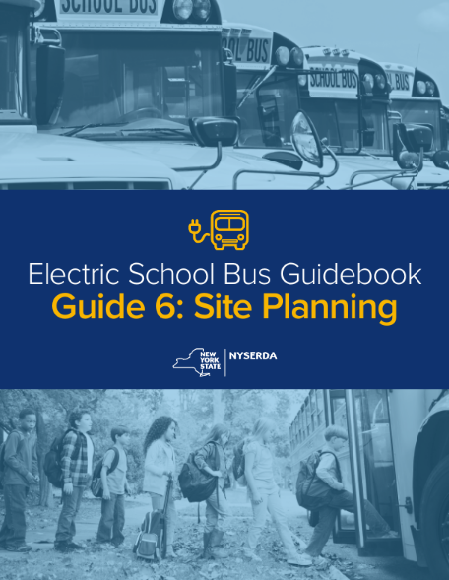
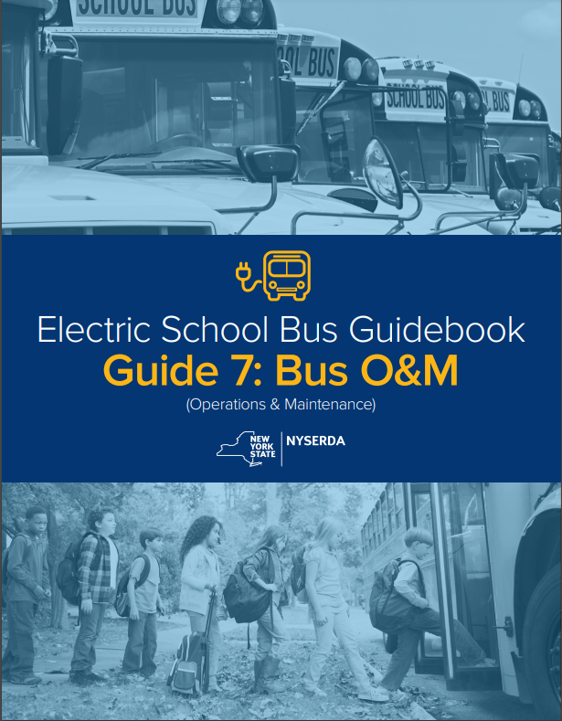
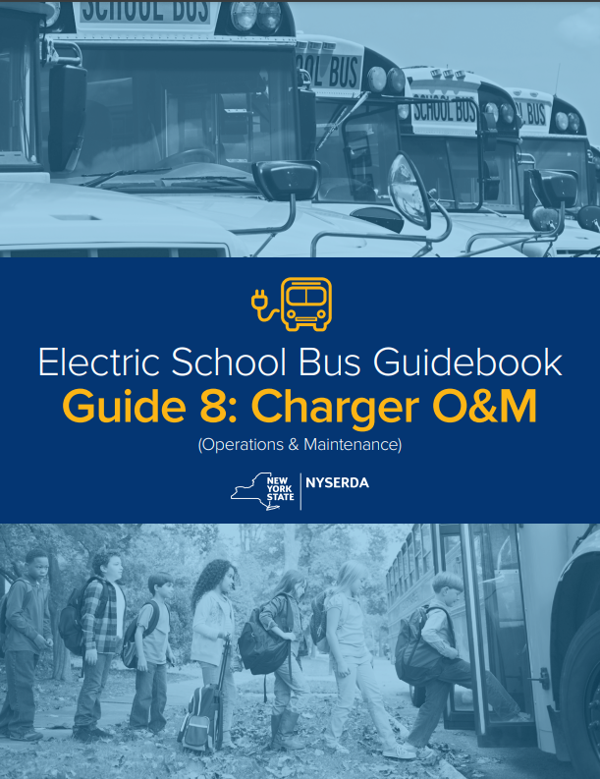
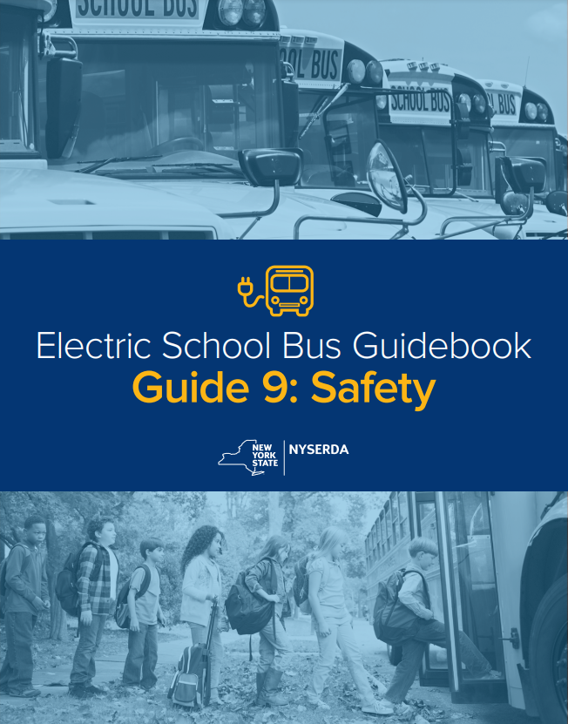
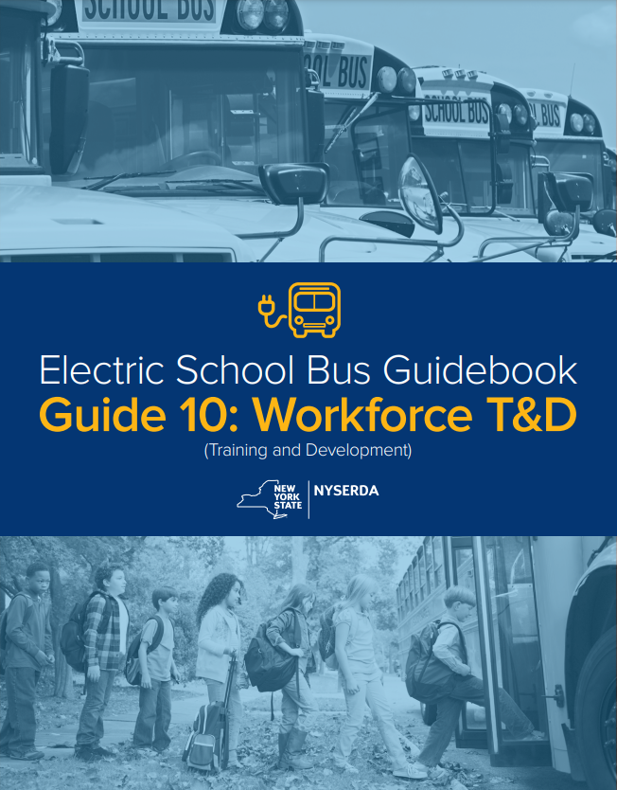
Progress to Date
Electric School Bus Guidebook
Provides living resources to help fleet owners and key partners get familiar with key terms, concepts, and near-term actions to take.
Fleet Electrification Planning
200+ studies underway or completed
BOCES-wide efforts to coordinated studies
Including all outreach, nearing half of all districts are in the pre-planning and planning stages
Electric School Bus Purchases
EPA Round 1 & 2: 330 buses ($127M)
EPA Round 3: closed 2/14/2024
~500 buses will be on NYS roads soon
Notes:
Key findings include:
When factoring in current incentives, the cost of owning an electric bus can already be cheaper than owning a diesel bus
Existing incentives and other state and local sources can cover majority of costs for school bus fleets between now and 2027
Continuing work needed with electric utilities on analysis of grid capacity and expected demand; exploring expanding and extending the MD/HD Make-Ready Pilot Program

Slide 4
NYSBIP Overview
Who can apply?
NYS public school districts or other public entities that provide pupil transportation services​
Third-party Operators under contract with a New York State public school district
School Bus Voucher Vs. Charging Voucher
NYSBIP provides two vouchers. One for ESBs and one for charging infrastructure costs.​
Approval for one voucher does not automatically guarantee funds for the other.​
Documentation for voucher applications and redemption differ​
Question​ | School Bus Voucher​ | Charging Voucher​
What does the voucher fund?​ | Eligible ESBs​ | Eligible charging costs​
Who submits the application?​ | Dealer​ | Purchaser​
How are the funds distributed to the Purchaser?​ | Point-of-sale discount​ | Reimbursement​
How to increase voucher funds?​ | Priority District Status​ Scrappage​ V2G Wheelchair Accessible | Priority District status​ Fleet Electrification plan​

Slide 5
Charging Voucher Amounts and Bonuses
Charging Voucher Amounts
District Type | Base Voucher Amount | With Fleet Electrification Plan​
Non-priority District | $25,000 | $55,000
Priority District | $35,000 | $65,000
What is a Priority District?
SED-designated High Need/Resource Capacity districts​
Districts with 40% or more of the population residing in NYS-designated Disadvantaged Communities (DACs)​
The bonus also applies to school buses that are stored in an existing depot located in a DAC

Slide 6
Charging Voucher Amounts and Bonuses
What is a Fleet Electrification Plan?​
A comprehensive evaluation existing fleet operations, analysis of current site capabilities, and a plan for electrifying the Purchaser’s entire fleet by 2035
What does a Fleet Electrification Plan include?​
Electrification goals​
Route analysis​
Utility assessment​
Charging strategy​
Phasing plan​
How do I get one?​
Reach out to NYSERDA for technical assistance.​
*Final Fleet Electrification Plans are due within 180 days of pre-approval submission.

Slide 7
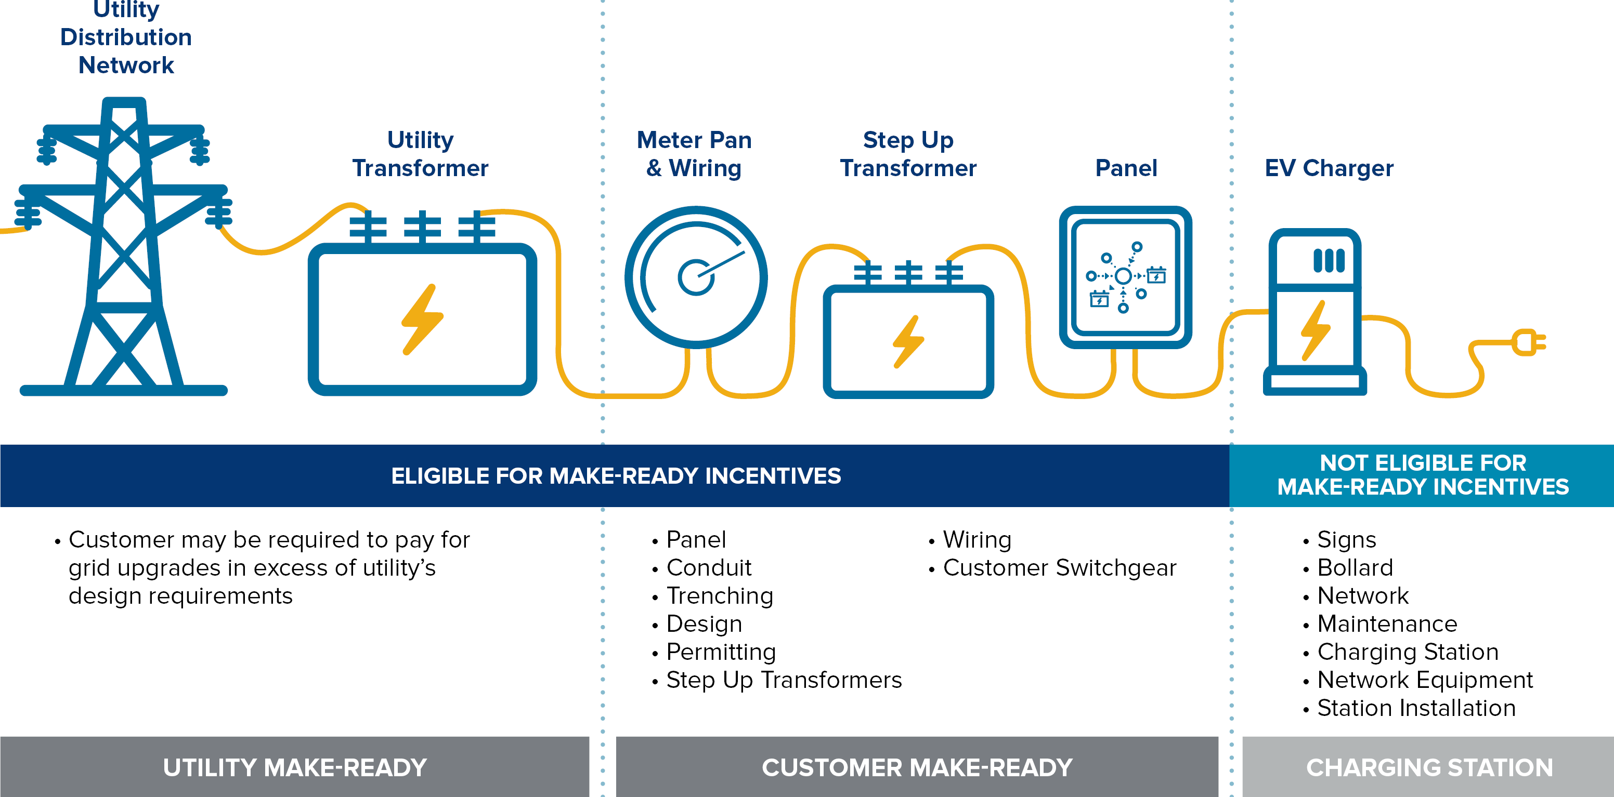
Charging Voucher Eligible Costs
Eligible Charging Costs​
Charger hardware costs​
Charger Installation costs associated with Charger hardware costs ​
Customer-Side “Make-Ready” Infrastructure costs, which covers electrical site upgrades on the customer’s side of the electrical meter​
Battery Storage Equipment that is connected to Charger
Ineligible Charging Costs​
Networking fees​
Extended warranties​
Permitting fees​
Project management costs​
Utility-Side “Make-Ready” costs​
Solar PV

Slide 8
Charger Requirements
Charging Infrastructure Requirements
Equipment must be new
Must have a product warranty that lasts at least two years from installation
Energy Star®-certified.
Most current software version installed
NIST compliant
Charger Requirements
Must be able to dispense at least 19.2 kW/port simultaneously
Eligible Charger and infrastructure must be compatible with the school buses purchased
Must be NRTL recognized by OSHA
Chargers must be capable of networking (OCPP v1.6 or newer)
Meet all applicable local, State, and Federal codes and follow prevailing wage
For all the NYSBIP Charger and Infrastructure requirements, refer to the Implementation Manual

Slide 9
Charging Voucher Process and Documents
Purchaser
Charging Voucher Application Submission and Optional Pre-Approval
Charging Voucher Application Approval
Charging Equipment Installation
Charging Voucher Redemption Submission and Approval
NYSERDA Releases Charging Voucher Payment
Optional Pre-Approval
Option for school district to reserve voucher funds before deciding on chargers and/or completing a Fleet Electrification Plan.
No Fleet Electrification Plan - You have sixty (60) days from pre-approval to upload your charger information and documentation.
Submitting a Fleet Electrification Plan - You have one hundred eighty (180) days from pre-approval to upload your charger information and documentation and your completed Fleet Electrification Plan.

Slide 10
Required Application Documents
Signed Charging Infrastructure Purchaser Agreement:
Purchasers agree to the requirements of participation in NYSBIP for a Charging Voucher.
Third party Operator Addendum
If you are a Third-Party Operator under contract with a School District
Charger Specification Sheets
One for each make/model and charger
Electric School Bus Purchase Order
May be provision, if you are applying for ESB purchased through another program or self-purchased
Award Letter
If you are applying for vehicles purchased through another program
Fleet Electrification Plan
If you are applying for the Fleet Electrification Plan Bonus

Slide 11
Demo
Portal Registration
Project Application
Post Application
If you already have a portal account, this step can be skipped.
8 steps
Application Received – Charger Information
Document Rejected – Resubmission
Application Approved – Voucher Redemption
Required fields on any step must be completed before you can advance to the next
Progress is automatically saved when completing a step and advancing to the next
User Guide: School Bus: Charging Incentive

