Slide 1
Residential Market Advisory Group
Kickoff Meeting
June 17, 2019

Slide 2
Welcome and Agenda
9:00 – 10:30 | Welcome & Session Overview
 | NYS Policy Updates and Residential Markets Overview
 | Team Icebreaker
 | NYSERDA Residential Updates
10:30 – 10:45 | Break
10:45 – 12:00 | Creating a Vision for the Future – Group Exercise Part 1
12:00 – 1:00 | Lunch
1:00 – 2:30 | Creating a Vision for the Future – Group Exercise Part 2
2:30 – 2:45 | Break
2:45 – 4:00 | Virtual Tour of NYSERDA Resources
 | Participant Updates
 | Summary, Next Steps, & Closing
Notes:
Please stay with your assigned table for the working sessions
Use the notepads on the tables to record ideas that come to you throughout the day that might not fit into the planned exercises
Note that we have allocated time at the end of the day for participants to make announcements to the group – tell us about your newsworthy activities, innovative projects, and big ideas!

Slide 3
Charter
NYSERDA’s Residential Market Advisory Group
Mission:
To bring together residential market actors to envision the next generation of residential efficiency solutions and to guide NYSERDA’s development of offerings that spur market growth, deliver customer value and enable achievement of New York State’s energy policy goals.

Slide 4
Charter (continued)
Scope:
To provide a forum to share information and gain insights on issues facing the residential energy efficiency and clean energy markets for 1-4 unit existing homes. The RMAG will serve as both a source and sounding board for new ideas and strategies and provide feedback on NYSERDA’s current residential initiatives.

Slide 5
Objectives
Maintain market awareness of public policy driving investments in energy efficiency and clean energy in the residential market.
Share information on NYSERDA’s current and planned activities to achieve those policy objectives
Discuss opportunities and challenges associated with wide-scale deployment of energy efficiency and clean energy services for the residential sector
Help guide the direction of NYSERDA’s existing and future solutions

Slide 6
Notes:
Thank you, Courtney (Moriarta), for that introduction. It’s a pleasure to be here representing NYSERDA – the stat’s innovation and energy authority, to launch the first meeting of our newly formed Residential Market Advisory Group
Governor Cuomo’s Green New Deal presents a sweeping plan that can deliver the carbon reductions we need to safeguard our communities and our planet, within a cost-effective framework that will provide flexibility to avoid unintended economic harm.
It is a clean energy and jobs agenda that is informed by two key aspects: the imperative to urgently address the threats posed by climate change and the successful track record to increase the amount of clean energy in New York State.
There is unanimous scientific consensus that climate change is being caused by human activities and we must act urgently to reduce greenhouse gas emissions to avoid catastrophe.
New York has already seen extreme weather events occurring in our state more frequently and in greater intensity, virtually every year.
In response, we need to add more clean energy, and reduce demand quickly.
However, ensuring cost-effectiveness, reliability and stakeholder engagement are key aspects of advancing any discussion about an economy-wide clean energy transition.
The Governor’s proposal includes elements to tackle the climate crisis in a holistic manner that combines both grid-level and distributed renewable generation of electricity, accelerated deployment of clean heating and cooling equipment in buildings, and making buildings as energy efficient as possible.
This is an “all of the above” plan that will require broad market participation to succeed
The Residential Market Advisory Group will provide a forum for open exchange of ideas and a resource for residential supply chain actors to interact and develop high impact strategies to contribute toward meeting our goals.

Slide 7
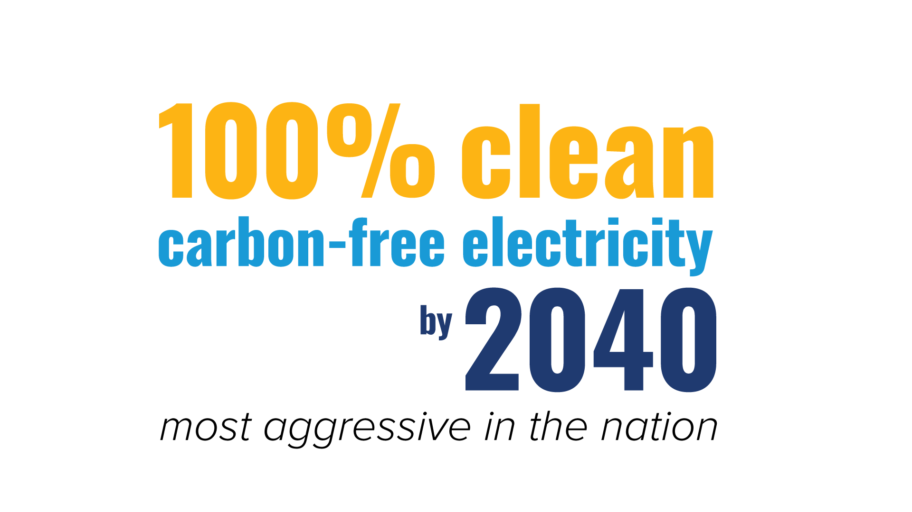
Notes:
The Green New Deal statutorily mandates for 100 percent clean, carbon-free electricity by 2040 -the most aggressive goal in the United States and five years ahead of California – and puts the state on a path to a carbon-neutral economy.
The newly-formed Climate Action Council will work with the State Energy Planning Board to develop a Net Zero Roadmap that will recommend pathways to achieve carbon neutrality and include a significant public engagement effort.
The Green New Deal is structured to deliver a 100 percent clean electricity target that is cost effective and emphasizes energy efficiency without compromising reliability.
It will maximize the contributions and potential of New York's renewable and energy efficiency resources while advancing options that provide flexibility as technology evolves over time, providing value to consumers as we reach the State’s carbon free goals.
On this path, over the next ten years New York State has the opportunity to spur the creation of over 100,000 new jobs through new investments in clean generation, grid modernization, and energy efficiency.
We will look to a portfolio approach to clean resources that will allow the most cost-effective renewable resources to deliver carbon-free electricity, increase energy efficiency in all sectors including residential, and ultimately eliminate our carbon footprint to effectively combat the climate crisis.

Slide 8
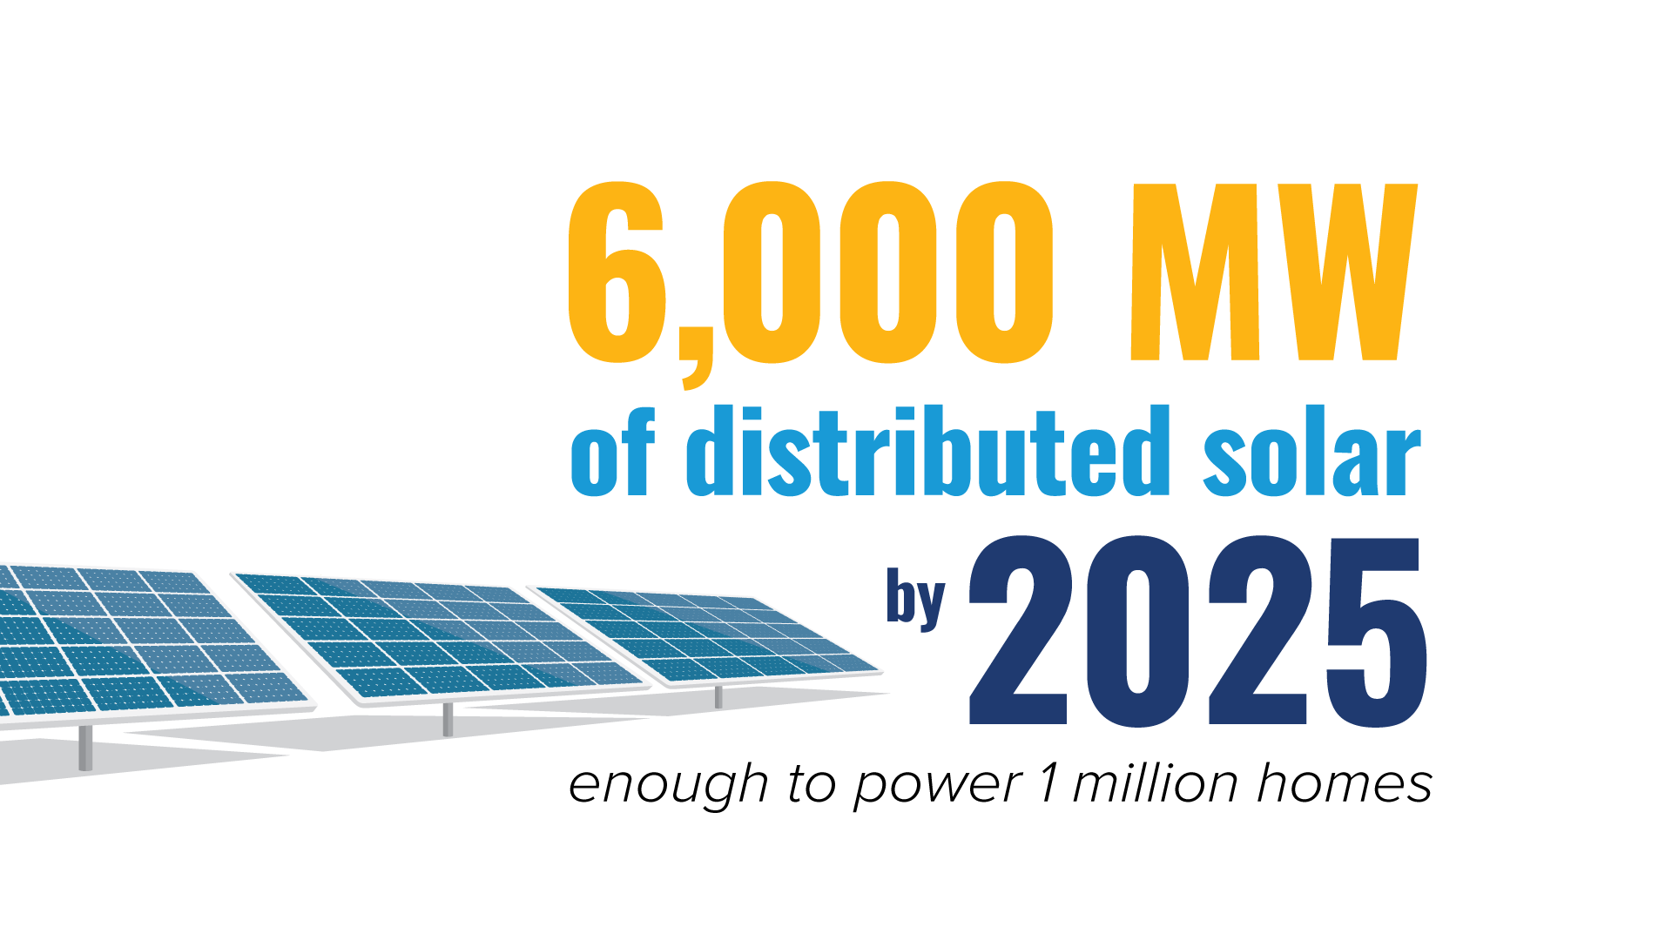
Notes:
Under the Green New Deal, the target for distributed solar deployment in New York is doubling to 6,000 megawatts by 2025, and we will expand the Solar For All program to ensure access to solar for low and moderate income New Yorkers.
Since 2011, NYSERDA’s NY-Sun program has spurred an increase of nearly 1,500 percent in installed solar energy, leveraging $3.5 billion in private investments.
At the same time costs to install solar have already been reduced by half.
These investments have helped to support the advancement and completion of nearly 86,000 solar projects across the state that are generating renewable energy equivalent to what is needed to power over 229,000 homes or taking over 165,000 cars off the road to reduce emissions – truly exciting when you think about the benefits it can bring not only to local communities, but also to the environment.
There are nearly 12,000 solar jobs across the state – New York currently ranks 4th for solar jobs.
Our solar strategy is comprehensive: from Solar for All, through which we are providing 10,000 low-income New Yorkers with access to no-cost community solar – to providing $40 million in funding to advance solar plus storage projects that will support the energy grid of the future –
Under Governor Cuomo, New York has emerged as one of the largest national markets for distributed solar energy, a clear indicator of our national leadership position when it comes to renewable energy, and provides a model that can inform our strategy for scaling up the deployment of residential energy efficiency.

Slide 9
Notes:
Last June Governor Cuomo announced the State's plan to jumpstart the development of energy storage in New York, and today our goal is the largest in the nation.
The state’s energy storage target of 3,000 megawatts by 2030 ensures we can build a more flexible and more resilient electric grid as we march to 100 clean electricity by 2040.
Reaching this goal will deliver more than $3 billion in gross benefits to New Yorkers and avoid two million metric tons of carbon dioxide emissions.
In April, during earth week, Governor Cuomo announced $280 million for energy storage projects to accelerate Growth within the industry and drive down energy storage deployment costs to build a sustainable and affordable market.
This funding is part of a $400 million investment to achieving New York’s nation-leading energy storage targets and supports Governor Cuomo’s Green New Deal.
Energy storage at the residential level will play an increasingly important role in managing both grid impacts and consumer energy costs as we seek to ramp up the adoption of heat pumps as a clean energy solution for home heating and hot water.
And independent research shows that New York’s energy storage industry could support more than 27,400 manufacturing and installation jobs by 2030, and NYSERDA is coordinating with government, industry and stakeholder partners to develop programs and approaches that will enable the energy storage industry to reach the state’s goal.

Slide 10
Notes:
We are also making great strides to reduce overall energy consumption by roughly doubling the level of energy efficiency achievement in the state by 2025, a move that will ensure affordability as we shift to a renewable portfolio.
Introduced as New Efficiency: New York, hitting this target will mean achieving the energy efficiency goal set in the 2015 State Energy Plan five years early.
It will also deliver nearly one-third of the goal to reduce greenhouse gas emissions 40 percent from 1990 levels by 2030.
Achieving the 2025 energy efficiency targets will reduce energy consumption by equivalent of 1.8 million homes annually and create as many as 50,000 new jobs.
We’ll get there by following a variety of pathways including:
Leveraging peer-based challenges to drive energy efficiency
Providing decision-quality information on energy efficiency opportunities for building owners and tenants
Demonstrating the cost effectiveness of new solutions and approaches and mobilize channel partners like utilities to scale-up adoption
Advancing applications of “Intelligent Efficiency”—usage sensors, improved analytics, communications, and streamlined M&V
Supporting deep energy retrofits by integrating long-term energy planning and goal setting for homeowners to enable them to pursue their goals incrementally over time

Slide 11
Notes:
2019 and 2020 are transitional years in terms of program deployment.
Starting in 2020 NYSERDA’s program implementation in the residential sector will be limited to serving low and moderate income customers.
Our utility partners will take over implementation of programs serving market rate customers with a $1.6 Billion allocation to fund those initiatives
NYSERDA will continue to work closely with the utilities to assist in the development of program strategies and provide market support by developing analysis, creating tools and resources, and testing new concepts to enable innovation and leverage both programs and market-based solutions
I would now like to introduce you to Emily Dean, NYSERDA’s Director of Market Development for the Residential Sector…

Slide 12
Notes:
The Green New Deal calls for the creation of a Climate Action Council comprised of experts that will bring together critical components and examine the costs and benefits of respective approaches, to allow consideration of regional solutions, to ensure consideration of economic competitiveness, and to develop a detailed roadmap to a carbon-neutral economy.
This will include a net zero carbon roadmap for buildings.
NYSERDA’s initial analysis of the market opportunity by sector identified both single family and multifamily residential buildings as priority market segments for this effort
Consumer feedback and strategic partner engagement will remain a critical component of developing the Roadmap and we look forward to continuing to work with each of you as we move forward on our path to carbon neutrality.

Slide 13
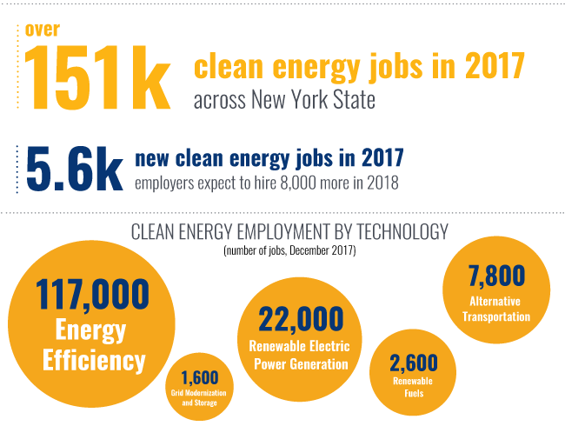
Employment Overview
Notes:
The job growth that is expected to result from Governor Cuomo’s Green New Deal would add to an already robust clean energy industry in New York State, which currently supports over 151,000 jobs across the State and for which employment is already growing at twice the rate of the larger economy.
New York Has Become a National Leader in Clean Energy Jobs.
Energy efficiency is the largest clean energy technology category in terms of jobs and investments - employing 117,300 workers in 2017 with firms receiving over $4.1 billion in investments since 2011.
Clean energy provides opportunities in all regions of the state. New Yorkers are rapidly embracing clean energy options, which is fueling job growth in communities across the state.
New York is focused on ensuring that workers are well prepared for clean energy careers, and firms have easy access to skilled, expert workers. NYSERDA is making $27.5 million available in workforce development hiring and training incentives to assist clean energy businesses with recruiting and training new employees, upskilling existing workers, and establishing a talent pipeline to reduce businesses cost of attracting and hiring new workers.
New training initiatives and businesses providing full-time jobs for workers in priority populations will receive preference and be eligible for additional incentives. Such priority populations include low-income individuals, veterans, Native Americans, disabled workers, displaced power plant workers, and the formerly incarcerated.
Workforce funding includes:
$7 million for Energy Efficiency and Clean Technology Training, $10 million for On-the-Job
Training, and $10.5 million Clean Energy Internship Program.

Slide 14
Notes:
Thank you, Janet. I am pleased to be here and have the opportunity to meet you all.
As we continue on the path toward greater energy efficiency and a clean energy supply, I look forward to working with all of you to ensure NYSERDA’s efforts support a robust market capable of delivering the residential energy services needed to meet our carbon reduction goals.

Slide 15
Notes:
NYSERDA’s recently completed residential building stock assessment illustrates the market opportunity for both energy efficiency and clean energy opportunities.
New York’s housing stock is older on average than most of the rest of the country, with nearly 70% of existing homes built prior to 1970.
The vast majority of homes use fossil fuels as a primary heating source, with less than 3% currently using heat pumps
While most homes have some insulation many are still in need of improvement and average building envelope air leakage is 4 times the leakage rate allowed by current new construction code

Slide 16
Notes:
In New York State, the residential sector is responsible for 28% of energy consumption across all sectors
56% of residential energy consumption can be attributed to space heating
This data underscores a significant opportunity and an urgent need for deployment of energy efficiency improvements at scale to ensure our clean energy goals are met while at the same time preserving comfort for building occupants and managing loads
With 4.3 million 1-4 unit homes to be served, scalability is key. We must combine public and private sector investments by not only incentivizing homeowners to take action, but also to create a value proposition for market actors to make energy efficiency and clean energy the option of choice for their customers.

Slide 17
Notes:
Home performance has made a valuable contribution to building up an infrastructure to deliver whole house energy efficiency services for the residential sector and stimulated more than $1 Billion in economic activity for the state’s residential energy efficiency market
As we move forward we will need to continue to tap the home improvement market to enable rapidly scalable solutions capable of reaching an even broader market
These solutions will require us to re-focus our efforts toward carbon emission reductions as well as saving energy.
Through active coordination and collaboration with our utility partners and residential supply chain stakeholders we are pursuing strategies that leverage technology and partnerships to deliver these services more efficiently by:
Creating tools and resources that help homeowners define their energy goals and offering them a variety of pathways to get there,
Streamlining sales and project management processes, and
Meeting the customer “where they are” by bringing energy efficiency into typical home improvement transactions, creating standardized packages, and enabling incremental investments

Slide 18
Investing in a clean grid, shrinking loads, strategic electrification, on-site renewables, and storage are all part of the same puzzle.
And all are necessary to meeting our energy goals.
Storage
Clean Grid
Electrification
On-site Generation
Reduced Loads
Notes:
Meeting our goals will require both technology and business strategy innovation.
We have the policy framework in place to bring all the pieces together.
It is now up to us all to determine how NYSERDA’s research and support for innovation can help your businesses contribute toward a common vision for the future.

Slide 19
Notes:
There is no off-the-shelf guidebook for the work we are doing – we are setting precedent each step of the way.
Energy efficiency remains our most cost-effective investment and NYSERDA’s teams are working to ensure we make smart investments in impactful and scalable solutions for the market at large while continuing to support our most vulnerable populations through the continuation and expansion of our Empower and Assisted Home Performance with Energy Star programs.
Furthermore, NYSERDA’s analysis projects the need to install approximately 60,000 heat pumps by 2025 to meet the state’s 5TBtu savings goal
This creates a need to rapidly ramp up the deployment of energy efficiency and load reduction measures in coordination with our heat pump deployment efforts
Our “heat pump ready” initiative, currently in development, is one strategy we are pursuing to address that need…

Slide 20
Notes:
An example of an innovative approach NYSERDA is currently developing is our “heat pump ready” initiative
In a recent survey of NYS homeowners conducted by NYSERDA, 62% of respondents indicated an interest in improving the envelope and ductwork in their homes.
The “Heat Pump Ready” initiative seeks to target customers who need envelope and duct improvements before they install a heat pump to reduce loads and improve comfort and customer satisfaction with their heat pumps
We expect this pilot to launch later this summer

Slide 21
https://www.youtube.com/watch?v=cd3sTNIc12k
Notes:
These are only some of the major components of the transformational plan that the Governor has proposed to meet the unprecedented challenges posed by the climate crisis
And only some of the strategies NYSERDA is pursuing to realize those goals
The challenges before us may seem daunting, but with thoughtful planning and smart strategies we are already seeing progress being made.
Today’s agenda focuses on creating a common vision for the future that will help to guide us in that journey. So, before I turn you back over to Courtney to continue that process, I’d like to show you a short video showcasing NYSERDA’s commitment to realizing New York’s clean energy future and the power of possibilities…

Slide 22
Impact of Energy Efficiency (U.S. 1965-2016)
Reference:
Lovins, Amory
“The Invisible Energy Bonanza: Creating Wealth Out of Nothing”
Forbes 2019

Slide 23
Icebreaker Questions (select one)
What technology or business solution will have the biggest impact on our clean energy goals for the residential sector?
Thinking about the residential market, which customer types will face the greatest challenges in the transition to clean energy?
What are your customers asking for now that they weren’t 10 years ago? What can you imagine they may ask for 10 years from now?

Slide 24
NYSERDA Residential Updates

Slide 25
Moonshot Idea
Convert 2.1 million existing homes to carbon neutrality by 2050
Notes:
Represents roughly 50% of the entire CEF 1-4 unit housing stock
Would require serving 70,000 homes per year 2020-2050, a ten-fold increase over current NYSERDA production rates

Slide 26
Single Family Residential
Courtney Moriarta

Slide 27
Goals and Current Activities
Goal: Invest $100 Million to scale consumer uptake of energy efficiency improvements in 2.6 million market rate homes in NY
Current Activities:
Home energy ratings pilots launched in Tompkins County and Queens
“Life Moments” targeted consumer marketing pilot
Pay for Performance pilot with National Grid in development
Developing “Heat Pump Ready” in coordination with NYSERDA’s Clean Heating and Cooling Team

Slide 28
What’s New or Coming Soon
Heat Pump Ready implementation to begin this summer
Revised Green Jobs Green New York statewide energy audit requirements
Novel business solutions awards to be announced (PON 3932)
Upstream partners training initiative
Zero Carbon Roadmap for single family residential sector

Slide 29
Biggest Challenge Our Team Faces
Convincing a $26 Billion home improvement industry and its customers to make energy efficient and clean energy options the obvious and most desirable choice
Leveraging our legacy investments to enable new strategies and thinking

Slide 30
Workforce Development and Training
Adele Ferranti

Slide 31
Goals and Current Activities
Goal: Invest nearly $70 million to develop clean energy training infrastructure and train 27,000 + New Yorkers through 2025
Current Activities To Support the Residential Market:
On-the-Job Training Wage Subsidies (PON 3715)
Financial Support for Businesses to Hire Interns (PON 4000)
New, business-driven training programs under development to support net-zero homes, passive houses, heat pumps and energy storage (PON 3981)

Slide 32
What’s New or Coming Soon
Strategies are being developed to build a pipeline of workers with the skills needed for ramping up energy efficiency and new technology deployment work in all sectors.
New solicitation being developed to secure the services of a variety of training providers to develop and deliver training on a broad range of clean energy technologies and practices.

Slide 33
Biggest Challenge Our Team Faces
Making sure training is informed by business needs, to focus on the right skills
Low unemployment rate
Young entrants into the workforce are not:
Aware of energy careers and career paths
Excited about crawling in crawl spaces and attics, blowing insulation or conducting audits

Slide 34
Clean Heating and Cooling Team
Wendy MacPherson

Slide 35
Goals and Current Activities
Goal: Decarbonize the heating and cooling of buildings in NYS
Current Activities:
Heat pump incentive programs – ASHP, GSHP, RHNY
Clean Heating and Cooling Community Campaigns
Workforce Development
Clean Energy Action Plan
Marketing and Awareness

Slide 36
What’s New or Coming Soon
Statewide utility heat pump program
Integrate LMI
Integrate Energy Efficiency

Slide 37
Biggest Challenge Our Team Faces
Workforce Development
Retirement of large numbers of HVAC contractors over the next several years
Awareness of & confidence in clean heating & cooling technologies

Slide 38
Low to Moderate
Income
Chris Coll

Slide 39
Goals and Current Activities
Goal- to increase energy affordability and access to clean energy solutions for LMI residents and communities
Investment of $70 million annually through initiatives that include energy efficiency, renewables, and market development activities
Alignment of NYSERDA and statewide LMI strategy and coordination

Slide 40
What’s New or Coming Soon
Statewide LMI portfolio under New Efficiency: New York
20% of utility funding dedicated to LMI energy efficiency
Statewide branding, central customer hub, efficiencies for customers, service providers, and administrators
Complementary offerings from NYSERDA and utilities
Investments targeting adoption of heat pump solutions for LMI market segment
Expansion of Solar for All

Slide 41
Biggest Challenge Our Team Faces
Balancing of priorities and finite resources
Energy affordability
Carbon Neutrality and Electrification
Scaling contractor capacity to meet programmatic needs
Addressing structural deficiencies in homes before energy efficiency work can happen
Incorporation of new technologies into LMI sector with appropriate balance of energy savings and consumer protections

Slide 42
Creating a Future Vision
Part 1

Slide 43
Group Table Exercise
What does the future of your assigned topic look like in residential buildings in the next 10-15 years?
What could the future “day in the life” of an average resident look like regarding the assigned topic?

Slide 44
Creating a Future Vision
Part 2

Slide 45
Group Table Exercise
What business and residential market challenges will need to be overcome to realize the future vision of your assigned topic?
What essential next steps must be taken to realize the vision of the assigned topic?
Notes:
Leave this slide up while the groups do their work.
Use the following topic slides as headers when the groups report out.

Slide 46
Topic 1: Predicting Consumer Demand

Slide 47
Topic 2: From Energy Consumers to Prosumers

Slide 48
Topic 3: Smart and Connected Homes

Slide 49
Topic 4: Efficiency as a Product vs. Efficiency as a Service

Slide 50
Walkthrough of
NYSERDA’s Resources
Laura Geel

Slide 51
NYSERDA’s Resources
Advanced Efficiency Solutions
Clean Heating & Cooling
Codes, Products & Standards
Communities and Local Government
Corporate Marketing
Distribution Energy Resources Technology
Energy and Environmental Analysis
Financing Solutions
Low and Moderate Income
Market Characterization and Evaluation
Market Insights
Multifamily Residential
New Construction
Single Family Residential
Standards & Quality Assurance
Technology & Business Innovation
Workforce Development & Training
& More!
Notes:
NYSERDA supports the residential energy market in many ways, well beyond programmatic offers
This is a list of some of the groups that, in one way or another, support the residential market

Slide 52
Standards & Quality Assurance
Provides effective and efficient infield Quality Assurance to support NYSERDA investments into clean energy technologies and foster market-based strategies to increase consumer and investor confidence in clean energy technology and solutions.
Notes:
The Standards and Quality Assurance team provides support across NYSERDA. In addition to their role provide quality assurance inspections, they support other strategies for increasing consumer and investor confidence in the clean energy market.
One example of their work is the “Quality Installer designation.” The Quality Installer Designation has been designed to be used by contractors as a third-party differentiator and validation of their work quality with clients and prospects. As a NYSERDA Quality Installer, contractors will receive special listing on the NYSERDA website and will be able to use the designation in marketing materials and on their website. The NYSun program rolled out their version, the Quality Solar Installer designation this past January.
The SQA team also recently announce their fact sheet for “What to Expect When Inspected” which is available to both contractors and consumers. These fact sheets provide an overview of the values of quality assurance as well as providing an explanation about what to expect during the process.

Slide 53
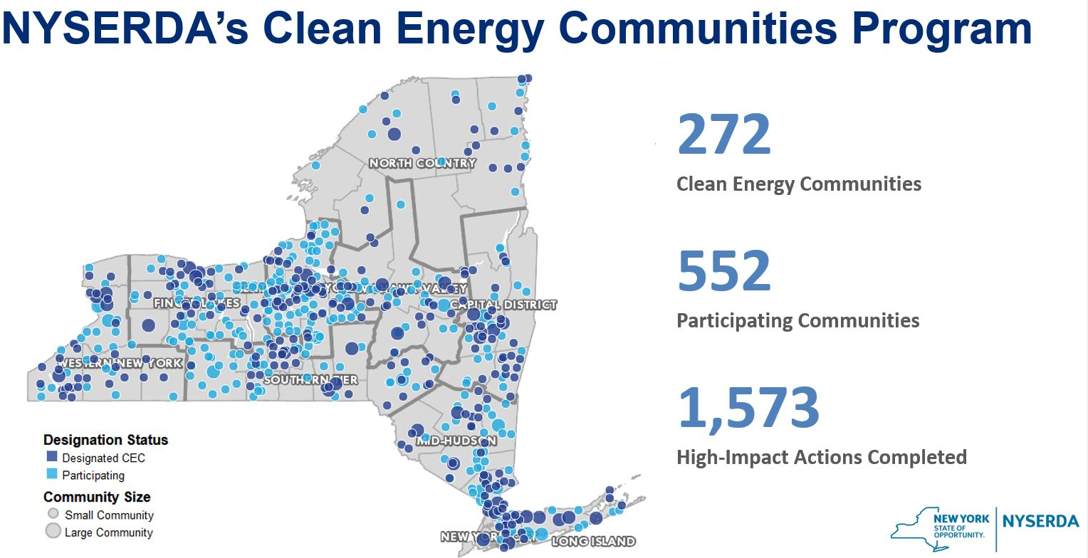
Communities and Local Government
Provides a unified approach toward local energy action to better serve local communities’ needs and advance clean energy policies statewide. Implements a common framework that enables communities to embed clean energy into their planning, helps facilitate and prioritize implementation, and recognizes/showcases community energy and sustainability actions.
Notes:
Clean Energy Communities program provides grants, direct technical support, tools and resources, and recognition to local governments that demonstrate leadership by completing NYSERDA-selected high-impact actions.
Another initiative, the Community Energy Engagement Program, kicked off in May 2018 and deploys Community Energy Advisors in each of the ten Economic Development Regions to conduct engagement activities to New York State residents, small businesses, and multifamily building owners, with an emphasis on low-to-moderate income households and communities.

Slide 54
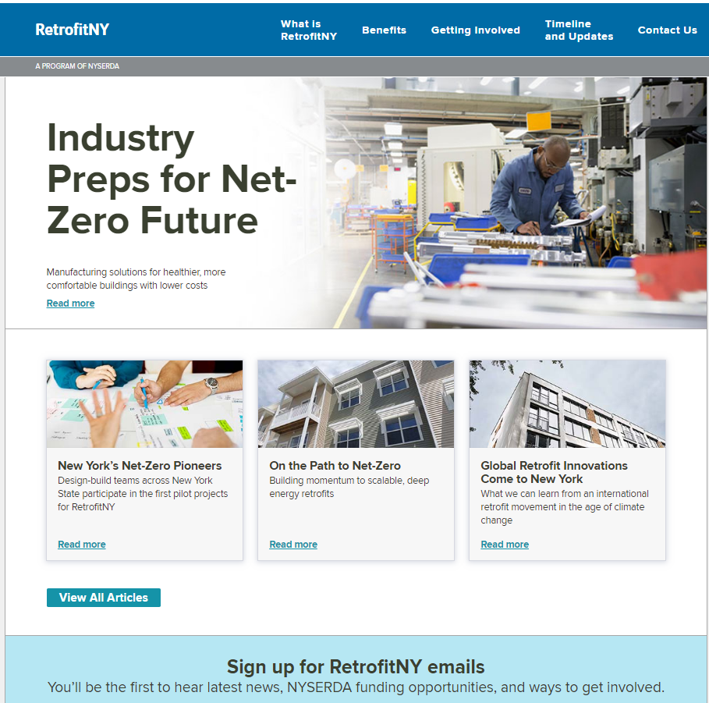
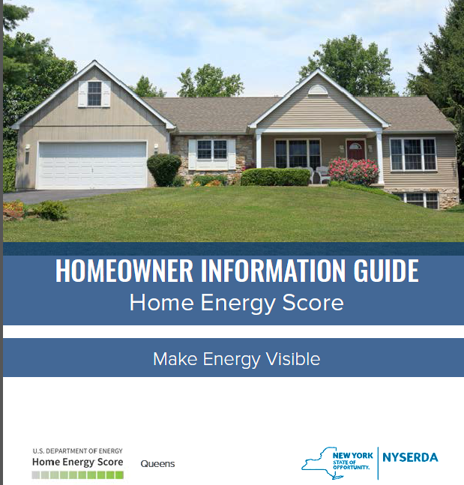
Corporate Marketing
Responsible for building awareness, interest, and engagement across key audience segments, encouraging actions to help New York reach its energy goals.
Notes:
A team of experts with private and public sector experience ready to serve as champions to help drive NYSERDA’s and New York State’s priorities.
Collaborate with Program Areas to develop and implement marketing plans based on business goals
Collaborate with social media team to deliver engaging content across channels
Recommend and develop marketing communications that further NYSERDA’s mission
Leadership in setting brand architecture, identity guidelines, and messaging platforms

Slide 55
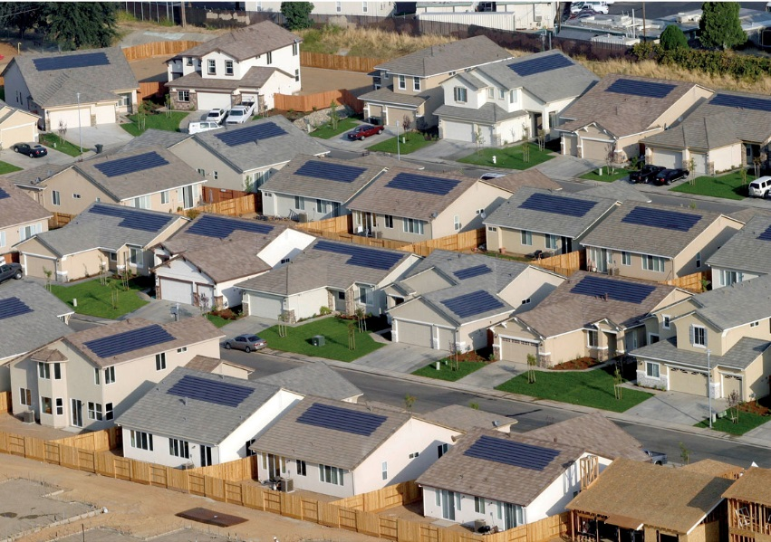
Market Insights
Conduct pre-investment primary and secondary market research to mine markets for information on customer
drivers, barriers, economics, and decision-making, enabling teams to leverage opportunities and investments with confidence to increase scale and clean energy adoption.
Market Discovery Research
Market/Audit Segmentation
Hypothesis/Concept Testing
Behavior pilot design and research
This Photo by Unknown Author is licensed under CC BY-SA
Notes:
Market Insights completed research to understand the real estate industry to determine methods that will drive increases in the value of homes with energy efficiency upgrades. This work informed proper delivery and established successful mechanisms for a home ratings pilot now underway.
A Segmentation analysis was completed through Market Insights to identify residential single-family housing profiles in NY that have the greatest potential for deep energy/net zero energy retrofits. Analysis will map clusters of household demographics and building typology for better targeting and honing programmatic opportunities.
The team also support a behavioral pilot focused on enabling contractors to better guide their customers through the audit process and communicate about the benefits of implementing the EE measures, with the goal of increasing cycle time and conversion to adopt upgrades. 13 contractors participated with 318 projects completed. Evaluation is underway with results due next quarter.

Slide 56
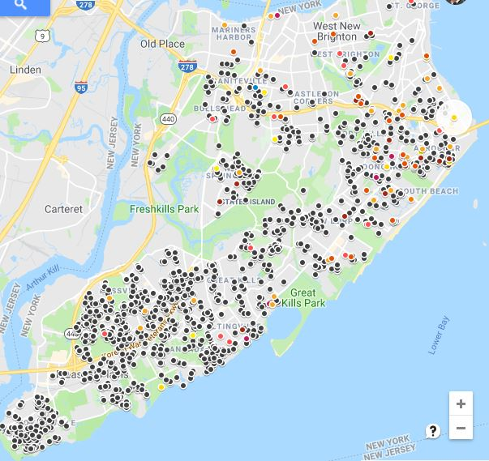
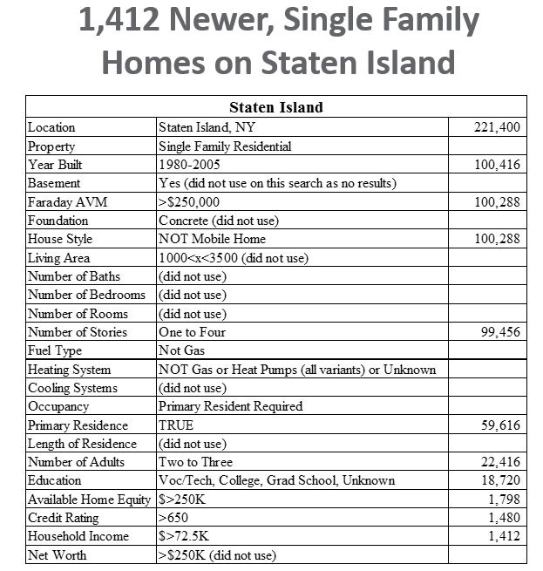
Information Products & Brokering
Facilitates the development and use of market-based information solutions, platforms and applications to support market confidence and lower soft costs.
Notes:
Within NYSERDA’s Advanced Energy Solutions team is the Information Products & Brokering group.
The team facilitates the development and use of market-based information solutions, platforms and applications to support market confidence and lower soft costs, including:
Customer Targeting Tools
Value-based Proposition Calculators and Matchmaking
Hackathons and Public Competitions
One example of their work is Faraday’s Customer Targeting Tool which was introduced to ASHP, GSHP installers in January 2019 for three-year program.
44 unique installers have registered to access the tool in order to support direct mail campaigns; social media resource coming soon.
Results in Tompkins County show 3-fold increase in market response.
This graphic shows middle income opportunities (a sweet spot) for heat pumps in Richmond County (Staten Island). The black dots are opportunities; the colored dots are known installations. There is quite a runway for growth.

Slide 57
Code, Products & Standards
Promotes energy efficiency across sectors through regulatory and supply chain interventions. The team supports building energy code advancement, education, and compliance, working with actors across the construction market, including building owners, developers, and elected officials, with a goal of promoting zerocarbon or even net-carbon positive building performance. The team also drives the promotion of improved product and appliance standards, along with the adoption and expansion of building energy and water benchmarking.
Energy Code Compliance and Training:
Training and tools
Direct support to municipalities
Compliance assessment
Increase community adoption of NYStretch Energy Code – 2020
For residential buildings, achieves approximately 20% greater energy savings and GHG emission reductions than the next NYS energy code
Significant energy and utility cost savings for consumers
Increases occupant comfort and health
Notes:
Support strategies for Energy Code Compliance and Training:
Training and tools
Direct support (to municipalities)
Pilots to test alternative enforcement
Compliance assessment
Increase community adoption of NYStretch Energy Code – 2020
For residential buildings, achieves approximately 20% greater energy savings and GHG emission reductions than the next NYS energy code.
Significant energy and utility cost savings for homeowners and renters.
Increases occupant comfort and health
Key changes from previous energy code:
Improved building envelope
Mandatory mechanical ventilation requirements
Renewable and electric vehicle readiness

Slide 58
NY-Sun
New York State is making solar energy more accessible to homes, businesses, and communities through NY-Sun. Our goal is to help make it possible for New Yorkers to choose clean energy while lowering their energy costs.
Notes:
NY-Sun is a major component of Governor Andrew M. Cuomo’s Reforming the Energy Vision (REV), which aims to create a cleaner, more resilient, and affordable energy system for all New Yorkers.
Over 86,000 homes in New York State are powered by solar energy.
Incentives and Financing
Education: Providing homeowners and renters the information needed to make informed decisions about solar
Community Solar for Your Home: Expanding access and the opportunity to participate in community solar projects for all New Yorkers
Graphic shows residential installations

Slide 59
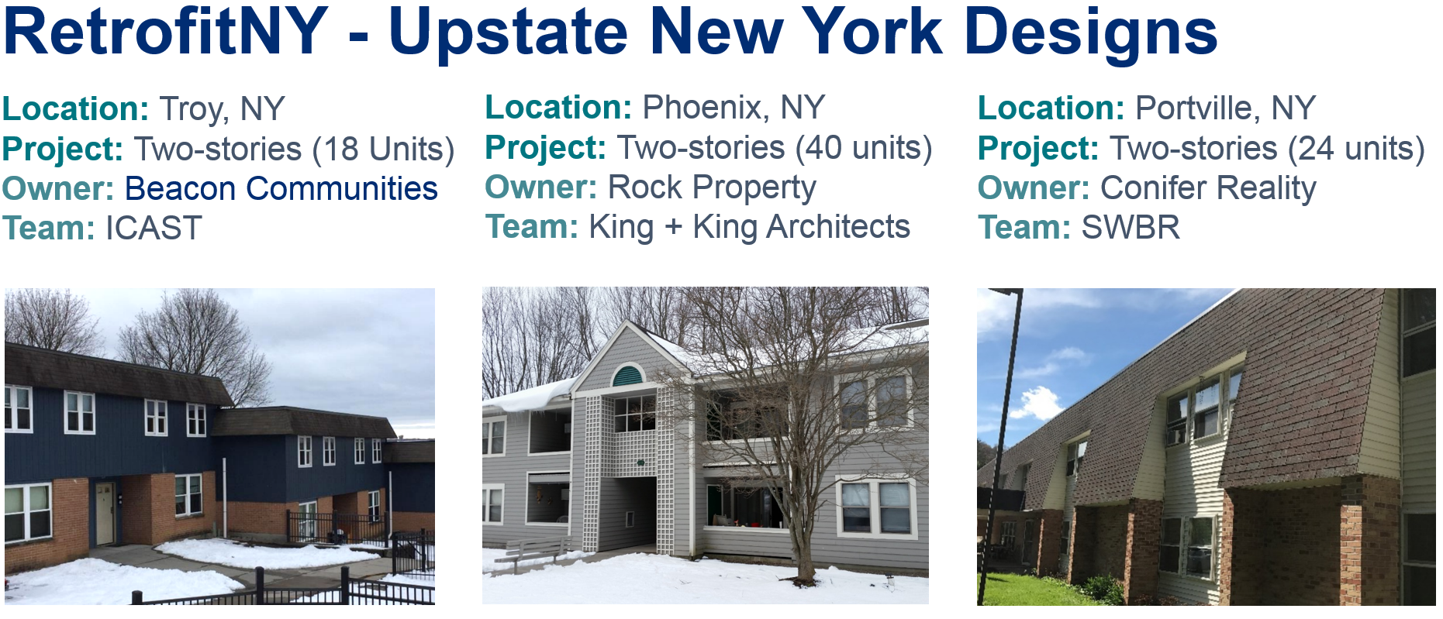
Multifamily Residential
Works to overcome market barriers in the multifamily sector, pursuing strategies to:
Create awareness and demand for energy-efficient and high-performance buildings
Increase market capacity to deliver energy services
Stimulate consumer demand and choice to select energy and Environmentally friendly buildings through clear and widely used labeling
Expand the pool of trusted energy professionals serving the needs of multifamily building owners, their technical skill sets and tools
Demonstrate viability of deep energy retrofits in multifamily affordable housing stock
Further the emergence of performance contracting
Notes:
The Multifamily Residential team works to overcome market barriers in the multifamily residential sector, defined as buildings with 5 or more units. One example of the work from this team is RetrofitNY focusing on bringing multifamily affordable housing to net zero energy performance levels with residents in place.
The approach is to renovate multifamily buildings while achieving or approaching net-zero energy use and creating standardized and scalable processes that will improve residents’ comfort and buildings’ energy performance. RetrofitNY will also produce a new model for economic growth that mobilizes vital innovations in the building industry to create new jobs and financing opportunities—all while dramatically reducing greenhouse gas emissions statewide.
First design 6 design have been done, 3 designs for 2 story garden style were upstate
Anticipating the first building to be retrofitted in the upcoming months.

Slide 60
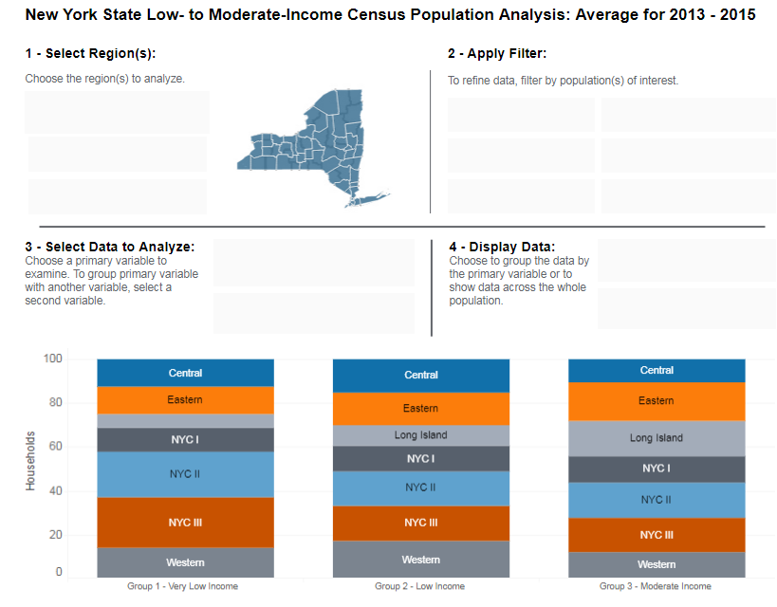
Informational Resources (Data and Analytics)
Building Stock Baseline and Potential Studies
Energy Statistics
Research and Technical Reports
New York State Low- to Moderate-Income Census Population Analysis Tool
Community Energy Use Data
https://www.ny.gov/programs/open-ny
Notes:
Many teams also contribute to the rich data and information available through NYSERDA and posted on our website and Open NY
Image is the Low- to Moderate-Income Census Population Analysis Tool

Slide 61
Matrix Team Example: Pay for Performance
A flexible, market-based approach to deliver energy efficiency that allows solution providers to innovate, reduce costs, and increase customer value by:
Investing in realized savings
Enabling multi-year revenue streams
Allowing for technology agnostic solutions
Focusing on achievements at the portfolio levels
Valuing energy efficiency in a manner comparable to other distributed energy resources (DERs)
Allowing for private market innovation and scale
Notes:
Managed through a matrix team approach comprised of staff members from across the organization. Work being done in small commercial and residential. Residential pilot expected to launch later this year.
A flexible approach to energy efficiency programs that allows solution providers to innovate, reduce costs, and increase customer value by:
Investing in realized savings based on weather-normalized meter data
Enabling multi-year revenue streams for delivered energy efficiency
Allowing for technology agnostic solutions – it is not a prescriptive programs
Focusing on achievements at the portfolio levels
Valuing energy efficiency in a manner comparable to other distributed energy resources (DERs)
Allowing for private market innovation and scale

Slide 62
Participant Announcements

Slide 63
Summary and Closing
Key takeaways from today
Action steps
Plan for re-engagement with RMAG
Email distribution list
Website landing page (coming soon)
Webinars
In person meetings

Slide 64
Thank You!

