Slide 1
Green Jobs Green New York
Advisory Council
September 16, 2019

Slide 2
Agenda
Welcome, Opening Remarks
GJGNY Financing Update and Loan Fund Changes
Loan Loss Reserve Initiative
GJGNY Residential Audits – Program Update
Outreach Update
Workforce Development Update
Review of GJGNY Loan Portfolio attributes and performance history on OpenNY
Legislation to amend On-Bill Loan Recording – Update
2019 Annual Report status
Other Business

Slide 3
GJGNY Financing Update

Slide 4
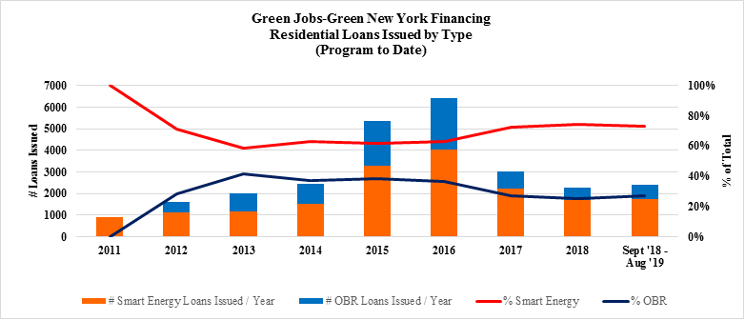
Notes:
Tiered interest rate changes in September of 2016 the number of GJGNY Residential loans has decreased by more than 50%. In the past year, since changes were implemented, there has been about a 5% increase in the number of loans from the prior year.

Slide 5
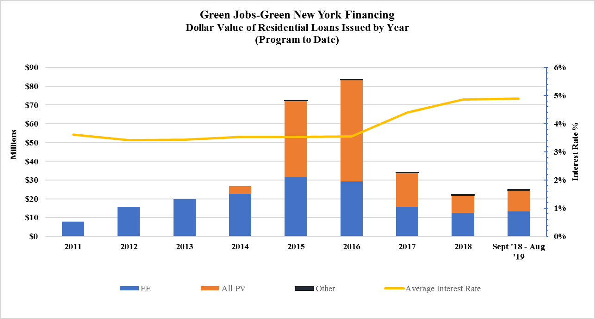
Notes:
Dollar value of the loans issued in the past year is approx. $2 million a month which is within the amounts approved in the RGGI operating plan

Slide 6
Portfolio Performance
Notes:
Estimated losses using Kroll (rating agency) assumptions is 4.94%

Slide 7
Loan Fund Changes
Notes:
As Alicia indicated we are currently looking at opportunities to improve the performance and implementation of the loan fund. In order to achieve this goal we are proposing some changes to the fund.

Slide 8
2019 Loan Fund Changes
Geo-based eligibility
Further simplify underwriting and income documentation for applicants not seeking reduced interest rates or subsidies
Eliminate Credit Affirmation form
Mailing of documents - Business Reply Envelopes
Contractor advance payments

Slide 9
1. Geographic Based Eligibility
No documentation of household income
Housing and Urban Development Median Income Block Data
  <=120% AMI for reduced interest rate (3.49%/3.99%)
  <= 80% AMI for AHPwES incentive (up to $4,000/50% of project costs)
Pilot Market
Interactive tool on NYSERDA website
Income documentation basis for customers outside designated areas
Notes:
Currently offer 3.49%/3.99% for consumers <=120% AMI with documentation of all household income.
Pilot – Rochester/Buffalo area with a well established contractor network and the Capital Region which is an area with limited contractor network.

Slide 10
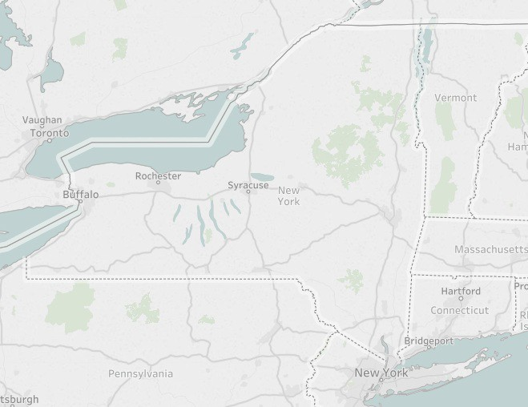
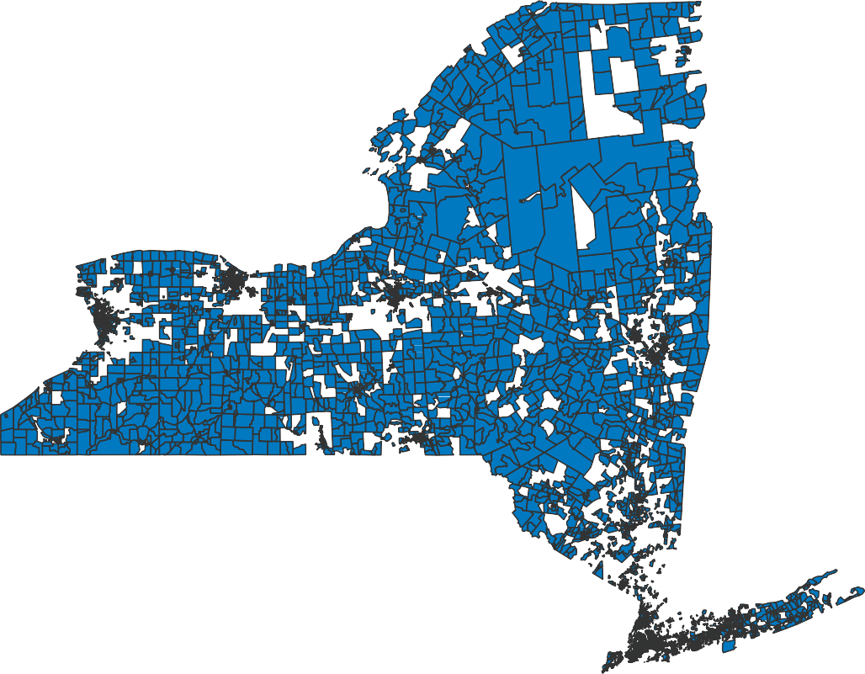

Median Income =< 120%
Geo Based Eligibility for Reduced Interest Rate
 | NYS | 120% AMI | %
Population | 19,673,174 | 14,581,315 | 74%
Households | 7,262,279 | 5,353,310 | 74%
Housing units | 8,255,911 | 6,084,233 | 74%
Notes:
HUD Mapping
Total 74% of all NYS households or about 5.4 million households

Slide 11
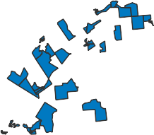
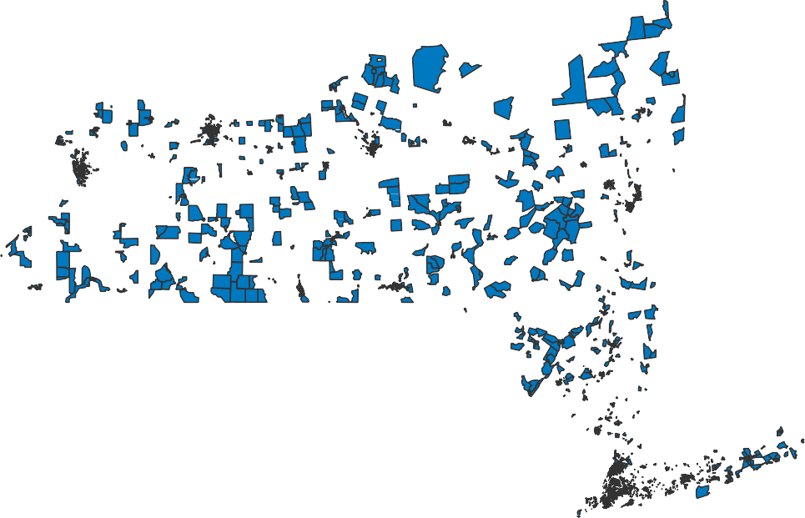

Median Income =<80%
Geo Based Eligibility for Project Incentives
 | NYS | 80% AMI | %
Population | 19,673,174 | 8,347,091 | 42%
Households | 7,262,279 | 2,975,067 | 41%
Housing units | 8,255,911 | 3,344,946 | 41%
Notes:
Total 41% of all NYS households or about 3 million households

Slide 12
2. Underwriting and Income Documentation Changes
(Applicants not Seeking Lower Interest Rate or Subsidies)
Eliminate income documentation for all applicants with credit scores of 720 or above
Eliminate income documentation for all applicants with loan <=$5,000
Applicants seeking income-eligible incentives or interest rates still need to document all income
Notes:
DTI requirements still applicable but calculated on stated income.
Nearly 18% of current portfolio have loans <=$5,000
These changes have been implemented effective 9/9/19

Slide 13
3. Eliminate Credit Affirmation Form
Form issued to customers with debt-to-income >50%
Contractor feedback – extended time of approval process
Eliminate standalone Affirmation Form - will include Affirmation language in application that all applicants must acknowledge
Notes:
Started issuing in May 2019.
Affirmation used to communicate with customer that savings numbers provided by the contractor are estimates only and not guaranteed and to the extent savings not achieved or less than expected than customer’s debt obligations as a percent of income could increase and regardless of actual savings customer still obligated for loan payments.
Change effective 9/9/19 – applicants must use most recent version of the application (Version 9.9.2019). Prior versions of application will not be accepted. New PDF version on EFS website.

Slide 14
4. Mailing of Applications and Documentation
Encourage use of on-line application
Additional Consumer Protection
Business Reply Envelopes addressed to EFS
Notes:
Prior to 2018 changes 15% of applications on-line now about 30%.
EFS reports higher use of on line in other states than in NYS.
Heard feedback that on-line not always possible b/c no access to internet, computer, scanner and sometimes there’s a perception takes too long or is too complicated. Working with EFS to make on line easier.
Considered implement financial rewards to applicants (lower fees) to use the online system but we received feedback from contractors and advocates that this could be seen as a regressive tactic that disadvantages LMI customers.
We don’t think consumers should be asked to provide sensitive income and utility account number info to contractor who is not directly involved in processing and safeguarding that info. Not good business practice and potential liability for contractors to collect and transmit this info.
Considered not allowing contractors to collect and/or fax of documents but based on negative feedback have decided not to pursue. Rather implementing change that we think can benefit consumers by better protecting info and contractors by giving them the means to avoid receiving and retaining info. Creating business reply envelopes that consumer can put info in and mail to eFS.

Slide 15
5. Contractor Advance Payments
GJGNY Loan fund underutilized by LMI customers
Participation Requirements:
  Only for customers qualified for 3.49%/3.99% interest rate
  Limited to contractors in good standing
  Contractor receives 50% advance when loan documents signed
  Remaining 50% disbursed at construction completion
  Project complete within 180 days of advance
  Funds must be returned if project not complete within 180 days
NYSERDA advances funds
Notes:
Aware contractors offer other financing programs to customers b/c can get cash at loan closing rather than construction completion
NG for customers, higher rates or higher monthly payments b/c dealer buy downs
Good standing – not on probation or not suspended w/in last 18 months
Need to sign Finance participation agreement
Exceptions to 180 day reviewed case by case
Ramifications include – interest rate charge, future incentives held, possible disbarment from NYSERDA programs
- Customer not accrue interest or start payment until 2nd 50% is disbursed

Slide 16
Next Steps
Geo-based Eligibility Pilot:
  Create interactive tool for NYSERDA website for Geo-based eligibility
  EFS system update to interface with Geo-based eligibility tool
Contractor Advance Payment:
  Create participation agreement
  EFS system updates to track payments, construction completion
Business Reply Envelopes
  Creating account
  Envelopes printed
  Distributed to contractors
Notes:
Program announcements will be made when these changes are ready for implementation – we will hopefully have them up and running by the end of Q1 2020.

Slide 17
Loan Loss Reserve Initiative

Slide 18
Loan Loss Reserves (“LLR”)
An LLR provides partial loss coverage for eligible financings – NYERDA proposing to use for Energy Efficiency and Renewable Energy (“EE/RE”) Financing Solutions for Residential, Small Commercial, NFP and Multifamily buildings in designated LMI communities.
This additional security enhances the risk profile of EE/RE projects and can motivate financial institutions to offer EE/RE financial products.
In the event of a default, the investor can recoup a portion of their losses from the reserve fund, up to a maximum sizing of the reserve fund thereby broadening access to capital and lowering interest rates.
Loan loss reserve funds take a portfolio approach to credit structuring. The loan loss reserve approximates the anticipated default rate on all the loans in the portfolio, which can mitigate lender risk and open up the market for additional EE/RE lending.
Programs have been successfully deployed in CA, CT, MA, MI with direct impact to underserved borrowers
REEL Introduction for Lenders

Slide 19
Loan Loss Reserves Impacts
The LLR could be expected to have the following impacts:
• Increase the number of capital providers. Could encourage local banks, credit unions, and community development finance institutions (CDFIs) to provide EE/RE Financing Solutions.
• Increase size of unsecured lending. Larger loans to finance more deeper upgrades
• Extend loan term. Loan term could extend for all class of borrowers from 5+ years to 15 – 25 years, allowing for the monthly payment to closely match the energy savings
• Expand underwriting criteria. Lender can consider expanded underwriting criteria (e.g. lower consumer credit scores or no minimum).
REEL Introduction for Lenders

Slide 20
New York has set ambitious climate change goals
energy retrofits for LMI borrowers and communities face financing barriers
but . . .
Challenges
Benefit to Borrowers and Communities of broader access to capital
Projects require large upfront costs and consumers lack necessary capital
Contractors don’t offer the most energy efficient options if they think customers lack funds
Existing loan products don’t meet needs
  Many homeowners do not want to use their property as collateral
  Credit card rates are high
  Credit Union and Bank unsecured loans are limited to 5 year terms and max loan amounts do not cover full retrofit
Access an opportunity to make wider range of energy efficiency upgrades to your home
Save money with lower interest payments and access more affordable payments through longer terms
Improve the value of your property by reducing the costs for deeper upgrades and energy retrofit
Combine with Federal, State, Utility, Community programs and grants for deeper upgrades to your home
Borrowers have the advantage of no lien on their property
REEL Introduction for Lenders

Slide 21
Loan Loss Reserve Process Overview
Open enrollment, application-based program for eligible lenders (subject to initial pilot program funding limit of $10M)
Each qualified applicant will be allocated an initial funding amount depending on the sector they serve. Applicants may apply for multiple sectors
For each qualifying financing issued by the participant, a contribution is made to the Lender’s LLR account that can be accessed in case of default of a loan
Lender recoups 90% of any loan losses (> 120 days past due) from LLR account, subject to a maximum level of losses as a percentage of their portfolio, and subject to the Lender’s maximum funding amount
Lender’s funding amount can be increased once they reach initial funding amount limit, and subject to reduction after 1st year if their originations don’t meet projected goals.
REEL Introduction for Lenders

Slide 22
Loan Loss Reserves Terms
Sector | Max Loan Amount | Initial LLR Funding Allocation | LLR Portfolio Maximum Coverage
Residential (1-4 family) | $50k | $200k | 10% > = 660 FICO 35% < 660 FICO
Small Commercial (<100 employees) | $500k | $500k | 20% of 1st $50k; 5% remaining $450k
Multifamily (5+ units) | $500k | $500k | 20% of 1st $50k; 5% remaining $450k
Not-for-Profit | $100k | $100k | 20% of 1st $50k; 5% remaining $50k
Predevelopment (IPNA/GPNA) Financing | $150k | $100k | 10% of 1st $50k; 5% remaining 150k
LLR offered for any type of financing – e.g. loan, lease, PPA, energy services agreement
New financing structures encourages – ESA, MSA, PAYS, off-balance sheet approaches, and performance-based structures
No prepayment penalty
LLR stays with financing structure for asset sale or securitization through maturity
Residential debt products min 580 FICO, but performance-based structures can be offered <580
REEL Introduction for Lenders

Slide 23
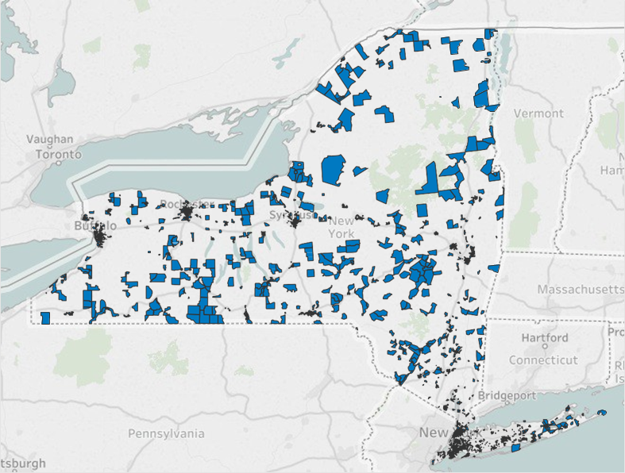
GEO Based Open Enrollment for LLR ( AMI < 80)
Using HUD Median Income Block Data (GEO) for qualifying
No documentation of household income for Residential underwriting in GEO areas
Interactive tool on NYSERDA website Statewide
For Residential borrowers outside of designated GEO areas an income based qualifying approach is available
Proposed Targeted Communities Population and Housing Units
 | NYS | 80% AMI | %
Population | 19,673,174 | 8,347,091 | 42%
Households | 7,262,279 | 2,975,067 | 41%
Housing units | 8,255,911 | 3,344,946 | 41%
Notes:
Total 27% of all NYS households or about 2 million households

Slide 24
GJGNY Residential Audit
Program Update
Notes:
As Alicia indicated we are currently looking at opportunities to improve the performance and implementation of the loan fund. In order to achieve this goal we are proposing some changes to the fund.

Slide 25
Modifications to GJGNY Audit Standard
Revise and update the definition of an audit to better align with current market conditions and policy objectives, while maintaining compliance with the requirements of the GJGNY Act of 2009.
Establish a universal audit standard that that can be used by multiple programs
  Delivering whole house energy audits, and
  Installation of individual pre-screened eligible measures with financing
Establish updated and streamlined protocols for whole home audits and single system audits.

Slide 26
Creating a Stand-alone Audit Program
GJGNY home energy audits and residential financing have been delivered through Home Performance with ENERGY STAR (“HPwES”) since November 2010.
HPwES for market rate customers is ending on December 31, 2019.
NYSERDA will continue to provide energy audits for market rate customers. These audits will not be connected to HPwES.
Low to moderate income customers will continue to be served through existing programs (Empower and Assisted HPwES).
Notes:
Because market rate HPwES is ending at the end of the year, we are developing plans to continue offering audits and financing for market rate customers in 2020.
Also because of the end of the HPwES market rate program, we are decoupling the terminology of HPwES and a GJGNY audit. The definition of a GJGNY audit will be defined as a minimum requirement and programs, such as EmPower and Assisted HPwES, may have additional requirements above these minimums in order to meet their Programs.
Low to moderate income customers will continue to be served through existing programs (EmPower and Assisted HPwES) and will access audits and financing through the existing LMI programs.

Slide 27
GJGNY Audit Requirements
Green Jobs – Green NY Act of 2009 minimum criteria defining an energy audit:
Formal evaluation of building energy consumption for purpose of identifying methods to improve energy efficiency.
Identifies health and safety issues.
Performed by certified auditors OR uses commonly employed energy auditing tools and technologies.

Slide 28
Types of Audits
Phase 1 (roll-out Q4 2019)
Whole House Audits
  With revised standards and simplified procedures
Single System Audit
  In compliance with the statutory criteria
  Enables access to financing for single measure projects
Phase 2 (Planning and development through 2020, target launch Q1 2021)
Remote Audit
  A new approach to roll out in a later phase, leveraging data and digital platforms to further streamline field-based burden
  Potential for utility collaboration
Notes:
Single System Audit:
Single measure audits can help us meet our policy objectives toward clean energy solutions and decarbonization without over-burdening customers or contractors.

Slide 29
Summary of Whole Home Audit Changes
Component | Current | Proposed
Customer Intake & Applications | Customer completes application, receives reservation number, selects contractor | Simple customer intake process. Exploring options for customer/contractor matchmaking.
Audit technical requirements | 3-4 hour audit following BPI 1200 standard; all diagnostic testing required at time of audit | 1.5 to 2-hour audit aligned with BPI 1200; diagnostic testing optional
Modeling requirements | Must use a NYSERDA-approved whole home energy simulation tool to produce an audit report including recommended measures and savings estimates. | Can use any modeling or estimating tool and a simplified NYSERDA-provided deemed savings calculator to produce a GJGNY coversheet/checklist summarizing recommended measures and savings estimates.
Access to financing | Workscope and modeling review by HPwES Program Implementer; relevant documentation is then passed to EFS | Pro-forma submitted directly to EFS using inputs from deemed savings calculator; no workscope review for technical or modeling requirements
Incentive Fee Schedule | 6 tiers of incentives for market rate customers | Simplified tiers of incentives for customers
Contractor requirements | Accreditation as a BPI GoldStar contracting firm + Specialty certification for oversight of installed work | Broader range of auditor qualifying criteria focused on skills for doing audits, not installing measures. Allows for participation of wider range of contractors. (Certified installers required for financed projects.)
Notes:
If the question comes up, we can note our intent to allow for custom analysis on an ad hoc basis if the deemed calculator is insufficient to model the proposed measure package for a specific project

Slide 30

Next Steps
Gathering stakeholder input now
Specific program design elements will be announced in October
Auditor requirement and sign ups in November/December
Offer live by end of 2019
Notes:
Reference slide for talking points
Turnover to Heather Clark to talk about residential financing

Slide 31
Outreach
Update

Slide 32
CEEP Background
NYSERDA continues outreach and engagement efforts through the Community Energy Engagement Program (CEEP) with $5.5 million in funding for 2017 through 2020 provided via the Clean Energy Fund (CEF) and Regional Greenhouse Gas Initiative (RGGI).
Notes:
The Community Energy Engagement Program (CEEP) incorporates and builds upon the success of previous engagement efforts including the Green Jobs, Green New York (GJGNY) Outreach Initiative, for which GJGNY funding was expended .
2) NYSERDA continues locally-based outreach and engagement efforts through the CEEP program with $5.5 million in funding provided via the Clean Energy Fund (CEF) and Regional Greenhouse Gas Initiative (RGGI) for outreach and engagement efforts.

Slide 33
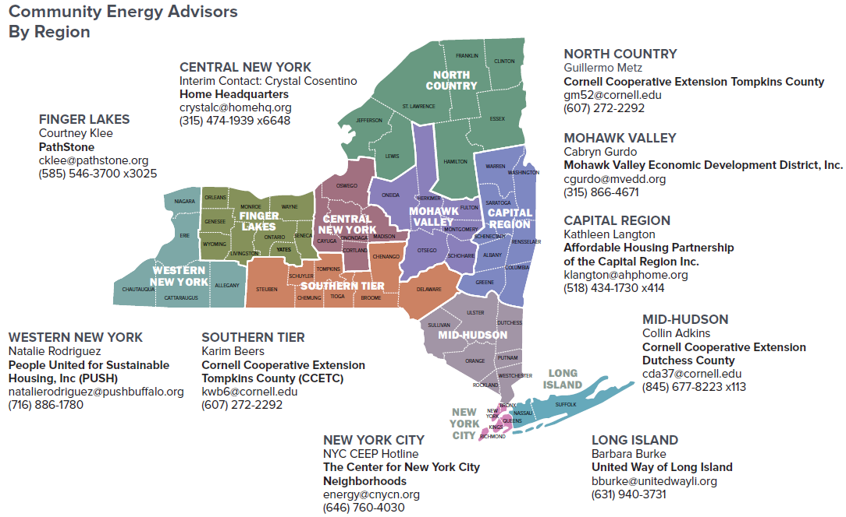
CEEP – Community Energy Advisors
Notes:
NYSERDA is working with locally based organizations and constituency based organizations (CBOs) statewide, with a regional approach to implement CEEP.
There are Community Energy Advisors all over the state…these are just the main contacts, not everyone. This map with contact information can also be found on the NYSERDA website and on the back of our fact sheet…have some here. The easiest way to find the information on our website is to just google NYSERDA CEEP. Otherwise, visit nyserda.ny.gov/ceep

Slide 34
CEEP – Community Energy Advisors
Community Energy Advisors
Free outreach/support/’hand-holding’ for clean energy projects from program application through project completion for:
Residents
Small Businesses
Multifamily Building Owners
Strong focus on Low-to-Moderate Income (LMI) customers
Notes:
Enable you to make informed energy decisions.
Inform you of financing options for energy efficiency and renewable energy projects and products.
Guide you through the process of implementing a clean energy project.
Connect you with the right energy contractors who can implement clean energy projects.

Slide 35
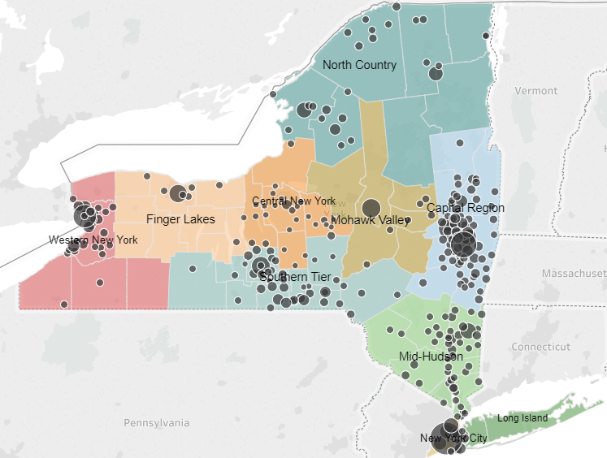
CEEP Progress
As reported by the Advisors from fall of 2017 through September 2019, Advisors via the CEEP were responsible for:
  $2.5 million in leveraged funds received by customers
  35 new partnerships developed with other locally based organizations
  Approx. 4,000 referrals to clean energy programs.
Notes:
Leveraged funds are non NYSERDA funds (public or private) that are braided with NYSERDA resources to implement a clean energy project that would otherwise not move forward due to structural deficiencies, health and safety issues, etc.
There are 35 key partners including, but not limited to, Offices for the Aging, Housing Assistance Providers, Weatherization Assistance Providers, Local Department of Health agencies, Chambers of Commerce, etc.
There have been 2,440 unique customers referred to a clean energy program (includes energy efficiency and renewable energy programs (e.g. Solar for All)) and approx. 4,000 opportunities (total number of program referrals).
Outreach and community engagement continues under the CEEP. In 2019, outreach efforts will be expanded to include additional, targeted, regionally specific initiatives that drive increased adoption of energy efficiency and other clean energy solutions.

Slide 36

Workforce Development Update

Slide 37
NYSERDA Workforce Development
to Support Clean Energy Worker Hiring and Training
NYSERDA has recently initiated programs that will benefit more than 22,000 New Yorkers
  Energy Efficiency & Clean Technology Training - 17,350 to be trained
  Building Operations & Maintenance - 4,661 to be trained
  On-the-Job Training - 99 hired
  Clean Energy Internship Program - 129 Interns hired summer 2019
Notes:
The underlying survey for the report also included questions related to workforce issues. We found that New York’s clean energy economy is growing rapidly and that employers looking to hire see plenty of applicants, but that employers struggle to find applicants with the desired mix of qualifications and experience.
Employers reported this shortcoming for multiple occupations, but especially for technicians and sales, marketing and customer service staff.

Slide 38
Energy Efficiency & Clean Technology On-the-Job Training (PON 3982)
Up to $100,000 per business, to eligible businesses on a first-come, first-served basis
Funding for businesses to hire and provide on-the-job training (OJT) for workers for energy efficiency and clean technology jobs
Businesses with 100 employees or less, NYSERDA pays 50% of a new employee’s hourly wage for
16 weeks. Incentives cover 50% of the wage for 24 weeks for a worker from a priority* population
Businesses with over 100 employees, incentives for workers from the priority populations only
Example: Halco Inc. has hired 12 new employees and provided on-the-job training for high-efficiency HVAC positions ranging from auditors to insulations installers. Halco has targeted its hiring efforts to recruit priority populations.
* Priority Populations include veterans, disabled workers, low-income individuals, formerly incarcerated, Native
Americans, dislocated power plant workers, and 18-24 year-old trainees in energy related job preparation programs.
Notes:
The underlying survey for the report also included questions related to workforce issues. We found that New York’s clean energy economy is growing rapidly and that employers looking to hire see plenty of applicants, but that employers struggle to find applicants with the desired mix of qualifications and experience.
Employers reported this shortcoming for multiple occupations, but especially for technicians and sales, marketing and customer service staff.

Slide 39
Appendix
Energy Efficiency & Clean Technology Training (PON 3981)
Projects to develop and deliver training, provide hands-on experience and job placement assistance to ensure that new and existing clean energy workers have the skills businesses need
Training activities eligible for funding include: developing, modifying or implementing curriculum; delivering training (on-line, classroom, on-site, etc.); equipment purchase for hands-on training; hiring and training trainers; marketing; internships; job placement services; pre-apprenticeships; and apprenticeships
Proposers can include unions, colleges and universities, manufacturers, distributors, trade associations, community-based organizations, technical high schools, training and job placement intermediaries, etc.
Maximum proposal $250,000, 30% cost share required
Preference for proposals to support Priority Populations
Example: Green City Force with its partners will deliver an energy boot camp, a pre-apprenticeship training model with career support, peer mentorship, and job placement coordination for up to 45 graduates of their AmeriCorps program
Notes:
The underlying survey for the report also included questions related to workforce issues. We found that New York’s clean energy economy is growing rapidly and that employers looking to hire see plenty of applicants, but that employers struggle to find applicants with the desired mix of qualifications and experience.
Employers reported this shortcoming for multiple occupations, but especially for technicians and sales, marketing and customer service staff.

Slide 40
Appendix
Clean Energy Internship Program (PON 4000)
$10.5 million available to eligible businesses on a first-come, first-served basis;
Creating a talent pipeline for clean energy businesses by reimbursing employers who offer paid internship opportunities to college students or 18- to 24-year-olds that have completed or are enrolled in technical high schools, energy training or certificate programs
NYSERDA will reimburse interns’ salaries based on the size of the business:
  For businesses with 20 or fewer employees, reimbursement of 90% of intern wages
  21 to 100 employees, reimbursement of 75% of intern wages
  100 or more employees, reimbursement of 50% of intern wages
Internships funded for a maximum of 12 weeks, business can apply for a maximum of five interns per session and a maximum of 12 interns over the course of the program
Example: Kinetic Communities Consulting – hired two interns for Summer 2019 to assist with NYCHA energy efficiency project. Interns also job-shadowed clean energy leaders weekly.
Notes:
The underlying survey for the report also included questions related to workforce issues. We found that New York’s clean energy economy is growing rapidly and that employers looking to hire see plenty of applicants, but that employers struggle to find applicants with the desired mix of qualifications and experience.
Employers reported this shortcoming for multiple occupations, but especially for technicians and sales, marketing and customer service staff.

Slide 41
Appendix
Building Operations and Maintenance (PON 3715)
$10 million available, up to 50% of the cost for eligible projects, with a cap of $400,000 per application
This program is designed to help employers and building owners develop training projects that create the educational strategy, on-site training framework, and tools needed to advance the skills of building operations and maintenance workers and prepare new workers beyond conventional classroom training.
Proposals must be for buildings or groups of buildings—including partnerships between businesses with common training needs—with annual energy expenditures of $1 million or more.
Example Partners: FS Energy, LLC, Memorial Sloan, Kettering Cancer Center, Ridgewood Bushwick Senior Citizens Council, NYS School Facilities Association, Association for Energy Affordability (AEA), New York University, Robert E. Hill, Inc. , Steve Winters Associates, Inc., Smith Engineering, Housing Works, NYU Medical Center, SUNY Brockport, Urban Green Council and SUNY ESF,
Notes:
The underlying survey for the report also included questions related to workforce issues. We found that New York’s clean energy economy is growing rapidly and that employers looking to hire see plenty of applicants, but that employers struggle to find applicants with the desired mix of qualifications and experience.
Employers reported this shortcoming for multiple occupations, but especially for technicians and sales, marketing and customer service staff.

Slide 42
Review of GJGNY Loan Portfolio Attributes and Performance History

Slide 43
Accessing the Data – Two Methods
NYSERDA Website
  https://www.nyserda.ny.gov/Researchers-and-Policymakers/Green-Jobs-Green-New-York/Data-and-Trends
2. NYS OpenNY Platform (data.ny.gov)
  Select “GJGNY” in Search
  Or navigation through Agencies & Authorities “Energy Research and Development Authority”
  Or through Categories “Energy & Environment

Slide 44
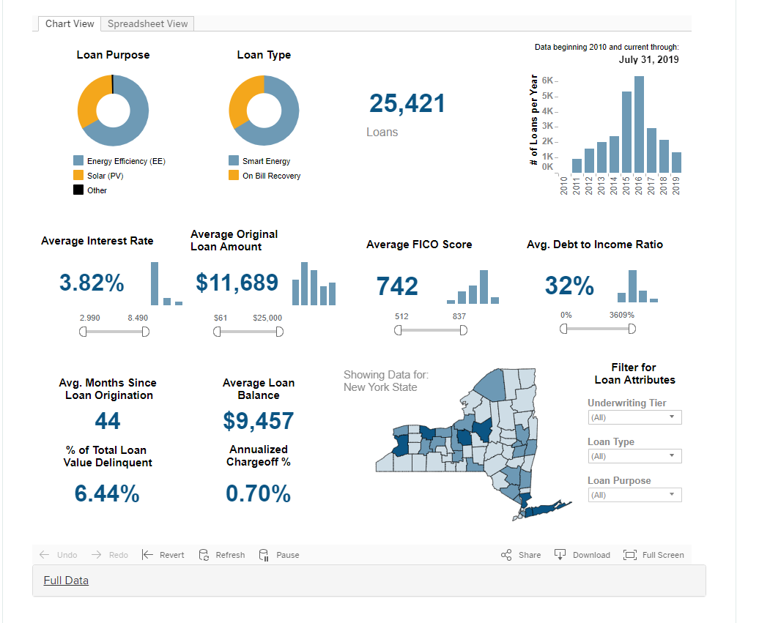
Chart View (NYSERDA Website page)
Sliders allow changes to filter loan data
Dropdown list filters
Click on a county
Or select multiple - Ctrl-Click
Click to see supporting data
Annualized loss rate (loans > 120 days past due as % of original loan principal) based on average age of loan portfolio (Avg Months Since Loan Origination)

Slide 45
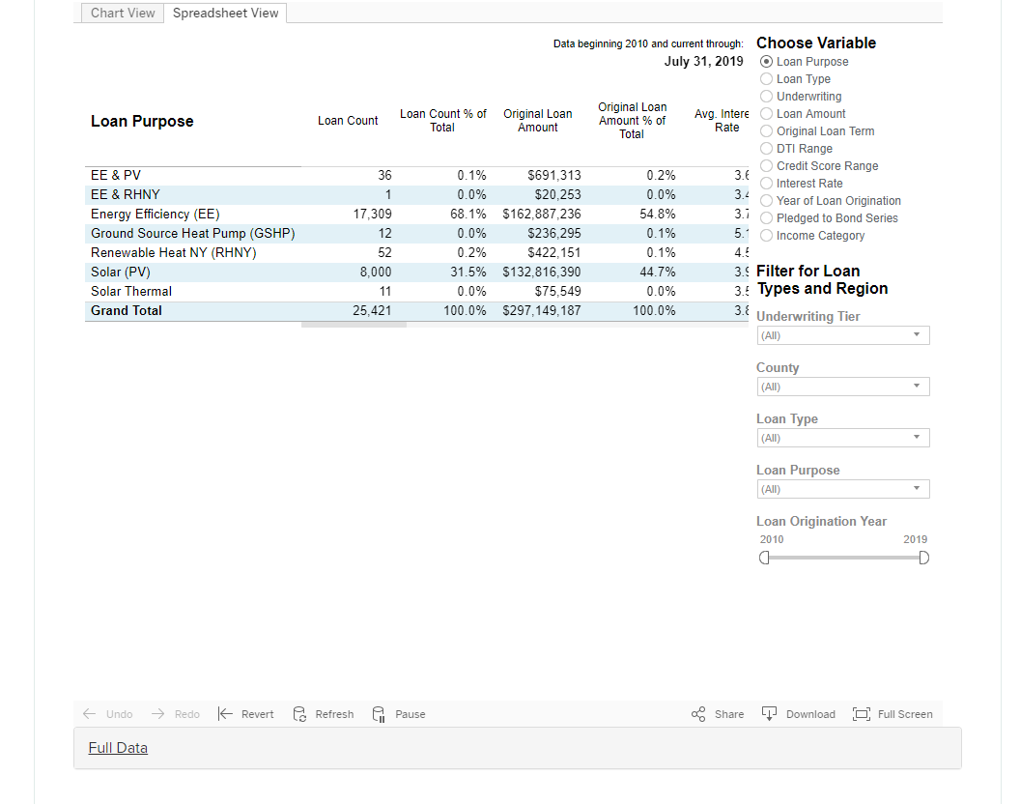
Spreadsheet View (NYSERDA Website Page)
Select Spreadsheet Summary to summarize the
portfolio by different attributes
Select Filters
Scroll to see additional columns to the right
Download table to Excel or PDF
Then select file format (Crosstab for Excel)

Slide 46
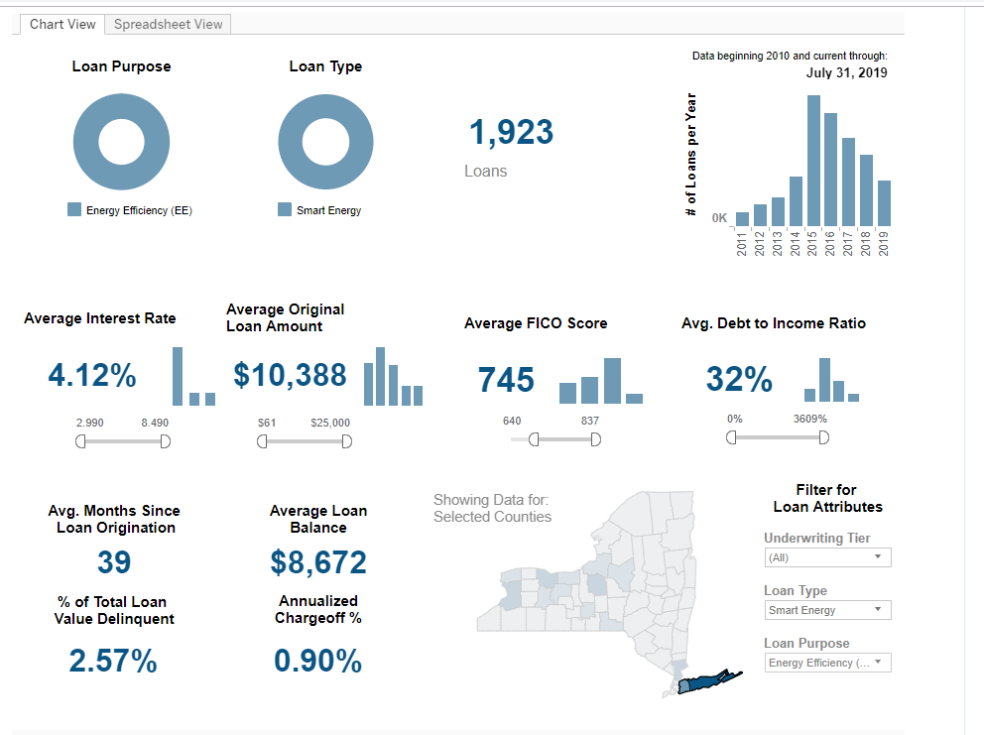
Example of Data Use
A lender serves the Long Island market and is considering offering a consumer loan product for energy efficiency loans and is interested in NYSERDA’s historical experience.
Here’s the steps:
Click Ctrl-click on Nassau and Suffolk County on the Statewide map
Select Loan Purpose of Energy Efficiency and click Apply
Select Loan Type and unselects On-Bill Recovery Loans (the lender can’t access the repayment method) and click Apply
The Lender sees that NYSERDA has issued loans with credit scores as low as 512, but its internal credit committee would require a minimum 640 credit score for unsecured consumer loans. The Lender adjusts the low side of the FICO score slider bar (or clicks on the low value) to 640.
Result:
Lender sees the result of NYSERDA 1,923 loans with 39 months of history. It shows that 2.57% of loans are delinquent, and that annualized cumulative losses/chargeoffs are .90% (cumulative losses = .90% * 39/12 = 2.93%)
4
3
2
1

Slide 47
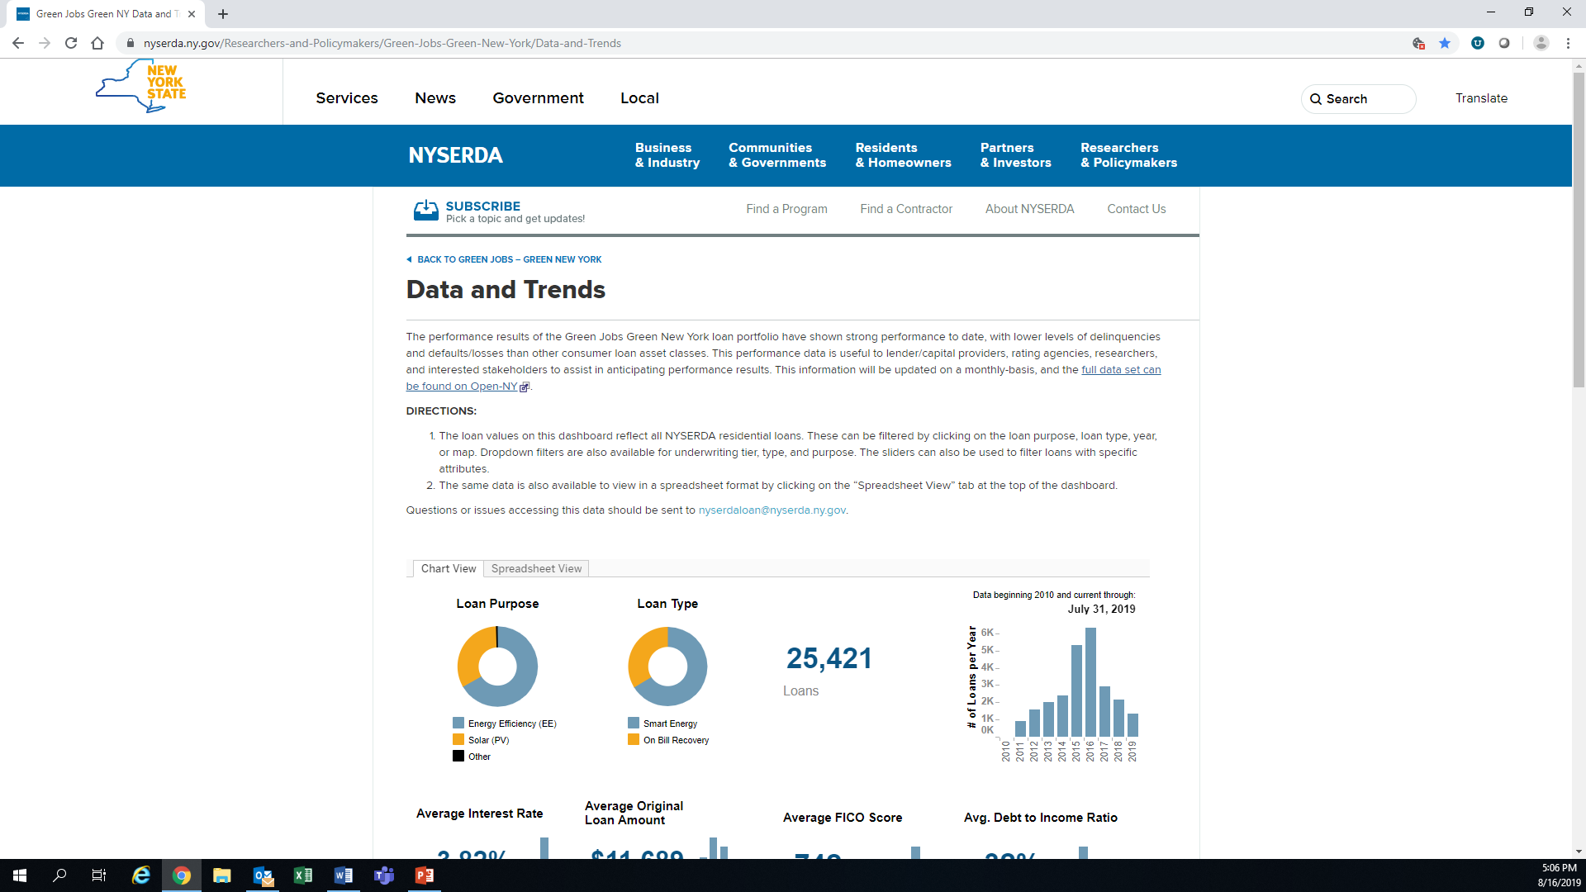
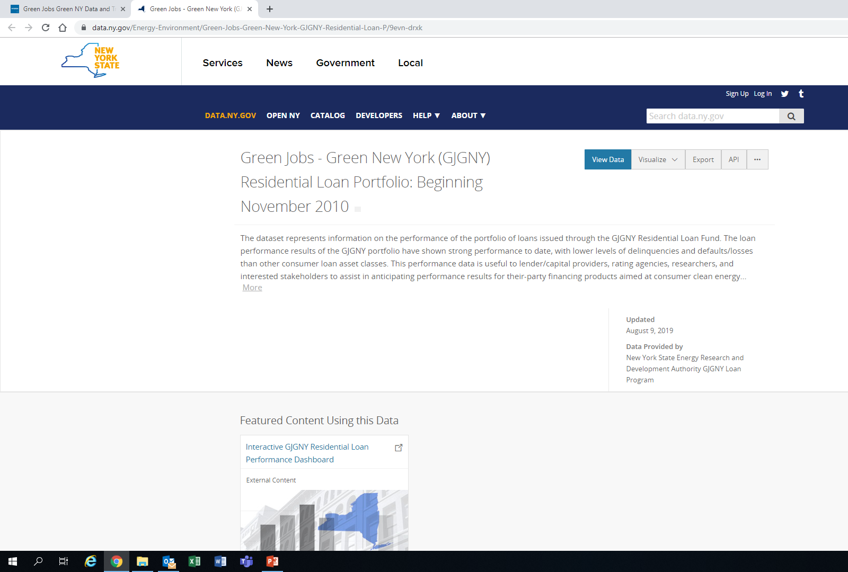
Exporting Loan-Level Data
From NYSERDA Website Page
Select “Full dataset can be found on OpenNY”
On OpenNY Page click “Export” and then select format

Slide 48
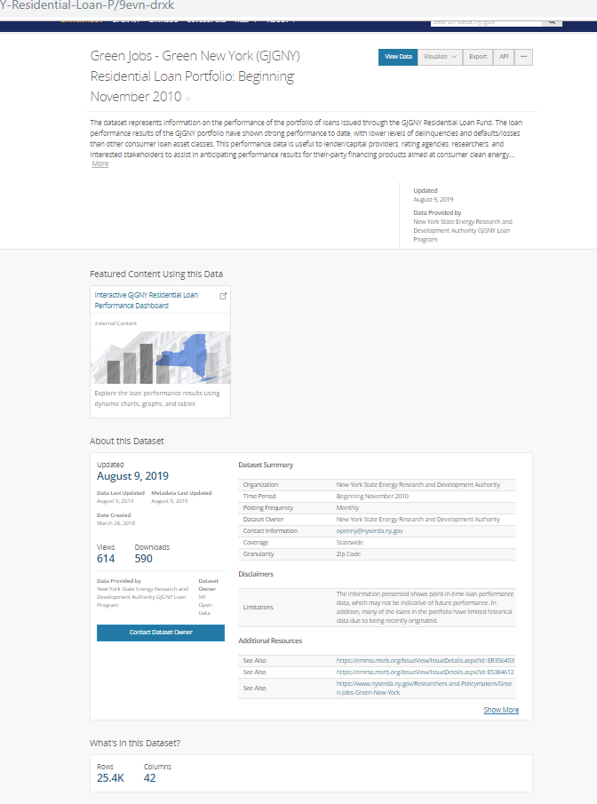
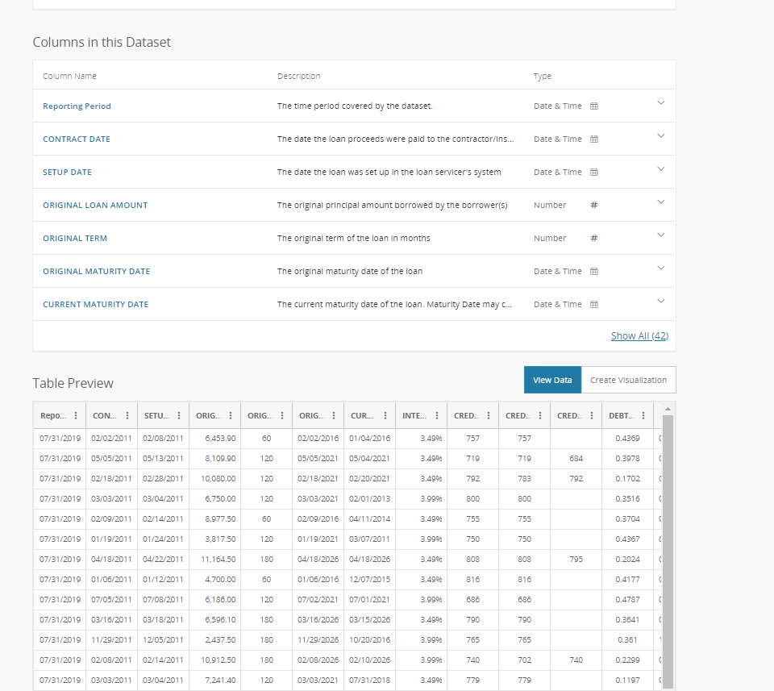
Datafile Descriptions (OpenNY Page)
Field descriptions

Slide 49
Legislation to amend On-Bill Loan Recording

Slide 50
Status Update
Aug 2018 meeting discussion
  Current OBR loan transferability causes confusion and is not effective
  Title search/recording fees unsustainable (~$1,555/loan, $456,000/yr, $3.5 million to date)
  Amend legislation to replace with voluntary assignment, eliminating the need for recording
  If unsuccessful in 2019 Legislative session, we will begin charging fees to borrowers
S6331/A8277 passed Senate, but not Assembly
Charging fees to borrowers could be regressive and detrimental
  Fees vary by county $226-$1,590; avg $304; weighted avg $536
  Charging $300 fee:
    Would increase APR .16%-2.5% (depending on loan amount), causing OBR to be less attractive
    Would increase monthly payment ~$2/month (minor impact on bill neutrality)

Slide 51
Recommendation
Defer passing fees onto consumer until after 2020 Legislative session if amendment not enacted
Will re-submit 2019 departmental legislative amendment and re-engage with Legislative staff early in 2020 session
Support from Advisory Council members could be helpful
Discussion?

Slide 52
2019 Annual Report

Slide 53
Wrap up/Discussion

