Slide 1
The following slides are a summary of the assumptions and results from The Renewable Natural Gas Potential Study, completed by ICF, Inc.
The results from this study were used to inform the Integration Analysis, though the exact inputs and resulting RNG potential or use may vary based on the scenarios developed within the Integration Analysis.
The CAC may consider the data provided, along with other relevant information, in developing the Scoping Plan.
The information herein does not constitute NYSERDA’s endorsement or recommendation regarding any policy measures relating to RNG, including the inclusion of certain feedstocks or technologies. The purpose of this work was only to provide an inventory of available potential.
A full written report with further description of the assumptions and results will follow shortly.

Slide 2
Potential of Renewable Natural Gas in New York State
Draft Material

Slide 3
Project Overview
Project objectives:
Determine the in-state energy potential of RNG and biogas from anaerobic digestion of the organic waste sector.
Determine the estimated costs in $/MMBtu of producing RNG from different feedstock sources in NYS from present until 2040.
3
Draft Material

Slide 4
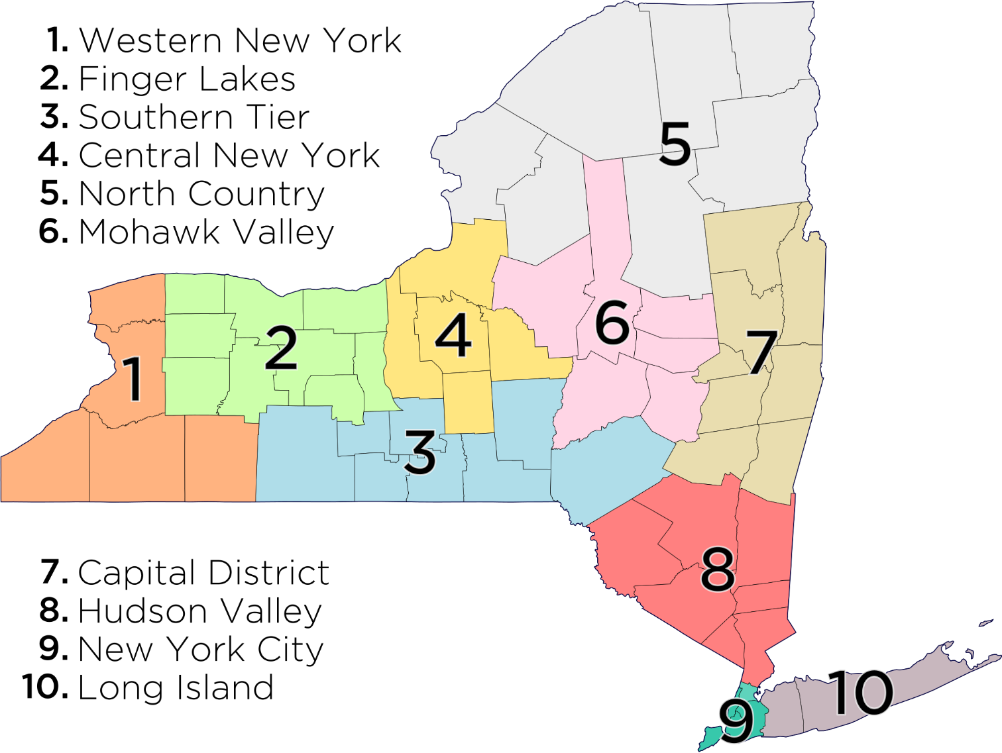
RNG Inventory Overview
Inventory focused on eight feedstocks, two production technologies and ten sub-state regions.
RNG Feedstock Categories & Production Technology
New York State Regions
Feedstock for RNG |  | Description
Anaerobic Digestion | Animal manure | Manure produced by livestock, including dairy cows, beef cattle, swine, sheep, goats, poultry, and horses.
 | Food waste | Commercial food waste, including from food processors, grocery stores, cafeterias, and restaurants, as well as residential food waste, typically collected as part of waste diversion programs.
 | Landfill gas (LFG) | The anaerobic digestion of organic waste in landfills produces a mix of gases, including methane (40–60%).
 | Water resource recovery facilities (WRRF) | Wastewater consists of waste liquids and solids from household, commercial, and industrial water use; in the processing of wastewater, a sludge is produced, which serves as the feedstock for RNG.
Thermal Gasification | Agricultural residue | The material left in the field, orchard, vineyard, or other agricultural setting after a crop has been harvested. Inclusive of unusable portion of crop, stalks, stems, leaves, branches, and seed pods.
 | Energy crops | Inclusive of perennial grasses, trees, and annual crops that can be grown to supply large volumes of uniform and consistent feedstocks for energy production.
 | Forestry and forest product residue | Biomass generated from logging, forest and fire management activities, and milling. Inclusive of logging residues, forest thinnings, and mill residues. Also materials from public forestlands, but not specially designated forests (e.g., roadless areas, national parks, wilderness areas).
 | Municipal solid waste (MSW) | Refers to the non-biogenic fraction of waste that would be landfilled after diversion of other waste products (e.g., food waste or other organics), including paper and paperboard, plastics, etc.
4
Draft Material

Slide 5
RNG Data Sources
Facility-level data where available:
Landfill gas
WRRFs
Animal manure – existing digesters and concentrated animal feedlot operations
Food waste facilities
County-level data for other biomass feedstocks:
Agricultural residue
Energy crops
Forestry and forest product residue
MSW
Feedstock for RNG | Potential Resources for Assessment
Animal manure | U.S. Environmental Protection Agency (EPA) AgStar Project Database U.S. Department of Agriculture (USDA) Census of Agriculture NYS Department of Environmental Conservation (DEC)
Food waste | U.S. Department of Energy (DOE) 2016 Billion Ton Report Bioenergy Knowledge Discovery Framework (KDF) NYS Pollution Prevention Institute
LFG | U.S. EPA Landfill Methane Outreach Program Environmental Research & Education Foundation (EREF)
WRRFs | U.S. EPA Clean Watersheds Needs Survey (CWNS) Water Environment Federation
Agricultural residue | U.S. DOE 2016 Billion Ton Report Bioenergy Knowledge Discovery Framework
Energy crops | U.S. DOE 2016 Billion Ton Report Bioenergy Knowledge Discovery Framework
Forestry and forest product residue | U.S. DOE 2016 Billion Ton Report Bioenergy Knowledge Discovery Framework
MSW | U.S. DOE 2016 Billion Ton Report Waste Business Journal
5
Draft Material

Slide 6
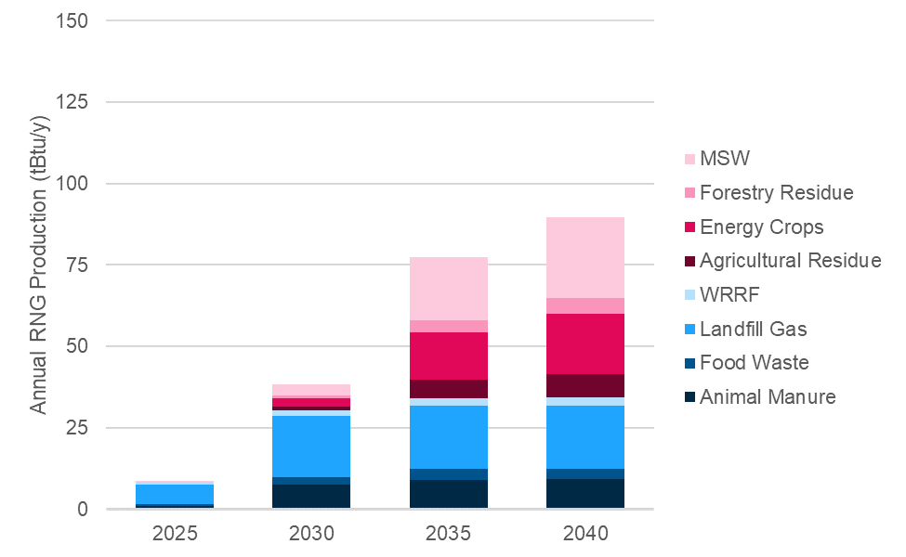
RNG Inventory & Scenarios Potential
Limited Adoption: represents a low level of feedstock utilization with 15% to 40% of feedstocks converted to RNG using anaerobic digestion and 20% to 40% using thermal gasification at lower biomass prices.
Balanced Deployment: represents balanced assumptions of feedstock utilization with 25% to 55% of feedstocks that were converted to RNG using anaerobic digestion and 40% to 50% using thermal gasification at low to medium biomass prices.
Optimistic Growth: represents higher levels of utilization, with 30% to 75% of feedstocks that were converted to RNG using anaerobic digestion and 50% to 60% using thermal gasification at higher biomass prices.
New York RNG Potential – Scenarios and Maximum (tBtu/y)
Balanced Deployment Scenario 2025–2040 (tBtu/y)
RNG Feedstock |  | Scenario
 |  | Limited Adoption | Balanced Deployment | Optimistic Growth | Maximum Potential
Anaerobic Digestion | Animal Manure | 6.1 | 9.1 | 12.1 | 20.2
 | Food Waste | 2.4 | 3.4 | 4.3 | 6.1
 | LFG | 13.9 | 19.3 | 24.8 | 50.5
 | WRRFs | 1.8 | 2.4 | 3.2 | 7.1
 | Subtotal | 24.2 | 34.2 | 44.4 | 83.9
Thermal Gasification | Agricultural Residue | 0.3 | 7.3 | 12.0 | 24.4
 | Energy Crops | 6.7 | 18.6 | 34.0 | 69.1
 | Forestry & Forest Product Residue | 1.3 | 4.8 | 25.0 | 42.2
 | Municipal Solid Waste | 14.9 | 24.9 | 31.1 | 52.7
 | Subtotal | 23.2 | 55.5 | 102.2 | 188.4
Total |  | 47.4 | 89.8 | 146.6 | 272.3
Percentage of Total Feedstock |  | 17.6% | 33.3% | 54.4% | 100%
6
Draft Material

Slide 7
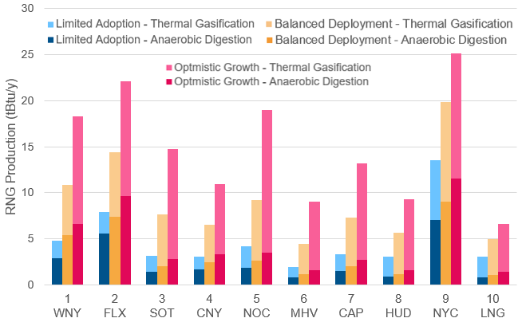
RNG Scenarios by Region
RNG inventory and scenarios broken down by regions.
Regions with large populations provide sources of population-based waste streams:
Landfills
Food waste
Municipal solid waste
Wastewater (WRRFs)
Less densely populated regions provide sources of rural RNG feedstocks:
Animal manure
Agricultural residues
Energy crops
Forestry residue
New York RNG Scenarios by Region and Production Technology (tBtu/y)
7
Draft Material

Slide 8
RNG Production Costs
RNG costs vary by feedstock and technology, with facility size a key driver for per-unit production costs.
Production Cost Assumptions
Production Costs: Range and Weighted Average by Feedstock ($/MMBtu)
Cost Parameter | ICF Cost Assumptions
Facility Sizing | Differentiate by feedstock; prioritize larger facilities to the extent feasible but driven by resource estimate.
Gas Conditioning | These costs depend on the feedstock and the technology required.
Compression | Capital costs for compressing the conditioned/upgraded gas for pipeline injection.
Operational Costs | Costs for each equipment type–digesters, conditioning equipment, collection equipment, and compressors–as well as utility charges for estimated electricity and natural gas consumption.
Feedstock | Feedstock costs or tipping fees associated with feedstocks
Financing | Financing costs, including carrying costs of capital (assuming a 60/40 debt/equity ratio and an interest rate of 7%), an expected rate of return on investment (set at 10%), and a 15-year repayment period.
Interconnection | Interconnection costs represent the point of receipt and any pipeline extension. Consistent with financing, constructing, and maintaining a pipeline of about 1-mile in length. The costs of delivering the same volumes of RNG that require pipeline construction greater than 1-mile will increase, depending on feedstock/technology type, with a typical range of $1-5/MMBtu.
Project lifetimes | 20 years. The levelized cost of gas was calculated based on the initial capital costs in Year 1, annual operational costs discounted at an annual rate of 5% over 20 years, and biogas production discounted at an annual rate of 5% for 20 years.
Feedstock |  | Cost Range ($/MMBtu) | Weighted Average Cost ($/MMBtu)
Anaerobic Digestion | Animal Manure | $27.11 – $50.02 | $34.56
 | Food Waste | $19.24 – $30.24 | $23.86
 | LFG | $7.67 – $21.53 | $11.29
 | WRRF | $13.36 – $68.69 | $27.68
Thermal Gasification | Agricultural Residues | $19.87 – $39.78 | $25.67
 | Energy Crops | $19.87 – $39.78 | $25.67
 | Forestry and Forest Residues | $19.87 – $39.78 | $25.67
 | Municipal Solid Waste | $19.87 – $39.78 | $25.67
8
Draft Material

Slide 9
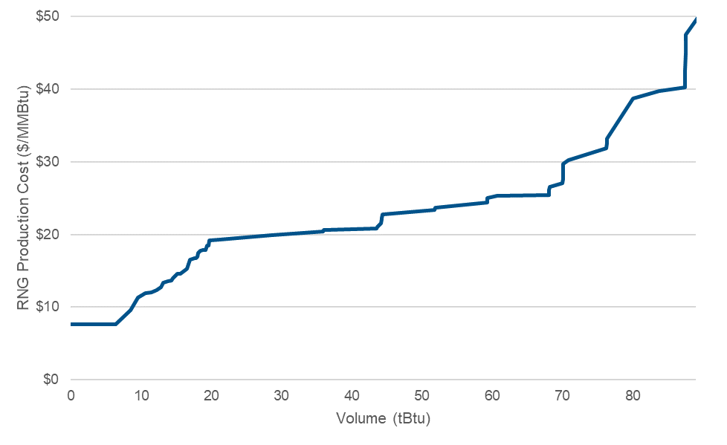
RNG Costs
Using estimated production costs by feedstock, supply-cost curves were developed for each scenario.
In general, LFG and large WRRFs make up the front-end (<$20/MMBtu) of the supply-cost curve in 2040.
The bulk of the supply-cost curve reflects RNG produced from a variety of feedstocks, including food waste, animal manure and thermal gasification facilities.
Tail end of the supply-cost curve comprised of RNG sourced from smaller animal manure and WRRFs projects.
For reference, final delivered natural gas price in 2040 estimated at $3.63/MMBtu ($2020).
Estimated RNG Supply-Cost Curve in 2040, Balanced Deployment Scenario (tBtu v real $/MMBtu)
9
Draft Material

