Slide 1
NYS Electric System
Climate Action Council
October 8, 2020

Slide 2
Bulk vs Distribution System
BULK SYSTEM
Generation: NYISO administers market for large facilities (typically > 5 MW)
Independent competitive generators
NYISO operates competitive electric wholesale markets
Bulk Transmission: NYISO administers planning for the Bulk Power Transmission System (generally 230 kV and above)
FERC sets rates for bulk system investments
NYS transmission facilities primarily owned by NYS utilities, along with independent developers
DISTRIBUTION SYSTEM
Local transmission and distribution carried out by regulated utilities, PSC as regulator
PSC approves funding of local transmission and distribution investments
Duty to ensure reliability at “just and reasonable rates”
Retail activities: Carried out by utilities as well as independent energy service companies

Slide 3
Rate Case Process
Primary mechanism for establishing utility capital and operating expenditure levels
Public window for guiding utility expenditures
Opportunity to receive comments on the implementation of the State priorities
Expert testimony provided by staff and interested parties; Commission decision based on full record though settlement or hearings
Balance between investments for system reliability, implementation of state programs and rate impacts to consumers

Slide 4
Note:
Bill Assistance:
927,000 Customers, $237 Million
Notes: All bills are at 600 kWh per month except Con Edison NYC which is at 300 kWh
For upstate companies taxes represent approximately 15% of the total monthly bill
For Con Edison taxes represent approximately 25% of the total monthly bill

Slide 5
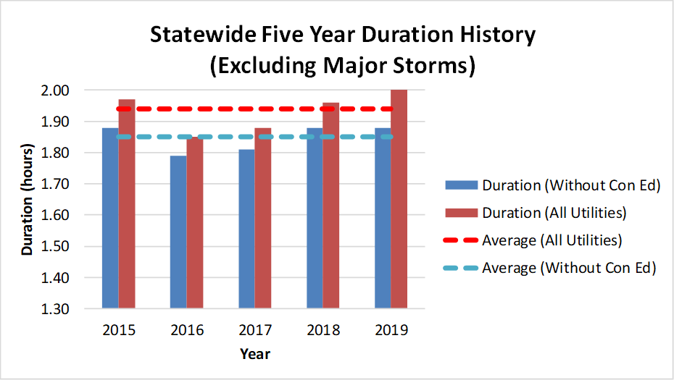
Recent Statewide Reliability Metrics
Note: Con Edison Has Significant Underground Facilities
Notes:
This graph shows the frequency performance for the last five years statewide.
Since Con Edison's networks are usually less prone to interruptions than overhead systems, and Con Edison serves a large percentage of the state’s electric customers,
Con Edison's data can skew the overall statistics. As a result, we also review the data with and without Con Edison.
Excluding major storms, the statewide frequency for 2019 was the same as last year and the five-year average.
On average, customers experienced one interruption every 18 months
For utilities other than Con Edison, the statewide frequency excluding major storms, was better than 2018 and the five-year average - customers on average experienced one interruption in 2019.
The major causes for interruptions excluding major storms were equipment failures and tree contacts.
To reduce the frequency of interruptions, the utilities invest in capital projects, inspections, and maintenance activities.
However, decisions made by utilities today, may take several years before being fully reflected in the frequency measure.
(next slide please)

Slide 6
Integration of New Resources
Goal: Integrate Reliably and Cost-effectively
Non-wires Alternatives
Utilities applying NWA suitability criteria to capital plans to identify potential NWAs
Currently over 40 NWAs are being pursued or under consideration
Distributed Energy Resources
Solar target - 6000 MW by 2025
Over 2400 MW installed
Approximately 4700 MW in utility queues
DPS staff ombudsman and interconnection working groups
Access to compensation through both retail compensation and NYISO markets

Slide 7
Integration of New Resources (continued)
Storage
Target: 1500 MW by 2025; 3000 MWs by 2030
936 MW operational/awarded, all programs
Approximately 1200 MW in utility queues
Utilities also pursuing storage projects through rate cases or PSC proceedings
Use cases:
Customer sided
Distribution system
Bulk system

Slide 8
Integration of New Resources (continued)
Beneficial Electrification
Electric Vehicles
PSC Make-Ready Order
Provides for utility funding of EV charging station through 2025
Sized to meet the NYS ZEV goal
Locational/System considerations
Building Electrification
PSC Order
Established targets and budgets for heat pumps
$454 million in funding to achieve 3.6 TBtu

Slide 9
Integration of New Resources - NYS Electric System Planning
Accelerated Renewable Energy Growth Act
PSC to establish State transmission and distribution plans to meet CLCPA goals
System studies needed to inform the Plan are underway
100x40, Offshore Wind, Utility Local T&D
Initial results will be available by end of December
In early 2021, PSC will:
Identify bulk level and local T&D investments and needs
Bulk projects may be implemented through the NYISO process or other mechanisms
Establish guidelines for integrating CLCPA goals in utility planning processes
PSC will revisit the plan and progress toward CLCPA goals by January 1, 2023 and every 4 years thereafter

