Slide 1
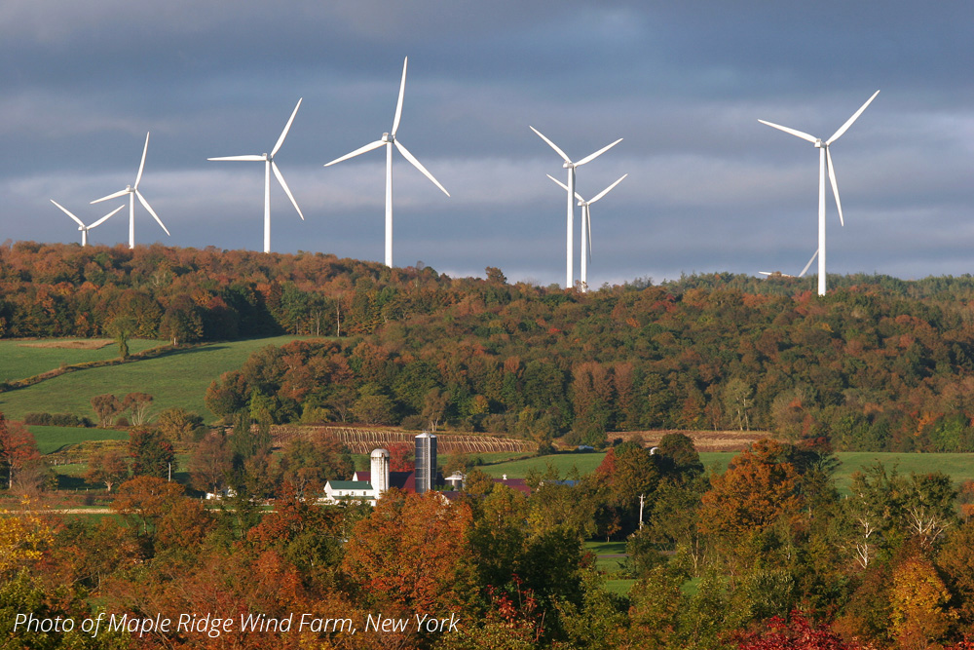
Power Generation Advisory Panel
Meeting 5
December 21, 2020
PowerGenPanel@dps.ny.gov

Slide 2
Agenda
Feedback from Climate Action Council Report Out (~10 min)
Feedback from Climate Justice Working Group (~15 min)
Updates from Subgroups (~30-45 min)
Barriers
Solutions for the Future
Resource Mix
Discussion: Equity Subgroup (~60-75 min)
Community Impact
Access and Affordability for All
Workforce Development
Next Steps (~15 min)

Slide 3
Feedback from Climate Action Council Report Out

Slide 4
Feedback from Climate Justice Working Group

Slide 5
Updates from Subgroups - Barriers - Solutions for the Future - Resource Mix

Slide 6
Discussion: Equity Subgroup

Slide 7
Equity: Community Impact
Scope topic/Subgroup: Equity Subgroup
Strategy under consideration |  | Community Impact – Develop recommendations to identify and proactively advance opportunities to address health disparities associated with hosting pollution sources, new renewable energy, access to energy efficiency, and siting
 | Rationale | Each region of NYS has specific community impacts and concerns that should be considered and addressed in relation to the future of power generation under the CLCPA
1 | Equity considerations | Reduce disproportionate impacts in overburdened communities (e.g. the operation of high emission power generation facilities result in significant health concerns for neighboring communities) Consider means for increasing access to energy efficiency, solar, and community distributed generation projects to specifically assist disadvantaged communities The siting of renewable projects and their potential impact on local communities both in the short and long term, particularly in rural areas The impacts on communities (e.g. jobs, revenues, etc.) where energy facilities are being retired
 | Potential Implementation challenges | NYS should prioritize replacing high emissions power generation in disadvantaged communities NYS will swiftly need to increase access to energy efficiency & solar and community distributed generation projects to disadvantaged communities by 2030 NYS will need to encourage the development of large scale renewables downstate, large scale renewables directly connected to downstate, distributed generation, and energy storage Some community members may have questions/concerns when it comes to the siting of local renewable projects and the potential impacts of these projects How to assist communities where energy facilities will be retired? Stronger valuing of renewables from community owned/lead projects in the VDER value stack
 | Issues to explore | What types of clean power generations technologies (e.g., wind, roof-top solar, tidal, etc.) can enhance the generation mix to meet peak demands? How developing/strengthening partnerships with community organizations and affordable housing providers to develop local solutions can lead to the equitable access of solar energy? How continued efforts to communicate with members of local communities for siting of local renewables and development of best practices with those communities can help with siting issues? Consider the wide range of aspects involving impacts to communities where energy facilities will be retired and how NYS can assist with the transition through economic support, job training/jobs and more Providing financial support to the pairing of Community Distributed Generation with energy efficiency, electrification and DR interventions
 | Additional thoughts

Slide 8
Discussion: Community Impact
Do any of the “Issues to Explore” require further clarification?
Is there any key area for recommendations that is missing?
Do members of the Advisory Panel have any advice for the subgroup as it begins to flesh out recommendations?

Slide 9
Equity: Access and Affordability for All
Scope topic/Subgroup: Equity Subgroup
Strategy under consideration |  | Access and Affordability for all (Enabling) – Develop recommendations to ensure New Yorkers have access and can afford to participate meaningfully in NYS’s clean energy future
 | Rationale | Equity includes access to affordable solutions, good paying jobs, and alleviating the disproportionate burden on communities. A majority of low and moderate-income residents, as well as small businesses, have a high energy burden and are already experiencing difficulties paying their bills.
 | Equity considerations | NYS must invest in residential energy efficiency and clean energy solutions in a manner that benefits disadvantaged communities, which includes low-moderate income individuals, while also considering support for small businesses.
 | Potential Implementation challenges | Costs including upfront/future costs – How can such costs be subsidized to not overburden low-moderate income residents/small businesses Lack of options for renters/subsidized housing (including NYCHA) Difficulty spreading information regarding existing programs to the community Lack of flexibility in utility billing increases customer confusion (e.g. flexibility in billing systems, consolidated billing, etc.) Additional rates for electric heating and cooking only Limited availability of the Solar for All program Federal Action – Loss on Investment Tax Credits for renewable energy development and tariffs on solar Predatory ESCOs Expand state funding/incentives for LMI energy efficiency and clean distributed generation Need solutions to reduce cost burdens to rate payers for improvements to the transmission grid & rate designs for behind the meter electric generational projects
 | Issues to explore | Identifying short/long terms costs so that there is a plan to reduce cost to low-moderate income renters/homeowners/affordable housing providers/small businesses Evaluating existing incentives, low-income programs, and more to ensure they can adequately assist low-moderate income residents/small businesses with increased costs Can alternative rate design be used to help control increased costs on NYS’s most vulnerable? How to help renters? How to strengthen community outreach/education efforts regarding new/existing programs? Providing financial support to the pairing of Community Distributed Generation with energy efficiency, electrification and DR interventions Increased financing options for energy efficiency, renewable energy, and distributed generation How to equitably distribute the cost of transmission system upgrades?
 | Additional thoughts | Low income customers should not bear the brunt of the burden for stranded assets Explore how the state has handled previous accelerated depreciation events (e.g. Rochester thermal system 1984) Explore how warranty of habitability laws can be leveraged to ensure the equitable provision of utilities it the future

Slide 10
Discussion: Access and Affordability for All
Do any of the “Issues to Explore” require further clarification?
Is there any key area for recommendations that is missing?
Do members of the Advisory Panel have any advice for the subgroup as it begins to flesh out recommendations?

Slide 11
Equity: Workforce Development
Scope topic/Subgroup: Equity Subgroup
Strategy under consideration |  | Workforce Development (Enabling) – Develop recommendations to enable an equitable clean energy workforce
 | Rationale | NYS should increase opportunities for members of disadvantaged communities to economically benefit from future investments in clean energy and supporting infrastructure
 | Equity considerations | Disadvantaged communities suffer disproportionately adverse environmental, economic, educational and health realities when compared to other communities. Investments in workforce development will need to be aggressive and targeted, and likely for longer periods of time than what is afforded through existing models (possibly throughout an individual's career), and ensure that jobs created result in meaningful, long duration careers, rather than short term job opportunities.
 | Potential Implementation challenges | Pre-apprenticeship programs and apprenticeship programs Given long term goals of NYS, workforce development may need to begin before H.S. to ensure a sizable flow of candidate for positions as they become available Address environmental injustices which led to inequitable and disproportionately exposure to airborn toxics resulting in school absenteeism Coordination and development with existing programs (e.g. Green City Force, Sustainable South Bronx, WeACt, etc.) Working with state and communities to ensure these jobs are NY jobs NYS should support and incentivize renewable supply chain and infrastructure projects in environmental justice communities
 | Issues to explore | How to increase diversity in all aspects of the industry? How to increase awareness of the growing industry and need for workforce? How the equity subgroup can coordinate with the Just Transition working group? How will these efforts increase support from communities and how can these efforts be tailored to community needs in order to reduce the potential for further amplifying the inequities already present?
 | Additional thoughts | As the demand for jobs in renewable energy sector grows, it is important to remember that the wages and benefits are just as important as the job itself NYS should continue to include prevailing wage in large scale renewables RFPs Some clean energy jobs (offshore wind steelworkers, building energy management workers, etc.) are more likely to be union jobs than others
Notes:
Potential Implementation challenges:
Given long term goals of the state, workforce development will need to begin before and in high school to ensure a sizable flow of candidates into educational programs, training and positions in the clean energy sector.
Internships, pre-apprenticeship programs and apprenticeship programs
Coordination and development with existing programs hosted by community based organizations, high schools/SUNY/CUNY/BOCES, unions
Issues to explore:
Involve organizations and institutions in existing k-university workforce development ecosystem so that existing workforce activities are not siloed.
Issues to explore:
How to increase diversity in the industry by partnering with key groups such as Boys and Girls Clubs, Girls Scouts, veterans organizations, programs serving the previously incarcerated and BIPOC community based organizations
How to increase awareness of the growing industry and need for workforce through the development of comprehensive clean energy careers pathways programs.
How to build more support for siting renewable energy projects in rural communities by investing in workforce training paired with increased investment in clean energy and energy efficiency programs.
How to assure that these programs are designed so as to be appropriate for all regions in our very diverse state.

Slide 12
Discussion: Workforce Development
Do any of the “Issues to Explore” require further clarification?
Is there any key area for recommendations that is missing?
Do members of the Advisory Panel have any advice for the subgroup as it begins to flesh out recommendations?

Slide 13
Next Steps

Slide 14
Next Steps
Continue discussion of issues and development of draft recommendations through subgroups
Engage in cross-panel discussions
Power Generation Advisory Panel meeting on January 11th, 9:30am EST
Topics for discussion?
Climate Action Council meeting on January 19th, 2pm EST (https://climate.ny.gov/)

